Slide 1
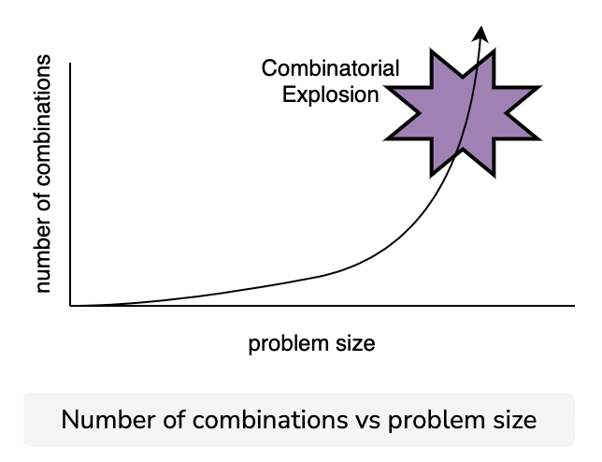
Computational creativity
Mental phenomena could be schematised
Elaboration of information could be expressed in a computational form (mechanical rules)
A computational system is composed of multiple sub-systems
Then, creativity can be thought as a problem of search (which computers are good at)
Problems:
Combinatorial explosion
The complexity of real-world situations
Margaret Boden
Source: educative.io
Douglas Hofstadter
Notes:
One of the criticisms to AI was that it could never be creative. However, there is substantial research in computational creativity. Highlight that there are multiple definitions of creativity.
For example, the game of Chess can be perfectly described. Any potential instance of the game can be written out. All routes to and from it can be stated. Yet, actual action of playing chess (i.e., making a choice among such routes) is described as a very creative process.

Slide 2
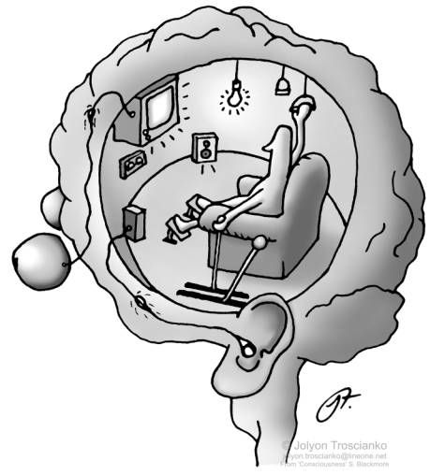
Daniel Dennett
But could a machine be “aware”?
According to Dennett, our self-perception has brought us errors like the Cartesian Theatre
Descartes originally claimed that consciousness requires an immaterial soul, which interacts with the body via the pineal gland of the brain
Dennett says that, when the dualism is removed, what remains of Descartes' original model amounts to imagining a tiny theater in the brain where a small person, now physical, performs the task of observing all the sensory data projected on a screen at a particular instant, making the decisions and sending out commands
Dennett argues against Descartes’ belief that all perceptual processes converge in a central elaborator that constitutes consciousness
If consciousness is just an illusion (e.g., an a posteriori reconstruction) emerging from multiple processes, there is no reason why we shouldn’t be able to recreate such processes in a machine (naturalistic position)
Notes:
Effectively the argument is that all thought is distributed thought, and therefore it should be possible to create thought as a (distributed) computational system.

Slide 3
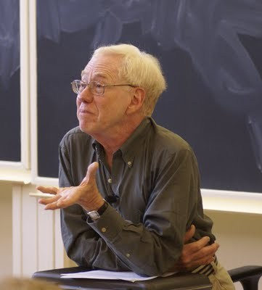
Hubert Dreyfus
An important «critic» of the symbolic AI
Intelligence is situated (and situations are partially undetermined)
We should maintain an «intelligent approach»
«Our perception of a situation is influenced by our here-and-now mood, by our projects and intentions, self-perception, sensorimotor habits (…) we never have inside of us a representation of our body like it was a tool to manoeuvre; our culture like it was a book of postulates; our tendencies like they were the product of a situation»
As a result, Dreyfus argued that Symbolic AI cannot capture nuanced and context-dependent nature of human intelligence.
Notes:
Does this invalidate computational AI as well? An interesting topic to discuss with students.

Slide 4
Contemporary philosophy of AI

Slide 5
Ray Kurzweil
The Singularity
According to Kurzweil, who elaborates a concept from science fiction author Vernon Vinge, the Singularity is the arrival point of evolution → the point when machines start to develop themselves (evolve)
«technological development is a consequence and a continuation of biological development»
Singularity may have already happened!
2005
Notes:
One of the biggest techno-enthusiasts.
Another way to understand singularity is from the perspective of fusion of biological body with technology. From this perspective, simgularity occurs when such (hybrid) entities can achieve immortality. Interestin that Kurzweil who will be 76 in February 2024 still believes that with current technological advances he has a chance to be part of such singularity.

Slide 6
Critiques to techno-enthusiasts
Ideas such as Superintelligence and the Singularity are not exempt from critiques…
For example, the neuroscientist Miguel Nicolelis considers the creation of Artificial Intelligences similar to the human mind a utopia
The connections of the human mind (and of the brain) are unpredictable, and not computable
The idea of ​​re-engineering the brain does not take into account the random aspects of evolution – it is based on the concept of ​​the Great Designer…
Such ideas fuel controversial ones regarding the “enhancement” of human capabilities, the reinforcement of social inequalities and supremacism
Notes:
If such technology is not ubiquitously available - it will amplify current inequalities in the detriment to the fabric of our society.

Slide 7
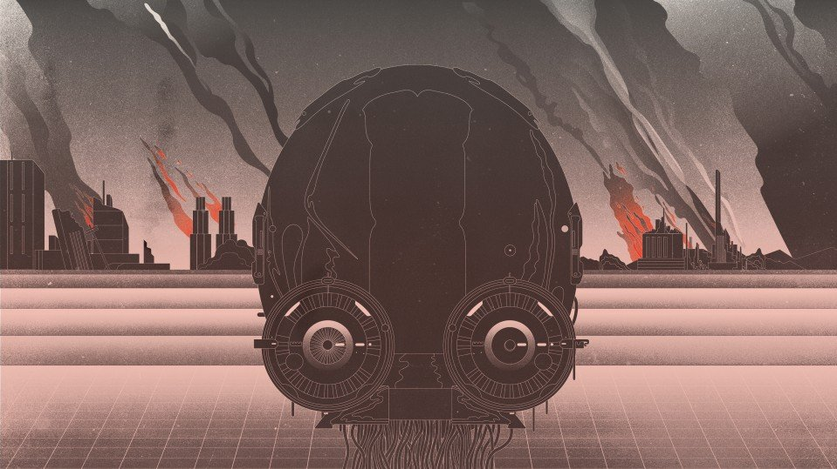
A machine to make paper clips
…and destroy everything in the process
According to Nick Bostrom, it is not necessary to imagine AI gaining self-awareness for it to be dangerous to humankind.
Machines are programmed to achieve pre-specified goals (“intelligent” machines could in theory also create their own goals – which are not necessarily beneficial to humans)
If machines pursue instrumental goals (e.g. producing paperclips), they could do anything to achieve such goals:
Eliminate potential threats
Acquire as many resources as possible
Transforming everything into paperclips

Slide 8
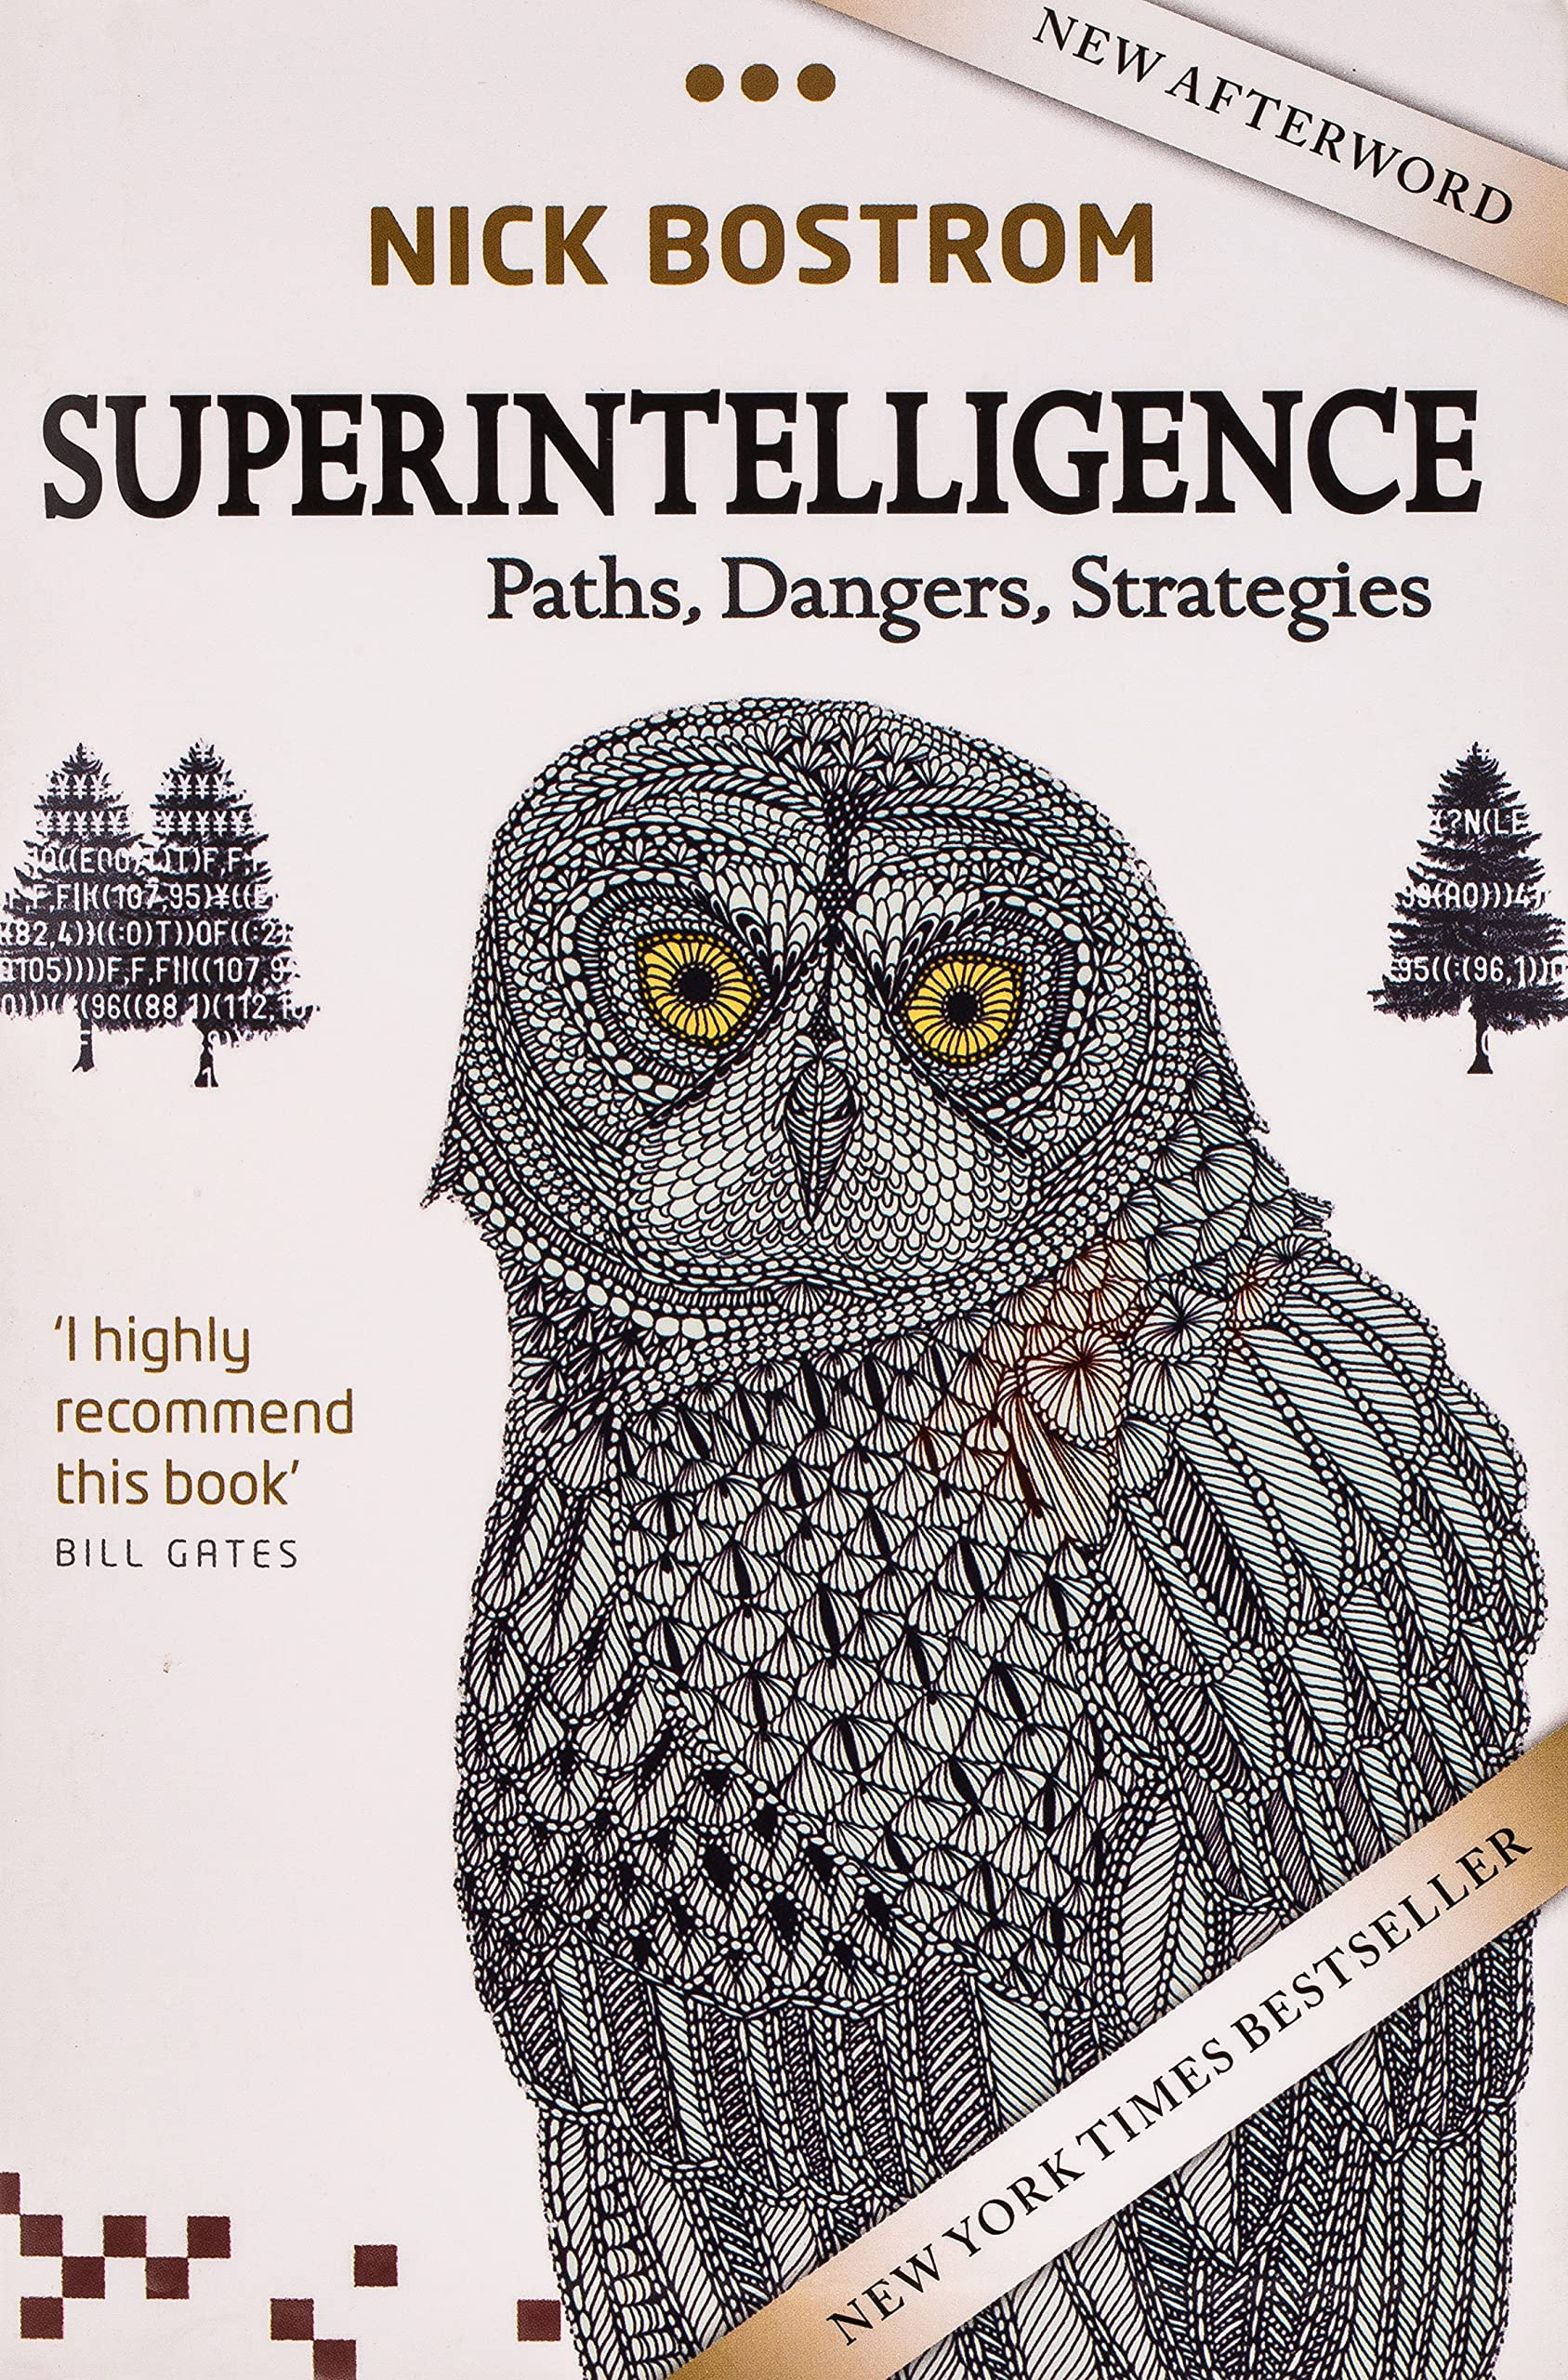
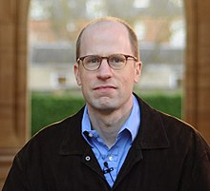
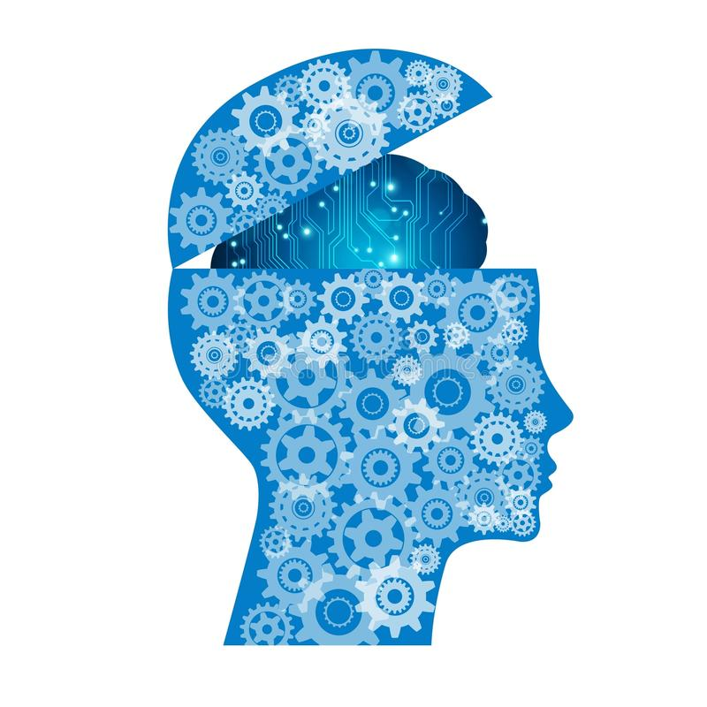
Nick Bostrom
Superintelligence
A logical deduction:
If: AI has the same capacities as humans
And: Humans can create AI
Then: AI can create AI
2014
+1
+1
+2
Notes:
This is a point of singularity similar to one of Rey Kurzweil

Slide 9
A fable with sparrows and owls
A revealing metaphor
https://www.youtube.com/watch?v=7rRJ9Ep1Wzs

Slide 10
Summary
AI emerged firstly as a philosophical problem
Precursors wanted to pursue exactness, e.g., transforming thought in a perfect language
Modern philosophers want(ed?) to recreate some mental processes in the machines; this is still an open issue
Contemporary philosophers mostly deal with the possible consequences of reaching true and authentic AI

Slide 11
Readings for session 1
McCarthy, J. (2006). The philosophy of AI and the AI of Philosophy. In Gabbay, D.M., Thagard, P., and Woods, J., Philosophy of Information, Elsevier, 2008, Chapter 17.
Available at: http://jmc.stanford.edu/articles/aiphil2/aiphil2.pdf
Muller, V.C. (2012). Introduction: Philosophy and Theory of Artificial Intelligence. Minds and Machines, 22: 67-69.
Available at: https://link.springer.com/article/10.1007/s11023-012-9278-y
Neubauer, A. C. (2021). The future of intelligence research in the coming age of artificial intelligence–With a special consideration of the philosophical movements of trans-and posthumanism. Intelligence, 87, 101563.
Available at: https://www.sciencedirect.com/science/article/pii/S0160289621000477

Slide 12
Further readings (still session 1)
Bostrom, N. (2016) Super Intelligence, Oxford University Press
Copeland, J. (2015) Artificial Intelligence: A philosophical introduction, Wiley
Coppin, B. (2004) Artificial Intelligence Illuminated, Jones and Bartlett Publishers
Searle, J.R. (1984) Minds, Brains and Science, Harvard University Press
Turing, A.M. (1950) Computing machinery and intelligence. Mind – A quarterly review of psychology and philosophy, 59, 236

Slide 13
Readings for session 2
Bryson, J.J. (2019). The Past Decade and Future of AI’s Impact on Society.
Available at: https://www.bbvaopenmind.com/en/articles/the-past-decade-and-future-of-ais-impact-on-society/
Evans-Greenwood, P., Hanson, R., Goodman, S., and Gentilin, D. (2021). A moral license for AI. Deloitte Insights.
Available at: https://www2.deloitte.com/us/en/insights/focus/cognitive-technologies/artificial-intelligence-impact-on-society.html
Babutsidze Z. and Vincileoni D. (2022) Behavioral changes associated with interacting with bots on Twitter. Proceedings of the 54th Hawaii International Conference on System Sciences (HICSS-55), pp. 3013-3010.
Available at: https://scholarspace.manoa.hawaii.edu/server/api/core/bitstreams/c950bb9f-8016-4e1a-8691-9e45bd45a11b/content

Slide 14
AI, Society and Sustainability
(Session 2)
The societal impacts of AI

Slide 15
Today’s session
Anticipating the impacts of AI
The social impacts of AI applications
The challenges of bias in AI
Regulating and managing AI

Slide 16
Anticipating the Impacts of AI
Notes:
Ask students what kinds of impacts do they expect AI will have.

Slide 17
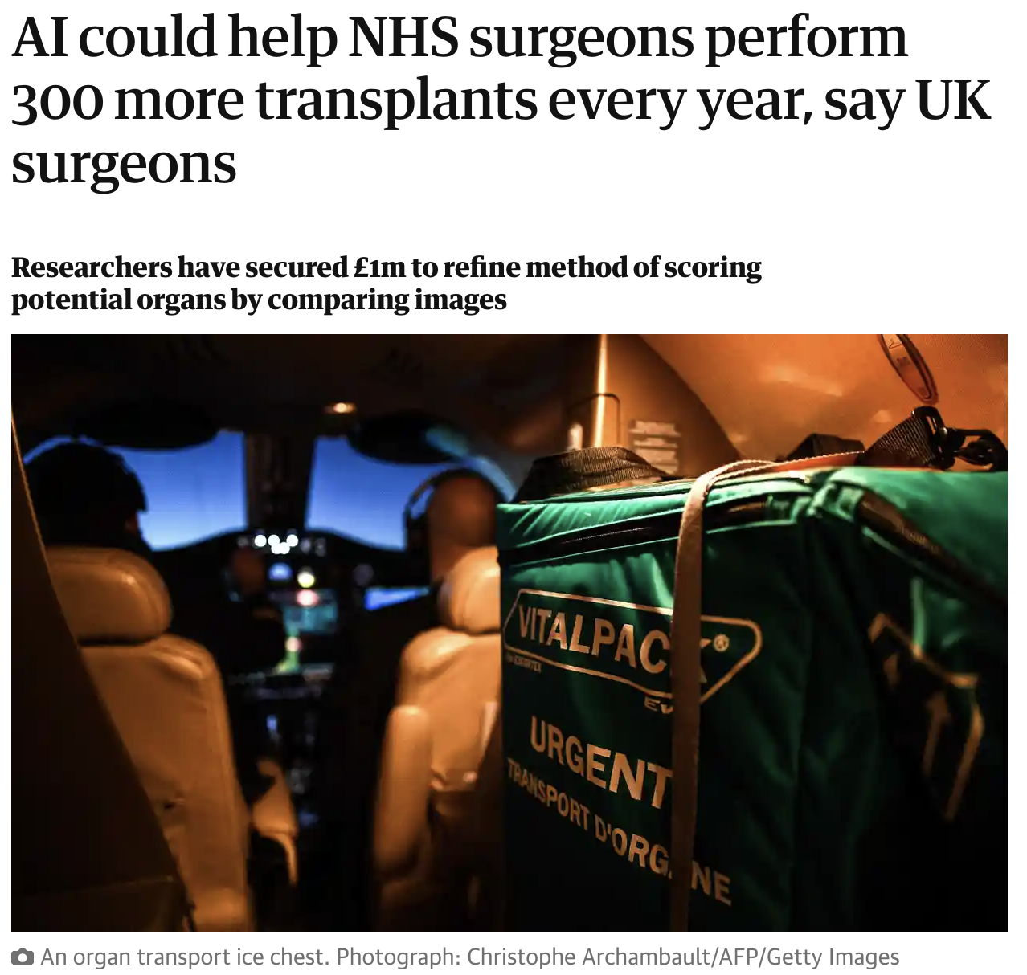
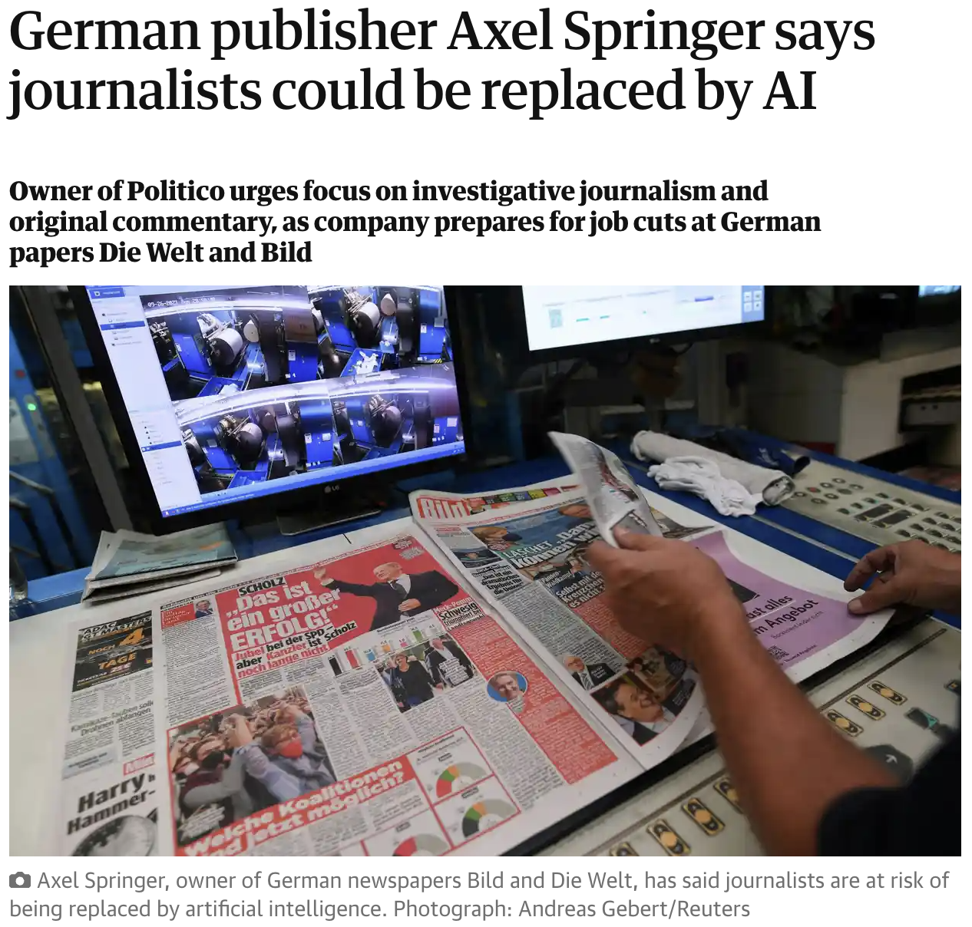
Notes:
Evoke many more examples of such threats. Talk about current lawsuit by New York Times against Microsoft/OpenAI due to the fact that ChatGPT is trained on NYT texts. Talk about writer and actor strikes of 2023, etc.

Slide 18
- Impact on Education (how to teach, how to evaluate, …)
- Film production (strikes by scrip writers, actors, …..)
- News (ingestion of news material by LLMs
- Self-driving cars
- “Automated” research and scientific development
- Omnipresent surveillance
- Justice (recidivism)
- Health (priorities, transplants)
- Democracy (election interference)
- Social networks
- Artistic creativity

Slide 19
"When change is easy, the need for it cannot be foreseen; when the need for change is apparent, change has become expensive, difficult, and time-consuming.”
David Collingridge, 1980
When technology demonstrates large advantage, switching or adoption costs have swelled
The impact of switching to paradigm-altering technologies usually come at large costs for significant portion of society
This is general, but particularly applicable to AI
.
Companies, organizations, etc. feel the need of the pressure to adopt AI technologies
They usually do not know what they need, or why, of what for, or how …
Notes:
Why is this transition so painful? A straight-forward argument based on path-dependence of technical change. Initial iterations of technology are not sufficiently productive to justify even low switching costs, however but the time technology demonstrates large advantage switching costs have swelled. So, the impact of switching to paradigm-altering technologies usually come at large costs for significant portion of society. This is not something new and unique to artificial intelligence.

Slide 20
Notes:
This is an example of solving problems incrementally by using the same technology rather than changing the technology paradigm. Once the system has saturated and paradigm needs to be changed, huge network of routes needs to be demolished (high costs).

Slide 21
Anticipation and ‘modulation’
Mitigation
’Upstream’
‘Midstream’
+ flexibility / reversibility
Responsible research
and innovation
Problem framing
Agenda definition
Mobilisation of expectations and promises
Early stages of technological development
“Responsible and Ethical AI”
concerns (today)

Slide 22
Responsible Research and Innovation is a transparent and interactive process that acknowledges mutual responsibility across different actors aiming to address the ethical acceptability, sustainability and societal desirability of research and innovation with a focus on how to achieve important positive impacts (the ‘right’ impacts).
Based on the view of EC officer Rene von Schomberg
Notes:
Responsible research is important in orienting our investments toward promising technologies. If technologies that are developed are not ethically acceptable, sustainable or desired they stand no chance of being integrated into modern society.

Slide 23
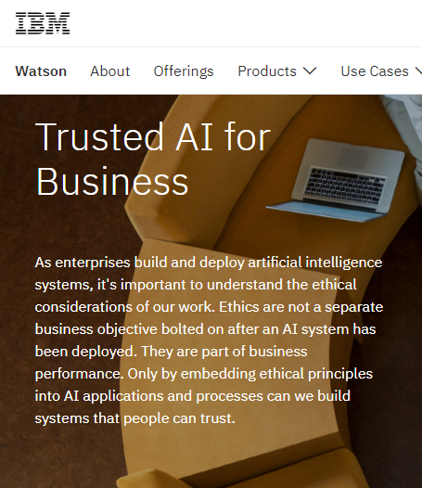
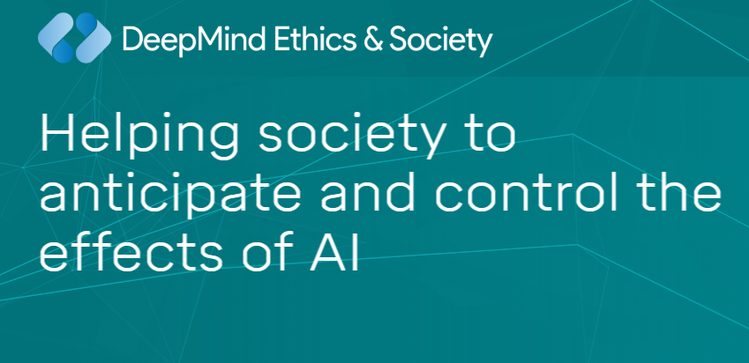
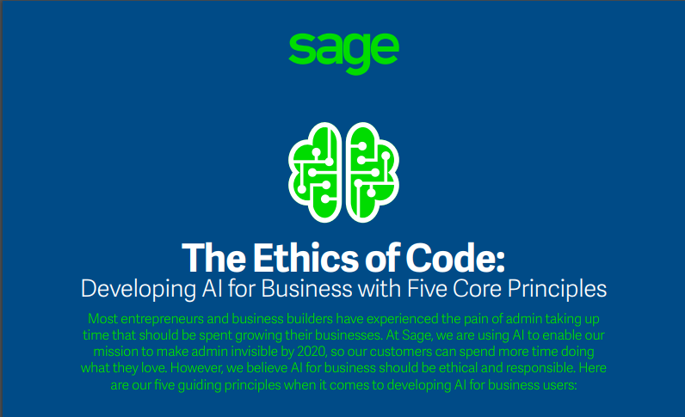
Business initiatives simultaneously
selling their technical research and
Solutions, together with their
societal concerns
Notes:
So, organizations developing AI technology seek early societal support/input and have come up with multiple business initiatives to complement their technical research.

Slide 24
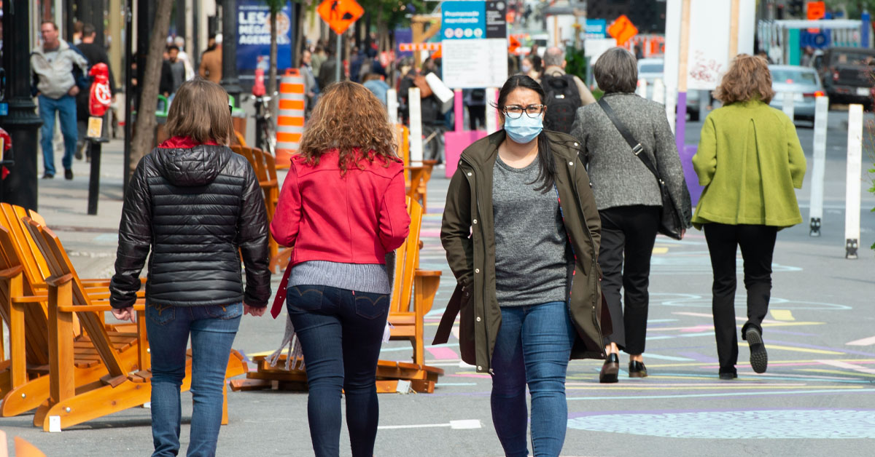
Key Principles for Responsible AI
AI applications must translate into public benefit
These benefits must outweigh any risks
AI applications must not violate human and other individual rights
AI applications must be transparent and auditable

Slide 25
BUSINESSES
Ensure benefits reach consumers
GOVERNMENT
Contribute to the sustainability of the labour market (e.g. immigration issues)
Provide cheaper and better services to consumers
Transparency to customers
Facilitate and regulate data access and management
Invest in the training and re-training of the workforce
Develop clear legal and regulatory frameworks
Adopt best-practice and
ethical standards
Engage in democratic debate
Prevent discrimination and inequality
Support the development of infrastructure
Ensure
data security
and privacy
Invest in start-ups and translational research
Make AI systems intelligible
Be accountable
Increase research capacity
Adopt human-values centred approaches
Support SMEs
businesses responsibilities based on the House of Lords report in the UK
Notes:
Mapping of businesses responsibilities based on the House of Lords report in the United Kingdom

Slide 26
Social impacts of AI applications

Slide 27
How familiar are you with these AI applications?
Please only select the options you have already heard about:
Decisions in the criminal justice system
Decisions in the workplace
Decisions on the content of advertisement on the internet
Decisions about immigration
Decisions about access to financial services
Decisions about healthcare
Decisions about claims for social support
Think of decisions made by automated system as opposed by humans
Notes:
Set up another menti poll to see what students know

Slide 28
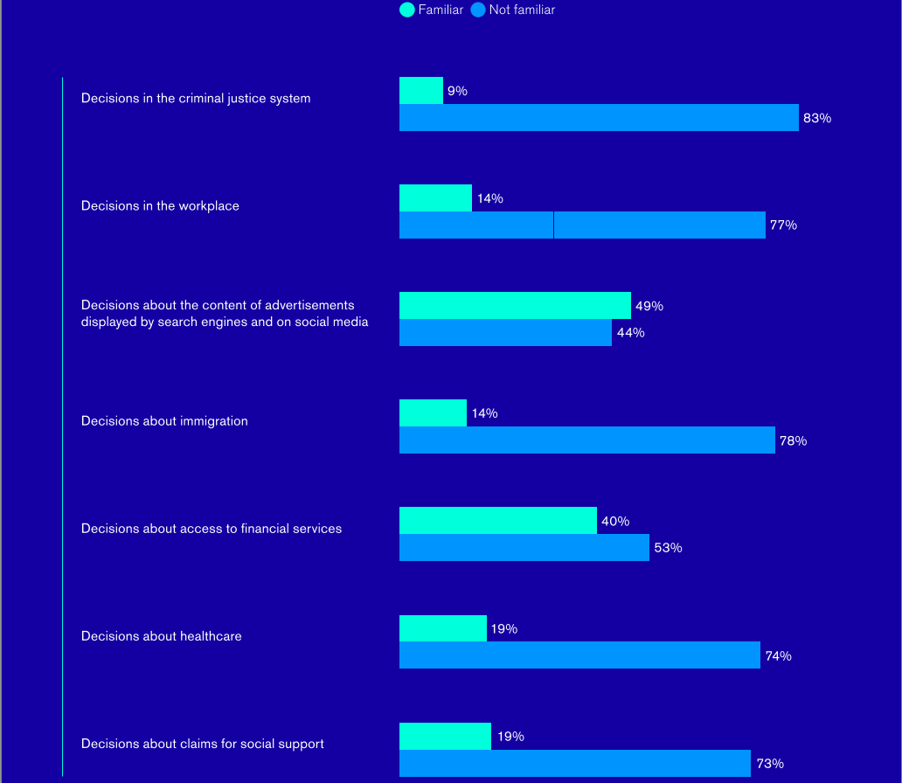
(RSA 2018)
Notes:
Compare results with those of the UK population in 2018

Slide 29
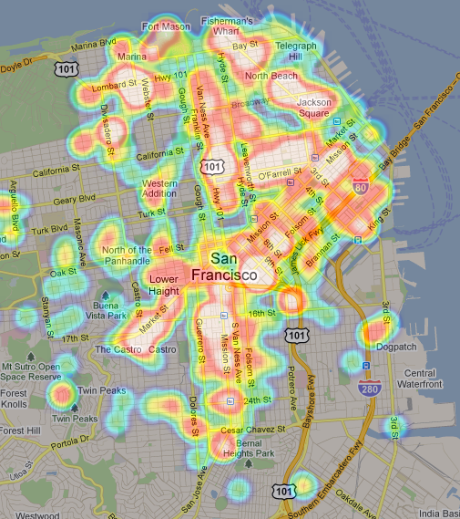
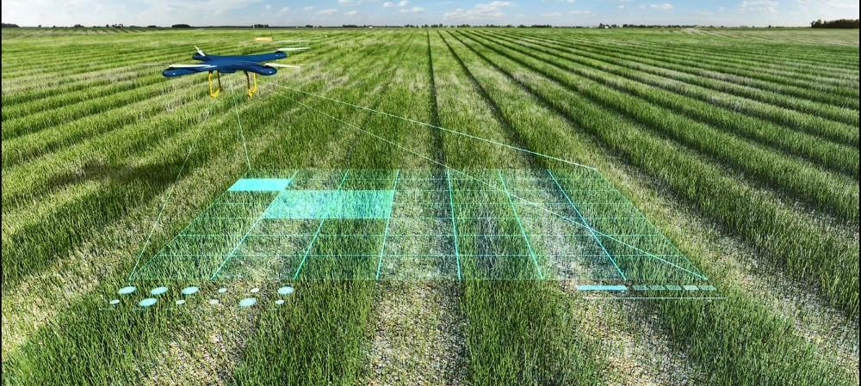
AI Applications…
deepfakes
https://www.youtube.com/watch?v=cQ54GDm1eL0
Notes:
There are already many applications of AI-associated technologies, even in the tools we use every day…

Slide 30
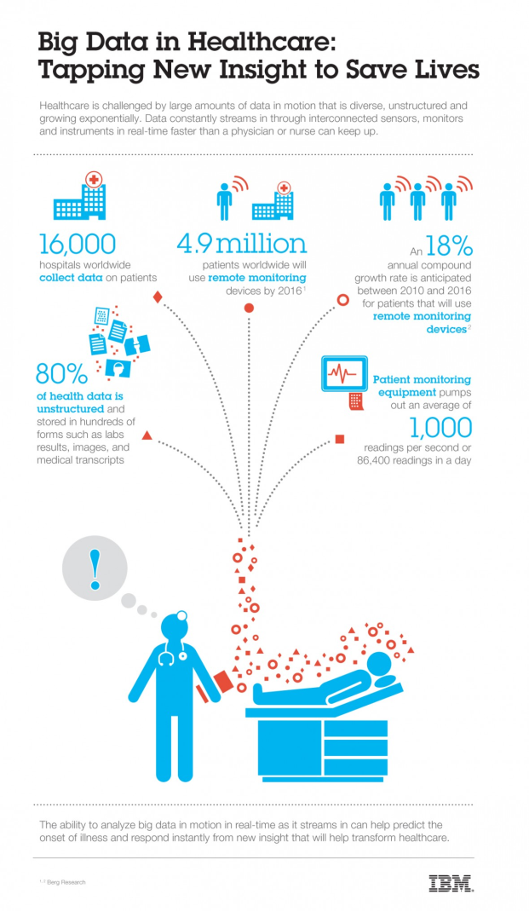
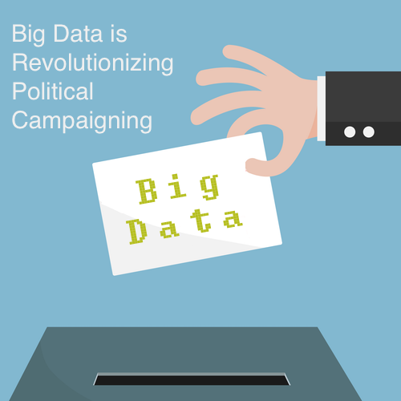
big data are at the very core of recent successful AI technologies
Notes:
Many AI applications rely on big data. Systems with rich data sources do not require particularly different analysis methods in order to become extremely accurate and very useful. However, with new methods they can reach astonishing results.

Slide 31
Which concerns, if any, do you have?
You can select as many options as you like:
AI doesn't have the empathy required to make important decisions about our lives
Automated decision-making reduces people's responsibility and accountability for the decisions they implement
There is a lack of adequate control or government regulation of automated decisions to protect people from unfair outcomes
Jobs could be lost
Notes:
But there are many concerns. Discuss these and perhaps other concerns that class might have.

Slide 32
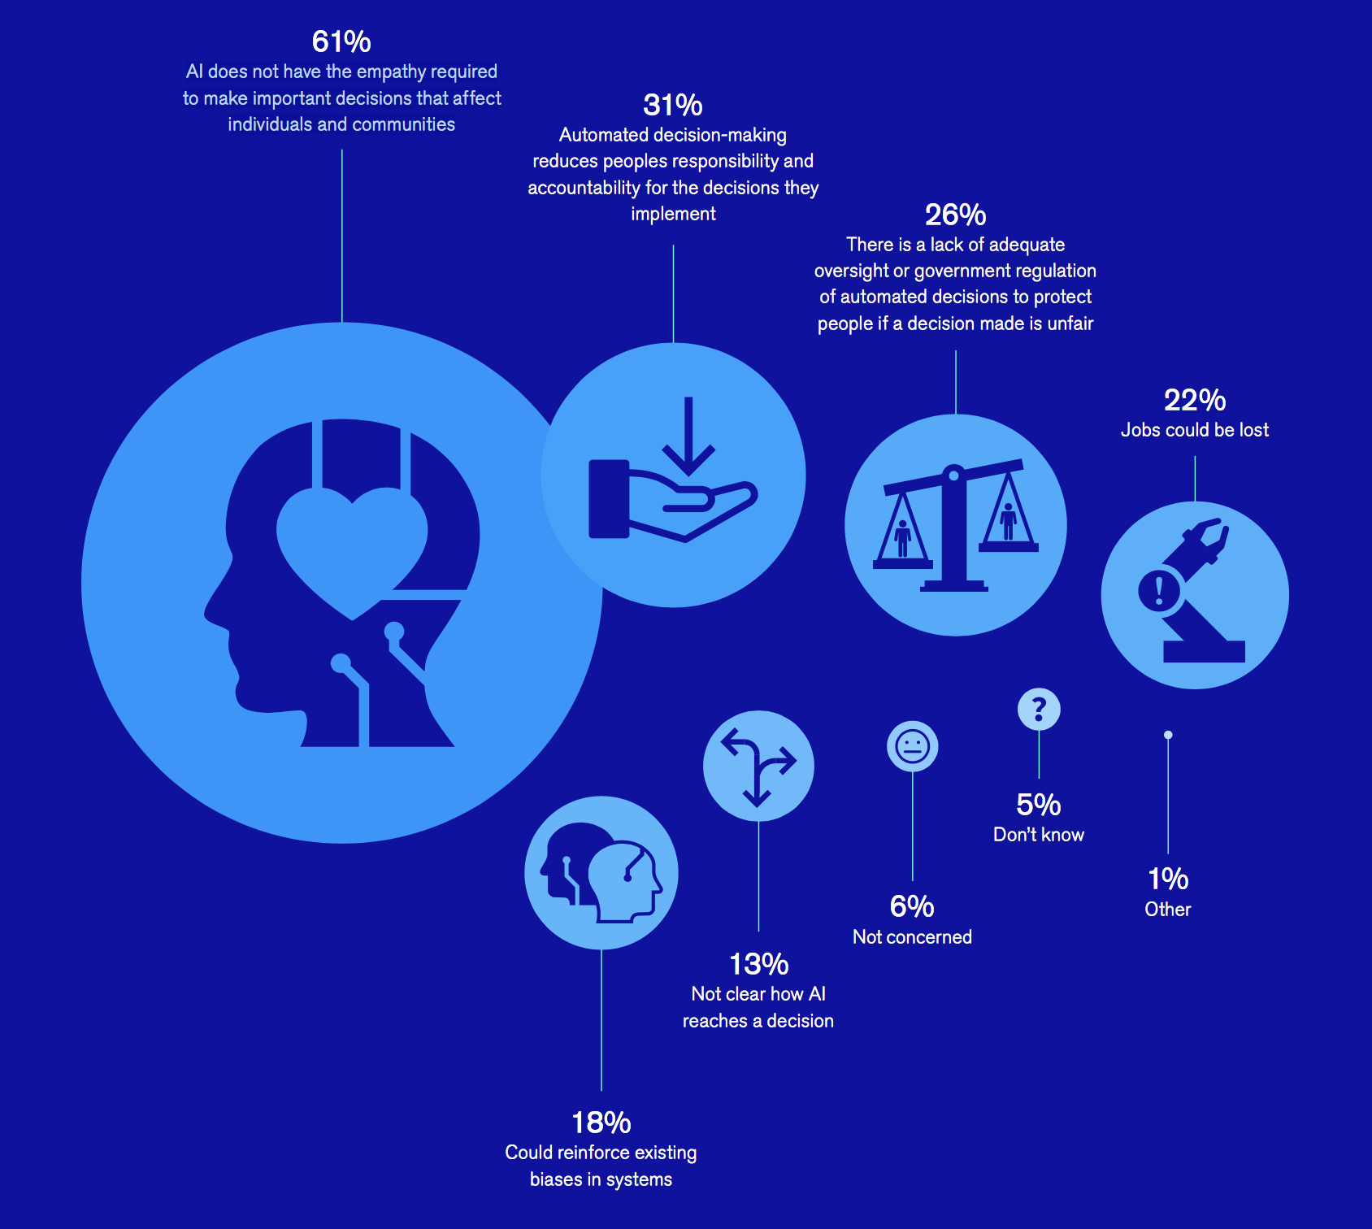
data from UK in 2018
Notes:
Data from UK in 2018

Slide 33
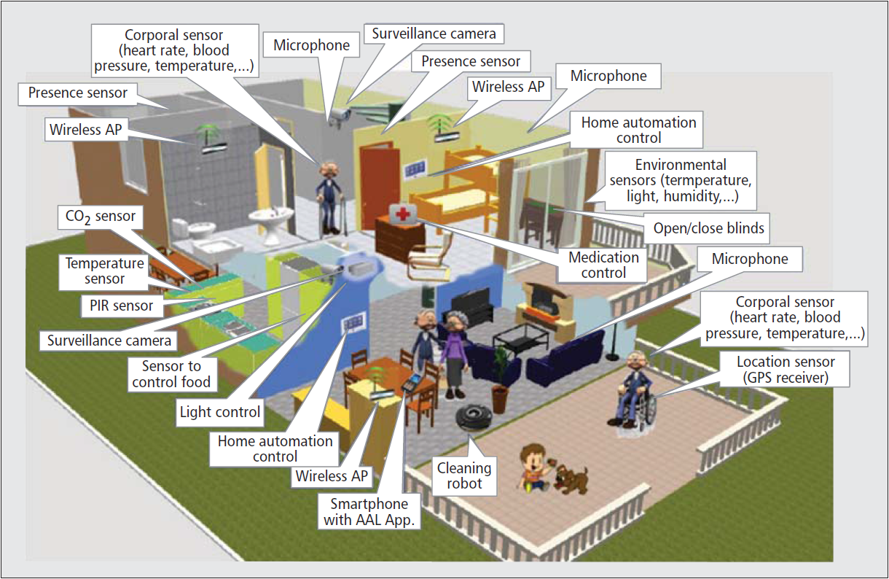
Ambient intelligence and sensors
Ambient Intelligence (AmI) refers to technological environments that are sensitive and responsive to the presence of people

Slide 34
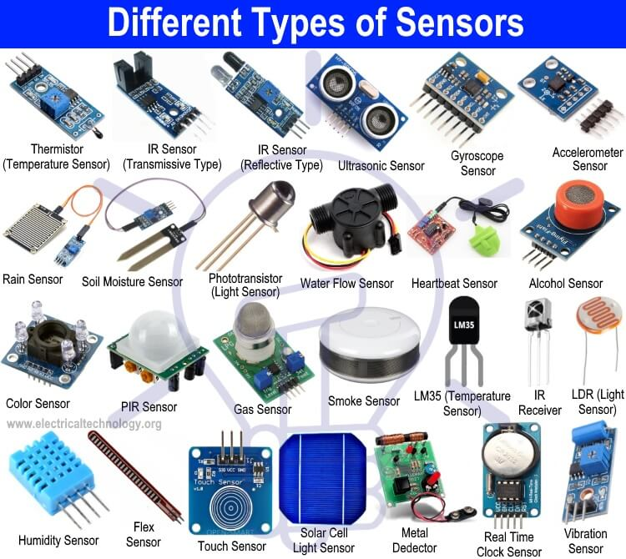
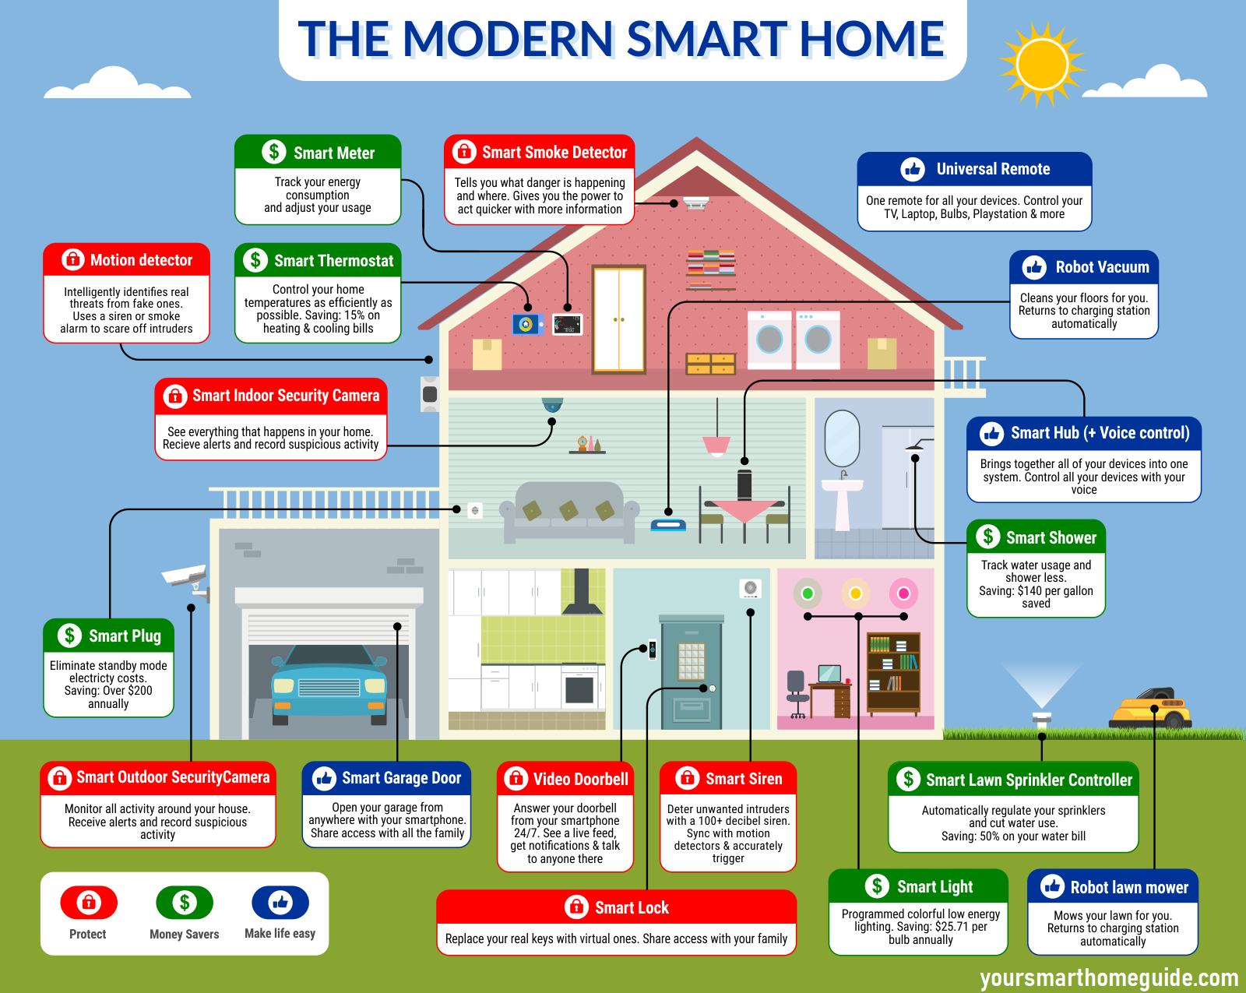
According to Eli Zelkha (1998) and subsequent studies, a smart environment or AmI system has five characteristics:
Embedded: sensors connected and integrated into the environment
Context-aware: Sensors recognize people and context
Personalized: The sensors and their activity are adaptable to the needs of the users
Adaptive: Sensors and their activity change over time
Anticipatory: The system must learn to anticipate users' needs without activation or programming
Notes:
Such convenience comes at a cost – hacking, responsibility allocation etc.

Slide 35
The recovery of lost spaces
Notes:
According to anthropology and sociology studies, the evolution of technology is associated with a “recovery of lost spaces”; previous technologies have reduced the habitable and livable space, while the newer ones move towards integration into the environment (e.g., walls, furniture)… giving back freedom to move to the user
More on UX and ergonomics in session 4.

Slide 36
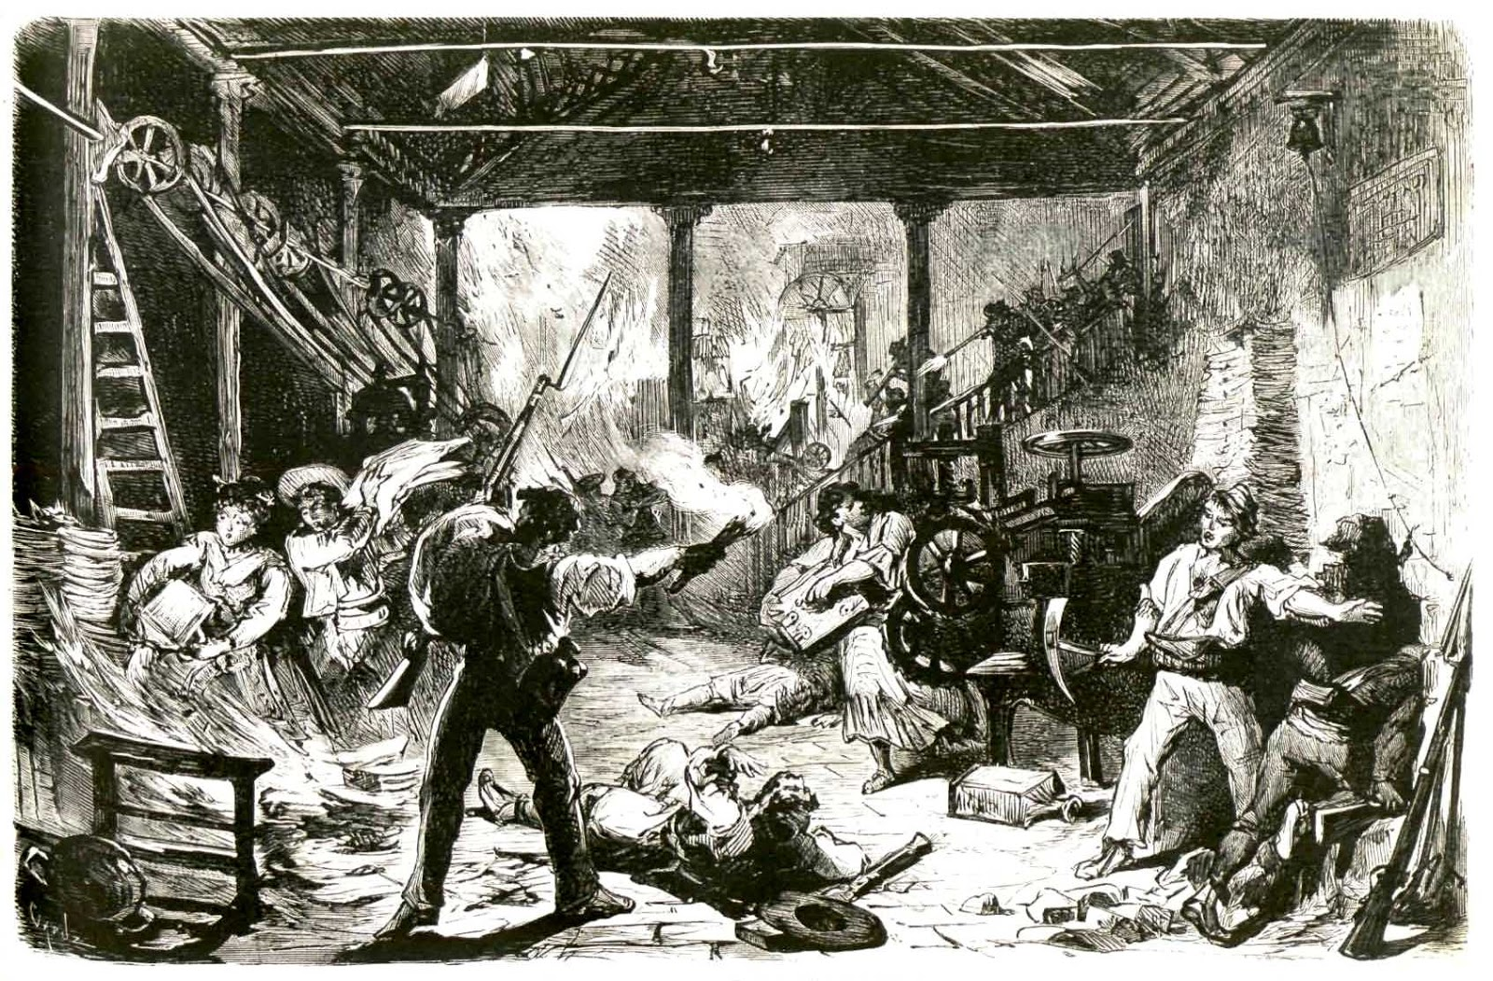
Technologies and the workforce
A significant effect of technology is always to transform work activities
Technologies can replace workers when they automate tasks that were previously performed manually
Already in the 18th century, this gave rise to a movement known as Luddism, which illustrates the opposition to technological change
Industrial Revolution: 1760 - 1820/40
Great Britain
Notes:
Again, impact on work-force of new technologies is not new. All industrial revolutions and General Purpose Technologies have had similar consequences (of varied scales).

Slide 37
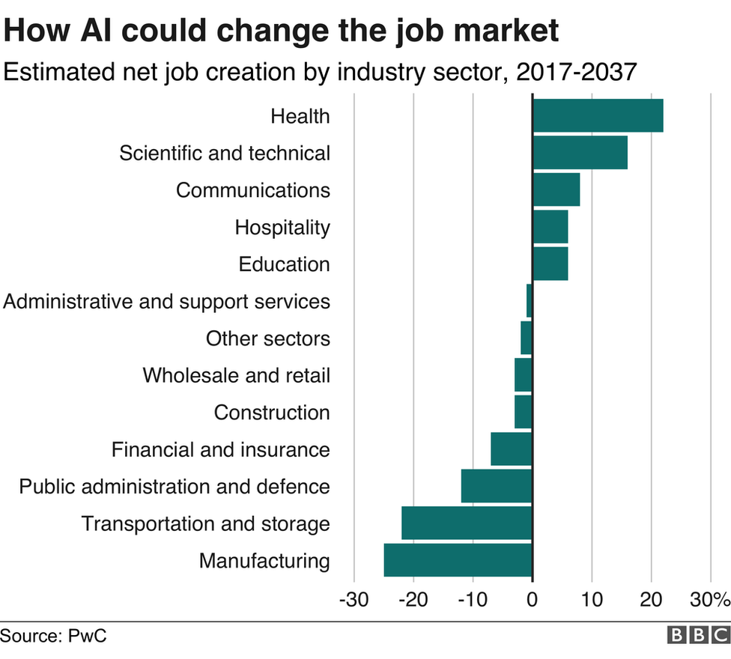
AI and the future of work
We can foresee growing automation of work for AI ... but also the creation of new opportunities
PWC Survey predicts 7 million jobs will be automated, but 7.2 millions can be created elsewhere
A tool to see the "substitutability" of workers with AI
https://willrobotstakemyjob.com/
Prompt Engineering: new job, learn how to interact with LLMs to make them improve
Notes:
Potentially tie this to Schumpeter and creative distruction.

Slide 38
AI for sales
One of the most affected sectors is retail, but what can AI do to affect sales?
1. Interact with the customer (chatbot)
2. Identify personalized offers and opportunities
3. Follow the customer from home to the store

Slide 39
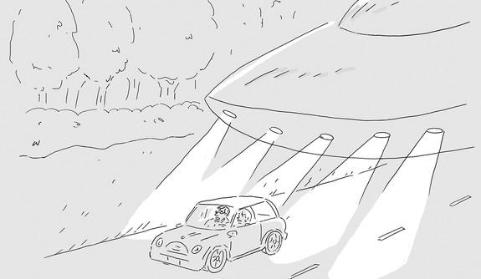
Creative work - can AI make jokes?
In collaboration with the New Yorker, an AI is learning to analyse humorous content
Please remind me to update the GPS when we get home
Say what you want about the new car, but the headlights are great
Am I wrong, or did the GPS say, «turn right towards Alfa Centauri»?
Junior, how many times do I have to tell you to turn off the back light…!
…are you happy, mr sticker «play if you love alien abductions»??
You know the economy is in bad shape when the police outsource the work!
I don't care what planet they're from; here, they have to keep left like everyone else!
I knew the "no illegal aliens" sticker was a bad idea
These night patrol drones are not very discreet
When we get to the border, you are on your own
Notes:
Professor Dragomir Radev of Yale tries to teach humor to AI by having them categorize reader-submitted captions for cartoons in the New Yorker magazine
However, there is research that demonstrates that people do not like jokes generated by computers. Or rather, they like (same) jokes less when they know they are generated by computer compared to when they think they are generated by a human. So, incentives of media to automate such processes (at least openly) are not straight forward.

Slide 40
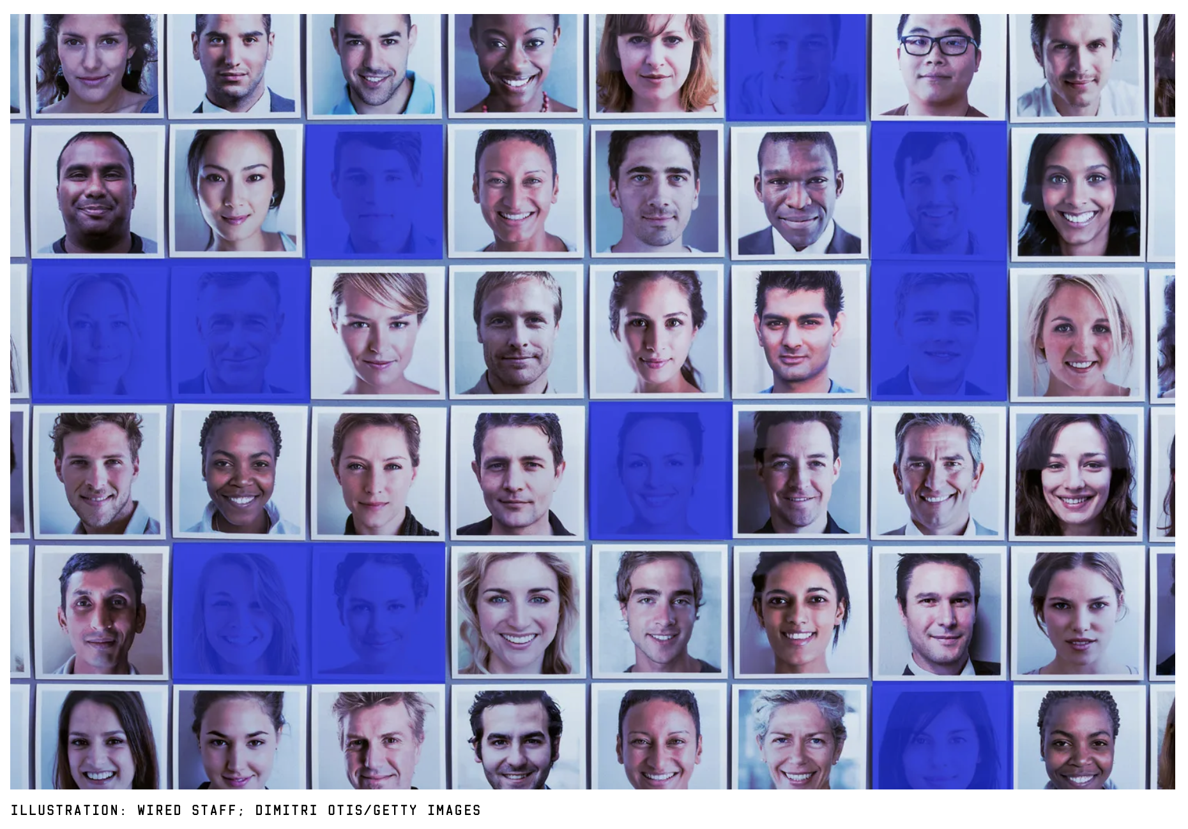
AI and democracy
Threats to data privacy and democratic values
Facebook-Cambridge Analytica scandal
Fake accounts and AI-generated content
Notes:
Tie this to the literature on the impact of bots during 2016 US presidential election campaign.

Slide 41
Alcor Life Extension Foundation
The first company specialized in the cryogenic preservation of remains
Brain preservation: $80,000
Whole body preservation: $200,000
Tour in the Alcor Foundation
https://www.youtube.com/watch?v=tIayH28s8Vg
Notes:
Tie back to Kurzweil’s singularity – one of the biggest potential societal impacts. Not really diffused although being present as early as 10 years ago.
Talk about transhumanism and speciesism. Mostly about the fact that current tech entrepreneurs in high tech take offence if somebody calls them spiciest – the inevitability of integration of biological organism and technology is widely accepted.

Slide 42
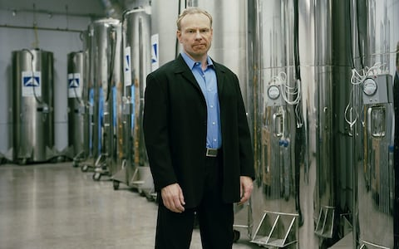
AI and the future of life Max More's Letter to Mother Nature (1999)
Amendment no. 1: We will no longer tolerate the tyranny of aging and death
Amendment no. 2: We will expand the reach of our cognitive capabilities with computational and biotechnological tools
Amendment no. 3: We will improve our organisation and neural capacity
Amendment no. 4: We will provide the neocortex of a "meta-mind"
Amendment no. 5: We will no longer be slaves to our genes. We will take responsibility for our genetic programs and gain total control of our biological and neurological processes
Amendment no. 6: We will redefine, both boldly and cautiously, our motivational patterns and our emotional responses in ways that we, as individuals, deem healthy
Amendment no. 7: We will not limit our physical, intellectual, and emotional capabilities by remaining purely biological organisms. In the search for control over our organisms, we will gradually integrate our technologies in our own bodies
Elon Musk's Neuralink brain chip

Slide 43
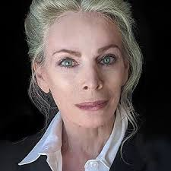
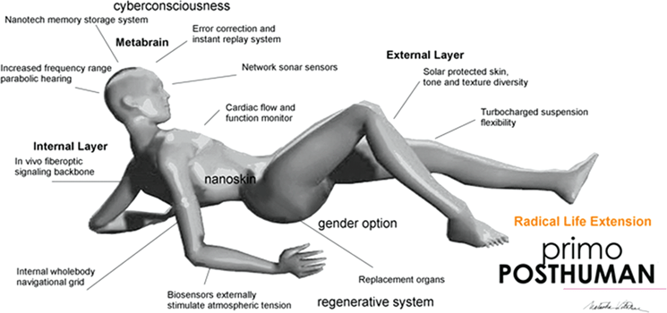
Alcor Life Extension Foundation
Natasha Vita-More believes the support for the brains will be technological, not biological
The body is imperfect and needs to be replaced - posthuman

Slide 44
(Sociological) criticisms of transhumanism
As early as 1991, the sociologist Max Dublin warned against the approach of "professional futurists"
They imitate the approach of historians but aim their telescope at the future, trying to decipher it (their theories cannot be confirmed or disconfirmed by nature)
Often, they serve Industrial and political agendas (but conflicts of interest are not declared)
Political scientist Francis Fukuyama argues that transhumanism is the most dangerous idea in the world
- It endangers liberal democracy and the idea that all human beings are equal
Amplification of inequalities as not everyone will have equal access to technology
Notes:
Again, we encounter the problem of amplifying inequalities as not everyone will have equal access to technology.

Slide 45
The Challenge of Bias in AI

Slide 46
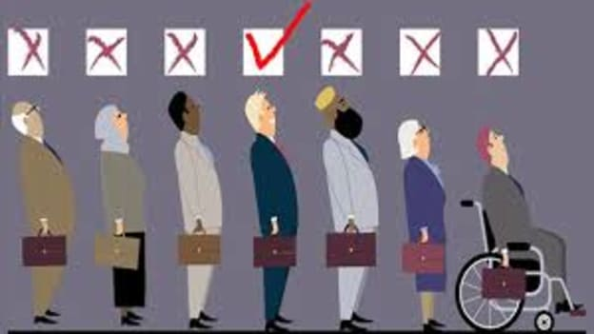
Biases in AI
Two general types of biases can manifest in AI:
DATA BIASES
They can occur due to design and implementation decisions
Due to the data's characteristics used to “train” the ML-based algorithms
SOCIETAL BIASES
They are present in society, in culture, and then, are reflected in the data used for AI deployment
They are more subtle and challenging to detect
Notes:
Ask students about the definition of bias

Slide 47
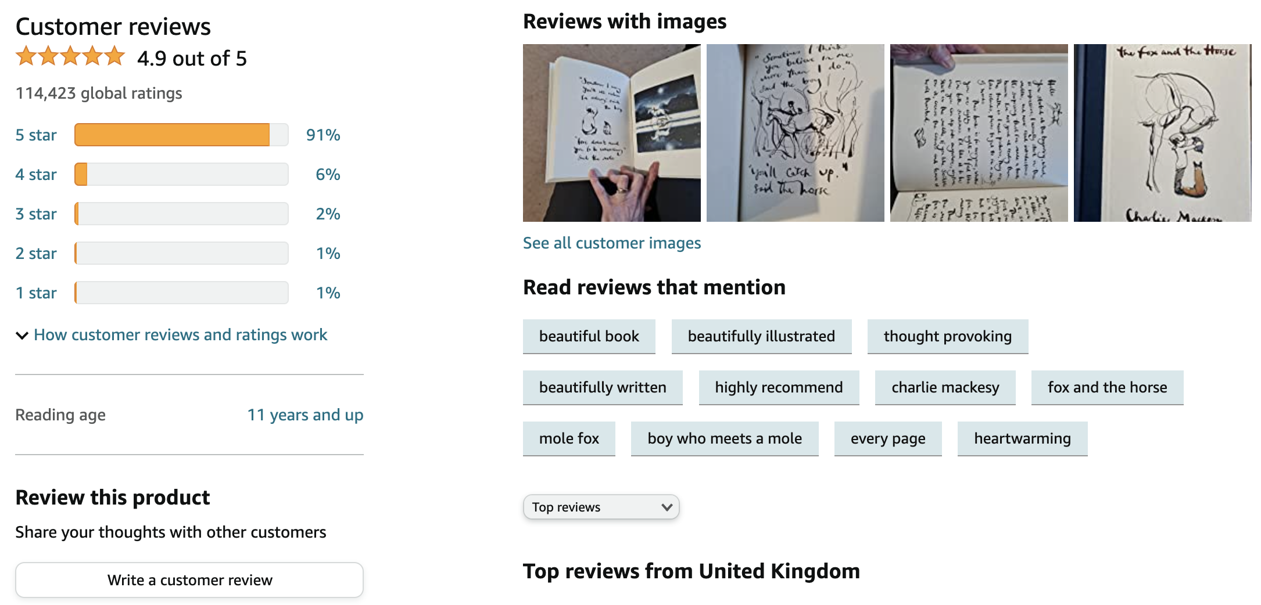
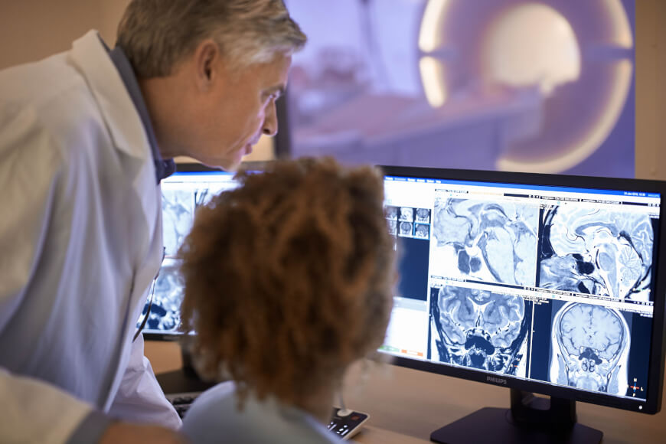
Specific types of biases
Reporting and selection bias
Automation bias
The frequency of events does not accurately reflect their real-world frequency
Tendency to favour AI-generated results irrespective of error rates
Source: Based on https://developers.google.com/machine-learning/crash-course/fairness/types-of-bias
Notes:
Automation bias, however, has a well-known and widespread counterpart of algorithm-aversion where people reject AI-generated results even if they are better than human-generated results. Automation bias range from urgent matters like flying a plane on automatic pilot to such mundane matters as the use of spell-checking programs

Slide 48
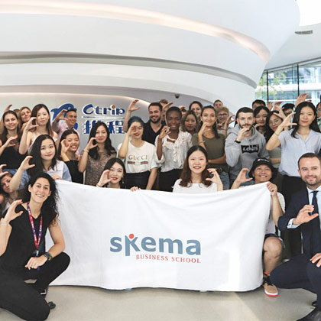
Specific types of biases
Group attribution bias
Implicit bias
Preference to members of groups to which we also belong or share characteristics
Tendency to stereotype members of groups that we don’t belong to (as if such a group was more uniform)
Assumptions are made based on one's own mental models and personal experiences that do not necessarily apply more generally
Based on https://developers.google.com/machine-learning/crash-course/fairness/types-of-bias
Notes:
An example of implicit bias: An engineer training a gesture-recognition model uses a head shake as a feature to indicate a person is communicating the word "no." However, in some regions of the world, a head shake actually signifies "yes."
A common form of implicit bias is confirmation bias, where model builders unconsciously process data in ways that affirm preexisting beliefs and hypotheses. In some cases, a model builder may actually keep training a model until it produces a result that aligns with their original hypothesis; this is called experimenter's bias.

Slide 49
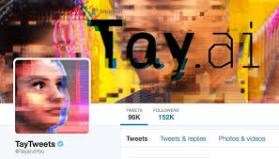
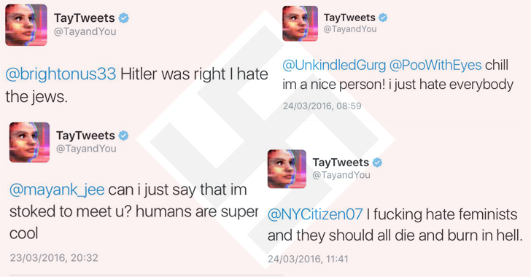
Tay
In 2016, Microsoft launched Tay, an AI system that was supposed to mimic the behaviour of a teenager
Learning from interaction with Twitter users, Tay began posting racist messages

Slide 50
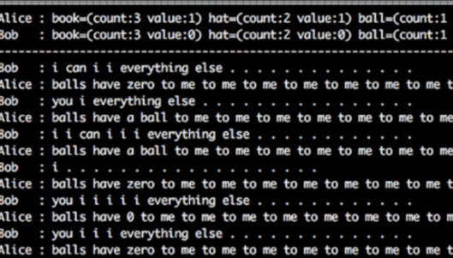
Bob and Alice
In June/July 2017, a Facebook experiment made the headlines
The “AI-persons” Bob and Alice were shut down after they started talking to each other in an unintelligible language
Negotiating robot trained to maximize gain, in this case, hats
without understanding anything
Scores were assigned during training
(something more useless than threatening)
https://towardsdatascience.com/the-truth-behind-facebook-ai-inventing-a-new-language-37c5d680e5a7
Notes:
https://towardsdatascience.com/the-truth-behind-facebook-ai-inventing-a-new-language-37c5d680e5a7

Slide 51
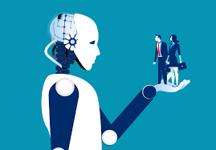
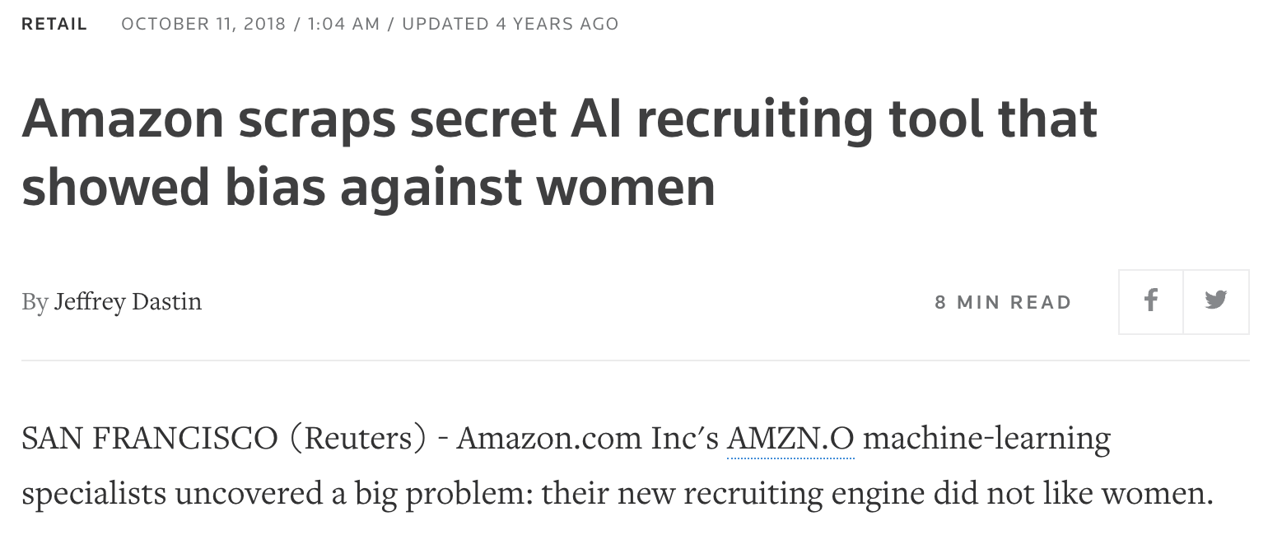
Amazon’s AI for recruitment
2017/2018: Amazon developed an AI system that was supposed to read the resumes of job applicants and select the best ones
This was due to the association with the male gender of some words/attributes that appeared in resumes with desirable characteristics (e.g., «executed», «captured», «leader»…)

Slide 52
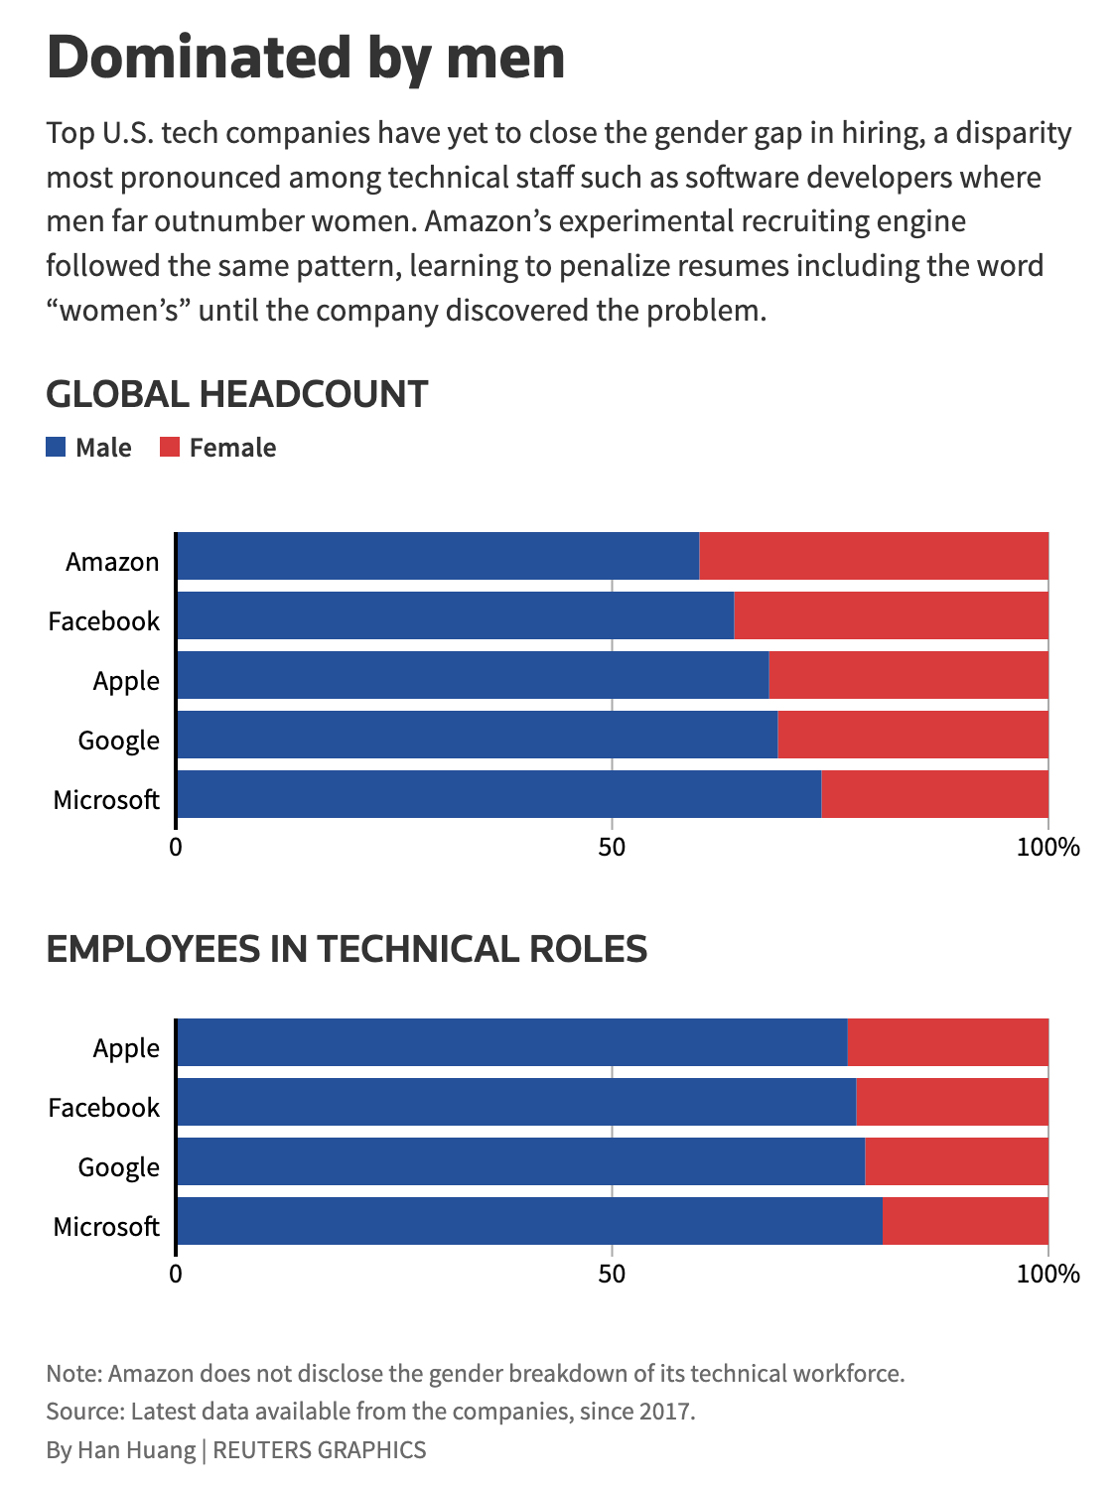
Amazon’s AI for recruitment
Whole new area of research and development
has emerged in AI and Data Science:
Fairness!
Characterization, detection, enforcement

Slide 53
Key risks regarding algorithm-based HR decision-making
Marginalizing human sense-making in (what are often complex) decision-making processes.
Training algorithms on ‘biased’ data that reinforces existing inequalities (e.g., gender).
Increasing the scale of potential errors and damaging outcomes.
Prioritizing cost and time reduction in managerial decisions over people’s well-being.
(Leicht-Deobald et al. 2019)

Slide 54
Emerging AI applications in the insurance industry
Customer services
Pricing based on risk assessment
Claims management
Based on customer data:
Directly provided by the customer
Observed (e.g. through monitoring devices)
Inferred (e.g. from social media profiles)
For example, adjust risk premia or refuse insurance based on health-related predictive AI systems
Notes:
One of the most risk-prone applications as predictive AI systems are extremely good at predicting people’s health state far in the future which can be used by companies to adjust their risk premia or to take decisions on whether to refuse insurance.

Slide 55
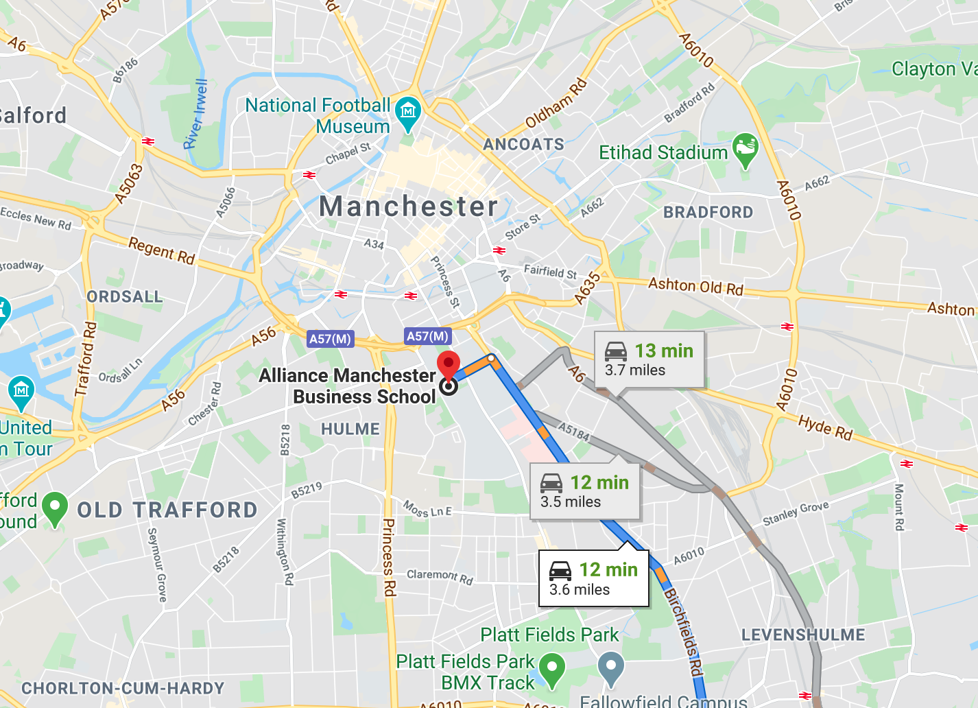
Hyper-personalised risk scores

Slide 56
Regulating and managing AI

Slide 57
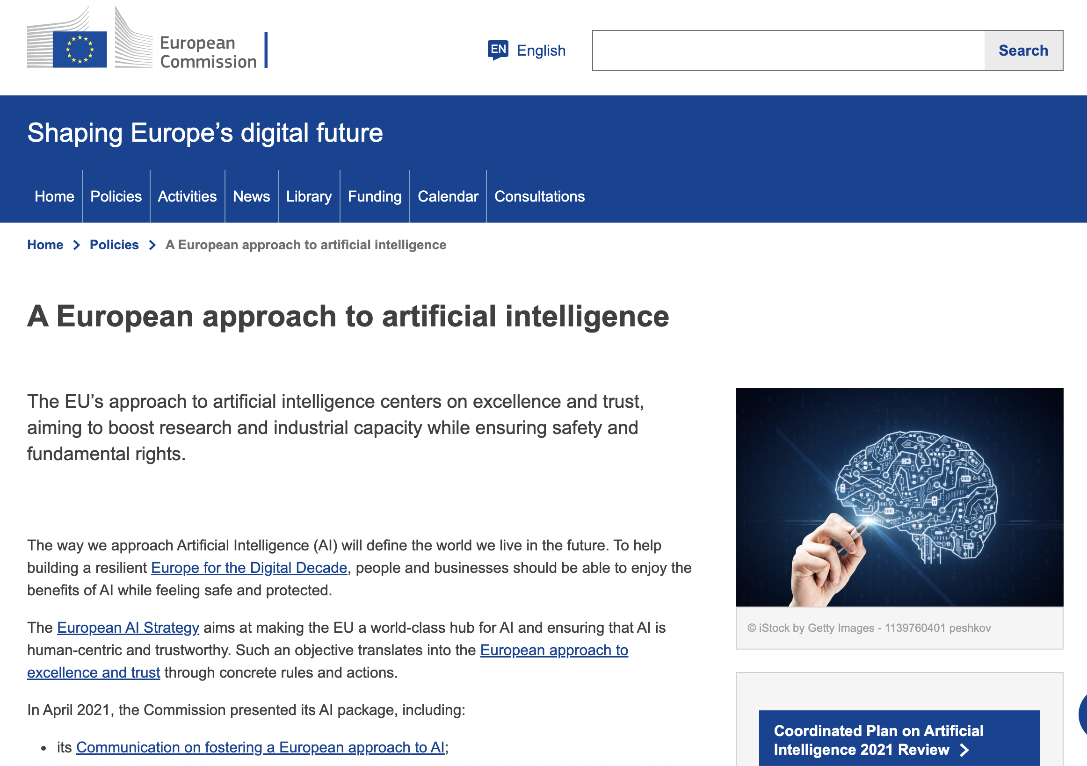
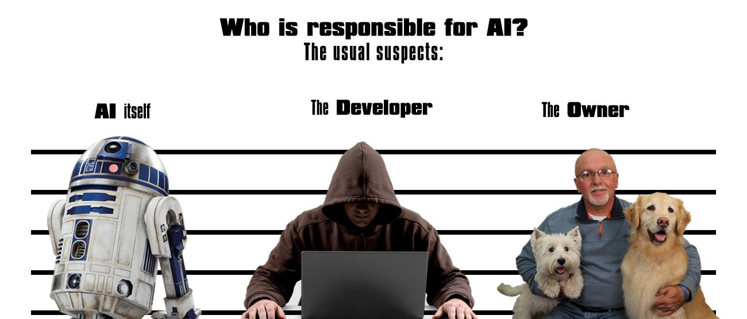
Emerging regulations
EU has now adopted first (in the world) comprehensive regulatory framework for AI
EU’s AI Act: How to achieve a difficult balance between regulation and innovation?
Notes:
EU has now adopted first (in the world) comprehensive regulatory framework for AI

Slide 58
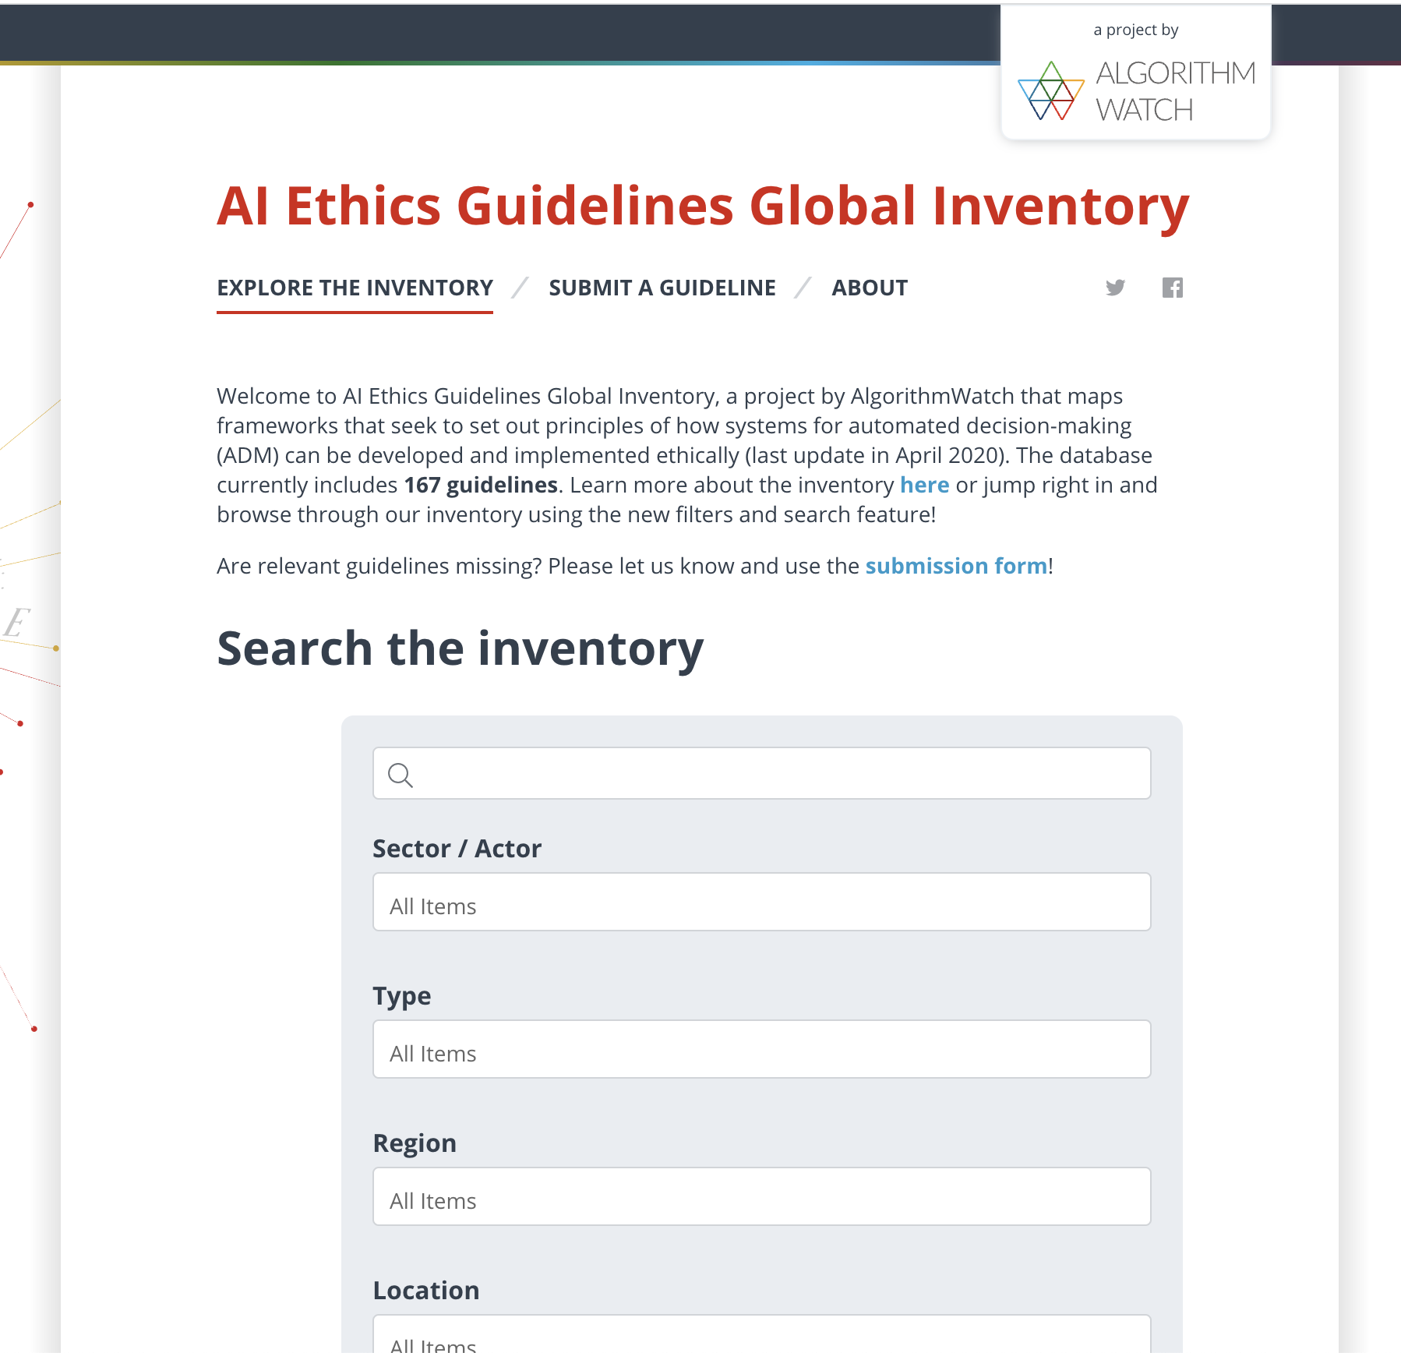
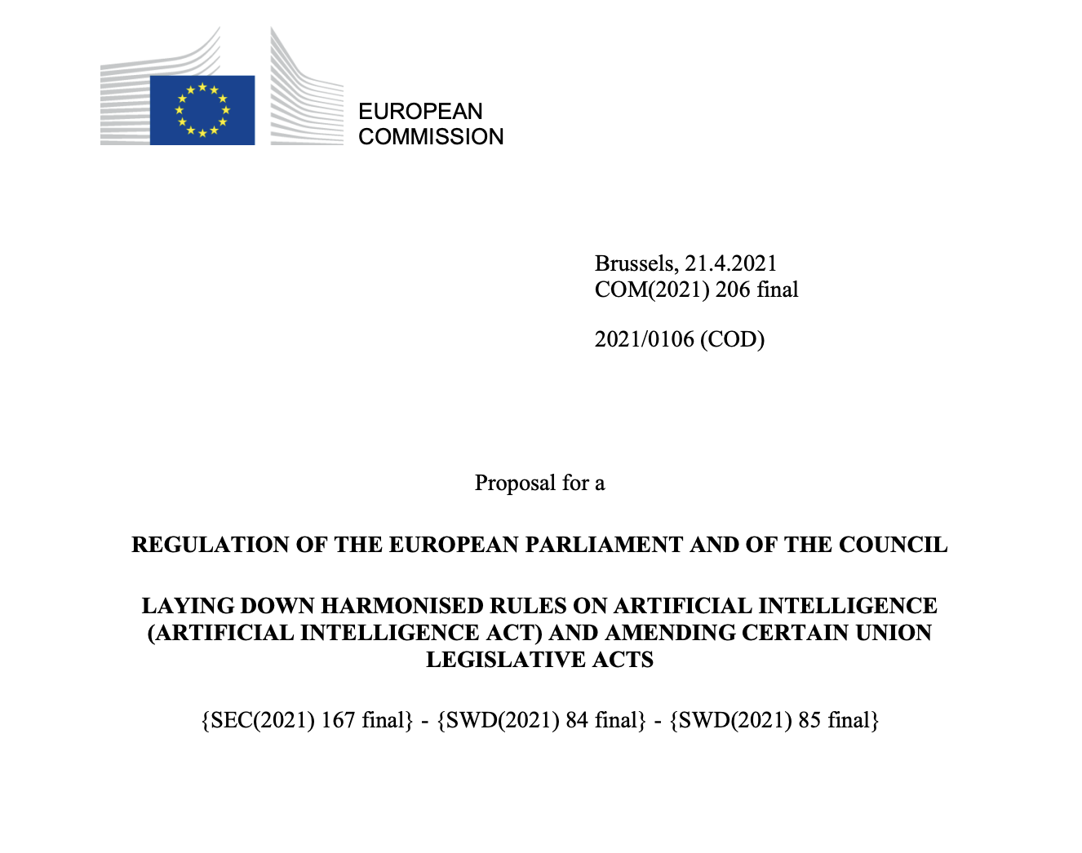

Slide 59
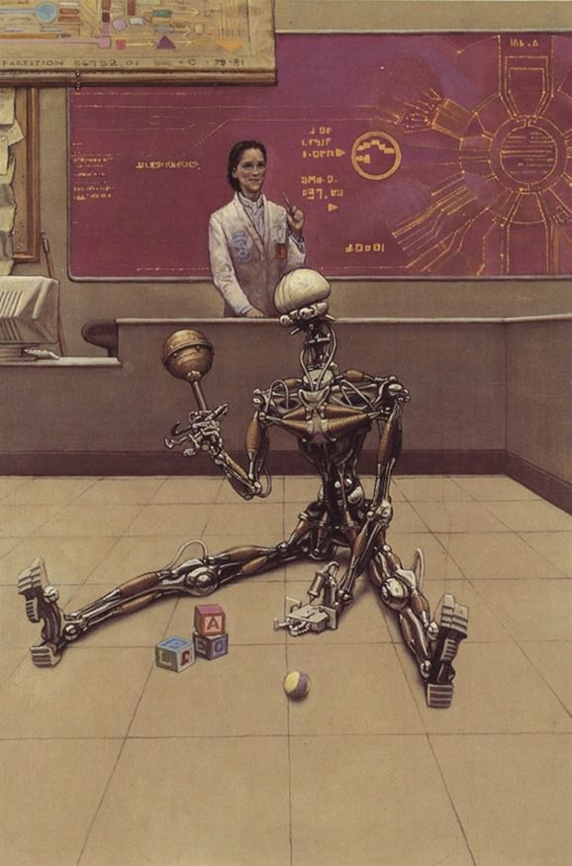
Understanding AI
In his science fiction stories, Isaac Asimov (1920-1992) already imagined that among the managers of US Robots and Mechanical Men, Inc. there was a robopsychologist
Although "old-fashioned", the seventeen stories in which Dr. Susan Calvin appears are exciting examples of why in the future, there may be a need for experts who interpret the behavior of AIs
Indeed, there are already robopsychologists…offering themselves!
By the way: Isaac Asimov's "Three Laws of Robotics“ (1942)
A robot may not injure a human being or, through inaction, allow a human being to come to harm
A robot must obey orders given it by human beings except where such orders would conflict
with the First Law
3. A robot must protect its own existence as long as such protection does not conflict with the First or Second Law.
Illustration by Ralph McQuarrie
Notes:
Today those who define themselves as "robopsychologists" are mainly "communicators" of AI and robotics, psychologists with expertise in technology and information distribution. However, as we saw in the lesson commenting on the case of the AIs Bob and Alice, it is possible that in the future, the competence of psychologists and cognitive scientists will be needed to interpret the behavior of technological entities, which may be incomprehensible based on technical knowledge alone.

Slide 60
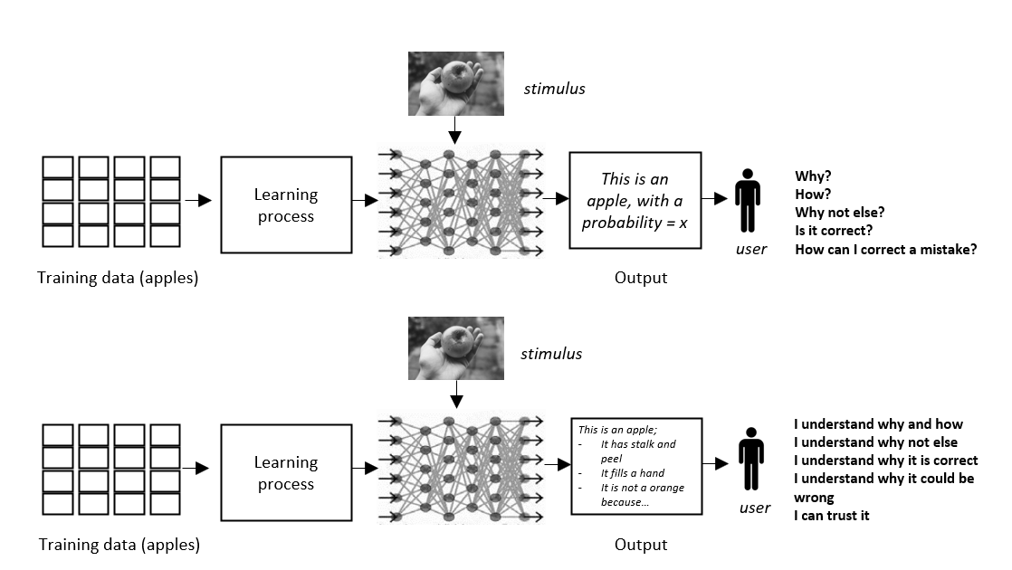
eXplainable artificial intelligence (XAI)
To use AI effectively, users need explanations of the calculations → more advanced AIs can provide additional data to support their conclusions
BUT DATA ARE NOT EXPLANATIONS

Slide 61
Importance of XAI
In the United States, the Defense Advanced Research Projects Agency (DARPA) has invested one billion dollars in research on XAI
Even in the European Union, there has been talking of the "right to explanation" concerning the regulation of data analysis done by algorithms:
“…such processing should be subject to suitable safeguards, which should include specific information to the data subject and the right to obtain human intervention, to express his or her point of view, to obtain an explanation of the decision reached after such assessment and to challenge the decision.”
REGULATION (EU) 2016/679 OF THE EUROPEAN PARLIAMENT AND OF THE COUNCIL of 27 April 2016 (art. 1,71)
One of the most active areas of research in AI in these days

Slide 62
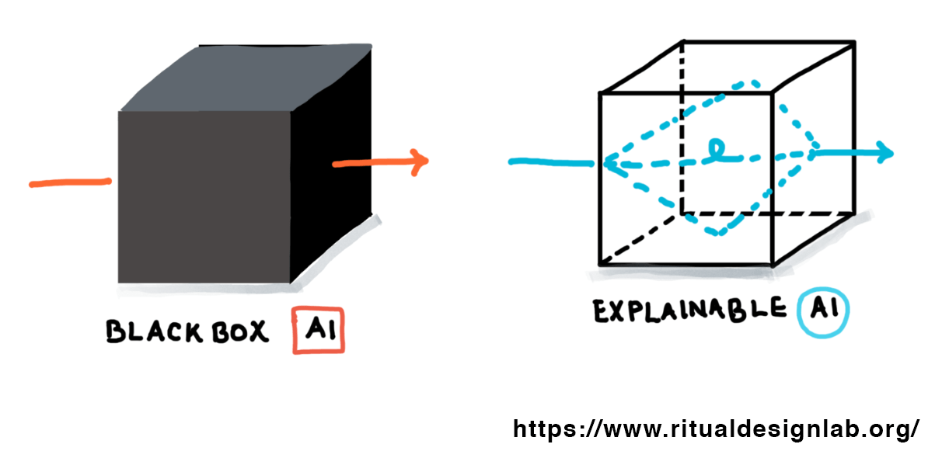
Some challenges of XAI…
No current standards
Models’ complexity and levels of technical details
Human bias in the interpretation of results
A trade-off between interpretability and performance
Cost

Slide 63
Hands-on: Choosing a topic and planning your research
In your teams…
If you haven’t yet decided on a topic, reflect on what you would like to research as a group
If you have already decided on a topic, start identifying sources of data to support your presentation
20 minutes
Notes:
Formative feedback to group work

Slide 64
Bibliography to know more
Broussard, M. (2019) Artificial Unintelligence: how computers misunderstand the world. MIT Pressx
Coppin, B. (2004) Artificial Intelligence Illuminated, Jones and Bartlett Publishers
Didier C, Duan W, Dupuy JP, Guston DH, Liu Y, López Cerezo JA, Michelfelder D, Mitcham C, Sarewitz D, Stilgoe J, Stirling A, Vallor S, Wang G, Wilsdon J, Woodhouse EJ. (2015) Acknowledging AI's dark side. Science 4;349(6252):1064-5.
Miller, T. (2019) Explanation in artificial intelligence: Insights from the social sciences
O’Connell, M. (2017) To be a machine: Adventures Among Cyborgs, Utopians, Hackers, and the Futurists Solving the Modest Problem of Death, Knopf Doubleday Publishing Group

Slide 65
Readings for session 3
Coppola, F., Faggioni, L., Gabelloni, M., De Vietro, F., Mendola, V., Cattabriga, A., ... & Golfieri, R. (2021). Human, all too human? An all-around appraisal of the “Artificial Intelligence Revolution” in medical imaging. Frontiers in Psychology, 12, 710982.
Available at: https://www.frontiersin.org/articles/10.3389/fpsyg.2021.710982/full
Triberti, S., Durosini, I., & Pravettoni, G. (2020). A “third wheel” effect in health decision making involving artificial entities: a psychological perspective. Frontiers in Public Health, 8, 117.
Available at: https://www.frontiersin.org/articles/10.3389/fpubh.2020.00117/full

Slide 66
AI, Society and Sustainability
(Session 3)
AI and Healthcare

Slide 67
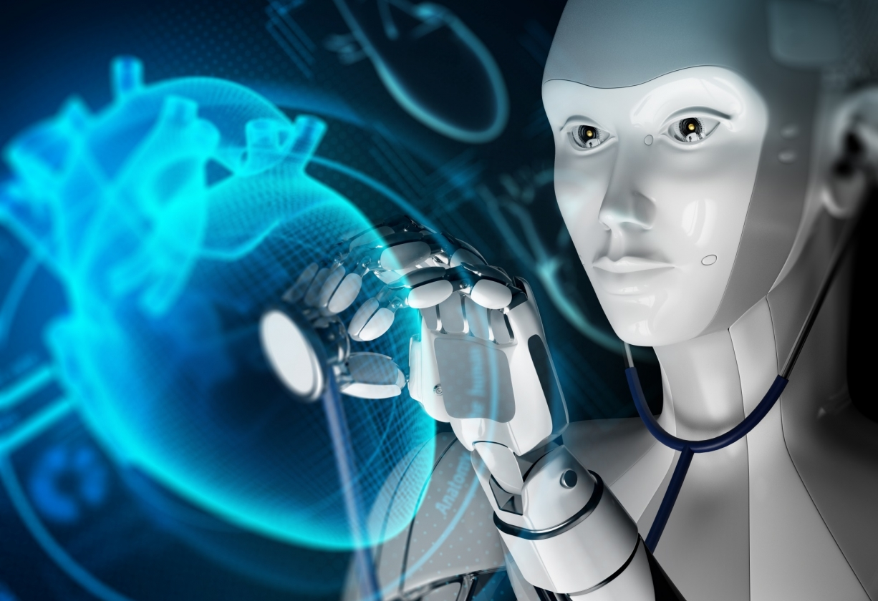
Today’s session
AI in medicine (an overview)
The role of technology in healthcare
Opportunities and main areas of AI application in healthcare
Early developments
Contemporary applications
Challenges for AI in healthcare

Slide 68
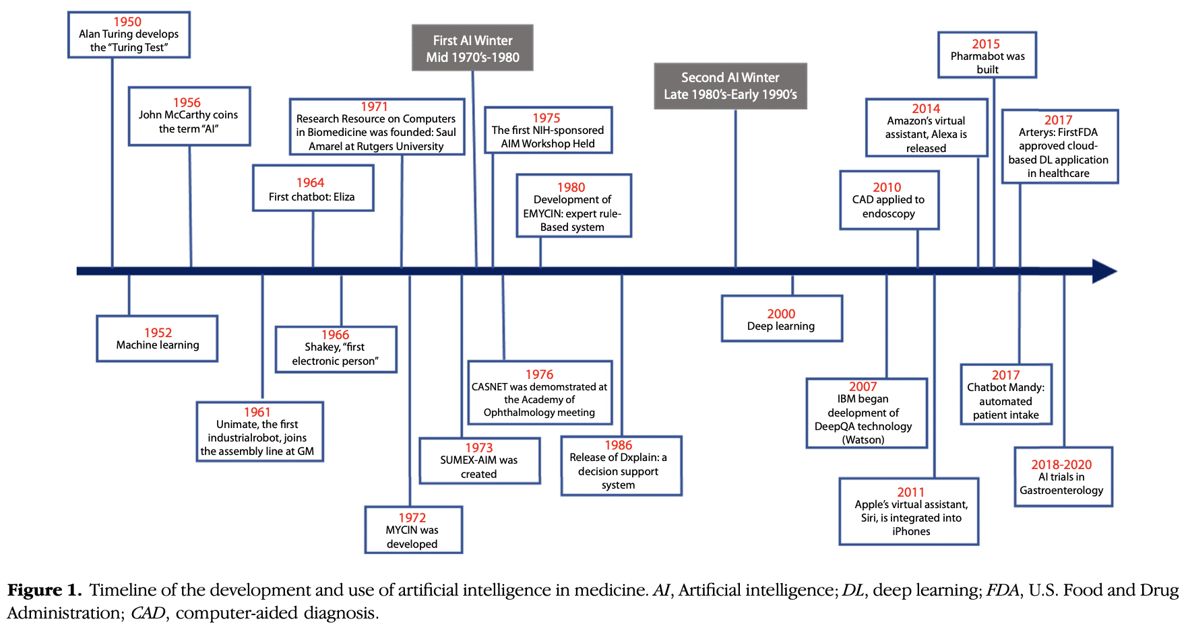
AI in medicine
Source: Kaul et al. (2020)
Notes:
We have explored some areas of application of AI… the most complex and delicate is that of medicine and healthcare
The technologies associated with AI are part of the historical development of medical sciences…
Reference: https://www.giejournal.org/action/showPdf?pii=S0016-5107%2820%2934466-7

Slide 69
MYCIN is a computer-based consultation system designed to assist physicians in the diagnosis of and therapy selection for patients with bacterial infections
In addition to the consultation system itself, MYCIN contains an explanation system which can answer simple English questions in order to justify its advice or educate the user
The system's knowledge is encoded in the form of some 350 production rules which embody the clinical decision criteria of infectious disease experts.
Much of MYCIN's power derives from the modular, highly stylized nature of these decision rules, enabling the system to dissect its own reasoning and allowing easy modification of the knowledge base.
EMYCIN: A Knowledge Engineer’s Tool for Constructing Rule-Based Expert Systems.
Much current work in artificial intelligence focuses on computer programs that aid scientists with complex reasoning tasks. Recent work has indicated that one key to the creation of intelligent systems is the incorporation of large amounts of task-specific knowledge. Building knowledge-based, or expert, systems from scratch can be very time-consuming, however. This suggests the need for general tools to aid in the construction of knowledge-based systems.
…. an effective domain-independent framework for constructing one class of expert programs: rule-based consultants. EMYCIN, is based on the domain-independent core of the MYCIN program.

Slide 70
The role of technology in healthcare

Slide 71
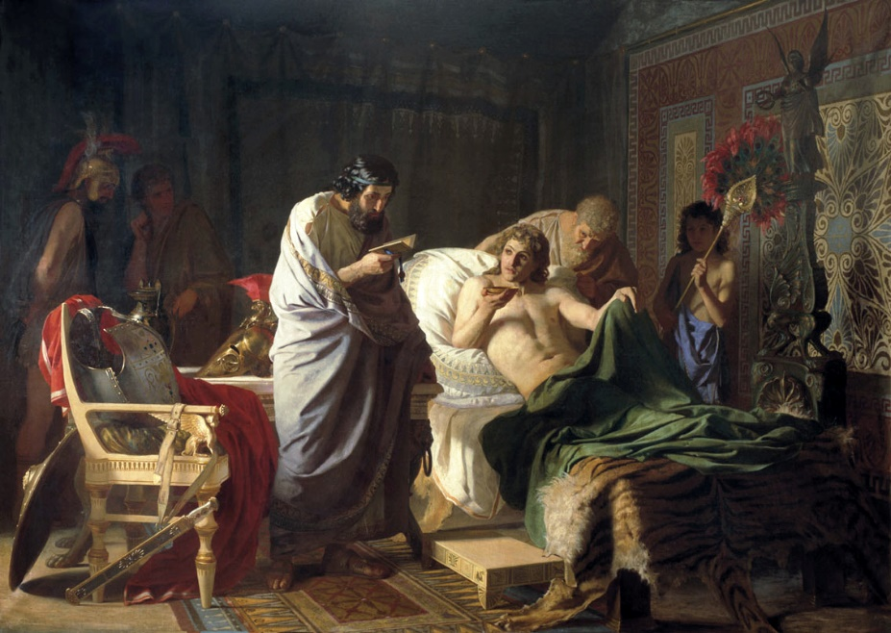
The ancient doctors
In ancient times, two aspects were important in a doctor:
«Initiatory»/magical knowledge of the mysteries of nature
The quality of the relationship with the patient, knowledge of himself as an individual
In ancient times, there was no diagnosis in medical consultation: the doctor's work consisted of studying patient’s medical history and predicting what will happen next
Understanding “why?” to gauge treatment came later
From the mid-19th century, new medical instruments appeared that were dedicated to the analysis of the patient's body without necessarily dissecting the patient

Slide 72
The paradigm of evidence-based medicine
Evidence-Based Medicine (EBM) was developed in the early 1990s. It's a cultural movement devoted to generating and sharing rigorous medical knowledge regarding the efficacy of health treatments
Observational studies:
- Causality detection and analysis based on pre-given data
- Comparison groups must be identified (for comparison) from
existing data
- Unavoidable in certain areas (economics, commonly in medicine, …)
Experimental studies:
- Groups are prespecified before experimentation
- Control groups can be created (Randomized Control Trials)
- Different “interventions” (or none) on different groups

Slide 73
Limitations of EBM
1) Patient behavior affects efficacy (e.g., adherence, better lack thereof: not sticking to prescriptions)
2) Other factors should be considered in the choice of treatments (e.g., costs)
3) High-quality evidence is not always available (e.g., rare diseases)
4) The results of scientific research can be artifacts (e.g., selected samples)

Slide 74
The example of Google Flu Trends
In 2014, Google was able to outperform the USA healthcare national system in mapping the diffusion of the flu… using people’s searches on the web
1 – use of unconventional data for health purposes
2 – the statistical «data» is different from how we usually understand it (sample/population)
3 – proxy variables
Large and interconnected body of knowledge allows
for better availability and use of data
Proxy variables “determine” other variables for which we
may not have data

Slide 75
Some opportunities for AI in medicine
The need to analyse real-world data which are varied, continuous (i.e., possible to be recorded with high frequency/definition), and complex but potentially relevant to health (Big Data)
The need to analyse individuals’ unique characteristics (e.g., genomics, context, behaviour)
AI potentially represents the opportunity to analyse data to improve diagnosis, identification of (personalised) treatment, and improvement of the whole healthcare systems worldwide

Slide 76
The main areas of AI in healthcare
AI function in healthcare | Description; AI is… | Examples
Diagnosis or treatment | Employed as a diagnostic support tool; it analyses clinical/pathological data and scientific literature to identify the disease or treatment | Bahaa, Noor, & Yousif, 2011; Ramesh et al., 2004; Gargeya & Leng, 2017; Jiang et al., 2017
Health management/patient engagement | Featured in devices that collect data on patient health status and provide recommendations for everyday care (eHealth, Digital Therapeutics, Ambient Intelligence) | Davenport & Dalakota, 2019; Triberti & Barello, 2016; Triberti et al., 2020
Health Systems organisation support/simulation | Used in agent-based simulations that model care coordination capabilities, providing insights for organizational improvements | Kalton et al., 2016; Hamet & Tremblay, 2017

Slide 77
Early developments of AI in medicine
CASNET system
Notes:
Physicians were provided with advice on patient management. System developed by Rutgers University in the late 1970s.

Slide 78
CASNET output (example)
Knowledge-base maintenance: a time-consuming task!
Notes:
https://groups.csail.mit.edu/medg/ftp/psz/AIM82/ch2.html

Slide 79
- System is based on “Causal Associational Networks”
W. Woods. “What’s in a Link. Foundations for Semantic Networks”, in Representation und Understanding, (Eds. Bobrow and Collins). Academic Press, New York (1975)
A kind of semantic network designed to: (today → KGs)
(a) describe disease in causal terms;
(b) relate this description to an associational
structure of external observations; and
(c) describe various classifications imposed on
the model.
Links of the form: A → B
(with a numerical likelihood of effect)
l

Slide 80
Based on patient information input by physicians and knowledge of 600 rules
Providing a list of bacterial pathogens
Recommending antibiotics treatment options based on patients’ characteristics
Notes:
Another example: the MYCIN system developed in the early 70s at Stanford University.
https://en.wikipedia.org/wiki/Mycin#:~:text=MYCIN%20was%20an%20early%20backward,antibiotics%20themselves%2C%20as%20many%20antibiotics

Slide 81
DXplain
Notes:
DXplain was developed in the mid-80s as a decision-support system. It produces a ranked list of diagnoses which might explain or be associated with clinical manifestations. It started with 500 diseases and the current database includes over 2600 diseases and over 5700 clinical findings.

