Slide 1
AI, Society and Sustainability
(Session 6)
AI Impact on Business

Slide 2
I. AI in Business: What for?
AI is relevant in business for several general reasons
Enhance productivity
Enhance sales
Identify opportunities
Reduce costs
Manage risks
AI is also relevant in business larger ecosystem
Finance
Economics
The specific business area

Slide 3
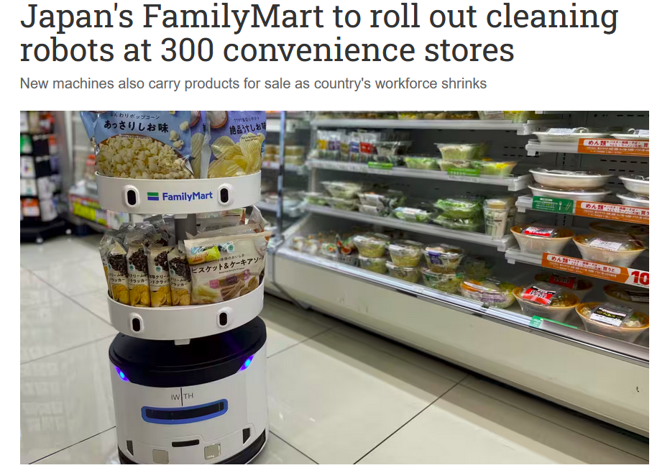

Slide 4
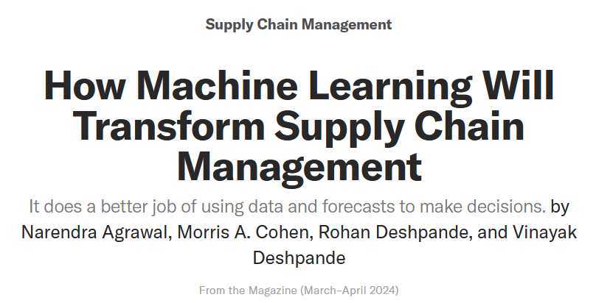

Slide 6
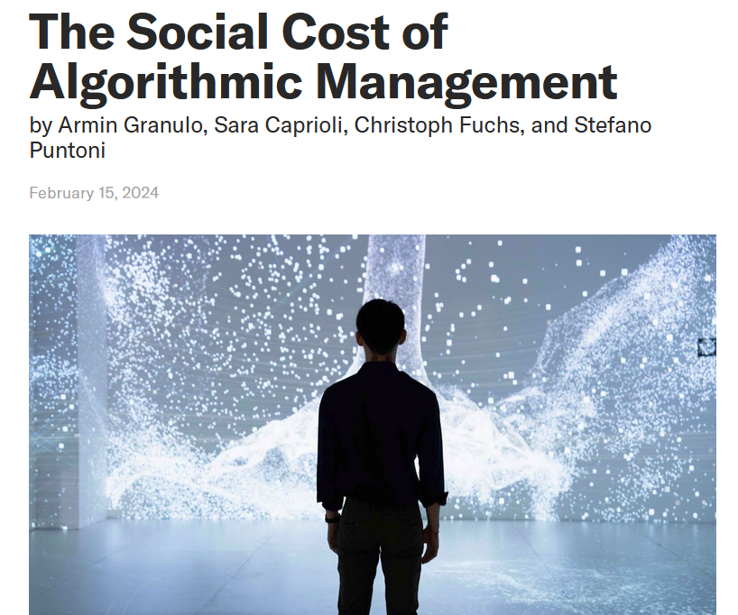
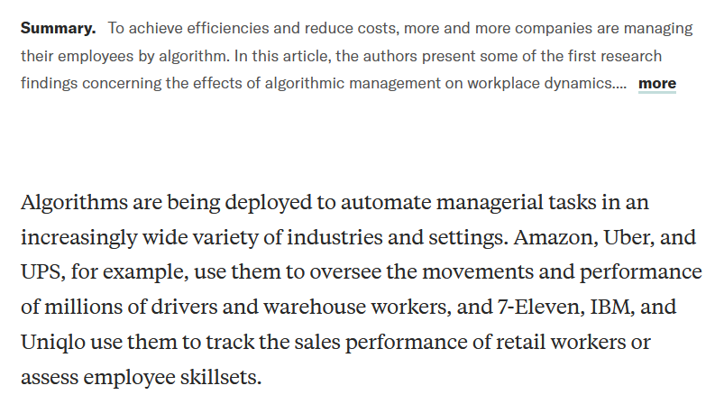

Slide 7
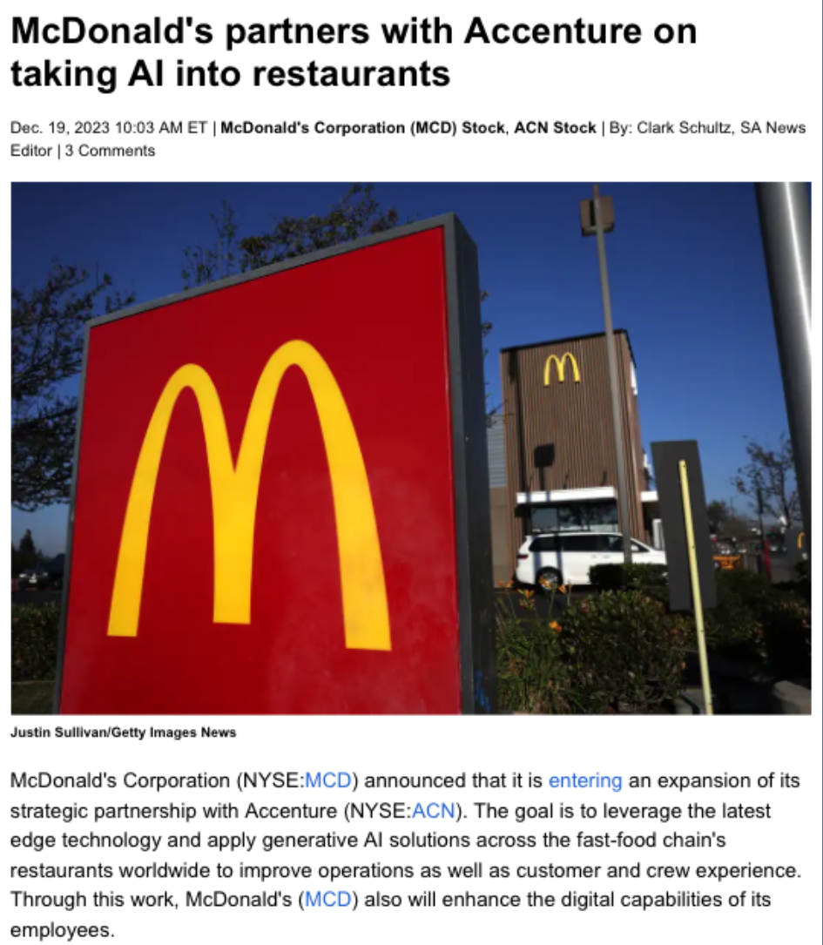

Slide 8
II. What Kind of AI in Business?
AI consists of many subareas that use different techniques
Some are particularly important for business applications
Machine Learning
Predictive Models
Predictive Maintenance
Decision Making
Recommender Systems
Business Models and Business Processes
Knowledge Graphs and Ontologies
Uncertainty Management
Explainable AI and Causality
Generative AI, Large Language Models (LLMs)
Generative Pre-trained Transformer (GPT) models, etc.
Ethical AI

Slide 9
What Kind of AI in Business?
Closely related areas of Computing Also relevant for business in general
Data Management
Data Science at large
Business Intelligence
Computing Infrastructures: Cloud-Computing, Web Services, Human-Computer Interaction
Cyber Security
They also support, enable or consume AI
Particularly crucial in business applications: Data-Centered AI
Things are about or start with data ...
Commonly leading to a Statistical or Machine-Learning Model

Slide 10
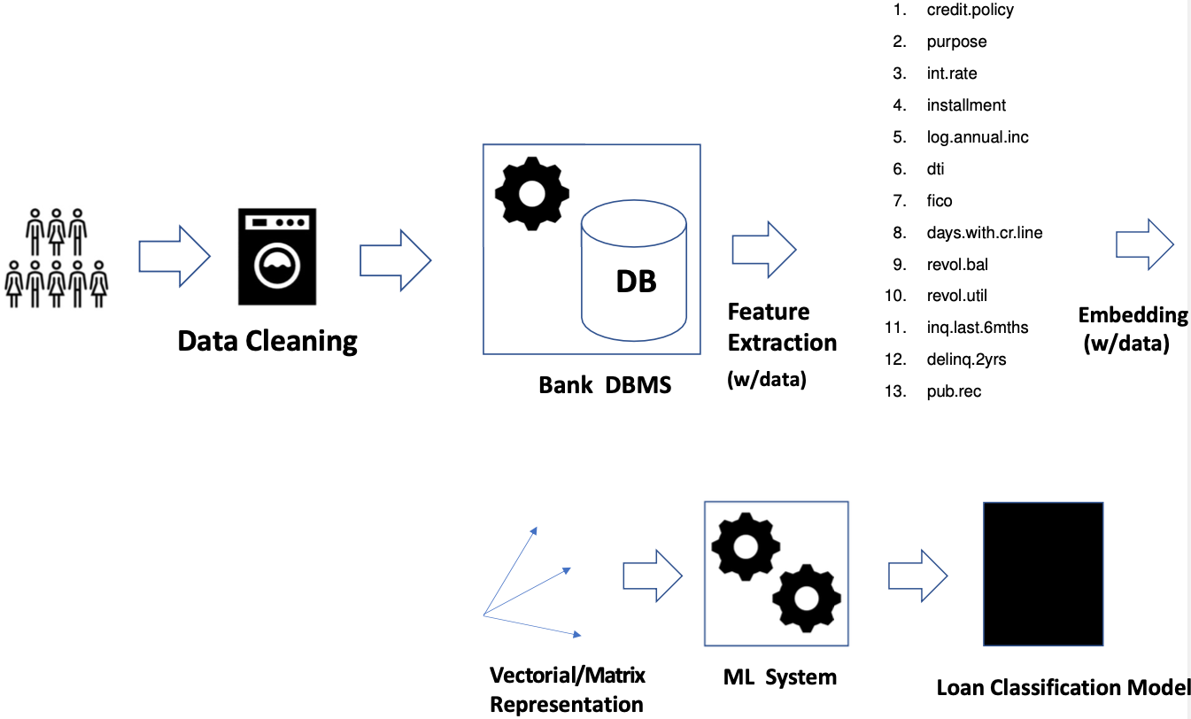
Usual process leading to an ML-based classification system

Slide 11
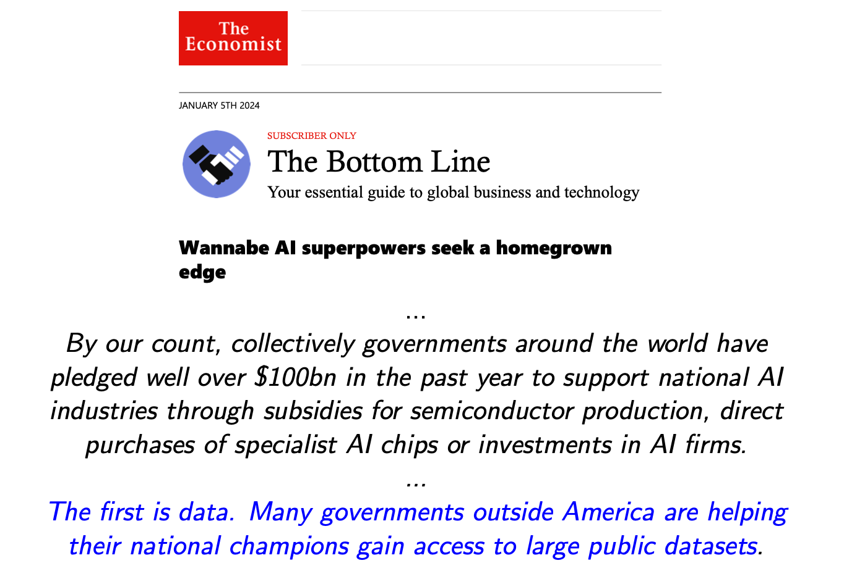

Slide 12
Some Common Applications
• Customer understanding
• Proactive and automated decision making
• Predictive Maintenance
• Product recommendation
• Marketing
• Inventory management
• Supply chain and logistics support
• Investment
• Market Analysis

Slide 13
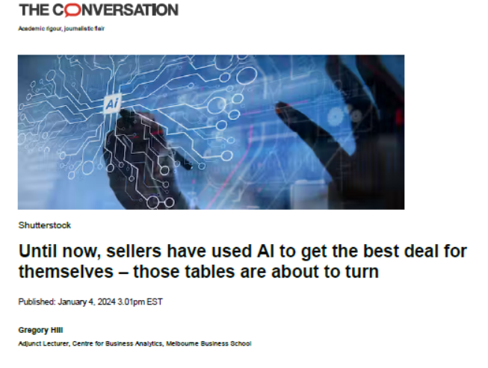
EXTRACT …

Slide 14
They are among the firms investing the most in AI in the form of data analytics and machine learning. Their investments include staff – often hundreds of data scientists – plus information technology systems and external consultants.
While some of the initiatives target costs by improving planning and reducing waste and fraud and theft, most target revenue via marketing and personalisation with the aim of getting the best deals to the customers who insist on them and the worst deals to the customers who will buy anyway.
Retailers, airlines, phone companies and insurers use sophisticated machine learning algorithms and real-time experiments to continuously tweak the prices and deals they offer individual customers, meaning there is often no such thing as a standard price.
To succeed at this game requires vast amounts of customer data, which they have via loyalty schemes and information about past, but their customers do not. That’s about to change. online purchases
Already, websites are offering AI assistants or “co-pilots” to pore over our financial records and scour the web, tirelessly haggling with providers’ automated copilots on our behalf. These new agents, with names like Comparison and Haggle It use information about our long-term spending patterns, preferences and broad financial goals to benefit us rather than the firms who are trying to sell things to us.
While the last wave of AI was used by big companies to make that task harder, the next wave is about to put that technology in the hands of consumers.

Slide 15
III. Business Intelligence: A Good Start
1. Multidimensional Data and Data Warehouses
In business applications, multidimensional and hierarchical data models are common
Data value seen from 3 dimensions that give context to it
Multidimensional DBs Data values seen from three dimensions
Dimensions structures as a hierarchy of categories They give context to numerical data
Dimensions with lattice-like structure (as above) or linear
Time: hour -> day -> month -> quartile -> year -> decade -> century

Slide 16
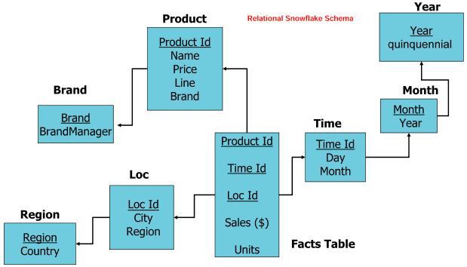
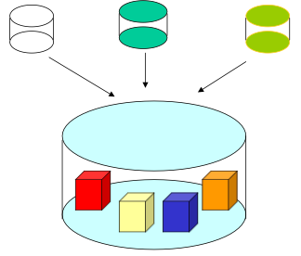
Lowest level corresponds to numerical facts
Pointing upwards to categories with lower levels of granularity and higher levels of abstraction
Lattice structure enables navigation and aggregation
E.g. of sale values at Country level
Rolling up the facts to Country category
DWHs enable data integration
A “cubic” view of data
DWHs support multidimensional business understanding and decision making
And exploratory analysis (operations: drill-down, roll-up, slice & dice)
Hypothetical queries: “What if?” (more later: “causality”)

Slide 17
2. Data Quality and Cleaning
Quality data is crucial to make data-centered and data-based systems deliver useful and meaningful results
Data quality assessment and data cleaning are among the most expensive and time-consuming activities
...
Data quality has multiple dimensions: completeness, consistency, accuracy, etc.
Data quality is context dependent
Models of context? Plenty of room for use of AI techniques
A couple of examples, for the gist:

Slide 18
Entity Resolution
External objects represented as records of feature values:
The problem consists of:
Identifying duplicates, i.e. different representations of the same external entity
Merging them
A common and costly problem for which many techniques have been developed
Many of them coming from AI Learn automatically to identify duplicates!

Slide 19
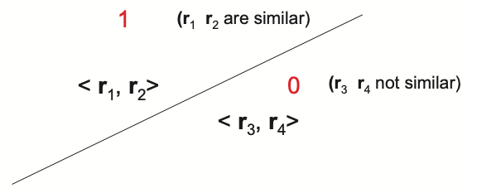
A supervised ML-classifier
Train one with labeled data of the form
Pairs of records (of feature values) with labels indicating if they are duplicates or not
Usually numerically encoded to enable (number-based) ML-techniques
For example:
Classifier to learn is separating plane
(in multiple-dimensions, a hyper-plane)
Possibly enhanced with additional domain knowledge,
e.g. ontologies, knowledge graphs, etc. (coming)
The latter also useful to specify and do the merging

Slide 20
Missing Values
Think of census-like data
What to do?
Different ways, all with problems and limitations
Record Deletion: data and information loss, bias creation
Imputation: Fill-in for MVs How? Mary, Income: na → 200 ???
How are there MVs?: Missingness Mechanisms (MMs)
E.g. missing completely at random, missing at random (but depending on observed variables), etc.
Why: Causes for MVs (as investigated in AI)
Possibly people with high income tend not to report it
Possibly unmarried people tend not to report children, etc.
MMs and causality help make estimations and inferences with MVs → AI techniques!

Slide 21
3. Data Mining
Common task: Discovering Association Rules
Typical example:
“Beers and diapers tend to be bought together”
If true (as supported by evidence): proactively place beer close to diapers in a supermarket
Evidence: Data! (and the way it is used/processed)
Discover rules of the form:
Set 1 of Items => Set 2 of Items (not logical implication)
Read: “Every time the items in Set 1 are bought, we also find those in Set 2”
(with high pre-specified confidence and support)
For example: {diapers} => {beer} or {BBQ sauce, coal, beer} => {meat}

Slide 22
There are algorithms for association rule discovery
Association rules can be used to detect buying patterns … and exploit them
They can be used as a basis for recommendations, as those from Amazon, Google, etc.
They can be enhanced with more sophisticated methods, e.g. personal profiles (coming ...)
Association rules do not necessarily capture causal relations
But only things that tend to happen together
Buying diapers does not cause buying beer
Buying beer does not cause buying diapers (maybe when you are old ...)
AI is having a huge impact on Business Intelligence; with much more yet to come

Slide 23
IV. Some Relevant Areas of AI for Business
ML for Prediction, Classification, Decision Making
Causality
Explainable AI
Ontologies and Knowledge Graphs

Slide 24
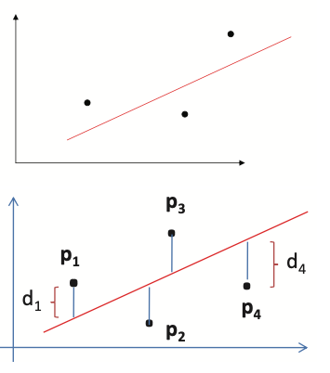
1. ML for Prediction, Decision Making
Prediction, Forecasting
Create/use model of customer behavior
Recall the linear regression model from Big Data Analysis class
$y=β_{0}+β_{1}x_{1}+β_{2}x_{2}+…+β_{5}x_{5}$
Predict/explain/understand sales ($y$) of a product as function of variables ($X$), with coefficients learned from data
2-dimentional case: $y=β_{0}+β_{1}x_{1}$ (right-hand side)
Coefficients learnt by minimizing aggregated distance (error, loss) to the line under discovery
Dependency may be linearly stochastic (uncertain) when $X$are random variables or there is a random error

Slide 25
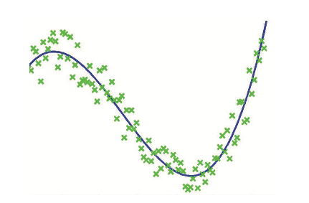
Model can be more complex than a multidimensional hyperplane
For example, a non-linear polynomial
Better adjustment to training data
Hopefully not too much (overfitting!)
To extrapolate/generalize well beyond training data
Why not a more complex
model?
A Neural Network as a
predictive model
May learn and generalize better, beyond linear or polynomial models (more coming)
More flexible for detecting/learning patterns and variable associations
Can take advantage of massive training data More difficult to interpret!

Slide 26
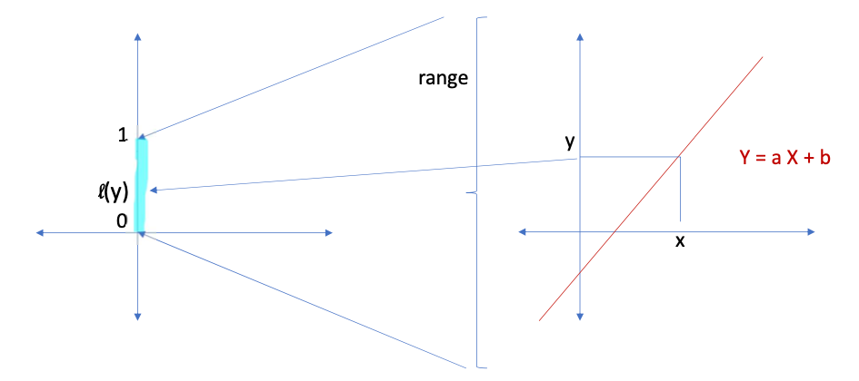
Decision Making
Can also be seen as a classification problem
We can start with a regression model as before
Prediction variable Y may take values all
over the real numbers
One can “squash” that range into a unit
real interval
- If l(y) > 0.5, then “yes” (e.g., buy or sell)
- Otherwise, “no”
This is Logistic Regression

Slide 27
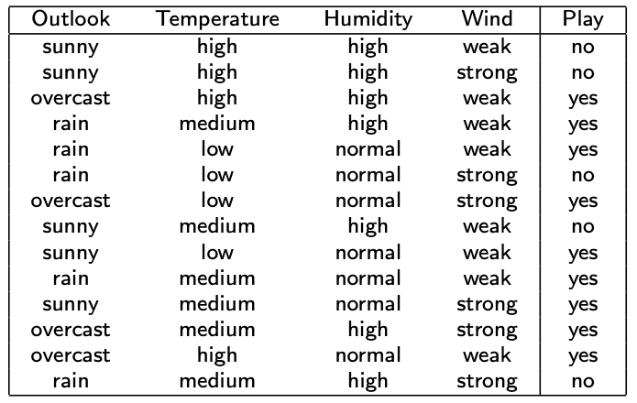
Other Forms of Decision Making and Classification
Start with weather data
Weather conditions under which tennis has been
played or not
Learning from data, we can create a model to decide
to play or not under given weather conditions
A particular weather condition described by record
of four feature values
Should we play when: Temperature = low, Humidity = high, Outlook=sunny, Wind=strong ?
(notice: not in the training data)
Binary decision variable: Play (yes/no or 1/0)

Slide 28
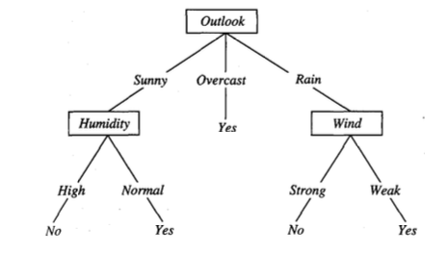
For a particular weather situation:
With training data we can learn a Decision Tree
An algorithm to decide:
A classifier that is easy to build, use and understand
How to learn it from training data?
Bring numbers into the picture: compute absolute and relative frequencies, estimate probabilities
Feature Outlook at the root has strong discrimination power
Put higher up most informative features Use estimated probabilities for that
These decision/classification problems can be applied to multiple problems in business
Buy stock? Open new branch? Approve loan request? Export to this country?

Slide 29
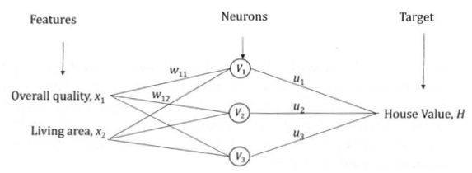
A Neural Network
NNs can be much more powerful classifiers and predictors
Start with finite number of features taking numerical values (they could be binary, i.e. 0 or 1)
Want to predict the value of a house: H
Input features: X1 : Overall Quality
X2 : Living Area
E.g. an input ⟨low, top⟩ goes into ⟨x1, x2⟩, resp.
Its values are sent to gates V1, V2, V3
At them, functions compute values using the
Inputs and coefficients (weights) w11, w21
(for V1), etc.
Outputs from V1, V2,V3 are passed over to output gate H
At H a function computes “house value estimation” using them and coefficients u1, u2, u3
What functions? Where do w11, w21, …, u1, u2, u3 come from?

Slide 30
NN has four neurons, one middle-layer, and one output gate
Three middle neurons represent three different
ways to combine the same feature values
Providing more flexibility to learn from the training data
Start by choosing NN structure and class of functions at the gates
Next: learn the weights w11, . . . , u3 plus the coefficients for
the functions at the neurons (if any)
Learn from training data (numerically encoded)
Of the form: ⟨House1: high, middle, $1M⟩, ⟨House2: low, middle, $0.8M⟩, etc.
Set of houses with their observed feature values and their commercial values

Slide 31
At each gate a function computes a
value to be passed over to the right
For example, at V1 we could have (quite common):
V1(x1,x2)
Initially we know the kind of function we want, but not its coefficients w11, w21, b1, etc.
The (non-trivial) rest: Learn unknown coefficients, the parameters
By minimizing aggregated error (loss) between house values produced by NN and pregiven house values coming with the data For example, the 0.8M for ⟨House2: low, middle, $0.8M⟩

Slide 32
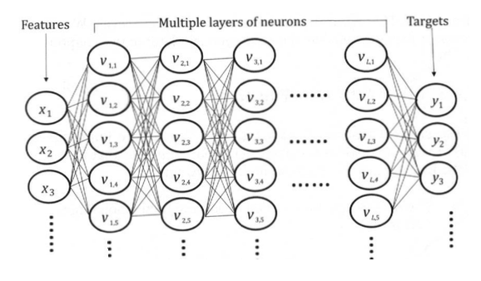
NNs can be much more complex than this
- With multiple middle layers and connections between them
- NNs for “Large Language Models” (LLMs) may have dozens of billions of parameters (to learn)
- With huge amount of training data (hundreds of Gigabytes to some Terabytes)
NNs come in different architectures
There are also different ways of training them
They are difficult to interpret or understand
(considered to be black boxes)
- Not much known about what is going on inside
- Not even creators of the new LLMs know
A challenge for Explainable AI!

Slide 33
2. Causality
Correlation captures a certain kind of dependencies and independencies between random variables (RVs)
Actually, only “linear dependencies” (think of linear regression)
A source of wrong explanations and conclusions: confusion between correlation and causality
We have all heard: “Correlation is not causality”
Causality is about the relationship between “cause and effect”
- Correlation between two RVs does not imply/show a cause-effect relationship
- Nor does a relationship expressed by an “association rule”
With a high correlation between two RVs, there could be causality only in one direction, or in none of them

Slide 34
Example: In the 50s – before the vaccine – polio was an epidemic
A hight (and initially surprising) correlation was detected:
Between the number of cases and consumption of ice cream
Neither of them was expected to cause the other
In cases like this, there may be other underlying (latent, confounding) variables
They may explain the variables at hand, their co-variations, correlations, and apparent dependencies
In this example:
- With hot summers, people ate more ice cream
- They also used to go to public swimming pools more often
Facilitating the transmission of the disease
The underlying explanatory variable!

Slide 35
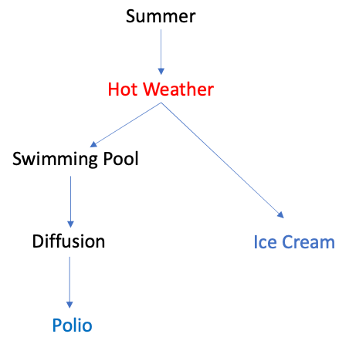
To model causality we may need other variables and their “cause-effect dependency relationships”
Causal Networks are directed acyclic graphs
- Possibly extended with probabilities and descriptions of the relationships at the links
- With explicit causal (and probabilistic) dependencies
This Causal Network shows:
- Hot Weather as a cause in common
- Polio and Ice Cream are not independent
Only conditionally independent via Hot Weather
Another example: “There is evidence for a positive and
statistically significant correlation of 0.791 between the
number of Nobel laureates per 10 million inhabitants and
the chocolate consumption in kilogram per year and capita”
(Franz Messerli, 2012)
What about “Diapers and Beer”?
Discuss these last two examples!

Slide 36
Causality has growing importance in Data Science, AI, ML
And in their applications in Business
- For explanations
- For training ML models (use causality instead of correlation)
- For Feature Engineering (selecting features for ML)
- Econometrics
Nobel Prize in Economics 2021: Guido Imbens
For applications of causality in Econometrics
Causal Networks can be learned from data, and used for inference
One of the hottest topics in AI today

Slide 37
Relevance in Business
If we want to “intervene” (or perform an “action” on) a particular market, associations can be useless or meaningless, even detrimental
You might exploit and strengthen certain given trends and associations
Place diapers and beer close together in a supermarket
But you may not be understanding what is going on, or the causes for such associations
Better if you learn that: “fathers who stop for diapers at the supermarket after work may want to buy
the beer to watch the game once home” (so the common story goes)
For business applications, the WHY is more relevant than the WHAT
With the WHY you know/understand the effects of your actions (business decisions and policies, etc.)
It is with known cause-effect relationships that you can properly do “What If?-Analysis”
Causal counterfactual are at the very root of hypothetical reasoning
Causality needed to properly address questions such as: “How much would I have made if I had invested in Stock 1 instead of Stock 2?” or “What if I augment the production next year by 20%?”

Slide 38
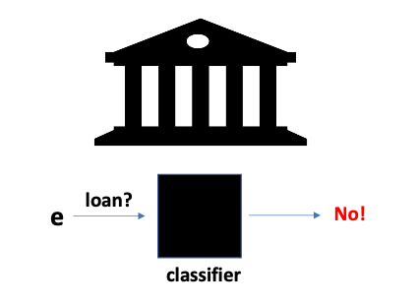
3. Explainable AI
Example: Client requesting loan from a bank
Bank client e = <john, 18, plumber, 70K, harlem, . . .>
As an entity represented as a record of values for features <Name, Age, Activity, Income, ...>
e requests a loan from a bank
- Bank uses a classifier
- The request is denied
The client asks why?
- What kind of explanation could the bank give?
- How and from what?
The classifier could be seen as a real black box!

Slide 39
Users and those affected by results from AI systems, the stakeholders, request explanations
- They may have the right to receive them
- They are subject to assessments (e.g. a credit score), classifications (good/bad client),
decisions (approve/reject loan), etc.
A whole new area of AI has emerged: Explainable AI (XAI)
Part of an even larger one: Ethical AI
- Touching (beyond Sci/Eng): Law, Sociology, Philosophy, ...
- Motivated by the need for more transparent, trustable, fair, unbiased, interpretable AI systems
New legislation forces AI systems affecting users to provide explanations and guarantee all the above
Different kinds of explanations have been proposed

Slide 40
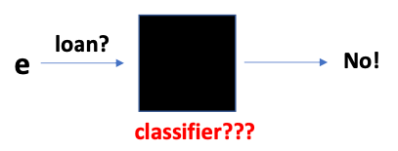
It may really be a “black box”!
- Not known what is inside
- Or so complex that internal model cannot be exploited
Explanations depend on whether we have a black-box or an open-box model
- Complex Neural Networks vs Decision Trees
- Sometimes we can rely only on Input/Output relation (not on what is inside)
Explanations commonly take the form of attribution scores
- For a decision or classification about/of an entity:
Assign numbers to feature values reflecting their relevance for the outcome
- A popular one is the SHAP score (based on Shapley value of Coalition Game Theory)
- Responsibility score (based on causality and counterfactuals)

Slide 41
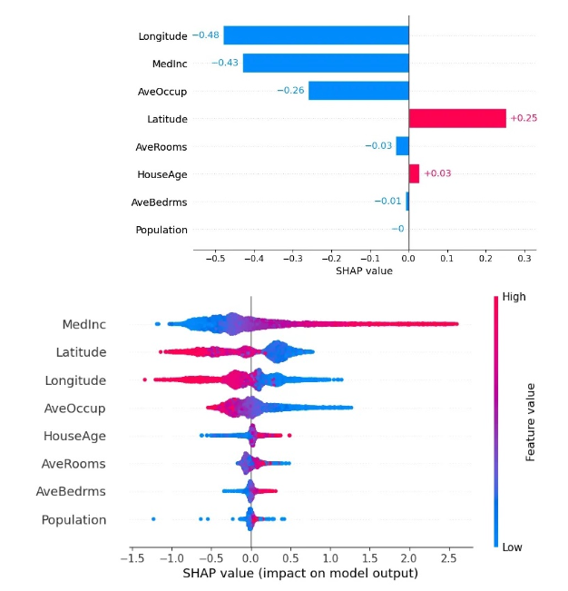
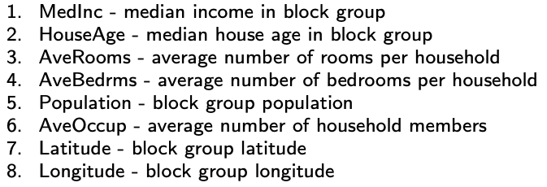
Example: California housing data
A set of 20 640 blocks of houses across California in 1990
Linear regression model to predict the median home price
fom eight features
Each SHAP score is for an entity e, a single prediction (top)
- MedInc has high impact, and negative
- Usually shown in an aggregated manner (over multiple
entities) to convey overall importance (bottom)

Slide 42
4. Ontologies and Knowledge Graphs
Ontologies have their origin in AI, and a long tradition
With some roots and inspirations in data management
- Conceptual Modelling
- Entity-Relationship (or ER) models
Many applications, in Business Intelligence in particular
Many spin-offs: Semantic Web Languages, Graph Databases, Knowledge Graphs, ...
General idea: Represent knowledge in restricted symbolic languages
- Symbolic (logic-based) or graphical languages
- For a good balance between expressive power and efficient reasoning
Ontologies are knowledge representations that describe a domain in terms of Concepts
(Entities, Classes) and Relationships between Concepts

Slide 43
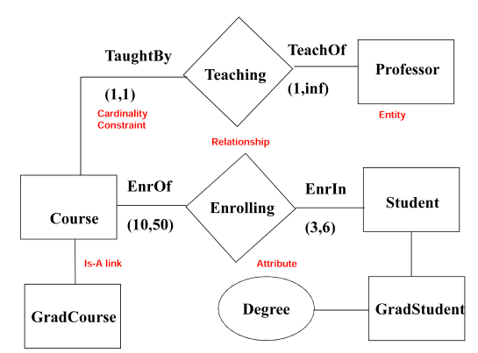
A Simple ER Model
One usually starts with an ER model to create a database
It captures (part of) the semantics (meaning) of application
domain
The IS-A link between GradCourse and Course indicates a
subclass (sub-concept, sub-entity) relationship
- It has predefined and fixed meaning
- Enables inheritance of attributes
For Course by GradCourse
A student enrols in 3 to 6 courses
As an extension of ER models, we have Roles as links, e.g. TeachOf
ER and its extensions are useful for business modelling

Slide 44
Knowledge Graphs
Much used in these days
Very and rapidly increasingly important for business
KGs have a simple intuition and are conceptually easy to understand
Main idea: Connect any two things that are related by means of a link that describes the connection
bought
JohnDoe “Sapiens” A “triple” of the form <subject, property, object>
It tells us that John Doe bought the book “Sapiens”
Not quite: How do we know it is a book? Well, say it:
bought is-a
JohnDoe “Sapiens” book
A directed graph with labeled edges!

Slide 45
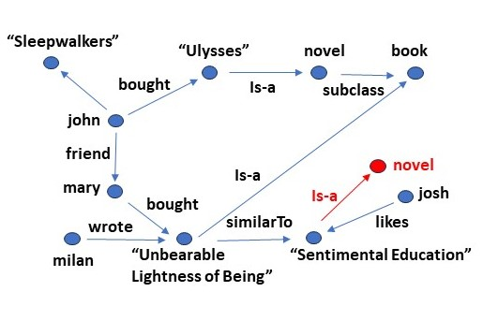
KGs were made popular by Google
To represent knowledge and links connections between webs, navigation, recommendations, etc.
They are now omnipresent in business applications
They are useful business models, including client
profiles …
Useful for a bookstore: Knowledge of clients,
buying trends, recommendations, etc.
KGs can be huge
Computational machinery needed to create, store,
update, navigate, query, learn from them, … → Graph DBs! (plus additional tools, e.g. for ML)
KGs by definition/construction are “incomplete”: There may be ”missing and implicit” links
For example, some missing “likes” or “similar” links → try to discover them!

Slide 46
ML is used to “complete” KGs, to learn those links
- And disambiguate others (remember “entity resolution”)
- KGs usually numerically encoded/embedded to apply ML
We can go beyond the graph, extending it with rules → create an ontology!
Rules are application dependent, e.g. making useful statements such as:
- ``If someone likes a book and has a friend, the latter also likes the book"
- ``If someone likes a book that is similar to another one, then the person also likes the other one"
- ``All novels are books“
- ``Friendship is symmetric"
- ``Friendship is transitive“
- ``Similarity is symmetric“ (nothing of this represented in the KG)

Slide 47
With these rules (and the KG) we can do reasoning
When rules are symbolically represented
For the gist: (do now worry about the details)
The 2nd and 3rd rules above:
Something a computer can symbolically process …
Many applications in business: portfolio management & discovery, smart contracts, etc.

Slide 48
Bibliography
Mandatory Reading: (click on links to download)
- «How to Build Knowledge Graphs that Enable AI-Driven Enterprise Applications”. Gartner, 2022.
- “The State of AI”. William R. Murray. Medium, Mar 16, 2022.
- «How Enterprises Are Using Open Source LLMs 16Examples». Matt Marshal, Venture Beat, 2024.
- « Why AI Matters: Opportunities, risks and regulation ». Economist Intelligence (EIU), 2023.
General References:
- John Hull. « Machine Learning in Business ». GFS Press, 3rd Ed., 2021.
- John Kelleher and Brendan Tierney. « Data Science ». MIT Press, 2018.
- Foster Provost and Tom Fawcett. « Data Science for Business ». O’Reilly 2013.
- Matt Taddy. « Business Data Science ». McGraw-Hill, 2019.

