Slide 1
Requirements Modelling with UML 2
SEG3101 (Fall 2015)
Miguel Garzón, University of Ottawa
Based on Powerpoint slides by Gunter Mussbacher
with material from:
K.E. Wiegers, D. Leffingwell & D. Widrig, M. Jackson, I.K. Bray, B. Selic,
Volere, Telelogic, D. Damian, S. Somé 2008, D. Amyot 2008-2011, and
G.v. Bochmann 2010

Slide 2
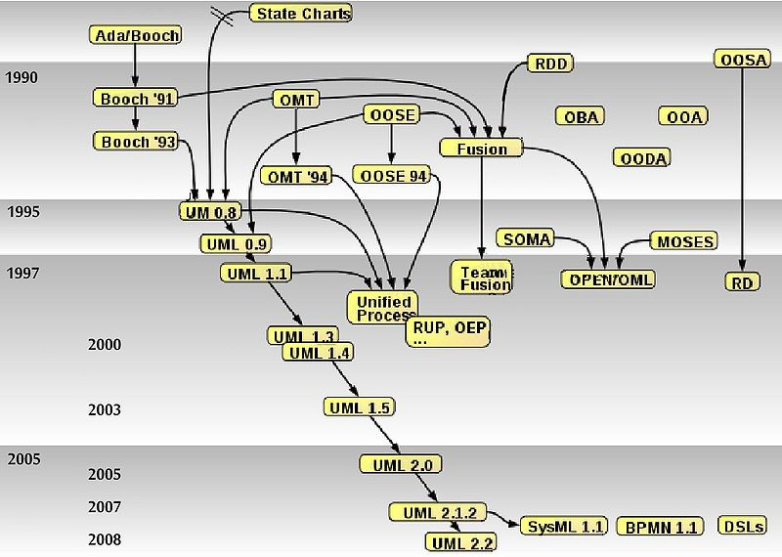

History of UML (http://www.omg.org/uml/)
Introduction Class Diagram Activity Diagram Sequence Diagram State Machine Diagram
Rumbaugh
Booch
Jacobson
http://www.omg.org/uml/
Official Version 2.4.1
(August 2011)
UML 2.5 Beta “simplified”:
831 pages!
Source: http://en.wikipedia.org/wiki/Unified_Modeling_Language

Slide 3

Dilbert on Standards
Introduction Class Diagram Activity Diagram Sequence Diagram State Machine Diagram

Slide 4
Thirteen Diagram Types in UML 2.x
Introduction Class Diagram Activity Diagram Sequence Diagram State Machine Diagram
According to UML Reference Manual
  Structural
    Class, object, composite structure, component, and use case diagrams
  Dynamic (that is, describing dynamic behavior)
    State machine, activity, sequence, communication, timing, and interaction overview diagrams
  Physical
    Deployment diagrams
  Model Management
    Package diagram

Slide 5
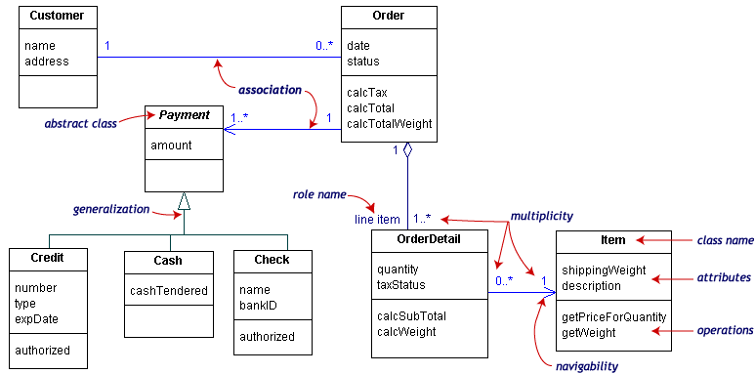
UML Class Diagrams
Introduction Class Diagram Activity Diagram Sequence Diagram State Machine Diagram

Slide 6
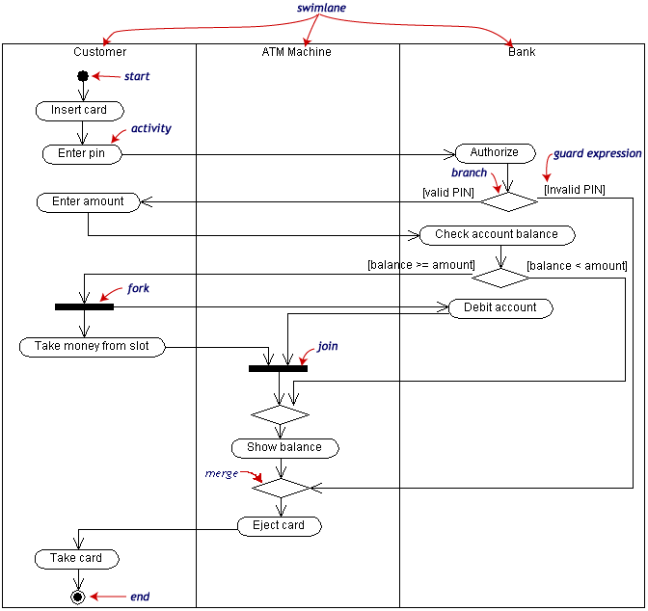
Basic Notational Elements of Activity Diagrams
Introduction Class Diagram Activity Diagram Sequence Diagram State Machine Diagram
Describe the dynamic behavior of a system as a flow of activities (workflow)
Flow
  Sequence
  Alternative
  Parallel
Note: in this diagram, the data flow objects are not shown. They may be shown as boxes on the control flow lines.

Slide 7
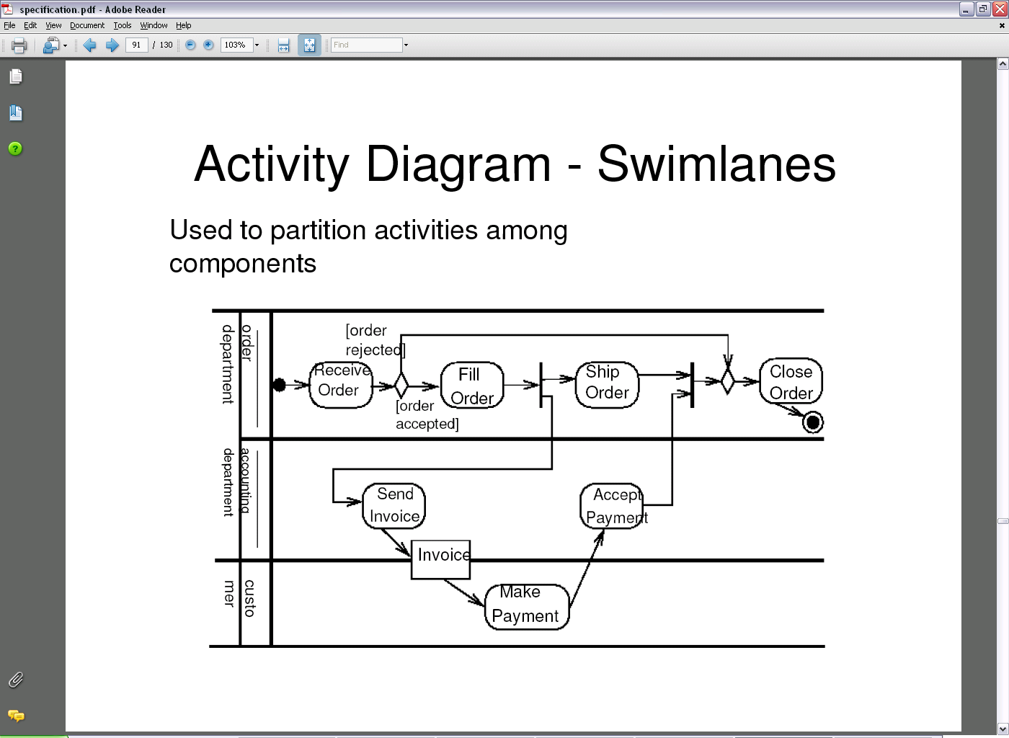
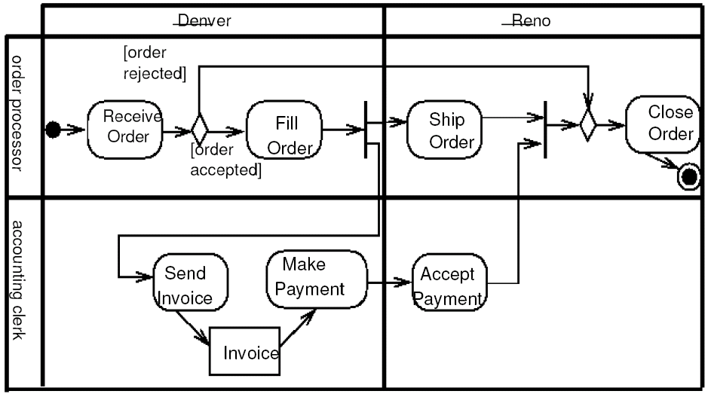
Partitions – Examples
Introduction Class Diagram Activity Diagram Sequence Diagram State Machine Diagram

Slide 8
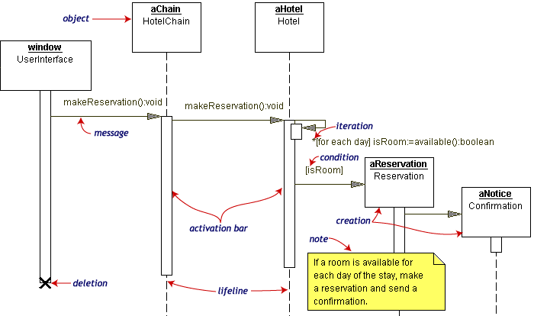
Basic Notational Elements of Sequence Diagrams
Introduction Class Diagram Activity Diagram Sequence Diagram State Machine Diagram
Describe the dynamic behavior as interactions between so-called “participants” (e.g. agents, actors, the system, system components). For each participant, there is a “lifeline”
participant

Slide 9
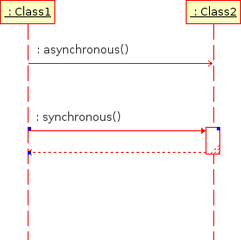
Lifelines and (A)synchronous Interactions
Introduction Class Diagram Activity Diagram Sequence Diagram State Machine Diagram
Participants, shown using lifelines, participate in the interaction sequence by sending / receiving messages
Messages can be synchronous or asynchronous

Slide 10
Combined Fragments
Introduction Class Diagram Activity Diagram Sequence Diagram State Machine Diagram
Allow multiple sequences to be represented in compact form (may involve all participants or just a subset)
Combined fragment operators
  alt, for alternatives with conditions
  opt, for optional behavior
  loop(lower bound, upper bound), for loops
  par, for concurrent behavior
  critical, for critical sections
  break, to show a scenario will not be covered
  assert, required condition
  ignore/consider(list of messages), for filtering messages
  neg, for invalid or mis-use scenarios that must not occur
  strict or seq, for strict/weak sequencing (WHAT IS THIS ?)
  ref, for referencing other sequence diagrams

Slide 11
Combined Fragments – Alternative
Introduction Class Diagram Activity Diagram Sequence Diagram State Machine Diagram
Alternative (operator alt)
  Multiple operands (separated by dashed lines)
  Each operand has guard condition (no condition implies true)
  One will be chosen exclusively – nondeterministically if more than one evaluates to true
  Special guard: else
    True if no other guard condition is true

Slide 12
Combined Fragments – Optional
Introduction Class Diagram Activity Diagram Sequence Diagram State Machine Diagram
Optional (operator opt)
  To specify a
  guarded behavior fragment with no alternative
  Special case of alt
  Equivalent to an alt
  with two operands
    The first is the same
    as the operand for
    the opt
    The second is an empty operand with
    an else guard

Slide 13
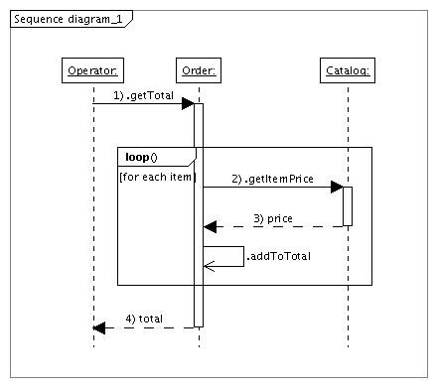
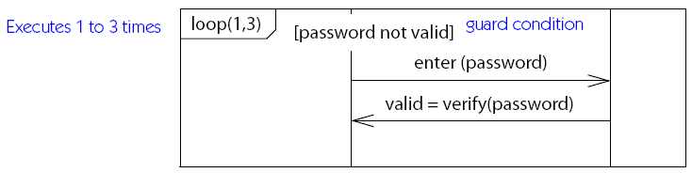
Combined Fragments – Loop
Introduction Class Diagram Activity Diagram Sequence Diagram State Machine Diagram
Loop (operator loop)
  Loop fragment may execute multiple times
  At least executed the minimum count
  Up to a maximum count as long as the guard condition is true (no condition implies true)
minimum, maximum count
Source for Password Example: UML Reference Manual

Slide 14
Combined Fragments – Concurrency
Introduction Class Diagram Activity Diagram Sequence Diagram State Machine Diagram
Concurrency (operator par)
  Two or more operands that execute in parallel

Slide 15
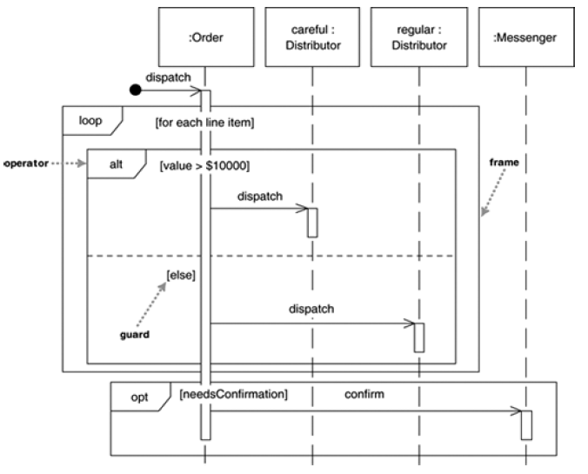
Nested Combined Fragments
Introduction Class Diagram Activity Diagram Sequence Diagram State Machine Diagram

Slide 16
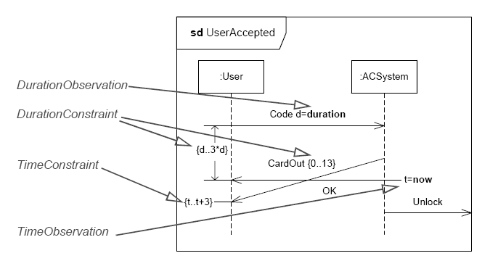
Temporal Aspects
Introduction Class Diagram Activity Diagram Sequence Diagram State Machine Diagram

Slide 17
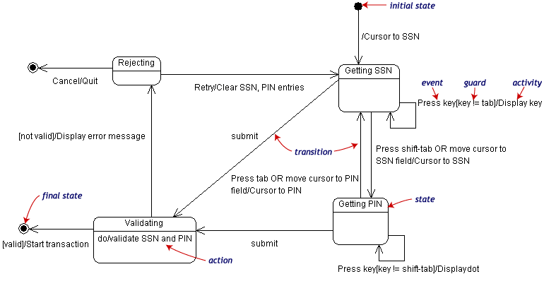
Basic Notational Elements of State Machine Diagrams
Introduction Class Diagram Activity Diagram Sequence Diagram State Machine Diagram
Describe the dynamic behavior of an individual object (with states and transitions)

Slide 18
Types of State Machines
Introduction Class Diagram Activity Diagram Sequence Diagram State Machine Diagram
UML allows both types to be mixed
on
on
Lamp On
Lamp On
print(”on”)
on/print(”on”)
on
off
off
off
off
Lamp
Off
Lamp
Off
Mealy Automaton
Moore Automaton

Slide 19
Variables (“Extended” States)
Introduction Class Diagram Activity Diagram Sequence Diagram State Machine Diagram
on
Lamp On
ctr : Integer
on/ctr := ctr + 1
off
Lamp Off
off

Slide 20
Modeling Behavior
Introduction Class Diagram Activity Diagram Sequence Diagram State Machine Diagram
In general, state machines are suitable for describing reactive systems based or events
Not appropriate to describe continuous systems (e.g., spacecraft trajectory control, stock market predictions)
threshold
time

Slide 21
UML State Machine Diagrams – Summary
Introduction Class Diagram Activity Diagram Sequence Diagram State Machine Diagram
Composite State
State
Initial
Pseudostate
top
Trigger
Ready
Transition
stop
/ctr := 0
Done
Final State
Action
stop

Slide 22
Entry and Exit Actions
Introduction Class Diagram Activity Diagram Sequence Diagram State Machine Diagram
LampOn
e2
entry/lamp.on();
exit/lamp.off();
e1

Slide 23
Action Ordering
Introduction Class Diagram Activity Diagram Sequence Diagram State Machine Diagram
Output actions: transition prefix
Input actions: transition postfix
LampOn
LampOff
off/printf(“to off”);
entry/lamp.on();
entry/lamp.off();
exit/printf(“exiting”);
exit/printf(“exiting”);
Resulting action sequence:
printf(“exiting”);
printf(“to off”);
lamp.off();
off/printf(“needless”);
printf(“exiting”);
printf(“needless”);
lamp.off();

Slide 24
State Activity (Do)
Introduction Class Diagram Activity Diagram Sequence Diagram State Machine Diagram
Creates a concurrent process that will execute until
  The action terminates, or
  We leave the state via an exit transition
“do” activity
Error
entry/printf(“error!”)
do/alarm.ring()

Slide 25
Guards (Conditions)
Introduction Class Diagram Activity Diagram Sequence Diagram State Machine Diagram
Conditional execution of transitions
Guards must not have side effects
bid [value < 100] /reject
Selling
bid [value >= 200] /sell
Happy
bid [(value >= 100) & (value < 200)] /sell
Unhappy

Slide 26
Hierarchical State Diagrams
Introduction Class Diagram Activity Diagram Sequence Diagram State Machine Diagram
Composed states, to manage complexity
LampOff
LampFlashing
flash/
entry/lamp.off()
FlashOn
off/
entry/lamp.on()
1sec/
1sec/
on/
on/
FlashOff
on/
LampOn
entry/lamp.off()
entry/lamp.on()

Slide 27
Group Transitions
Introduction Class Diagram Activity Diagram Sequence Diagram State Machine Diagram
Default transition to
Initial pseudostate
LampOff
LampFlashing
entry/lamp.off()
flash/
FlashOn
off/
entry/lamp.on()
1sec/
1sec/
on/
FlashOff
on/
LampOn
entry/lamp.off()
entry/lamp.on()
Group transition

Slide 28
Completion Transition
Introduction Class Diagram Activity Diagram Sequence Diagram State Machine Diagram
Triggered by a completion event
  Automatically generated when an embedded state machine terminates
Completion transition
(without trigger)
Committing
Phase1
CommitDone
Phase2

Slide 29
Triggering Rules
Introduction Class Diagram Activity Diagram Sequence Diagram State Machine Diagram
Many transitions can share the same triggering event
  When leaving, the most deeply embedded one takes precedence
  The event disappears whether it triggers a transition or not
LampFlashing
FlashOn
on/
off/
on/
FlashOff

Slide 30
Action Ordering – Composite States
Introduction Class Diagram Activity Diagram Sequence Diagram State Machine Diagram
S1
exit/exS1
S2
entry/enS2
/initS2
S11
exit/exS11
E/actE
S21
entry/enS21
Action sequence on transition E:
exS11 ⇨ exS1 ⇨ actE ⇨ enS2 ⇨ initS2 ⇨ enS21

Slide 31
Orthogonal Regions
Introduction Class Diagram Activity Diagram Sequence Diagram State Machine Diagram
Combine many concurrent perspectives – interactions across regions typically done via shared variables
age
financialStatus
Child
Poor
Adult
age
financialStatus
Child
Rich
Retiree
Poor
Adult
Retiree
Rich

Slide 32
Semantics of Orthogonal Regions
Introduction Class Diagram Activity Diagram Sequence Diagram State Machine Diagram
All mutually orthogonal regions detect the same events and respond simultaneously (possibly interleaved)
legalStatus
financialStatus
LawAbiding
Poor
robBank/
robBank/
Outlaw
Rich

Slide 33

Conclusion…

