Slide 1
Introduction to Software Quality Assurance
From S. Somé, A. Williams

Slide 2
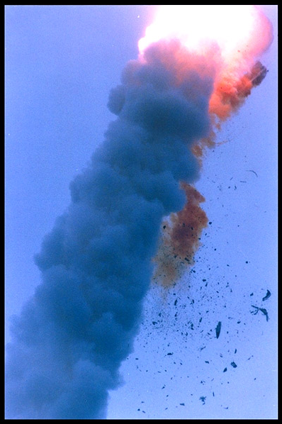
Introduction to Software Quality Assurance
Left: The Ariane 501 rocket’s guidance computer software just threw an unchecked exception.
[Image source: European Space Agency]

Slide 3
What is Software ?
According to the IEEE
Software is:
Computer programs, procedures, and possibly associated documentation and data pertaining to the operation of a computer system.

Slide 4
Software Errors, software faults and software failures
A bug/defect/fault is a consequence of a human error.
Results in non-conformance to requirements.
Manifests as failure in running software.
Software development process
software error
software fault
software failure
Reliability: The measure of success with which the observed behavior of a system conforms to some specification of its behavior.

Slide 5
Basic Definitions (Lethbride and Laganière)
A failure is an unacceptable behaviour exhibited by a system.
The frequency of failures measures the reliability.
An important design objective is to achieve a very low failure rate and hence high reliability.
A failure can result from a violation of an explicit or implicit requirement (viz., assumed as obvious or resulting from unexpected from exceptional contexts)
A defect is a flaw in any aspect of the system that contributes, or may potentially contribute, to the occurrence of one or more failures.
It might take several defects to cause a particular failure.
An error is a slip-up or inappropriate decision by a software developer that leads to the introduction of a defect.

Slide 6
Nine Causes of Software Errors
First and foremost: Faulty requirements definition.
Client-developer communication failures.
Deliberate deviations from software requirements.
Logical design errors.
Coding errors.
Non-compliance with documentation and coding instructions.
Shortcomings of the testing process.
User interface errors.
Documentation errors.

Slide 7
What is Software Quality ?
According to the IEEE:
Software quality is:
The degree to which a system, component, or process meets specified requirements.
The degree to which a system, component, or process meets customer or user needs or expectations.

Slide 8
What is Software Quality ?
According to Pressman:
Software quality is:
Conformance to explicitly stated functional and performance requirements, explicitly documented development standards, and implicit characteristics that are expected of all professionally developed software.

Slide 9
What is Software Quality ?
Conformance to requirements, as opposed to:
Narrowest sense of software quality:
Lack of bugs.
Low defect rate (# of defects/size unit)
High reliability (number of failures per n hours of operation).
Mean Time To Failure (MTTF): probability of failure-free operation in a specified time.

Slide 10
When are defects introduced?
The majority of defects are introduced in earlier phases.
Requirements (typically in English…) are the top factor in a project’s success or failure.
Phase | % of defects | % effort to fix
Requirements | 56 | 82
Design | 27 | 13
Code | 7 | 1
Other | 10 | 4

Slide 11
Cost of fixing defects
Relative cost of fixing defects
benchmark: cost at requirements phase = 1
Phase found | Cost ratio
Requirements | 1
Design | 3 – 5
Coding | 10
Unit / integration testing | 15 - 40
System / acceptance testing | 30 – 70
Production | 40 - 1000

Slide 12
Importance of Software Quality
Software is a major component of computer systems (about 80% of the cost) – used for
Communication (e.g. phone system, email system).
Health monitoring.
Transportation (e.g. automobile, aeronautics).
Economic exchanges (e.g. e-commerce).
Entertainment.
etc.
Software defects are extremely costly in term of
money
reputation
loss of life

Slide 13
Importance of Software Quality (2014)
52.7% of projects exceed their budget - costing 189% of original estimates.
cost $59 billion
16.2% of software projects completed on-time and on-budget (9% for larger companies).
Large companies - delivered systems have approximately only 42% of originally-proposed features and functions.
78.4% of smaller companies projects get deployed with at least 74.2% of their original features and functions.

Slide 14
Importance of Software Quality
Notable consequences of software errors:
1988 shooting down of Airbus 320 by the USS Vincennes - cryptic and misleading output displayed by tracking software.
1991 patriot missile failure - inaccurate calculation of time due to computer arithmetic errors.
London Ambulance Service Computer Aided Dispatch System – several deaths.
On June 3, 1980, the North American Aerospace Defense Command (NORAD) reported that the U.S. was under missile attack.
First operational launch attempt of the space shuttle, whose real-time operating software consists of about 500,000 lines of code, failed - synchronization problem among its flight-control computers.
9 hour breakdown of AT&T's long-distance telephone network - caused by an untested code patch.

Slide 15
Importance of Software Quality
Ariane 5 explosion June 4, 1996
First flight of the European Ariane 5 launcher crashed about 40 seconds after takeoff.
Cost was about half a billion dollars.
Explosion was the result of a software error:
Uncaught exception due to floating-point error: conversion from a 64-bit integer to a 16-bit signed integer applied to a larger than expected number.
Module was re-used without proper testing from Ariane 4 .
Error was not supposed to happen with Ariane 4.
No exception handler.

Slide 16
Importance of Software Quality
Mars Climate Orbiter - September 23, 1999
Mars Climate Orbiter, disappeared as it began to orbit Mars.
Cost about $US 125-million.
Failure due to error in a transfer of information between a team in Colorado and a team in California.
One team used imperial units (e.g., inches, feet and pounds) while the other used metric units for a key spacecraft operation.

Slide 17
Importance of Software Quality
Mars Polar Lander - December, 1999
Mars Polar Lander, disappeared during landing on Mars.
Failure most likely due to unexpected setting of a single data bit.
Defect not caught by testing.
Independent teams tested separate aspects.

Slide 18
Importance of Software Quality
Internet viruses and worms
Blaster worm (US$ 525 million)
Sobig.F (US$ 500 million – 1 billion)
Exploit well known software vulnerabilities
Software developers do not devote enough effort to applying lessons learned about the causes of vulnerabilities.
Same types of vulnerabilities continue to be seen in newer versions of products that were in earlier versions.
Usability problems

Slide 19
Importance of Software Quality
Monetary impact of poor software quality (Standish group - 1995)
175,000 software projects/year - Average Cost per project
Large companies - $US 2,322,000
Medium companies - $US 1,331,000
Small companies - $US 434,000
31.1% of projects canceled before completed.
cost $81 billion
Read “Death March Projects”

