Slide 1
Model-Based Testing
with
Use Cases
MBT: Generate Tests (and possibly test cases)
from a Model

Slide 2
Models for assessing software quality
Models are a standard engineering practice for performing analysis of a system.
Properties of a good model:
Simpler than the actual system, but preserves relevant attributes of the system.
Compact: small enough to be comprehensible – either for human or machine processing, and to be created with less effort than an actual system.
Predictive: The model must represent a relevant characteristic well enough to distinguish between good and bad outcomes of an analysis.
Semantically meaningful: a failure diagnosis with respect to a model should be equally applicable to the actual system.
Sufficiently general: Models intended for use over a range of systems should be applicable across the domain.

Slide 3
Graph representations of software
Software execution can be considered as a sequence of states alternated with actions (i.e. machine operations) that modify the system state.
A graph can be used as the execution model in two ways:
Option 1: Actions occur within graph nodes, and an edge represents a system state while control flow transfer occurs.
Option 2: A system state is represented by a graph node, and actions occur on the graph edges.

Slide 4
Examples of graph models
Option 1: A control flow graph.
Option 2: A finite state machine.
1
read(a)
if (a>7)
a / b
c / d
false
true
2
b = 12
b = 7
a / g
c / g
3
4
print(b)
Notation: input / output

Slide 5
Scenario
Graphs

Slide 6
Scenario Graph
Generated from a use case
Nodes correspond to point where system waits for an event
environment event, system reaction
There is a single starting node
End of use case is finish node
Edges correspond to event occurrences
May include conditions and looping edges
Scenario:
Path from starting node to a finish node

Slide 7
Use Case Scenario Graph (1)
Title: User login
Actors: User
Precondition: System is ON
User inserts a card
System asks for personal identification number (PIN)
User types PIN
System validates user identification
System displays a welcome message to user
System ejects card
Postcondition: User is logged in
1a: card is not valid
1
1a.1
2
1a.2
3
4a.1
4b:PIN invalid
and attempts ≥ 4
4
4a:PIN invalid and
attempts < 4
4b.1
5
4a.2
6

Slide 8
Use Case Scenario Graph (2)
Alternatives:
1a: Card is not valid
1a.1: System emits alarm
1a.2: System ejects card
4a: User identification is invalid
AND number of attempts < 4
4a.1 Ask for PIN again and go back
4b: User identification is invalid
AND number of attempts ≥ 4
4b.1: System emits alarm
4b.2: System ejects card
1a: card is not valid
1
1a.1
2
1a.2
3
4a.1
4b:PIN invalid
and attempts ≥ 4
4
4a:PIN invalid and
attempts < 4
4b.1
5
4a.2
6

Slide 9
Binder’s 3 Patterns for
System-Level Testing
Path Sensitization via Extended Use Cases
CRUD
Performance Profiling

Slide 10
System Testing
Fundamental truth about OO software testing: individual verification of components cannot guarantee a correctly functioning system.
We need to test the system against the requirements
Binder suggests 3 patterns for system-level testing
UML ’s use cases are typically assumed to capture the requirements when in fact they each capture a set of scenarios associated to some requirement(s)…
Complete, consistent and verifiable requirements are necessary to develop an effective test suite ☹
Use cases are in English and thus not test-ready.
<<uses>> and <<extends>> are transitive: Binder suggests at least checking every fully expanded UC.
A scenario graph of a use case can help understanding the paths to test.

Slide 11
Binder ’s Format for Testing Patterns
The proposed format is:
Name: suggests a general approach
Intent: kind of test suite produced by this pattern
Context: When does this pattern apply?
Fault Model: What kinds of faults are to be detected?
Strategy: How is the test suite designed and coded?
Oracle: How can we derive expected results?
Automation: How much is possible?
Entry and Exit Criteria: Pre- and Post conditions to use
Consequences: Advantages and disadvantages

Slide 12
Pattern 1: Extended UC Test
Intent: Build a system-level test suite by modeling essential capabilities as extended use-cases
Context: Applies if most, if not all, essential requirements of the SUT can be expressed as extended Use Cases
Strategy: A UC specifies a family of responses to be produced for specific combinations of external input and system state. This pattern represents these relationships as a decision table.
To use eUCs we need to determine operational variables
Operational variables are inputs, outputs, and environment conditions that:
lead to « significantly different » paths of a use case
abstract the state of the system under test
result in « significantly different » system responses

Slide 13
ATM Example
Figure 8.4: Use Case Diagram for an ATM system
Table 14.1 considers different resulting paths of a same use case in terms of input and output combinations
This viewpoint is re-expressed in table 14.2 in terms of operational variables for each use case:
We need 4 variables to capture all combinations
We will discuss combinational models in detail later but we must understand NOW that the variants do not overlap!
We have partitioned the input and output space successfully!
Finally, we can minimally ensure every variant is made true at least once, and false at least once.
A true test case is a set of values that satisfies all conditions in a variant
A false test case has at least one condition false
see table 14.3

Slide 14
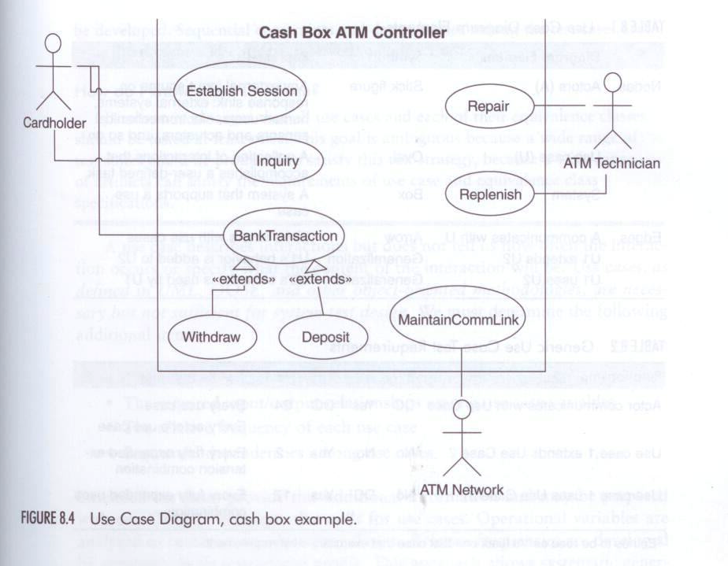
Use Case Diagram for ATM

Slide 15
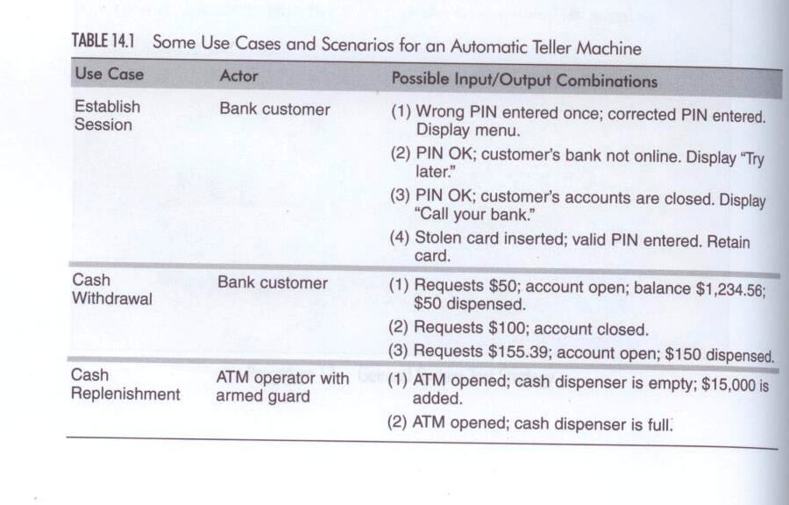
I/O for Use Cases

Slide 16
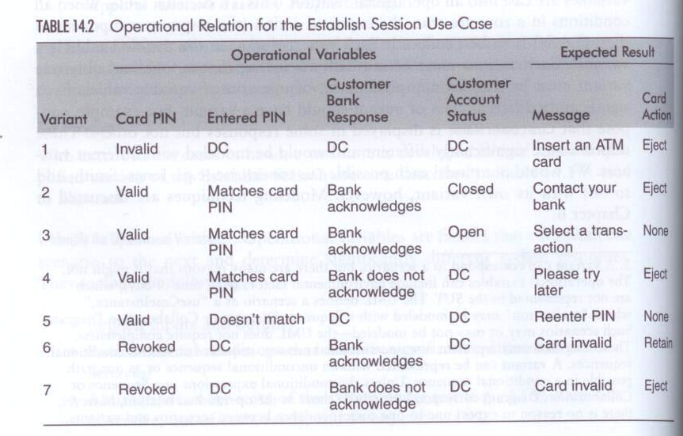
Identifying Operation Variables

Slide 17
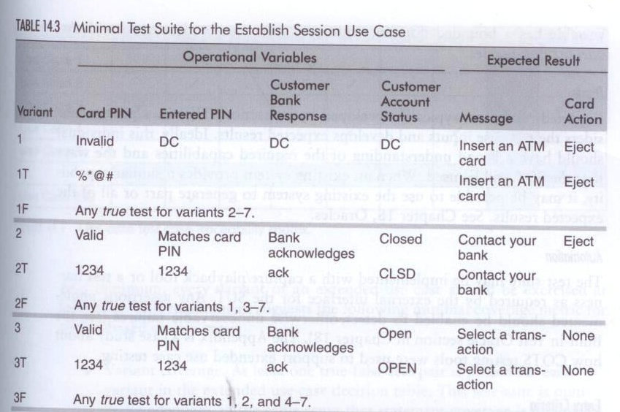
From Op. Vars to Tests (1)

Slide 18
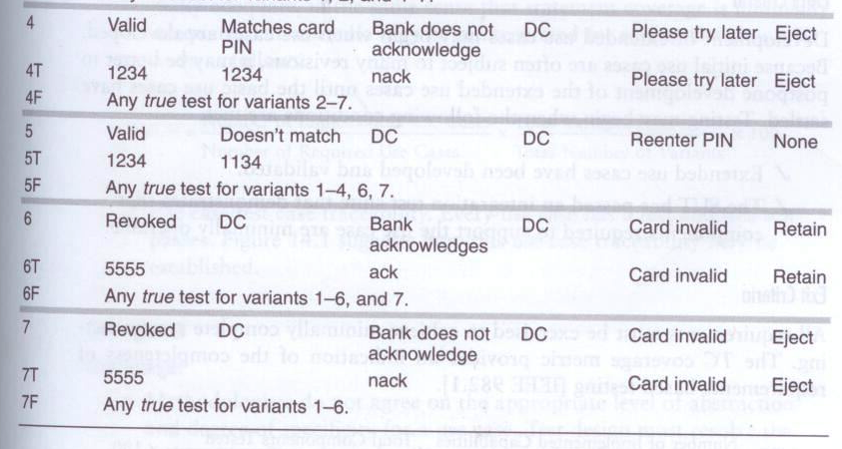
From Op. Vars to Tests (2)

Slide 19
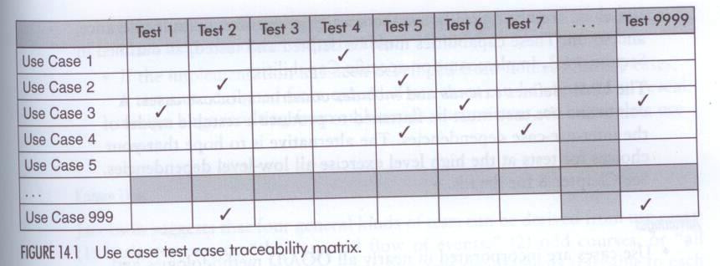
Use Case Traceability Matrix
To wrap up the pattern:

Slide 20
eUCs: Typical Expected Faults
domain faults: usually on boundary of conditions
Card has expired
logic faults: logic of specification is incorrectly coded
Allowing a negative balance
incorrect handling of don’t cares
In a high-interest savings account, there’s a charge for a withdrawal only if your balance is less than 10K. In fact, this charge should be for everyone in this type of account.
incorrect or missing dependency on pre-conditions
a UC behaves correctly despite a violated pre-condition...
Expired card works…
undesirable feature interactions (or is it scenario interactions)
e.g., ATM shut downs while user is doing a transaction!
incorrect output (e.g., wrong balance)
abnormal termination (e.g., ATM eats your card…)
omissions and surprises
e.g., PIN does not get validated, all your accounts are zeroed…

Slide 21
eUCs: Other Fields
Oracle: expected results by human intuition
Automation: no… finding opvars is not necessarily trivial
Entry criteria:
extended UCs must be complete, consistent, verifiable (how to check?)
no execution of test cases at system level before its components have been tested (i.e., bottom up test execution…)
Exit criteria: (as a % of completeness of req coverage)
XUVC = (# of implemented UCs) * (Total # variants tested) * 100
(# of required UCs) (Total # of variants)
Consequences:
Leaves out performance, fault tolerance, etc.
extended UC reduces to a decision table
Given no one agrees on level of abstraction of a UC, this pattern may be very dififcult to apply!

Slide 22
Pattern 2: Covered in CRUD
Intent: Verifies that all basic operations are exercised for each class in the system under test…
Strategy:
Build a use case/class coverage table matrix
Class 1 Class 2 Class 3
C R U D C R U D C R U D
UC1 √ √ √ √ √
UC2 √√ √ √ √ √
C: creation; R: read, U: update, D: delete
Exit criterion:
All basic operations of each class have been exercised at least once…

Slide 23
Pattern 3: Allocate Tests by Profile
Intent: Allocate the overall testing budget to each use case in proportion to its relative frequency.
Context: any time you use Pattern 1, especially in the presence of a combinatorial explosion of possible paths.
Strategy: you must somehow (!) obtain an operational profile from the potential users. Then you merely sort.
My comment:
frequency alone may not be sufficient: priority or importance (a la Boehm) must also be considered!

Slide 24
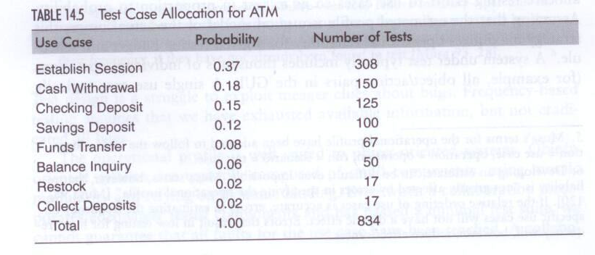
Profiling

Slide 25
Implementation Specific System Tests
Several issues are typically downplayed if not ignored through use cases:
Configuration (wrt versions of s/w and h/w)
Compatibility
Setup/shutdown
Performance (see next slide)
For Human Computer Interaction:
Usability, security, documentation, operator procedure testing
Beyond system testing?
Alpha and beta testing (by independent volunteers), acceptance testing (by real customer), compliance testing (wrt standards and regulations)

Slide 26
About Performance
We need quantitative formulations of performance reqs:
Throughput: number of tasks completed per unit of time
Response time: we need average and worst-case
Utilization: how busy is the system
Other issues:
We need a worst case analysis
Performance modeling initially requires lots of magic numbers
Load testing considers how the system responds to increases in input events
Concurrency testing: load testing with concurrent events
Stress testing: rate of inputs exceeds design limits
Recovery Testing: testing recovery from a failure mode
For real-time systems we must distinguish 3 types of events:
Repeating: must be accepted within a certain interval
Intermittent critical: aperiodic input with response within a fixed interval of time
Repeating critical: combination of 2 previous ones

