Slide 1
Structure & Content
HTML
Web
page
Web
page
Presentation
&
Style
Behaviour
& Interaction
Java
Script
CSS

Slide 2
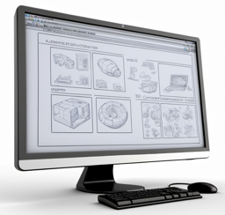

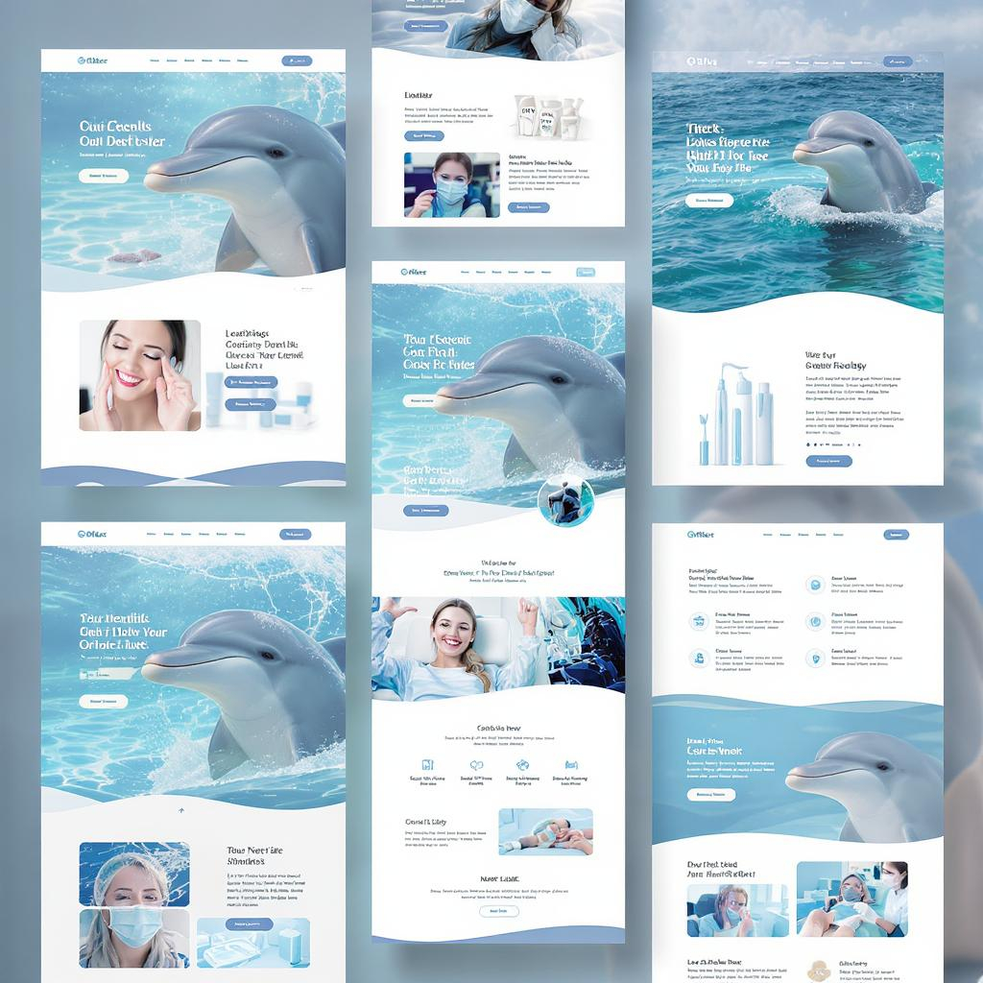
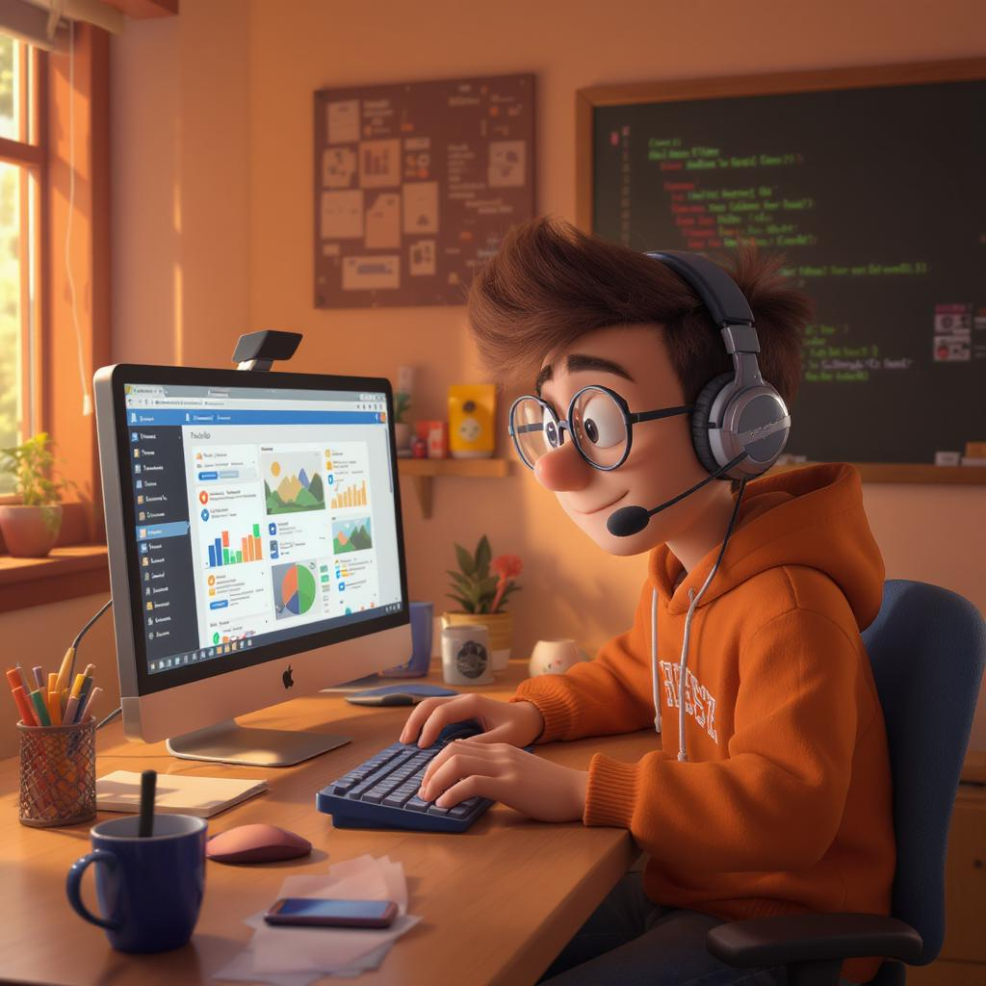
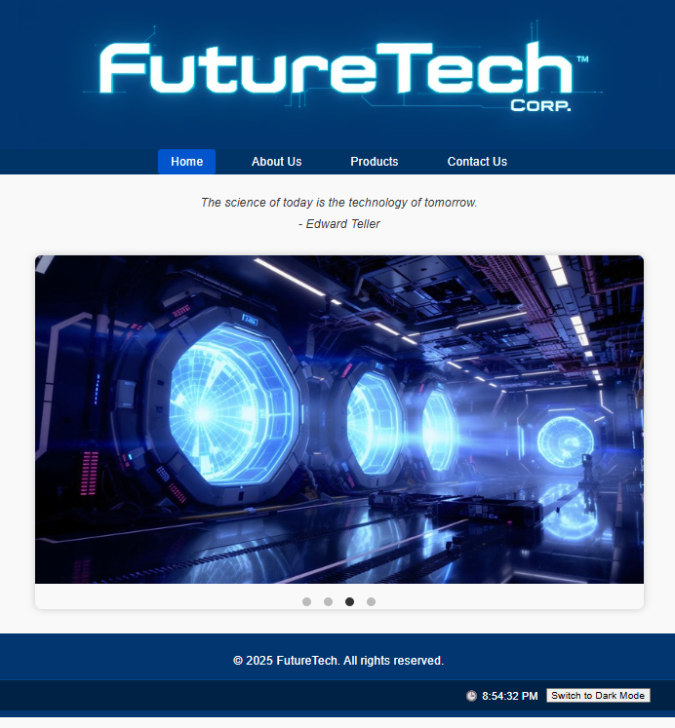
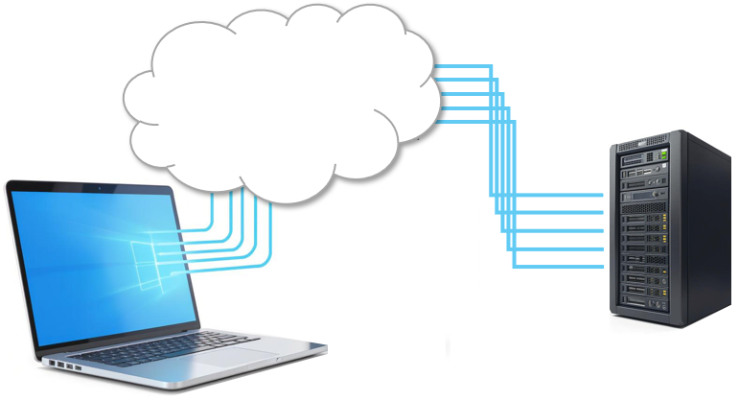





Slide 3
Document type declaration
Declares language of the content to be English
Indicates start of webpage
<!DOCTYPE html>
<html lang="en">
<head>
<meta charset="UTF-8">
<title>My Simple Webpage</title>
</head>
<body>
<h1>Hello Everyone!</h1>
<p>This is our first-created COMP 2406 webpage.</p>
</body>
</html>
an opening tag
Declares character encoding to be 8-bit Unicode Transformation Format
Header
its corresponding closing tag
Body
User-defined text that will be shown
Indicates end of webpage

Slide 4
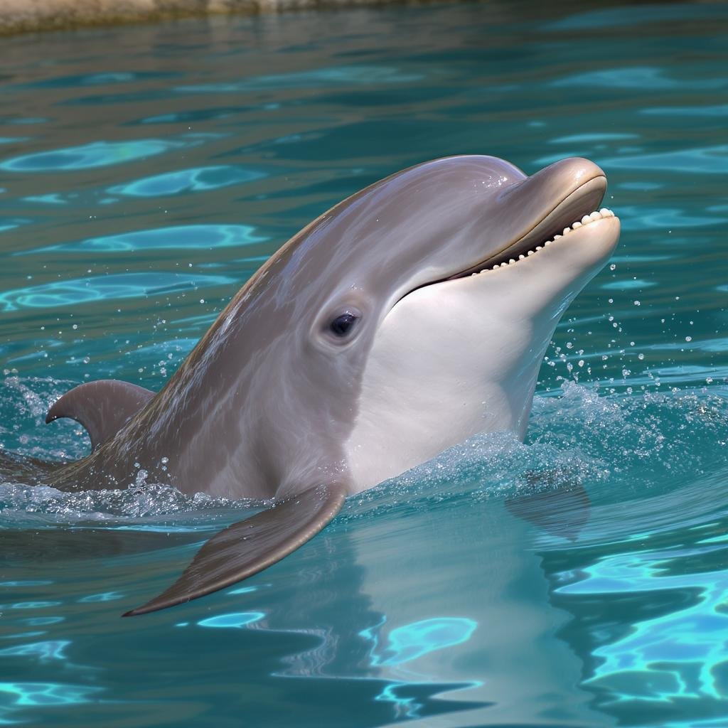


──── food-website
│ about.html ← about the food brand
│ contact.html ← contact page
│ index.html ← main homepage
│
├─── icons ← favicons or SVG icon files
│ apple-touch-icon.png
│ favicon.ico
│
├─── images ← images for main page
│ background-pattern.png
│ banner.png
│ logo.png
│
├─── products ← product category pages
│ │ baked-goods.html
│ │ beverages.html
│ │ fruits.html
│ │
│ └─── details ← specific product detail pages
│ apple.html
│ chocolate-cake.html
│ lemonade.html
│
├─── scripts ← JavaScript files
│ interactivity.js
│
└─── styles ← CSS files
main.css

Slide 5






Company Name and Logo
Duplicated header on
each page
Navigation bar
(like a menu)
Home About Us Products Contact Us
Horizontally-Scrolling
(on a timer)
Images of Various
Company Labs
Duplicated footer on
each page
Footer with Copyright info

Slide 6
Company Name and Logo
Company Name and Logo
Home About Us Products Contact Us
Home About Us Products Contact Us
About Us
Contact Us
Paragraph Describing
the Company
Company
Address
Company Building Photo
Map Image
Name:
Email:
Message:
Submit
Footer with Copyright info
Footer with Copyright info

Slide 7

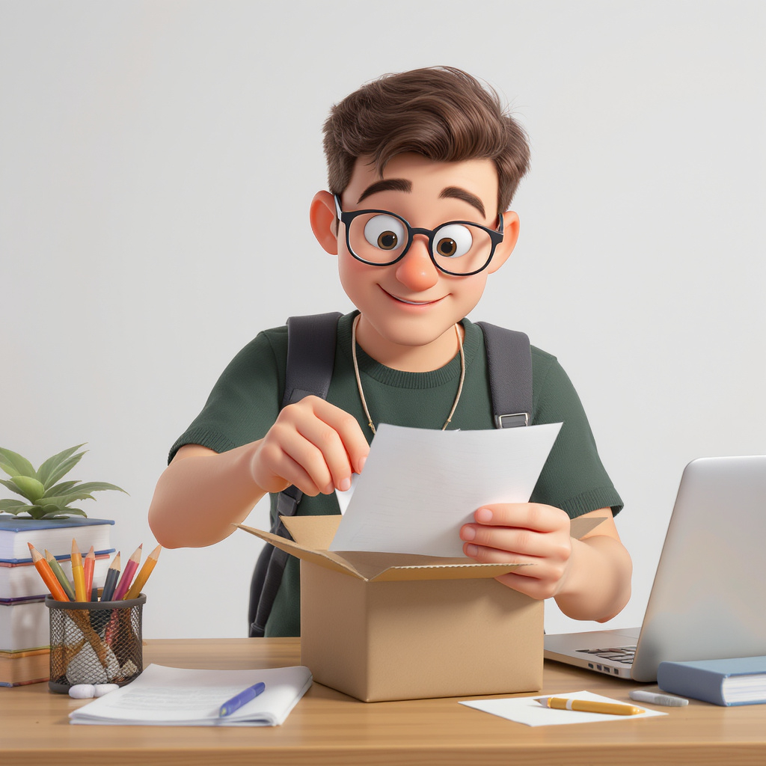
Company Name and Logo
Company Name and Logo
Home About Us Products Contact Us
Home About Us Products Contact Us
Products
Product 1 Name
Short description of what this product does
Product 1
Short description of what this product does
Product 2
Large
Product 1
Image
Product 1
Image
Product 2
Image
Key Features:
Specifications:
Pricing:
Optional Accessories:
Short description of what this product does
Product 3
Short description of what this product does
Product 4
Product 3
Image
Product 4
Image
Table of Specs
Pricing Table
Product 3
Product 4
Product 5
Product 6
Buy Now
Footer with Copyright info
Footer with Copyright info

Slide 8
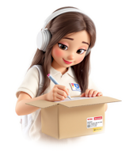
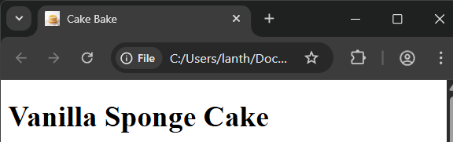
──── FutureTechCorpWebsite
│ about.html
│ contact.html
│ index.html
│ products.html
│
├─── icons
│ favicon.ico
│
├─── images
│ │ logo.jpg
│ │ other.jpg
│ ├── large
│ │ product_1.jpg
│ │ product_2.jpg
│ │ product_3.jpg
│ ├── small
│ │ product_1_small.jpg
│ │ product_2_small.jpg
│ │ product_3_small.jpg
│ └── news
│ scroll_1.jpg
│ scroll_2.jpg
│ scroll_3.jpg
│
├─── products
│ product_1.html
│ product_2.html
│ product_3.html
│
├─── scripts
│ java-script_1.js
│ java-script_2.js
│ java-script_3.js
│
└─── styles
styles_1.css
styles_2.css
styles_3.css
HTML pages: (About Us, Contact Us, Home, Products)
icon files
images for various
HTML pages
images for
product detail
pages
images for
products
page
images
to scroll
Home page
HTML
product details
pages
JavaScript
files
CSS
files

Slide 9
Document
HTMLDocument
HTMLHeadElement
HTMLBodyElement
Text
Node
CharacterData
HTMLTitleElement
Comment
HTMLHeadingElement
HTMLParagraphElement
Element
HTMLElement
HTMLTableElement
HTMLAnchorElement
Attr
HTMLImageElement
HTMLDivElement
HTMLFormElement
HTMLInputElement
HTMLButtonElement
etc..

Slide 10
800px
View
Image 0
Image 1
Image 2
Image 3
Image 0
Image 1
Image 2
Image 3
Image 0
Image 1
Image 2
Image 3
Image 0
Image 1
Image 2
Image 3
Image 0
Image 1
Image 2
Image 3

Slide 11


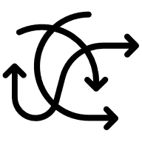














Console
output
output
input
input
Storage
Keyboard/Mouse
User 2
Server 1
Storage 1
phone
User 1
The
Internet
User 3
pc
tablet
Server 2
laptop
User 4
Storage 2
client

Slide 12


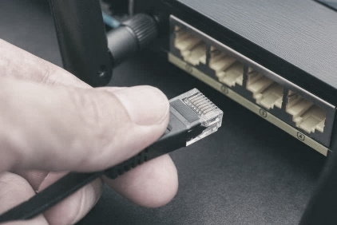
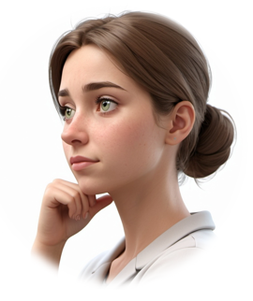

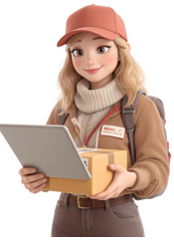
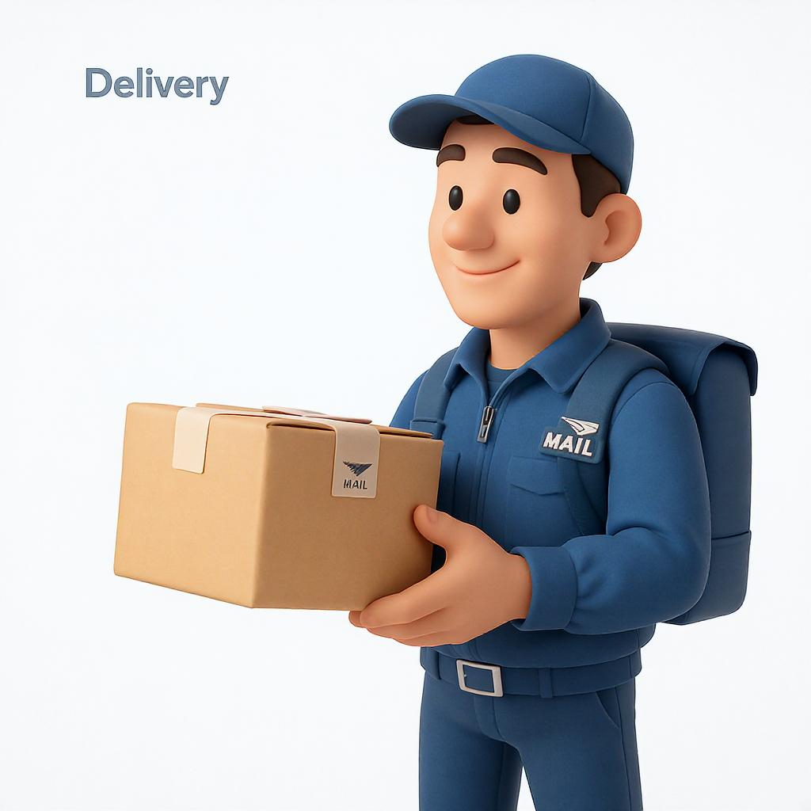
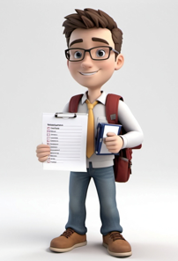
The
Internet
Browser
Application Layer
Application Layer
Transport Layer
Transport Layer
Network Layer
Network Layer
Link Layer
Link Layer
Client
Server

Slide 13


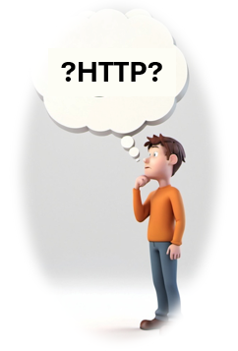
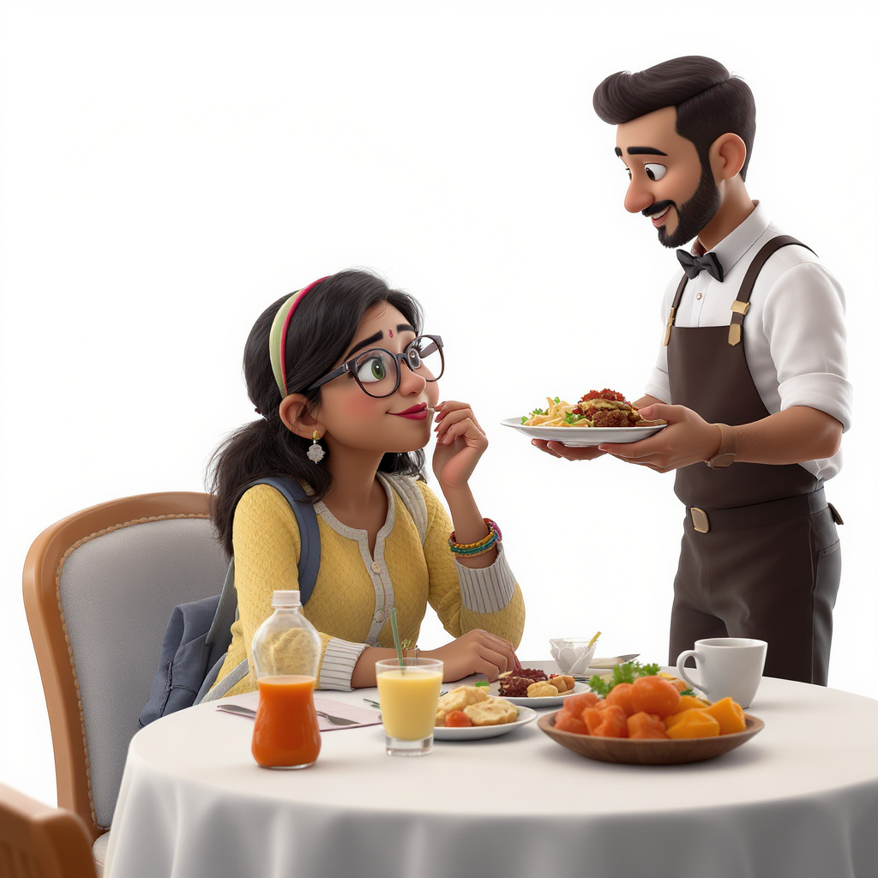
HTTP requests
Internet
HTTP responses
Client
(web browser)
Server
(web server)
Front-end
Back-end

Slide 14

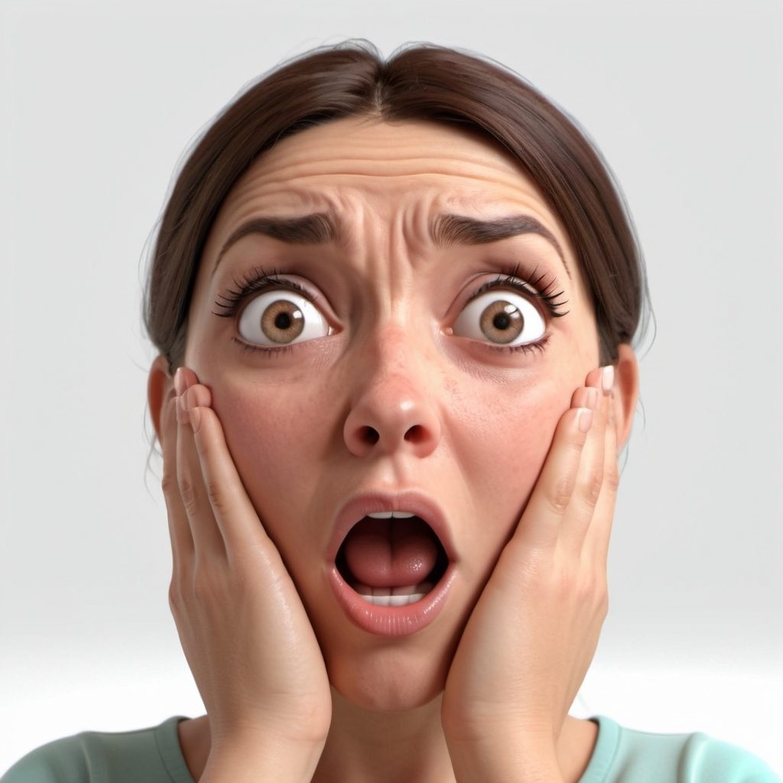
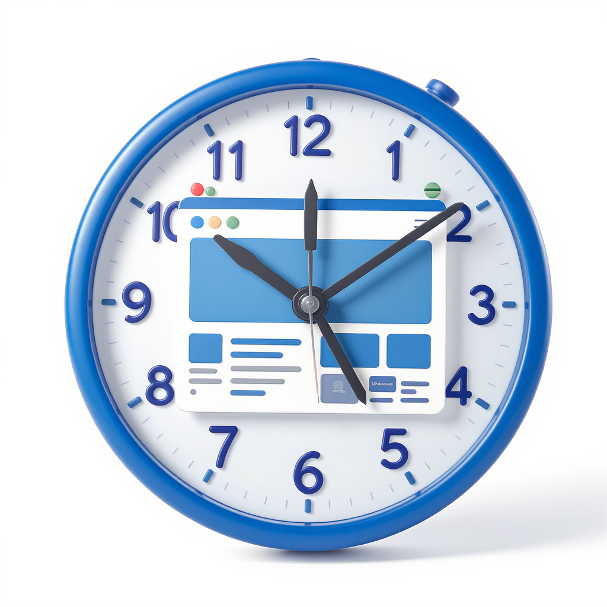
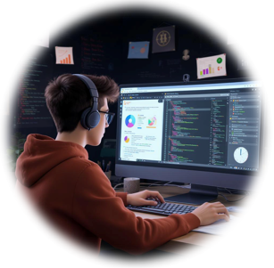
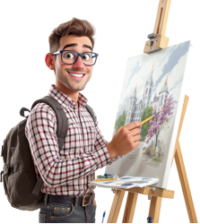

requests
Internet
responses
Client
Server

Slide 15
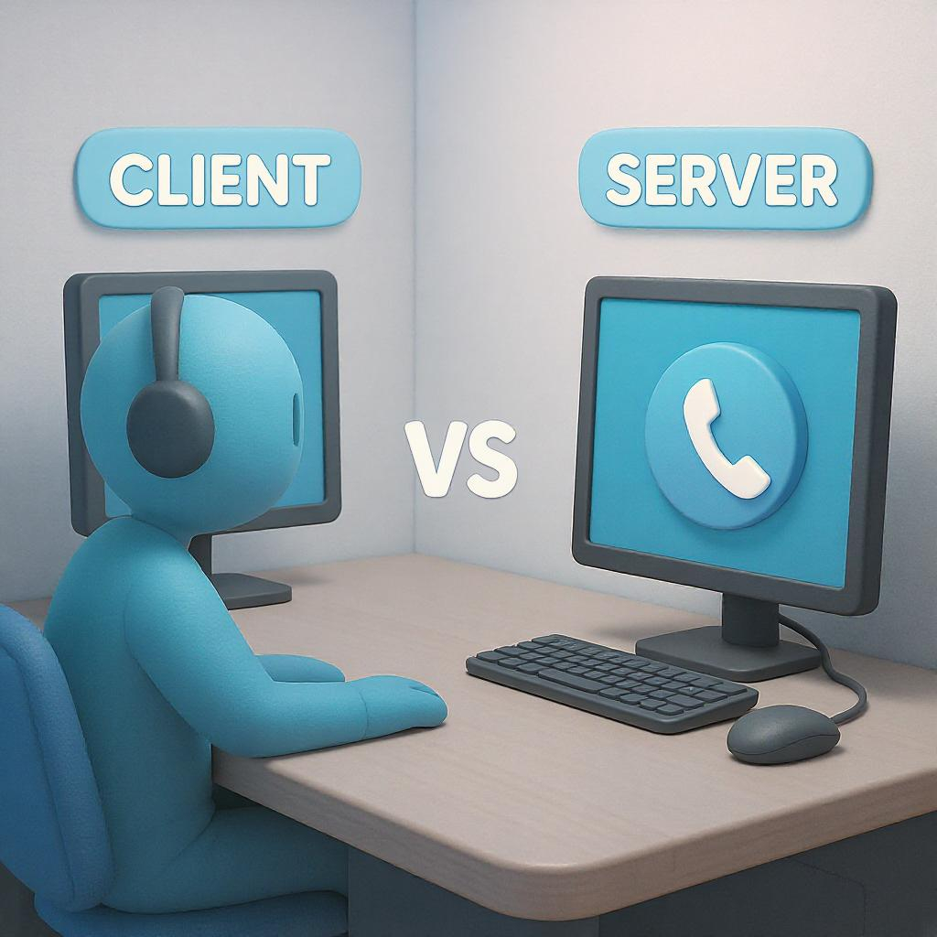

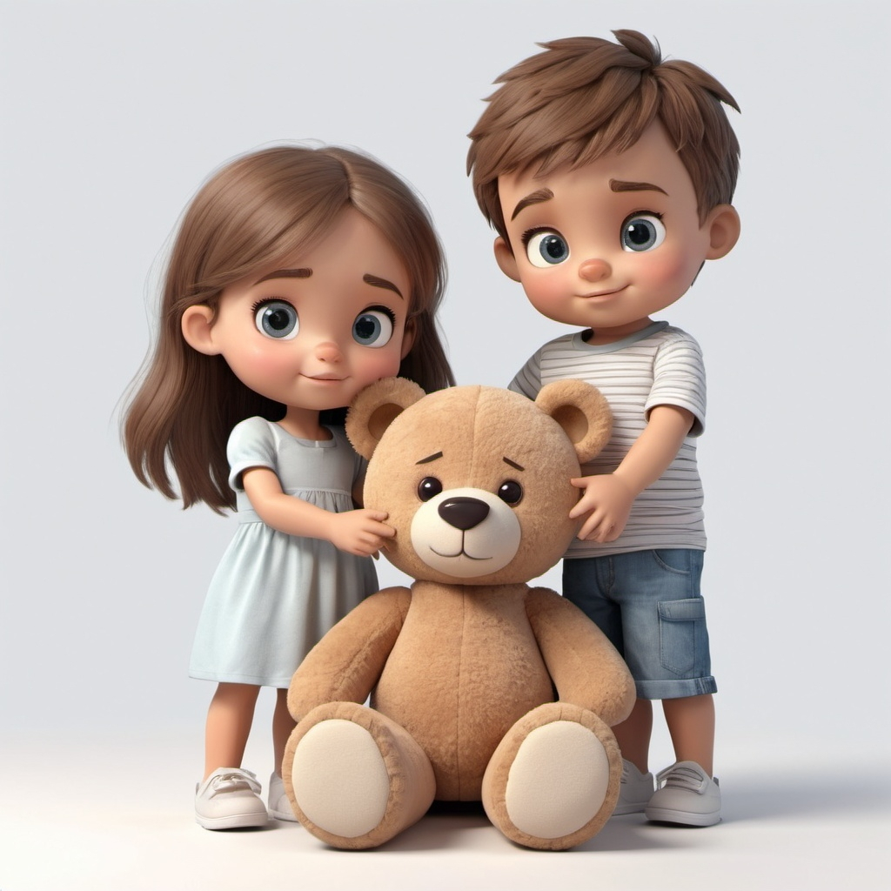

Slide 16
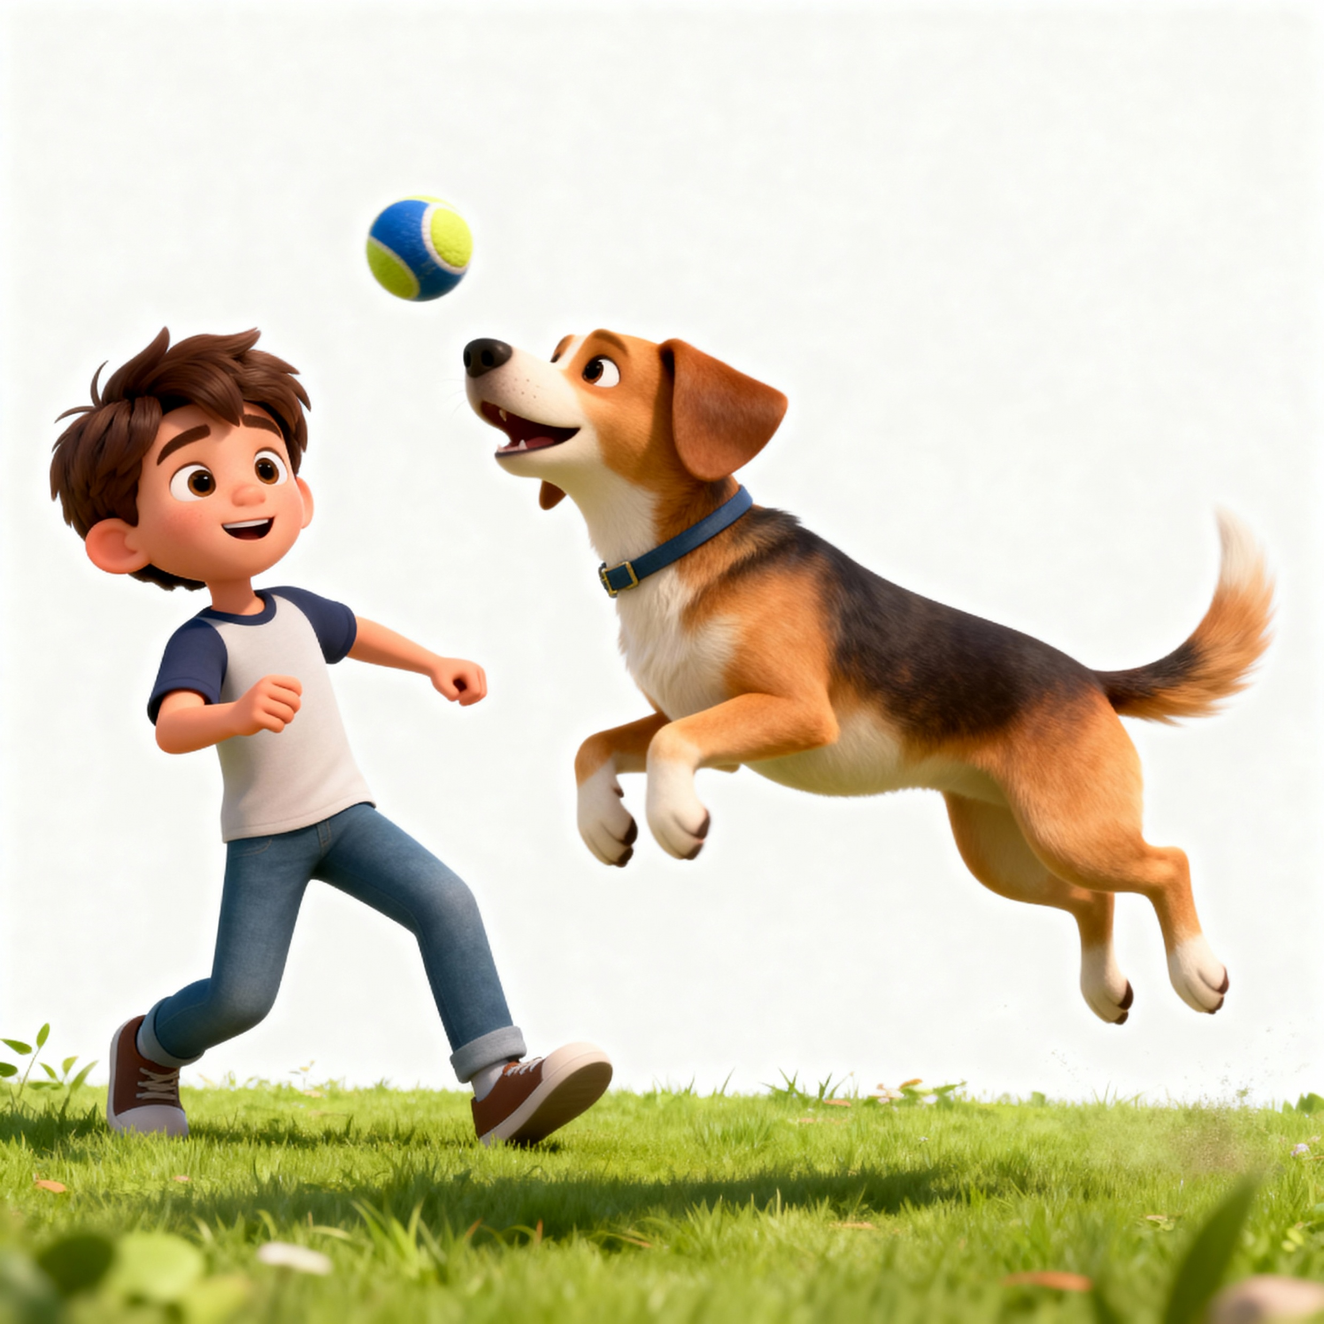


Slide 17

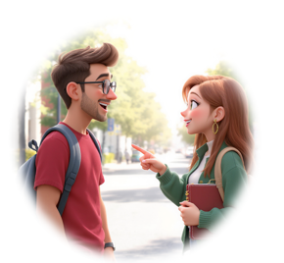
Us
Teller
Bank System
Time
How can I help you?
What is my balance?
What is your account #?
#654321
Balance for #654321
$2,459.21
Your balance is $2,459.21

Slide 18
Client
Browser
Bank
Server
File
System
GET/login.html
Time
read login.html
parse HTML
login.html
login.html
GET/bank-logo.jpg
read bank-logo.jpg
bank-logo.jpg
Page displayed
bank-logo.jpg
Login clicked
POST/account.html (with form data)
read account.html
account.html
account.html
Page displayed

Slide 19
Client
Browser
Client
JavaScript
Bank
Server
File
System
account.html
Time
parse HTML
GET/script.js
read script.js
script.js
script.js
Page displayed
AcceptDeposit
clicked
call acceptPay()
POST / deposit(#,$)
update rec
ACK rec updated
response 200=OK {data}
update view
Page displayed

Slide 20
Client
Browser
Client
JavaScript
Bank
Server
File
System
account.html
Time
parse HTML
GET/script.js
read script.js
script.js
script.js
Page displayed
AcceptDeposit
clicked
call acceptPay()
POST / deposit(#,$)
update rec
Payment FAILED!
response 500=ERROR
Alert!
Page displayed

Slide 21






HTTP
requests
HTTP
responses
Give me the main page of “…”
Here it is:
Give me the CSS file “…”.
Here it is:
Give me the JS file “…”.
Here it is:
Give me the JS file “…”.
Here it is:
Give me the CSS file “…”.
Here it is:
Give me the image file “…”.
Here it is:
Give me the icon file “…”.
Here it is:
Give me the image file “…”.
Internet
Here it is:
browser
web server

Slide 22
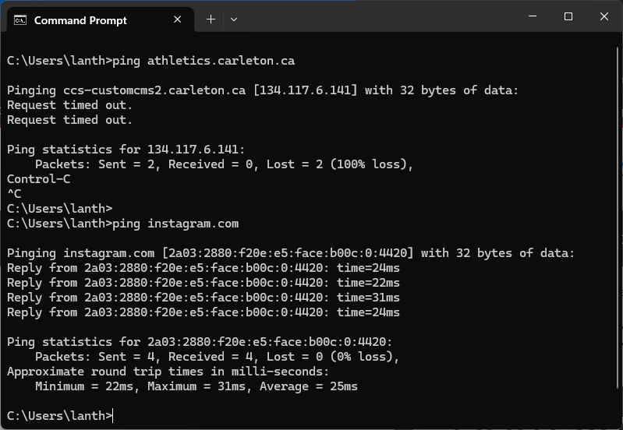

Slide 23
Request Type
Resource requested
HTTP version
Status Code
Status Text
Request Line
GET resource-name HTTP/1.1
HTTP/1.1 200 OK
…
…
…
…
…
…
…
…
…
…
…
…
Header lines
Header lines
A blank line
A blank line
…
…
…
…
…
…
…
…
…
…
Body lines
Body lines

Slide 24



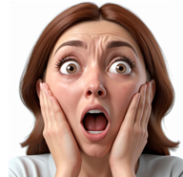
Browser Cache
Local copy
GET HTTP request
Internet
load
Client Browser
304 Not Modified HTTP response
Web Server

Slide 25


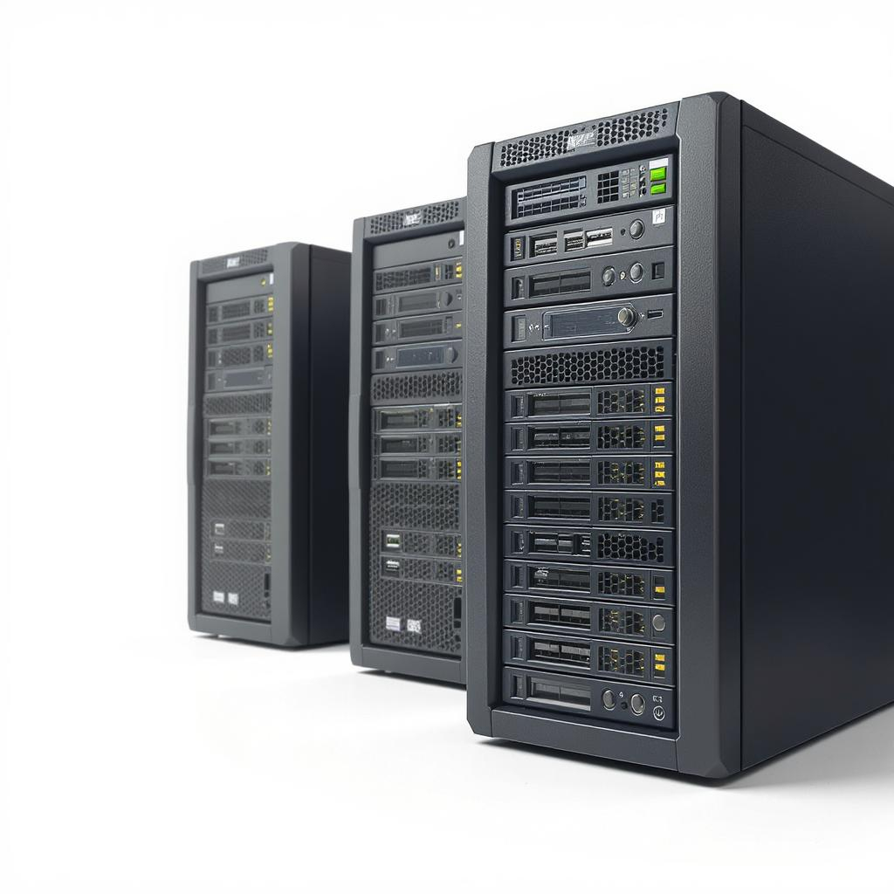

Slide 26
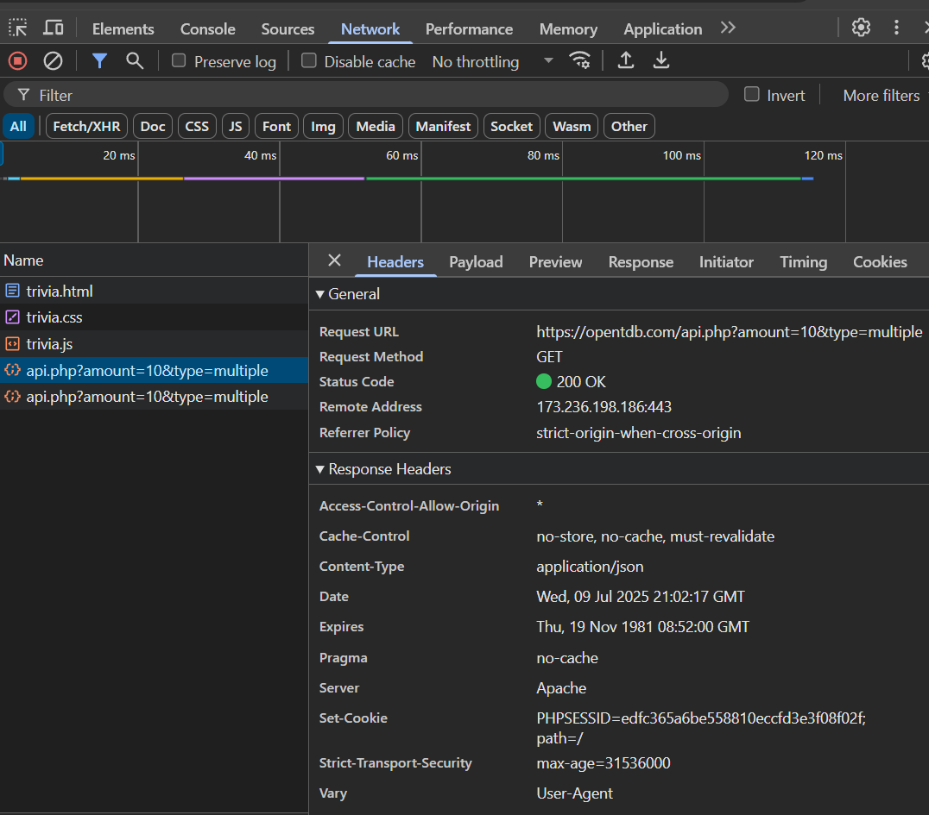

Slide 27
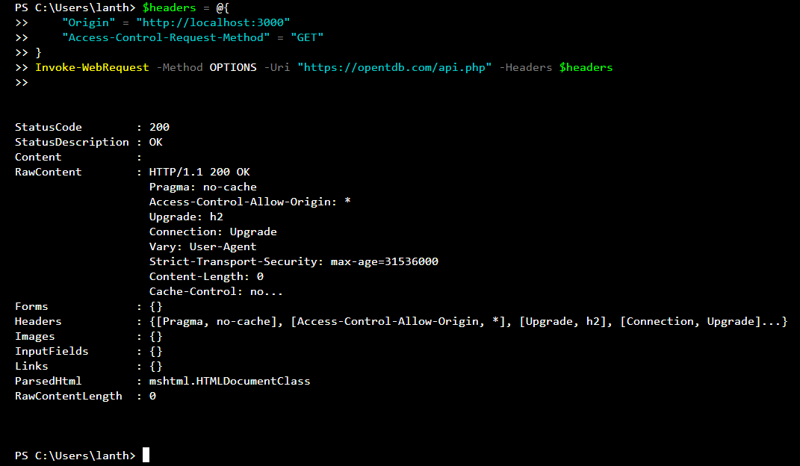

Slide 28
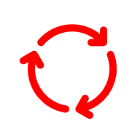






Slow
Process Per Request Web Server
2
1 (blocking)
Running Processes
Spawn
Slow
3
4
File System,
Database,
Computation,
Network …
Client Request
Server Response
Slow
Thread Pool Web Server (e.g., Apache)
Fixed-Size Thread Pool
File System,
Database,
Computation,
Network …
Task Queue
Client Request
Server Response

Slide 29
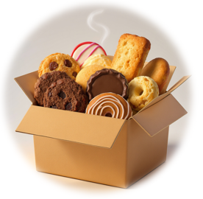

Node.js Web Server
Worker threads
Event Loop
Client Request
Event
Queue
Server Response

Slide 30
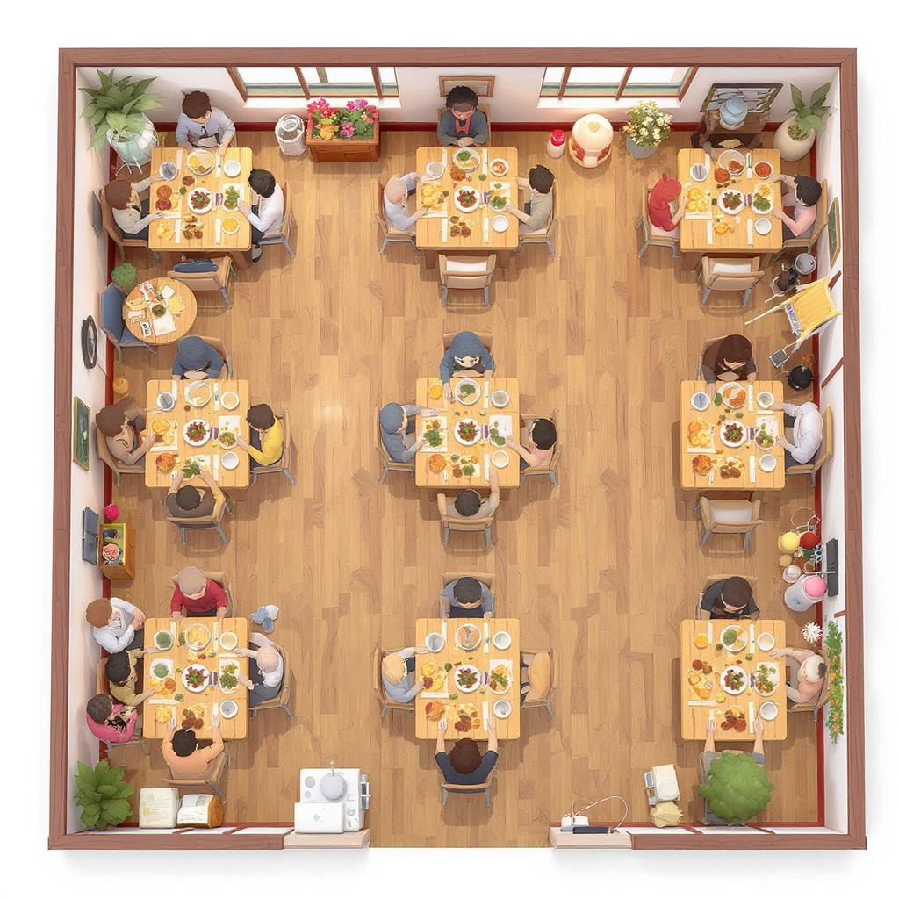
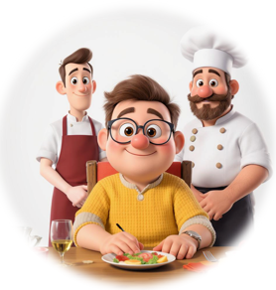
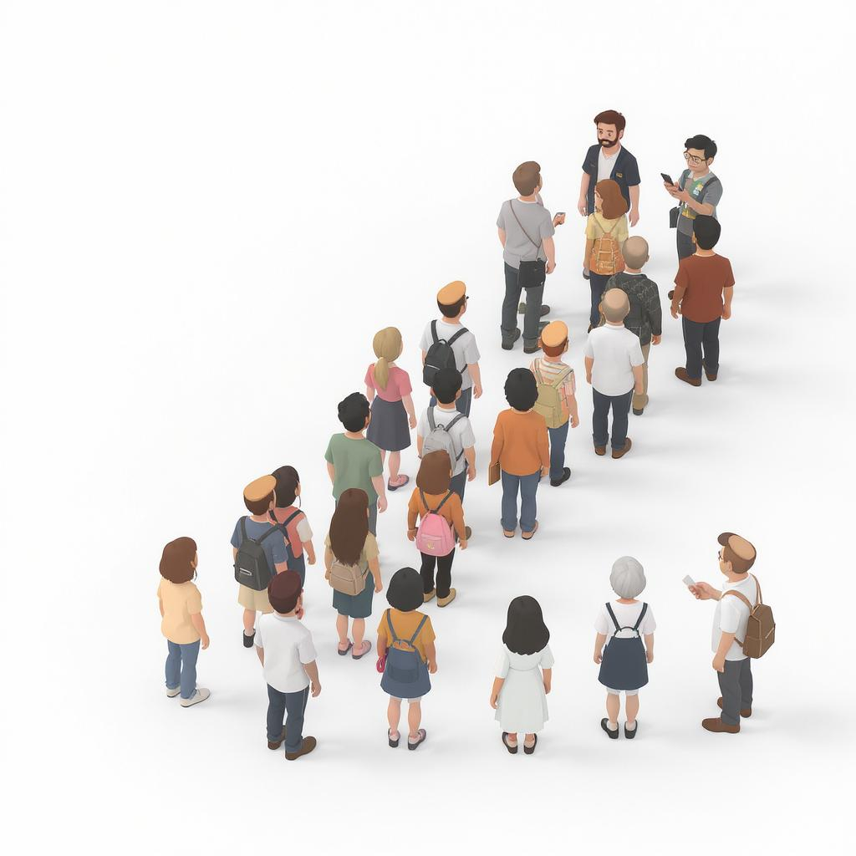
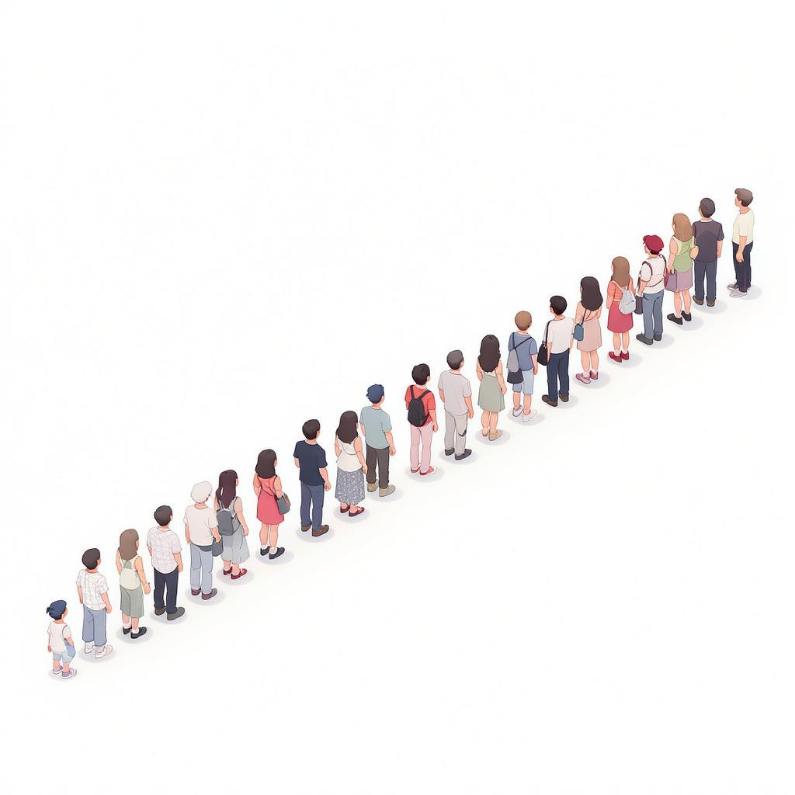
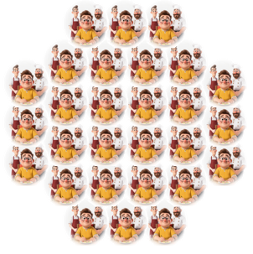


Slide 31
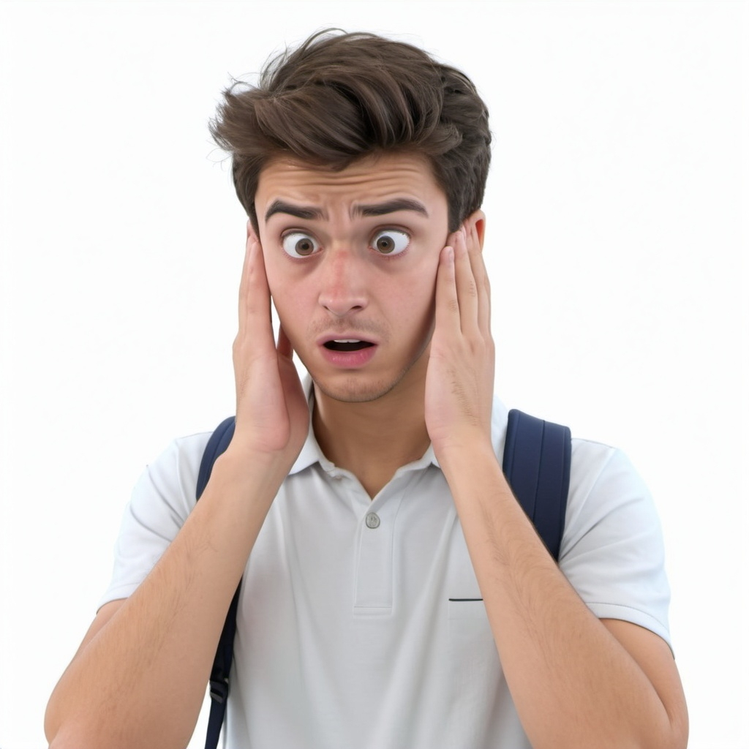



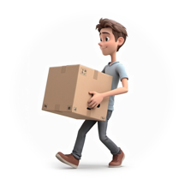
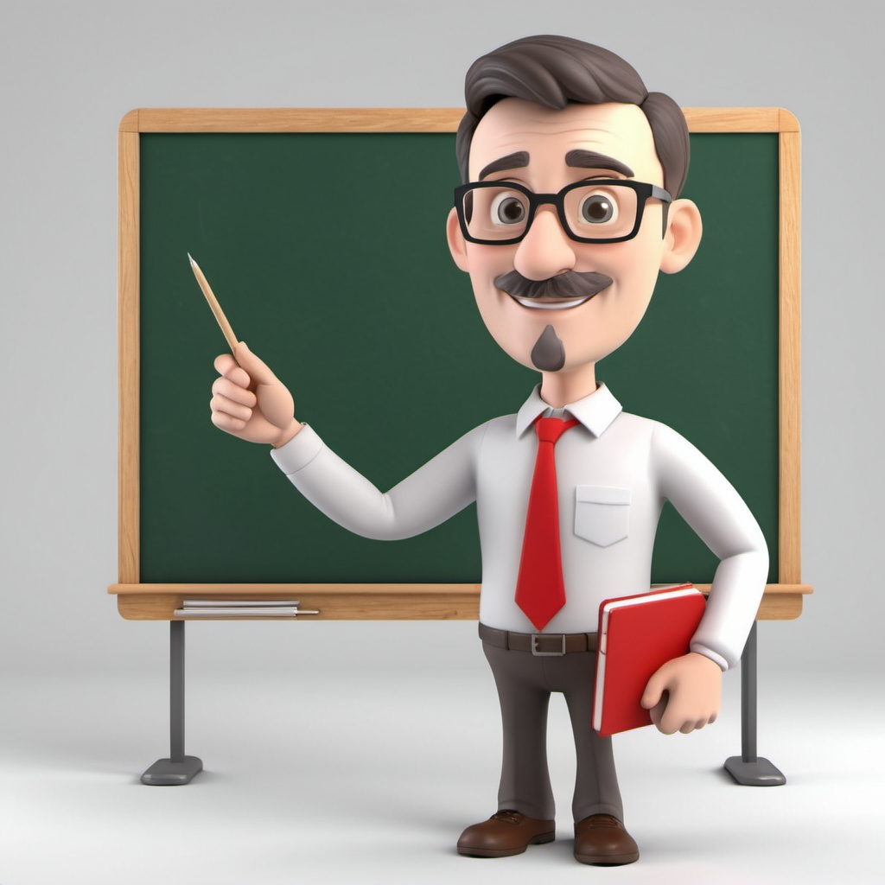
Execute all synchronous (top-level) code
REPEAT {
Handle any queued asynchronous callbacks
} UNTIL (there is no more work to do)
my_projects
node_modules
my_module.js
fun_project
fun_server.js
funner_project
funner_server.js
funnest_project
funnest_server.js
my_projects
node_modules
my_module.js
fun_project
fun_server.js
funner_project
funner_server.js
funnest_project
node_modules
my_module.js
funnest_server.js

Slide 32


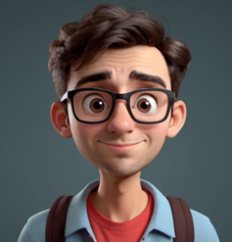
{
"name": "05_01",
"version": "1.0.0",
"main": "server.js",
"scripts": {
"test": "echo \"Error: no test specified\" && exit 1",
"start": "node server.js"
},
"keywords": [],
"author": "Alina",
"license": "ISC",
"dependencies": {
"express": "^4.18.2",
"pug": "^3.0.2",
"socket.io": "^4.7.2",
"underscore": "^1.13.6"
},
"devDependencies": {},
"description": ""
}
Caret ^ or Tilde ~
^ tells NPM: “Install the most recent version that is still part of the same major version.”
~ tells NPM: “Install the latest patch version, but stay within the same minor version.”
If nothing here … tells NPM: “Install this exact version only”.
^1.13.6
Major
Changes that are not backwards compatible with older versions
Minor
New features added that are backwards-compatible
Patch
Small fixes like bug fixes or performance improvements

Slide 33









Template
Data
<h1><%- name %> EJS!</h1>
<% if(someVal){ %>
<h1>…</h1>
<% } else{ %>
<h1>... else</h1>
<% } %>
()
Template
Engine
“<html>
…
</html>”
HTML
String/Page

Slide 34

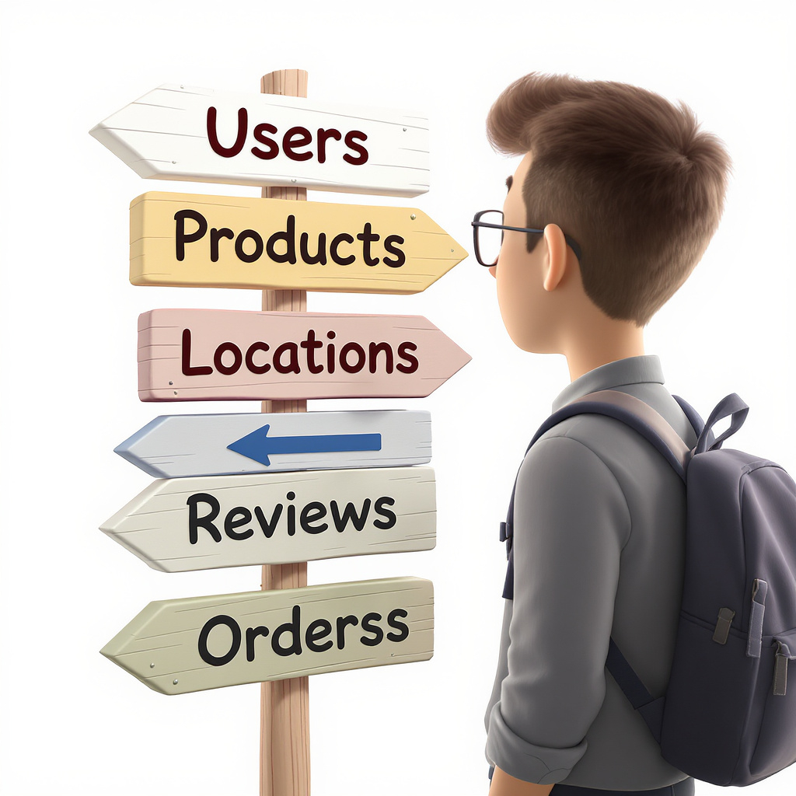
date-a-science-ejs
server.js
style.css
clientscript.js
images
homer.jpg
marge.jpg
ling.jpg
ahmed.jpg
favicon.jpg
logo.jpg
unknown_person.jpg
loveBanner.jpg
data
members.js
views
index.ejs
about.ejs
profile.ejs
partials
header.ejs
footer.ejs
date-a-science
server.js
style.css
clientscript.js
about.html
images
homer.jpg
marge.jpg
ling.jpg
ahmed.jpg
favicon.jpg
logo.jpg
unknown_person.jpg
loveBanner.jpg
from https://www.petergirnus.com/blog

Slide 35
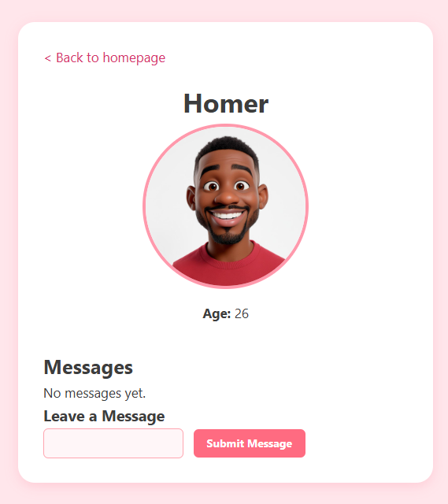
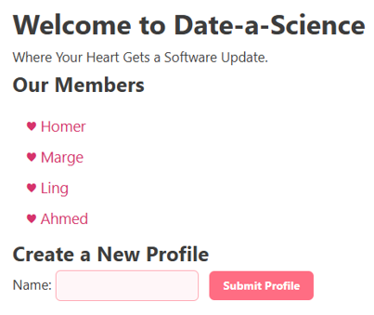
Dynamic
Content

Slide 36
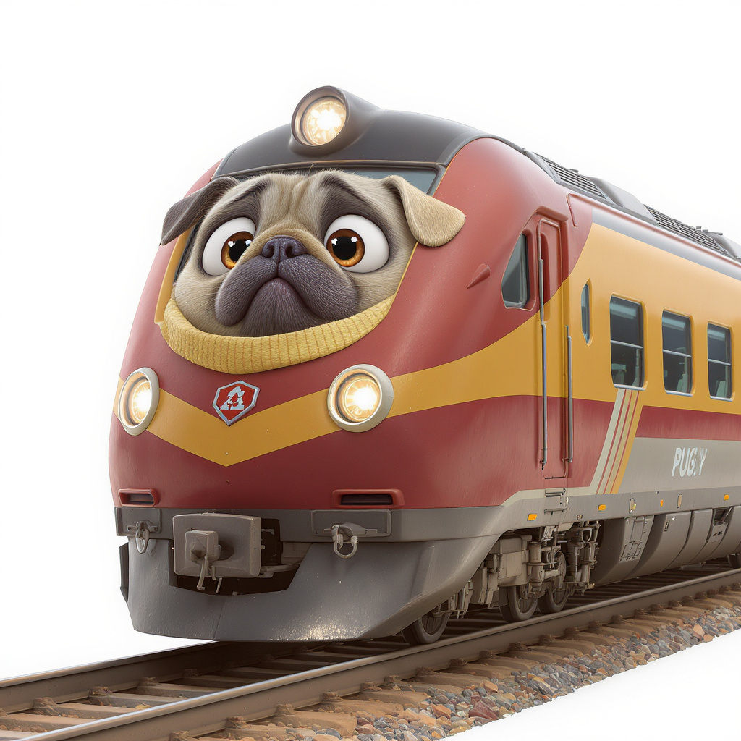
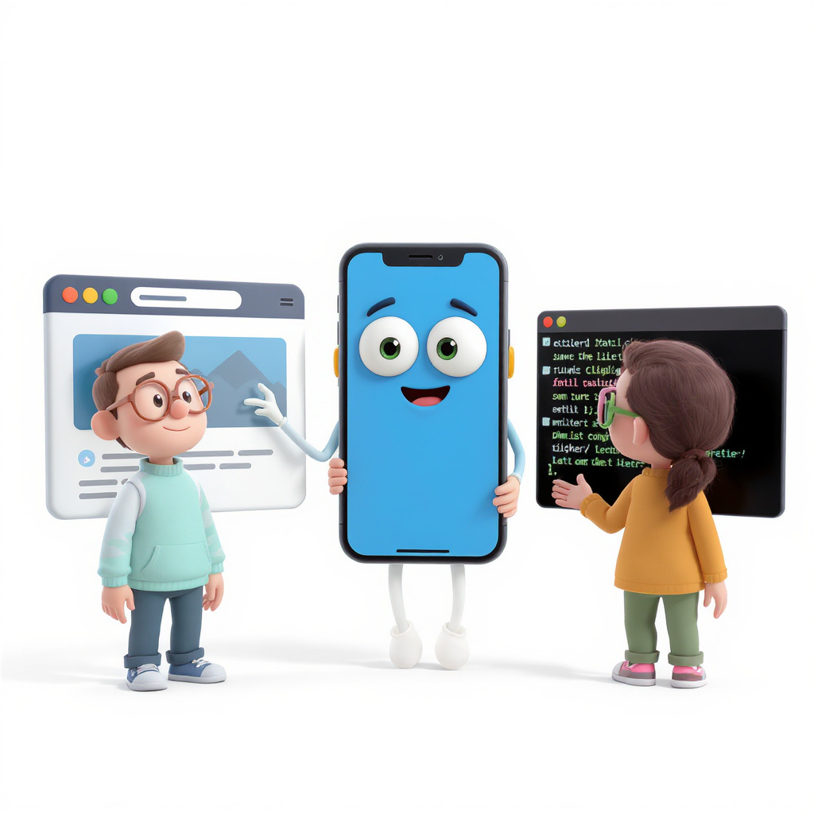
Dynamic
Content
Dynamic Content

Slide 37
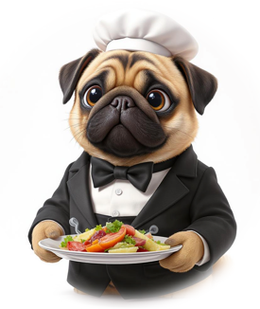
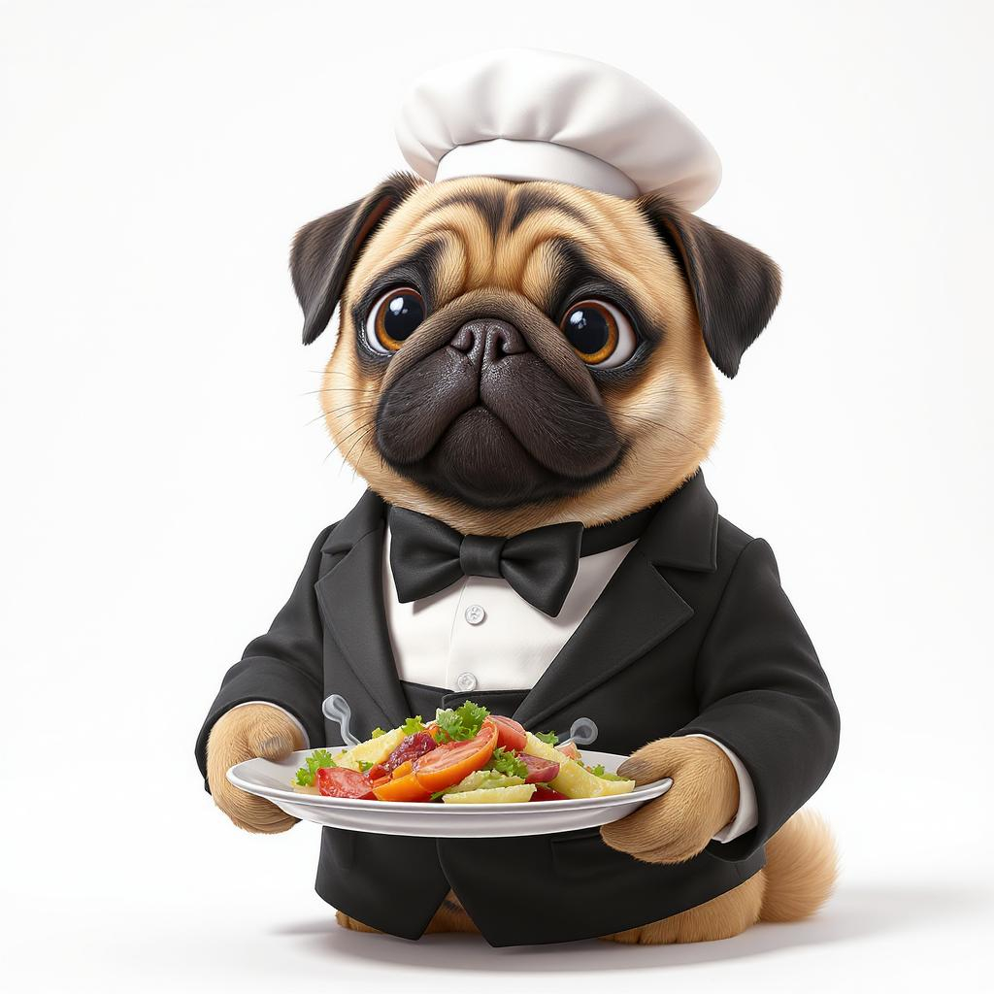

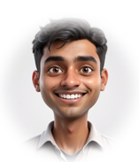
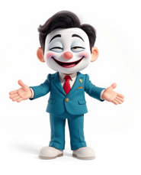





Slide 38

express app
app.method(path, function(req,res,next){});
HTTP request method (get, post, put, use, etc..)
URL path requested
function called when route matches
request
response
next function
app.method(path,
f1(req,res,next){},
f2(req,res,next){},
f3(req,res,next){},
//etc...
);
If we leave out the path, this function (or list of functions) will be applied to all paths.
app.method(function(req,res,next){});

Slide 39






 futuretech-site
├──  icons
│ └── 🔣 logo-icon.png
├──  images
│ ├──  large
│ │ ├── 📷 cloakingSuit.jpg
│ │ ├── 📷 jetpack.jpg
│ │ ├── 📷 neuralBooster.jpg
│ │ ├── 📷 phasingSuit.jpg
│ │ ├── 📷 portalTransporter.jpg
│ │ └── 📷 timeMachine.jpg
│ ├──  news
│ │ ├── 📷 android.jpg
│ │ ├── 📷 portals.jpg
│ │ ├── 📷 robotics.jpg
│ │ └── 📷 scientists.jpg
│ ├──  small
│ │ ├── 📷 cloakingSuit_small.jpg
│ │ ├── 📷 jetpack_small.jpg
│ │ ├── 📷 neuralBooster_small.jpg
│ │ ├── 📷 phasingSuit_small.jpg
│ │ ├── 📷 portalTransporter_small.jpg
│ │ └── 📷 timeMachine_small.jpg
│ ├── 📷 headquarters.jpg
│ ├── 📷 logo.jpg
│ ├── 📷 logo_short.jpg
│ └── 📷 topview.jpg
├──  products
│ ├── 🌐 product_01.html
│ ├── 🌐 product_02.html
│ ├── 🌐 product_03.html
│ ├── 🌐 product_04.html
│ ├── 🌐 product_05.html
│ └── 🌐 product_06.html
├──  scripts
│ ├── 📜 captions.js
│ ├── 📜 dark-mode.js
│ ├── 📜 quotes.js
│ ├── 📜 slider-script.js
│ └── 📜 time-clock.js
├──  styles
│ ├── 🎨 details.css
│ ├── 🎨 general-body.css
│ ├── 🎨 header-footer.css
│ ├── 🎨 image-slider.css
│ └── 🎨 products-style.css
├── 🌐 index.html
├── 🌐 about.html
├── 🌐 contact.html
├── 🌐 products.html
└── ⚙ server.js
':id' is a placeholder (i.e. parameter) that we can access by doing this: req.params.id
So, for a routed request like users/367, id would be 367
Here we use two placeholders in the route (i.e., ':id' and ‘:sz?'). So, for a routed request like products/23789/size/large, id would be 23789 and sz would be 'large'. By using the ? on the :sz parameter, we indicate that the size is optional. So, a routed request like products/23789, will match but the size will be undefined.

Slide 40






Request GET /products
app.use()
Middleware 1
next()
app.use()
Middleware 2
next()
app.use()
Middleware 3
next()
app.get()
GET /
R
O
U
T
E
R
app.get()
GET /about
app.get()
GET /products
app.post()
POST /contact
app.put()
PUT /profile
res.send()
app.delete()
DEL /profile
404
Not Found
Response
HTML
RR

Slide 41
 futuretech-site
├──  icons
│ └── 🔣 logo-icon.png
├──  images
│ ├──  large
│ │ ├── 📷 cloakingSuit.jpg
│ │ └── 📷 ...
│ ├──  news
│ │ ├── 📷 android.jpg
│ │ └── 📷 ...
│ ├──  small
│ │ ├── 📷 cloaki_small.jpg
│ │ └── 📷 ...
│ ├── 📷 headquarters.jpg
│ └── 📷 ...
├──  products
│ ├── 🌐 product_01.html
│ └── 🌐 ...
├──  scripts
│ ├── 📜 captions.js
│ └── 📜 ...
├──  styles
│ ├── 🎨 details.css
│ └── 🎨 ...
├── 🌐 index.html
├── 🌐 about.html
├── 🌐 contact.html
├── 🌐 products.html
└── ⚙ server.js
 futuretech-site
├──  icons
│ └── 🔣 logo-icon.png
├──  images
│ ├──  large
│ │ ├── 📷 cloakingSuit.jpg
│ │ └── 📷 ...
│ ├──  news
│ │ ├── 📷 android.jpg
│ │ └── 📷 ...
│ ├──  small
│ │ ├── 📷 cloaki_small.jpg
│ │ └── 📷 ...
│ ├── 📷 headquarters.jpg
│ └── 📷 ...
├──  scripts
│ ├── 📜 captions.js
│ └── 📜 ...
├──  styles
│ ├── 🎨 details.css
│ └── 🎨 ...
├──  pages
│ ├── 🌐 index.html
│ ├── 🌐 about.html
│ ├── 🌐 contact.html
│ ├── 🌐 products.html
│ └──  products
│ ├── 🌐 product_01.html
│ └── 🌐 ...
└── ⚙ server.js
 futuretech-site
├──  public
│ ├──  icons
│ │ └── 🔣 logo-icon.png
│ ├──  images
│ │ ├──  large
│ │ │ ├── 📷 cloakingSuit.jpg
│ │ │ └── 📷 ...
│ │ ├──  news
│ │ │ ├── 📷 android.jpg
│ │ │ └── 📷 ...
│ │ ├──  small
│ │ │ ├── 📷 cloaki_small.jpg
│ │ │ └── 📷 ...
│ │ ├── 📷 headquarters.jpg
│ │ └── 📷 ...
│ ├──  products
│ │ ├── 🌐 product_01.html
│ │ └── 🌐 ...
│ ├──  scripts
│ │ ├── 📜 captions.js
│ │ └── 📜 ...
│ ├──  styles
│ │ ├── 🎨 details.css
│ │ └── 🎨 ...
│ ├── 🌐 index.html
│ ├── 🌐 about.html
│ ├── 🌐 contact.html
│ └── 🌐 products.html
└── ⚙ server.js
Current Structure
PUG Structure
 futuretech-site
├──  icons
│ └── ...
├──  images
│ ├──  large
│ │ └── ...
│ ├──  news
│ │ └── ...
│ ├──  small
│ │ └── ...
│ └── ...
├──  scripts
│ └── ...
├──  styles
│ └── ...
├──  products
│ ├── product_01.html
│ ├── product_02.html
│ ├── product_03.html
│ ├── product_04.html
│ ├── product_05.html
│ └── product_06.html
├── index.html
├── about.html
├── contact.html
├── products.html
└── futureTechServer.js
 futuretech-site
├──  icons
│ └── ...
├──  images
│ ├──  large
│ │ └── ...
│ ├──  news
│ │ └── ...
│ ├──  small
│ │ └── ...
│ └── ...
├──  scripts
│ └── ...
├──  styles
│ └── ...
├──  data
│ └── product-data.js
├──  views
│ ├──  pages
│ │ ├── index.pug
│ │ ├── about.pug
│ │ ├── contact.pug
│ │ ├── product.pug
│ │ └── products.pug
│ └──  partials
│ ├── header.pug
│ └── footer.pug
└── futureTechServer_Pug.js
new
split
new
new
new
(A)
(B)
(C)

Slide 42

The Random Rack Store
 random-rack-site
├──  images
│ └── ...
├──  node_modules
│ └── ...
├──  products
│ └── ...
├──  reviews
│ └── ...
├──  routers
│ ├── products-router.js
│ ├── reviews-router.js
│ └── user-router.js
├──  styles
│ └── ...
├──  users
│ └── ...
├──  views
│ ├──  pages
│ │ ├── index.pug
│ │ ├── product.pug
│ │ ├── products.pug
│ │ ├── review-profile.pug
│ │ ├── reviews.pug
│ │ ├── user-profile.pug
│ │ └── users.pug
│ └──  partials
│ ├── footer.pug
│ └── header.pug
├── config.json
├── package.json
├── package-lock.json
├── data-generator.js
└── random-rack-express-server.js
1
2

Slide 43

2
1
3

Slide 44


1
6
3
2
5
4

Slide 45




1
2
4
3

Slide 46



Browser
AJAX code
GET
/songs/42
HTTP Response
{ "id": 42, "title": "Song Name", ... }
DB Response
Song data
Database
Web API
song data
DB Query
SELECT * FROM songs WHERE id=42
Server

Slide 47



fetch(url)
.then(response => {
...
return ;
})
.then( => {
...
return ;
})
.then( => {
...
return ;
})
.then( => {
...
})
.catch(err => { // Handle errors
console.error("Error: ", err);
});

Slide 48








 product-management
├──  routes
│ └── products.js
├──  styles
│ └── style.css
├──  views
│ ├──  pages
│ │ ├── add.pug
│ │ ├── delete.pug
│ │ ├── index.pug
│ │ ├── search.pug
│ │ └── update.pug
│ └──  partials
│ └── header.pug
├── db.js
└── server.js
I’m Dave

Slide 49




Client
Browser
Web
Server
POST /login
{ "username": "dave", "password": "Cool_Dude_75" }
Authentication
Successful !
200 OK
Set-Cookie: sessionId=yw3dup93z;
Create Cookie
& Update
Page
GET /calendar
Cookie valid
200 OK
{[{"id": 1, "title": "Team Meeting", "date": "2025-08-28", "time": "10:00"},
{"id": 2, "title": "Doctor Appointment", "date": "2025-08-29", "time": "14:30" },
{"id": 3, "title": "Birthday Party", "date": "2025-08-30", "time": "18:00"}]}
Update
Page
GET /profile
Cookie valid
200 OK
Update
Page
{ "username": "Dave", "fullName": "David Rave",
"email": "dave@example.com", "age": 28, "role": "user",
"preferences": { "theme": "dark", "notifications": true }}

Slide 50
Client
Browser
Web
Server
POST /login
{ "username": "dave", "password": "Cool_Dude_75" }
Authentication
Successful !
200 OK
sessionId=yw3dup93z
Update
Page
GET /dave/calendar?session_id=yw3dup93z
session valid
200 OK
{[{"id": 1, "title": "Team Meeting", "date": "2025-08-28", "time": "10:00"},
{"id": 2, "title": "Doctor Appointment", "date": "2025-08-29", "time": "14:30" },
{"id": 3, "title": "Birthday Party", "date": "2025-08-30", "time": "18:00"}]}
Update
Page
GET /dave/profile?session_id=yw3dup93z
session valid
200 OK
Update
Page
{ "username": "Dave", "fullName": "David Rave",
"email": "dave@example.com", "age": 28, "role": "user",
"preferences": { "theme": "dark", "notifications": true }}

Slide 51







mySite.com -
mySite.com
Calendar
Welcome back Dave!
Profile
LOGOUT
mySite.com -
mySite.com
Username
Dave
Password
************
LOGIN

Slide 52


Slide 53









Slide 54







Slide 55



Adaptive Design
Responsive Design

Slide 56



DPR 1
DPR 1
DPR 3
1 CSS pixel =
1 physical pixel
1 CSS pixel =
4 physical pixels
1 CSS pixel =
9 physical pixels

Slide 57

3
1
2

Slide 58




color of
boxes at
50% of
viewport
Box goes beyond viewport
scroll bars appear now
text
remains
fixed
Text does
not all fit

Slide 59


Slide 60
iPhone 5
width = 568px
iPad (portrait)
width = 768px
iPad (landscape)
width = 1024px
Hello
Hello
Hello

Slide 61





High res: 2560×2560
Medium res: 1080×1080
Low res: 480×480

Slide 62


