Slide 1
Physics
The science of motion

Slide 2
Physics
The study of matter and energy
Astronomy
Classical mechanics
Thermodynamics, statistical mechanics
Electricity and magnetism
Quantum mechanics
Particle physics
Relativity

Slide 3
Physics
The study of matter and energy
Astronomy
Classical mechanics
Thermodynamics, statistical mechanics
Electricity and magnetism
Quantum mechanics
Particle physics
Relativity

Slide 4
Game physics
Classical mechanics
movement of objects responding to forces
F=ma
"Galilean relativity"
ordinary vector sum of velocities
excellent approximation at speeds much lower than c
Computational elements
discretization, numerical methods

Slide 5
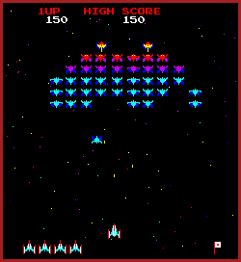

Slide 6
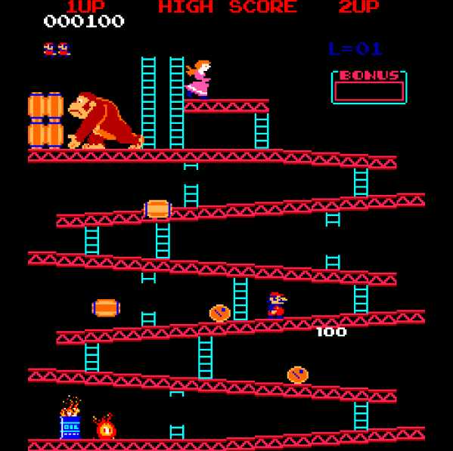

Slide 7
Kinematics
movement without forces
still have velocity, maybe acceleration
space invaders: aliens can change direction, move in straight lines or arcs, but no force simulation used

Slide 8
Parametric Motion
Can step even further back from physics: if you have a function of position wrt some parameter, can use directly (1d parameter to nd position)
must define function, either mathematical expression or lookup of handcrafted movement path
Ballistic motion (cannonball, firework)
platforms, elevators (8-bit games, early consoles)
primitive human figure ("animatronic")

Slide 9
Physics proper
Physics: the study of motion
or, laws governing motion
A game (that has moving parts) has laws (code/algorithms) governing motion
Ideas from physics are needed even if your game does not include real-world physics
Real-world physics is (somewhat) familiar and is a shortcut to inventing and communicating a new physics

Slide 10
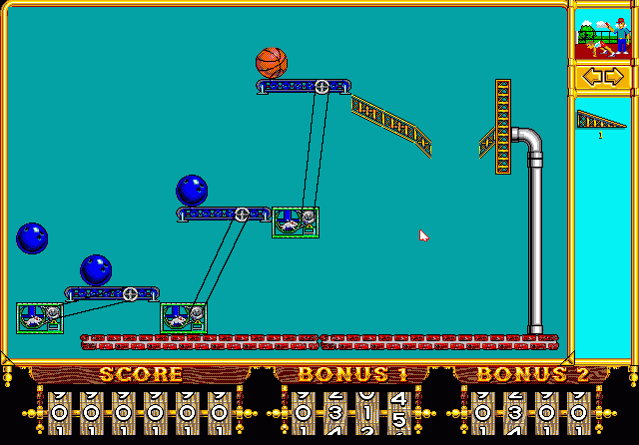

Slide 11
[ Pain,
Idol Minds]

Slide 12
Why use real physics?
Well studied body of knowledge
Familiar to players
Entirely algorithmic
"clockwork universe"
We don't actually use real physics

Slide 13
Quaternion Rotations
Quaternion encodes a rotation by angle θ about axis v
note, must normalize axis
Written as (cos(θ/2), v sin(θ/2))
"Unit quaternion": q∙q = 1 (if v is a unit vector)
Why not use s for angle, v for axis directly?
lack ability to normalize (trivial objection)
difficult to compose rotations (serious)
q * q' = s*s' - u∙u' + (u x u' + s*u' + s' * u)

Slide 14
Game physics
Subset and simplified form of real physics
Motion
forces, resulting movement
Collision
collision detection
collision resolution

Slide 15
Physical Simulation
Possible for human characters, but the control problem is basically unsolved
Widely used for situations where errors are more tolerated, and strict control less valuable
cloth and fluid animation (very high DOF)
rigid body motion (excellent algorithmic specification)

Slide 16
Physical Simulation
Particle motion
each object is a point
forces lead to changes in velocity lead to changes in position
Rigid-body motion
each object has spatial extent
need to consider torques, leading to changes in angular momentum, which produces changes in orientation

Slide 17
Physical Simulation
Particle motion
each object is a point
forces lead to changes in velocity lead to changes in position
Rigid-body motion
each object has spatial extent
need to consider torques, leading to changes in angular momentum, which produces changes in orientation
Linear Physics
Rotational Physics

Slide 18
Simulation: Advantages
Well-studied (in physics) description of the way the world really works
game designer: doesn’t need to invent it
player: doesn’t need to be taught it
Potentially rich gameplay possibilities
Algorithmic, no heuristics needed
Interactions with environment come "for free"
Everything can be computed at run-time

Slide 19
Simulation: Disadvantages
Difficult to control
controls can be incorporated; if physical, still difficult to use, and if non-physical, reduces the advantages of simulation
Difficult to implement and test
Subject to numerical error
Collision detection difficult
Players might short-circuit challenges
Incomplete description – does not scale well to extremely complex scene elements
May not advance gameplay goals, distraction

Slide 20
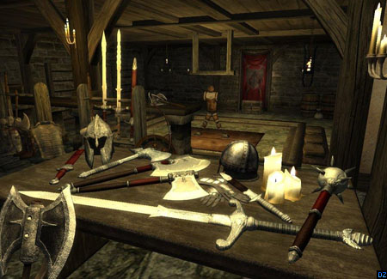

Slide 21
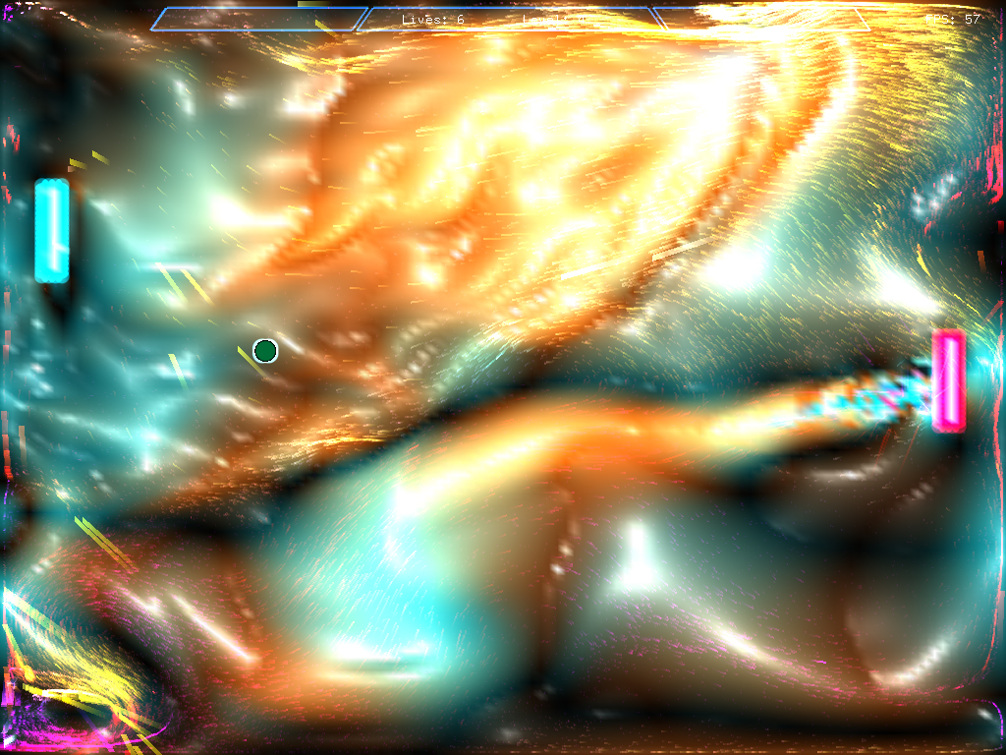

Slide 22
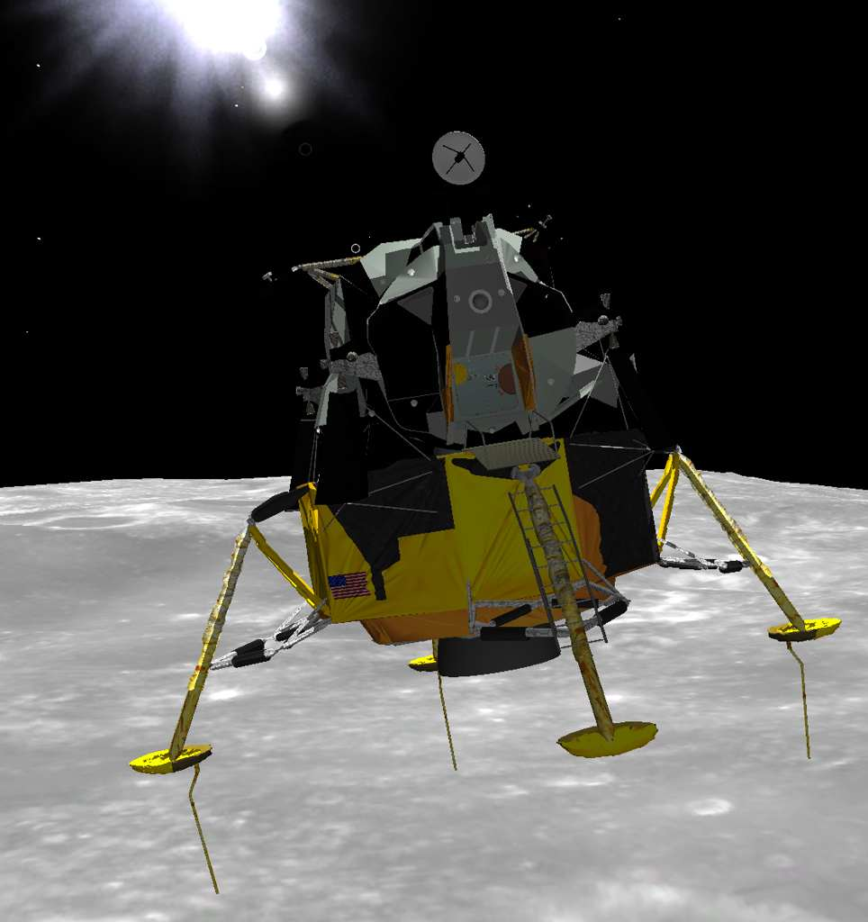

Slide 23
The Physics of Points
A body is equivalent to a point: the entire motion of the object can be specified by giving the trajectory of the centre of mass
We need:
position x, velocity v, acceleration a
mass m
forces F
Some notion of time (t)

Slide 24
The Physics of Points
The trajectory of a body is its position, x(t), for all times t.
The rate of change of position wrt time is called velocity.
The velocity is affected by forces, which induce acceleration.
v = dx/dt or x = ∫vdt
a = dv/dt or v = ∫adt

Slide 25
Newton's Laws
First Law: A body at rest remains at rest.
Second Law: F=ma.
Third Law: For every action there is an equal and opposite reaction.
The Second Law is the most useful for us
has the most predictive power

Slide 26
F=ma
F=ma (plus the relationships between position, velocity, and acceleration) allows us to derive the positions of scene elements based on their histories and current forces
Store force explicitly with object
D'Alembert's principle: forces accumulate (vector sum)

Slide 27
Sources of Forces
Forces can come from
game world: gravity, collisions, springs, air resistance
players, player-controlled game elements
e.g., “Ooch” in Pain
gameplay mechanics: fake forces to enforce a certain trajectory, state
e.g., Mako in Mass Effect tries to stay upright
Humans are sensitive to ballistic errors, so be careful when injecting fake forces

Slide 28
Numerical Integration
Suppose we have known forces, F(t)
How do we determine position?
x(t) = ∫∫(F/m)dt
Analytic solution possible only in simple cases

Slide 29
Key Concept: State Vector
state vector x(t), derivative x'(t)
Update state by integrating x'
i.e., x(t+∆t) = x(t) + ∫x'(t)dt
State vector contains all information about object
position, velocity, mass, orientation, whatever your simulator has to keep track of (dynamic properties)
Update state by integrating
Note "x" used in general sense here, not just x position

Slide 30
Euler Integration
Assume we can determine derivative from state (dx/dt from x, t, other variables)
Then, assume derivative is constant over a small interval (time step) dt
x(t+dt) = x(t) + x'(t) * dt

Slide 31
Euler Integration
x(t+dt) = x(t) + x'(t) * dt
x
t

Slide 32
Inverse Mass
Usually better to store momentum as state variable, not velocity
will store angular momentum with rigid bodies
Momentum: p = mv
Need to compute v for position updates: v = p/m
Inverse mass: ssam = 1/m
Advantages:
Can represent infinite mass
Can use impulse directly (j = ∆p)

Slide 33
Stiff Equations
Some systems of equations are called "stiff":
so difficult to integrate that the time step must be chosen wrt stability concerns rather than error bounds
Unfortunately, some very common systems of equations are stiff

Slide 34
Spring-Mass Systems
Simple Hookean springs:
F = -k∆x
Force is proportional to distance moved from rest, but opposite in direction.
Single spring has simple solution (harmonic oscillator)
Systems of springs in common use in graphics (cloth, muscles, other elastic structures)

Slide 35
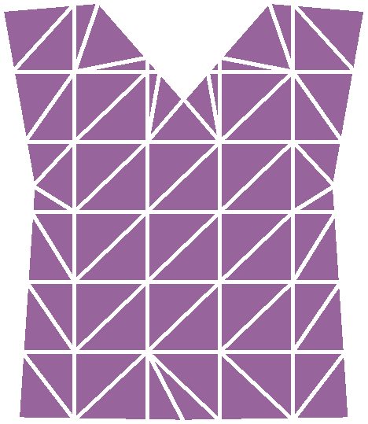
Spring-Mass Systems
Connect points in 1D line:
hair, springs
Connect points in 2D mesh
cloth, skin
Connect points in 3D lattice:
semi-rigid structures
used for flesh/muscle motion
e.g., Jurassic park dinosaurs

Slide 36
Spring-Mass Systems
Spring-mass systems are stiff, hence suffer from stability problems
The stiffer the spring (the larger the proportionality constant k) the worse the stiffness of the equations.

Slide 37
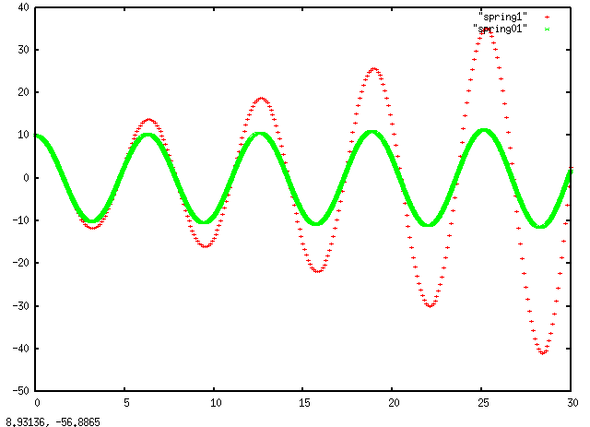
Spring-Mass Systems

Slide 38
How to address stiffness?
Use better integrator
not always plausible
Move out of stiff regime: introduce damping
friction, viscosity, air resistance
things slow down
Spring case: F = -k∆x – μv
adds a term always opposing velocity

Slide 39
Collisions
Relatively simple: move a point in space without interactions
particle systems
More complex: include interactions
Collision: two objects come near enough to interact
collision detection
collision resolution

Slide 40
Collision Detection
A case where accuracy is required: objects must not interpenetrate
Can test all pairs of objects for collisions: n^2 tests (far too costly in practice)
Spatial subdivision: only test nearby objects
nearby = objects in same bin (or adjacent bin)
Bounding geometry
detect collisions with simpler geometry (e.g., spheres)

Slide 41
Spatial Subdivision
Subdivide space in some clever way (e.g., octree)
Can be useful for rendering also!
raytracing involves “collision detection” with rays
Reduces the number of tests needed to determine whether object intersection occurs
Can be hierarchical

Slide 42
Spatial Subdivision: Grid
Divide space into regular grid (2D or 3D)
surprisingly, 2D grid often sufficient for 3D
In O(1), can find cell that point lies inside
Only perform collision detection between objects that lie in the same cell
Large objects: may occupy multiple cells

Slide 43
Spatial Subdivision: Grid
Advantages:
simple to code
no preprocessing, run-time data structure
Disadvantages:
most helpful when objects evenly spaced out
works best for points
very large objects (relative to grid size) slow things down
doesn't take advantage of known structure

Slide 44
Collisions in Games
Relatively few moving objects
player, enemies, bullets, ...
Complex but static scene geometry
buildings, walkways, trees, crates, ...
Often have large flat surfaces (walls, floors, ground)
These characteristics play to the strengths of BSP: binary spatial partition (partitioned by planes)

Slide 45
Spatial Subdivision: BSP Tree
Irregular subdivision: series of arbitrary planes
i.e., any orientation
Hierarchical: Each side of the plane has separate subdivision
Customizable: Can match plane placement, orientation with scene geometry

Slide 46
Spatial Subdivision: BSP Tree

Slide 47
Spatial Subdivision: BSP Tree
O (log n) traversal of tree – each node a plane
extended objects: descend both sides of plane
often crossing plane means collision
Collision detection between objects in same leaf
Often, align planes with geometry (e.g., walls, floor) so that traversal can double as collision detection
e.g., if you are an extended object across such a plane, then a collision has happened

Slide 48
Spatial Subdivision: BSP Tree
Advantages:
use high resolution where needed, low resolution in empty areas
oriented planes can match scene geometry
well suited to static geometry (fixed tree)
Disadvantages
creating BSP tree is hard (usually offline)
not well suited for completely dynamic environments
not everything is well described by planes

Slide 49
Bounding Geometry
Create simple geometry that encloses your actual geometry: sphere, cylinder, axis-aligned box, any box
Detect collisions between bounding geometries
no collision: definitely no real collision
collision found: might be a collision
depends how tight the bound is
Often use hierarchical bounding geometry
especially when rendering (pixel-perfect images)
More often, first test was good enough (physics)

Slide 50
Bounding Geometry
Philosophy: separate rendering geometry from simulation geometry
Can afford high-resolution meshes for rendering
still tricks for sublinear performance, but max O(n)
Can't afford them for physics
mostly wasted anyway: player can't tell
If your game has high-resolution simulation geometry, you're doing it wrong

Slide 51
Intersection testing
Collision detection boils down to intersection testing
Various intersections used:
sphere-sphere
sphere-line
sphere-plane
line-plane
plane-plane
others

Slide 52
Three philosophies
proximity testing
"am I too close?"
actual intersection
does this line cross this plane?
inside-outside testing
"am I inside this box?"
bounding boxes, planes

Slide 53
Sphere-Sphere intersection
Simplest case
Sphere 1 with radius R, sphere 2 with radius r
positions p1, p2
if |p1-p2| < R+r, collision happened
Otherwise, safe
p1-p2
p1
p2

Slide 54
Sphere-line intersection
equivalent to "point-to-line distance"
A, B, C, D all positions (vectors)
line to C distance: (B-A)x(C-A)/|B-A|
cross product gives area of parallelogram
parallelogram area is base times height
ergo, base is cross product / height
line to D distance:
check if endpoints are further
dot product check available
sphere D
endpoint B
endpoint A
sphere C

Slide 55
Bounding Box
Test whether point is inside
corners of one box vs other, then reverse
Check the axes: x, then y, then z

Slide 56
Bounding Geometries
various possibilities:
spheres, hierarchies of spheres
anything remotely compact, highly recommended
cylinders
for humans, say: upright cylinder
axis aligned bounding boxes (AABBs)
not very compact if object rotates off-axis, fast
object oriented bounding boxes (OOBBs)
can be compact, need to transform, in common use today

Slide 57
Planes
special common case where no bounding geometry needed: use the plane directly
plane representation: point P, normal N
object located at B
compute signed distance: s = (P-B)∙N
if s changes sign, point crossed plane
Note, can also find projection of B onto plane:
B-sN for s as above

Slide 58
Collision Resolution
Can appeal to physics: momentum is conserved
Elastic collisions: also conserve energy
Plastic collisions: some amount of energy is lost

Slide 59
Impulse
Instantaneous change in momentum
Useful concept for instantaneous collisions
collisions resolved within one timestep
can avoid complicated force calculations
rigid bodies: forces are infinite – no alternative to impulse
J = ∆p

