Slide 1
Science Student Success Centre
How to reach us!
We can help you…….
Office: 1152 HP
Phone: 613- 520-2600 ext 3111
Email: sssc@carleton.ca
Website: www.carleton.ca/sssc
Facebook Group:
SSSC - Carleton University Science Student Success Centre
Find the resources you need on campus
Improve the way you prepare for your semester.
Find summer research opportunities
Improve the way you
Manage your time
Take notes
Study for science exams
Clarify ideas and concepts to better understand course content
We are here to help you learn how to learn the things you need to know.
Office hours: Monday-Friday 9:00 – 5:00

Slide 2
COMP 3501 Foundations of Game Programming and Computer Graphics
Dr. David Mould

Slide 3
What this course is
The basics of graphics for computer games
Real-time hardware-accelerated rendering
Realistic and stylized lighting; texture
Linear and rotational physics
Mathematical foundations of 3D graphics
XNA for game development
Simultaneous development for PC and Xbox
Free, sophisticated IDE and graphics engine

Slide 4
Textbook
“XNA Game Studio Creator’s Guide”, Stephen Cawood and Pat McGee
Basic XNA primer
Includes useful program examples, models
We will use the text as support material
some advanced topics not in textbook: procedural texture, raytracing
Available at bookstore, elsewhere

Slide 6
Instructor information
Dr. David Mould
5346 Herzberg
mould@scs.carleton.ca
Office hours:
10:00-11:30 Tues, or by appointment

Slide 7
Grading
Assignments: 25%
8 assignments of varying difficulty
approximately weekly, with gaps
Midterm: 15%
Oct 27
Final exam: 40%
as determined by exam schedule
Project: 20%

Slide 8
Project
A significant development project
Presented in the last week of class
Three requirements:
interactive system
includes 3D graphics
developed in XNA
Group of 2 or 3
Suggested projects online

Slide 9
Previous projects
Small game: "Monkeyship", "Illumination", "Guided missile"
Special effects
particle system
X-toon specialized shader
Physical simulation
solar system
fluid simulation, cloth simulation

Slide 10
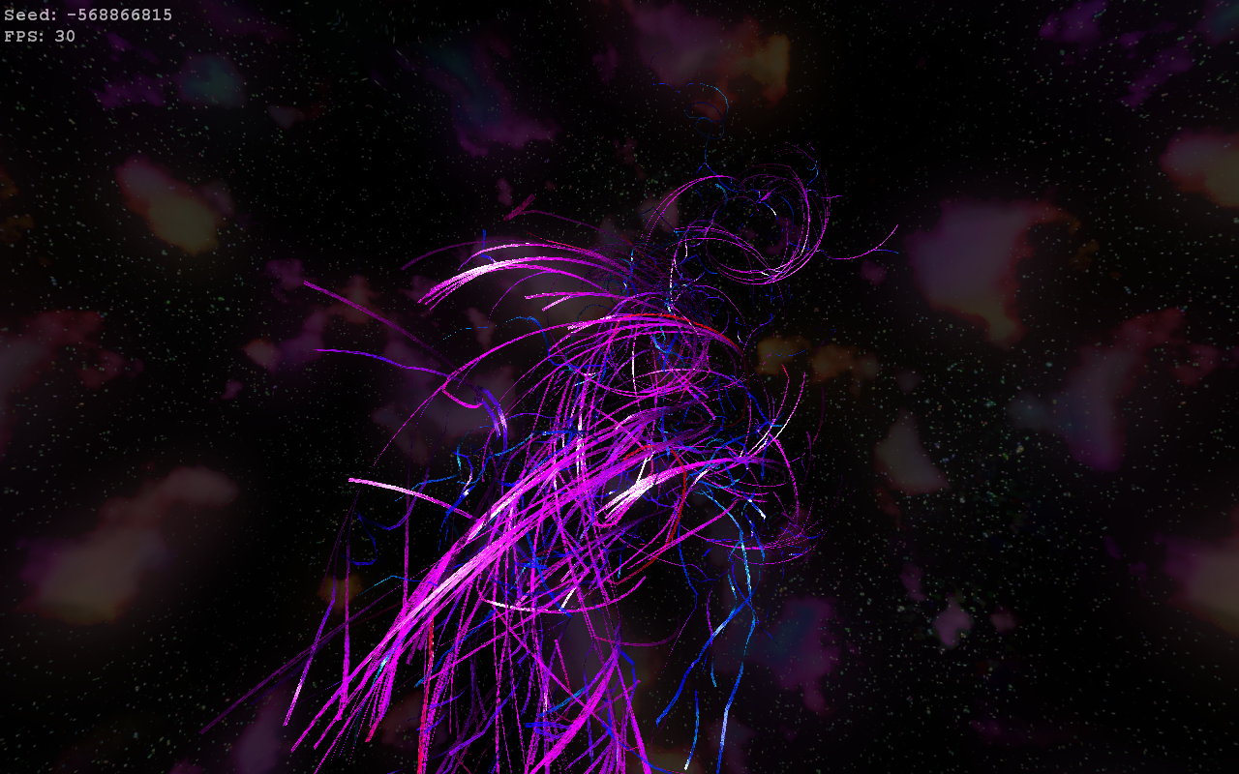

Slide 11
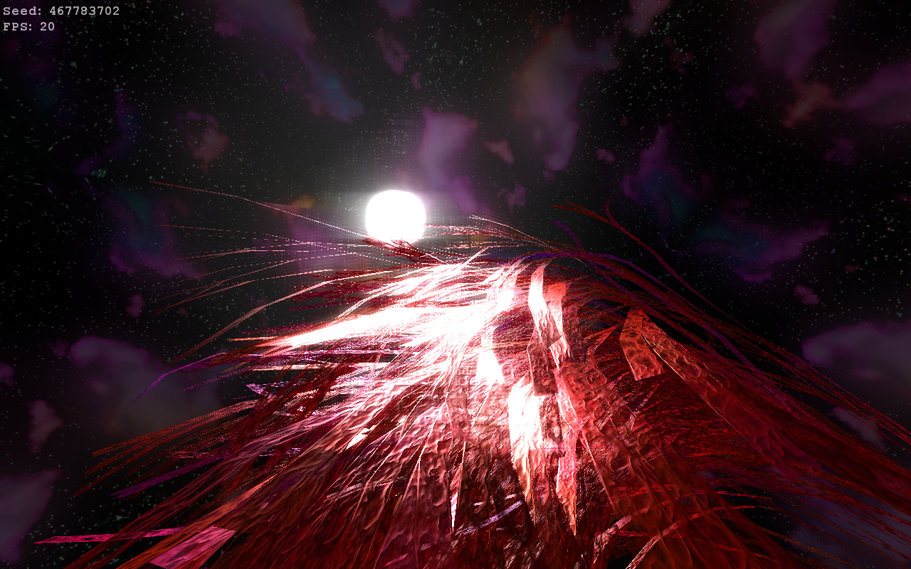

Slide 12
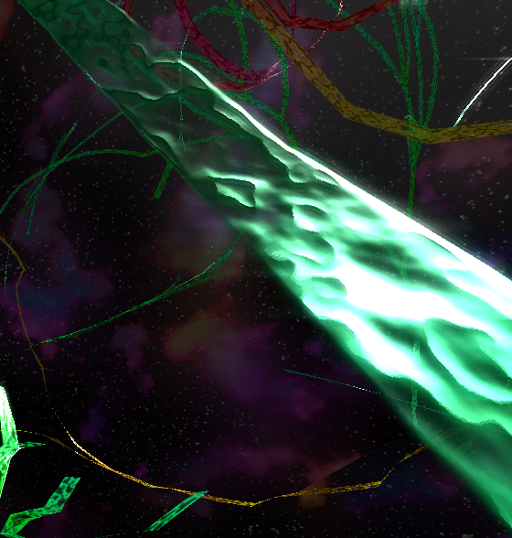

Slide 13
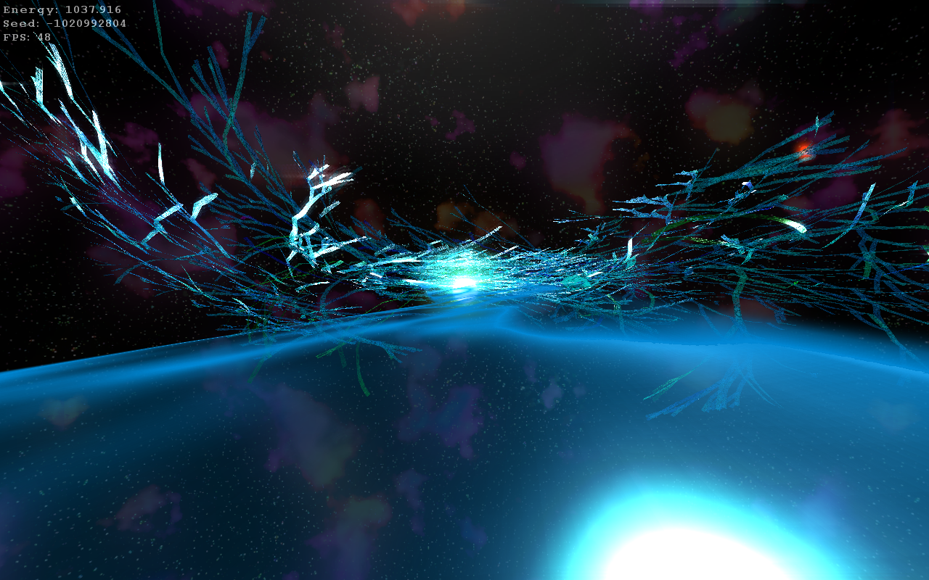

Slide 14
Project milestones
Project proposal: Sept 27
one to two pages
names of team members
basic idea
plan for completion: pieces, roles, timeline
Preliminary report: Oct 22
one to two pages
progress report, screenshots, revised timeline

Slide 15
Project milestones, cont’d
Presentation: in class, Nov 29 or Dec 1
about 10-20 minutes
exact time depends on number of groups
ideally, live demo of completed system
Final project: Dec 6
writeup (“game manual”): 6-8 pages
plus appendix with technical notes, credits
XNA project, assets
adequately documented code

Slide 16
Project resources
your professor
the graphics literature
the textbook and other texts
tutorials and code snippets found online
All of these are fair game, but remember:
You MUST give credit when you have used someone else’s work!

Slide 17
Pitfalls
Various problems inevitably emerge during the term
people problems
design problems
technical problems
time management problems

Slide 18
People problems
DO:
keep your group informed (of absences, illnesses, travel plans, future plans)
involve everyone in all parts of the project
maintain a single build
DO NOT:
change groups without informing your first group
fork development with the idea of merging later
try to merge multiple projects the week before the end of term

Slide 19
Design problems
DO: (or at least think about doing)
design a small game that can be expanded
prototype novel game mechanics on paper
separate level design from game technology
DO NOT:
try to make Oblivion
focus on design to the exclusion of technology

Slide 20
Technical problems
DO NOT:
wait to see if a topic will be covered in class
attempt to use human-figure animation
design your own camera from scratch
DO:
use tricks to avoid AI programming
separate design problems and technical problems
ask the professor for help

Slide 21
Time management
Most of the preceding can be solved by taking more time
But, the term is of fixed length
Plan ahead! Write an explicit time budget
Include 2 weeks of bugfixes at the end
Front-load your development
Have a playable prototype by Oct 1!

Slide 22
Access to games
of course you know about the game lab, games available on Steam
library also has console games (no PC games because of legal issues)
and can get more – email me your requests
and, library has board games
source of game design ideas – board games tend to be more varied than modern computer games

Slide 23
XNA
We will use XNA 3.1, the latest full release
XNA 4.0 still in beta as of this writing
Installed in the game lab
Home use:
uninstall XNA 3.0, if necessary
download+install XNA Game Studio Express 3.1

Slide 24
Topics of interest?

Slide 25
Favorite games?

