Slide 4
Particle Systems
Simulation for special effects

Slide 5
Physics of points
F=ma, v = ∫adt, x = ∫vdt
Without interaction, point physics is very easy
Particle systems:
large numbers of points
do not interact with each other
might interact with rest of game world

Slide 6
Particle Systems
Use a huge number of points to represent objects or phenomena
Usually, motion governed by physics
Well-suited to amorphous objects or to phenomena inherently made of points:
smoke, fire, clouds
explosion, fireworks, fountain
rainfall, snowfall, galaxy

Slide 8
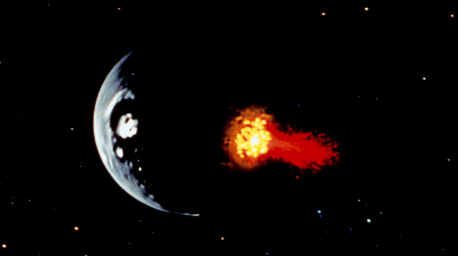
Particle Systems
Notes:
First use of particle systems – invented by Bill Reeves (1982)

Slide 9
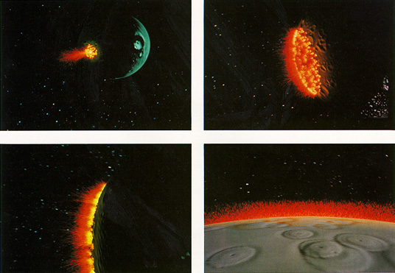
Particle Systems
Notes:
"Genesis Effect", Star Trek 2

Slide 10
Notes:
Fire is probably the most widely used particle system effect

Slide 11
Notes:
This is the login screen for world of warcraft – probably the fire effect seen by the most people

Slide 12
Particle Systems
Huge number of particles representing a complex system
Each particle has its own properties:
position, velocity
size, shape, color
temperature, mass
age, maximum lifespan
All properties are functions of time

Slide 13
Particle Systems
Each particle independently obeys its own dynamics
The system should have a way of generating new particles
Particles generally have a finite lifespan, and die when their time is up (or when other conditions are met)
Behavior of generator as important as dynamics

Slide 14
Rendering Particle Systems
Particles are points from a dynamics point of view, but can be rendered differently
polygons
alpha blended polys
texture chips
groups of polygons
small models
secondary particle system
point sprites (points with texture)
available in XNA

Slide 15
Dynamic Rendering
Rendering parameters can be functions of time
control color directly
derive color from temperature
material parameters changing
dynamic textures

Slide 16
Particle Dynamics
Position, velocity, other characteristics of particles change over time
Can determine future state of system from present state
Updates made by numerical integration (e.g., Euler integration, Runge-Kutta integration)

Slide 17
Generator Dynamics
Can obtain many interesting effects by adding dynamics to the generator
Simple generator: fixed position, fixed distribution of outgoing particles (e.g., fountain)
More complex generators: changing position, changing parameters of outgoing particles (e.g., comet, rocket; arbitrarily complex generator shape)

Slide 18
"Self-Breathing Head" – Sims, 1990

Slide 19
Particle Dynamics
Gravity:
constant force (F=mg)
on the large scale: F = GMm/r²
Orbital dynamics: force along radius, but nonzero velocity perpendicular to radius leads to elliptical trajectories

Slide 20
Particle Dynamics
Air resistance (wind resistance)
F = μ∆v, for coefficient of friction μ, difference in velocities ∆v
Force direction opposed to velocity difference
In still air, ∆v = -v
If air is moving, need to know wind direction and magnitude
simple models often suffice

Slide 21
Particle Dynamics
Can add in whatever force terms you like
Radial force in xy-plane, no force in z-direction: helical paths
Derive forces from sampling a texture (especially procedural texture): chaotic, unpredictable paths
Forces based on behaviour of nearby particles

Slide 22
Fireworks
Simple dynamics, well-defined rules for birth and death
dynamics: F=mg is only force
death: either by explosion (lifespan expires) or on striking the ground
birth: in explosion event, some number of new particles are created
initial position: at location of explosion
initial velocity: random distribution around velocity of exploding particle

Slide 23
Particle Trails
Not all particles need the same dynamics
Simple way of producing trails: each active particle leaves behind a trail of inactive particles
Inactive particles: may change color, transparency, etc., but location not subject to dynamics
Once used for modeling (e.g., grass) – rarely used this way now
sometimes still see it: Neubert et al, SIGGRAPH 2007; Xu & Mould, Cae 2009

Slide 26
Point Sprites
Primitive designed for particle systems
point with spatial extent
oriented towards camera (exists in screen space and world space)
has texture (but no texture coordinates)

Slide 27
Point Sprites
Upside: extremely useful for special effects
good performance
particle systems well understood
Downside: XNA functionality lacking
need to create custom vertex declaration
need to write custom shader

Slide 28
Custom Vertex Declaration
Create a structure that contains your data
position (location in 3D)
size (spatial extent around central position)
color (optional)
other stuff your shader might want
... plus methods
getters and setters for data (optional)
VertexElements: detailed description of data

Slide 29
VertexElement
One VertexElement has:
stream it is read from (typically 0)
offset from beginning of list (starts at 0, counts up)
data type (such as VertexElementFormat.Vector3)
render-time method (often VertexElementMethod.Default)
usage for data (such as VertexElementUsage.Position)
counter for semantic (0 for first, 1 for second...)

Slide 30
VertexElements
array of VertexElement items
one for each piece of data
note: calculate offset by accumulating the size of the elements listed so far
Ugly, but has to be done once for each different particle type you want

Slide 31
Custom Shader
Create vertex and pixel shader as before
Note: input to vertex shader should have:
same data as specified in vertex format
same semantics used (eg, PSIZE0)
data should be in the same order
Vertex shader should spit out UV 1.0,1.0 if texture-mapped particle is desired

Slide 32
Point Size Semantic
PSIZE: shader semantic we haven't used before
represents radius of point
single floating point value
PSIZE must be part of vertex shader output
Can calculate point size in vertex shader, or just pass through input point size
PSIZE is not available to be modified in pixel shader (too late)

Slide 33
Notes:
fire effect in the demo code

Slide 34
Focus on Dynamics
Important things:
appearance of individual particles
how the appearance changes over time
become smaller, fade, change color
how the particles move
how the particles are born and die
Relatively unimportant:
details of setting up vertex format, etc.
necessary, but look it up when you need it

Slide 35
Flocking
Designed for flock/school dynamics
Particles with this particular behaviour called 'boids'
Boids know where other nearby boids are, and react to what is going on

Slide 36
Flocking
Each boid obeys only its own local rules, yet an overall flock behaviour results
Cited as an example of emergence: local rules produce global behaviour
Unpredictable complexity can arise from repeated application of seemingly simple rules
Exploited in graphics for data amplification

Slide 37
Boid Rules
Separation: each boid tries to avoid getting too close to any other boid
Alignment: each boid tries to match its velocity with that of its flockmates
Cohesion: each boid tries to move towards the center of the flock
These simple rules provide extremely robust flocking behaviour

