Slide 1
Upcoming deadlines
Midterm: Wed, Nov 3
Project presentations: last week of class
Nov 29, Dec 1
Project submission: last day of class
Dec 6
will accept late without penalty until Dec 10

Slide 2
Project comments
mostly in good shape
gameplay often lacking
Universal advice: set a schedule
a realistic schedule
include recognition of delays
avoid one-person "keystone" dependencies

Slide 3
Screen-Space Special Effects

Slide 4
Basic Idea
Pixel shaders can modify final color
But, execute in parallel over entire image
without ability to look at nearby pixels
Perform color calculation in two passes:
First, render to texture
Second, render sprite or triangles to screen with texture from first pass as input

Slide 5
Second Pass
Now, can sample texture arbitrarily in second pass, allowing typical image processing operators to be used:
blurring, sharpening
edge detection
morphological operators
whatever you can fit in the instruction limit

Slide 6
Example Effects
toon shading, greyscale / sepia, negative
blur, depth-of-field
bloom
"wavy" – drunkenness, underwater (?)
"transmission error" – flicker, film grain
transitions, pausing

Slide 8
Operators
Single-point operators – act simultaneously on each pixel in the image
do not actually need multiple passes
may be easier to manage if all in one shader rather than distributed to many shaders
Neighbourhood operators – act at a single pixel using information from a small region of surrounding pixels

Slide 9
Thresholding
each pixel is compared with a threshold:
I_{ij} = 255, if I_{ij} > t
I_{ij} = 0, if I_{ij} < t

Slide 10
Thresholding

Slide 11
Color Mapping
Very general case of thresholding
Each pixel value indexes into a color table
Can be called false-coloring, pseudocoloring
Human visual system sensitive to color edges, so enhances feature visibility

Slide 12
Color Mapping

Slide 13
Applying a function
Most general case
Pixel value takes on the value of an arbitrary function
I_{ij} = F(I_{ij})

Slide 14
Convolution
Most general linear neighbourhood operation
Each pixel becomes a weighted sum of the pixel values in its neighbourhood
Not computed in-place! Use only the original values in the computation

Slide 15
Convolution
C_{ij} = Σ_{s,t} W_{s,t} I_{i+s,j+t}

Slide 16
Convolution
C_{ij} = Σ_{s,t} W_{s,t} I_{i+s,j+t}
Convolution result – same dimensions as original image

Slide 17
Convolution
C_{ij} = Σ_{s,t} W_{s,t} I_{i+s,j+t}
Sum over the size of the neighbourhood

Slide 18
Convolution
C_{ij} = Σ_{s,t} W_{s,t} I_{i+s,j+t}
set of weights – one per point in region

Slide 19
Convolution
C_{ij} = Σ_{s,t} W_{s,t} I_{i+s,j+t}
each pixel in the neighbourhood

Slide 20
Boundary Conditions
What to do at the edges of the image?
Have to do something!
Three possibilities:
special operators at boundary
treat pixels outside image as zero/constant
use toroidal topology (wrap around)

Slide 21
Convolution
Can achieve many different effects depending on what the weights are
NB, set of weights called mask or kernel
blurring
sharpening
edge detection

Slide 22
Blurring
Simple filter: all weights 1/(n*n) for a neighbourhood of n x n

Slide 23
Blurring
The larger the mask, the stronger the blurring.

Slide 24
Edge detection
What are edges?
discontinuities in image characteristics
intensity
color
texture
boundaries of objects

Slide 25
Edge detection
Certain convolution masks can detect intensity edges
Simple masks: Sobel operators, detect edges in x direction or y direction
First derivative operators
magnitude of difference = edge strength
1 | 2 | 1
0 | 0 | 0
-1 | -2 | -1
1 | 0 | -1
2 | 0 | -2
1 | 0 | -1

Slide 26
Morphological Operators
Cleaning up binary images
Nonlinear neighbourhood operator
Simplest operators: erosion and dilation
Erosion: run eraser along boundary pixels
Dilation: run paintbrush along boundary

Slide 27
Morphological Operators
General case:
binary image input
structuring element: binary mask
set operator (intersection, union…)

Slide 28
Erosion
Center structuring element on pixel
If any 1 in the structuring element covers a 0 in the input, set the output pixel to 0
Apply to entire input simulteneously
Interiors of regions (all 1's) unchanged
Holes grow
Regions shrink
Isolated tiny regions vanish

Slide 29
Dilation
Reverse of erosion
Cover pixel with structuring element
If any 1 in structuring element matches 1 in input, set output to 1
Regions grow, holes shrink

Slide 30
Opening and Closing
Opening: erosion followed by dilation
opens up gaps between regions
Closing: dilation followed by erosion
fills in little holes
disconnected strings of pixels become connected – tidies up edge map

Slide 31
Bloom
Light bleeding into dark areas from nearby light areas
phenomenon of sensor, seen in photos
related to effect experienced as eye adjusts to amount of incident light
One approach: greyscale dilation
B(u,v) = max(G*I)
convolution of Gaussian with original

Slide 35
Wavering
Remember, we can sample the texture anywhere, not just at our own pixel
Are not even obliged to sample our own pixel: i.e., can read from elsewhere in texture
Recall Perlin marble:
sin(x+a*T(x,y))
sample location offset by Perlin turbulence

Slide 36
Wavering
Same principle: modify location where sample is taken
Funhouse mirror: static modification (location-dependent)
Underwater: time-dependent modification
Hallucination, drunkenness: sum of local value and offset value ("seeing double")

Slide 37
Use for Special Effects
Image processing operators can be combined and composed to create a wide variety of effects
Exploring the space of nonlinear local operators is extremely difficult!
One approach – genetic algorithms (Karl Sims, 1991)

Slide 38
Artificial Evolution
Striking images
Incomprehensible code
(warped-color-noise (warped-bw-noise (dissolve x 2.53 y) z 0.09 12.0) (invert z) 0.05 -2.06)
Human in the loop making decisions about which genelines live or die

Slide 39
Sims: random code
Various primitives:
+, -, *, /, mod, round, min, max, exp, log, and, or, xor, cos, tan, blur, hsv-to-rgb, noise, …
Random arguments:
random scalar or vector, variable, another expression, an image
Combined at random, guided by small changes to what looks good to a user

Slide 40
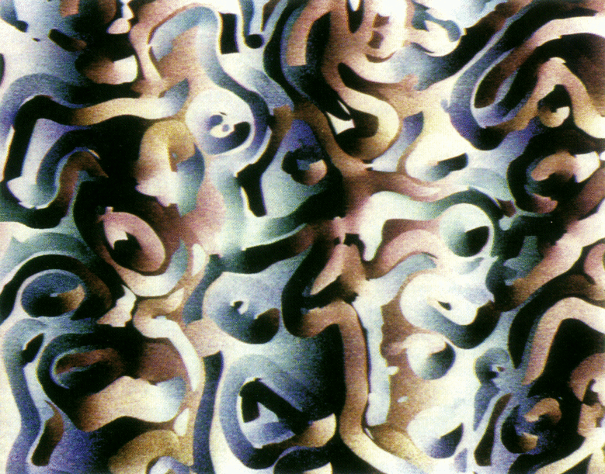

Slide 41
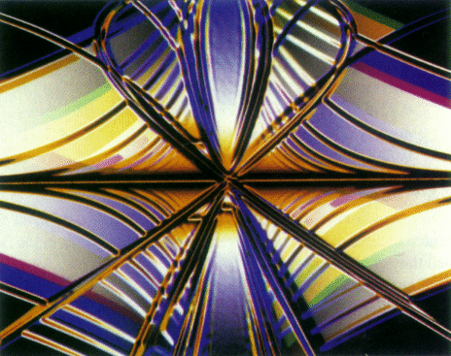

Slide 42
