Slide 1
Statistical Natural Language Processing
Richard Khoury
12 March 2015

Slide 2
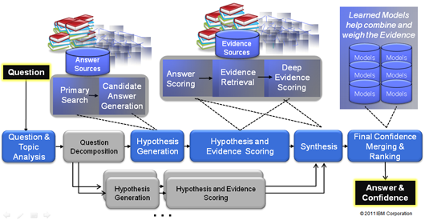
Objectives
Overview of standard NLP techniques
Build a question-answering AI
Text Representation → Classification → Information Retrieval → Question-Answering

Slide 3
Natural Language Processing
Branch of AI that makes computer agents that can “use” human languages
Automated translation
Automated summary
Text classification & clustering
Text generation
Speech understanding & generation
Author recognition
Information retrieval & question-answering
Sentiment detection
Event detection in social media
Spam filtering
Digital assistants
Etc.

Slide 4
Statistical NLP
Uses corpus of language to learn typical usage probabilities
Develop algorithms that make best (e.g. most probably correct) decision
Other alternatives:
Neural network NLP
Rule-based NLP
Fuzzy NLP

Slide 5
Statistical NLP
Modelling language use with probabilities
“But I don’t count probabilities when I talk!”
Actually, you do…
Zipf’s law of least effort
People try to do the minimum amount of effort
But they are smart about it
If more effort now means much less effort later on, they use effort now
So what is the effort to minimize when using language?

Slide 6
Least Effort in Language
Imagine two people
Tina talks all the time
Lester listens all the time

Slide 7
Least Effort in Language
What’s the effort in talking?
Choosing the words to say with the correct meaning
Least effort = one word with all meanings

Slide 8
Least Effort in Language
What’s the effort in listening?
Choosing the correct meaning of the words heard
Least effort = one meaning per word

Slide 9
Least Effort in Language
Tina and Lester have exactly opposite least efforts
But in real life, no one talks or listens all the time
Natural languages evolve to balance out effort of talking and listening

Slide 10
Least Effort in Language
Natural language have:
A few words that are used a lot and have flexible meanings
A lot of words that have precise meanings and are rarely used

Slide 11
Zipf-Mandelbrot Law
Count frequency of each word in a NL corpus of any language
Plot frequency rank × frequency count
Will create a power-law distribution
English: P = 10^{5.4}, ρ = 100, B = 1.15
Foundation of statistical NLP!
$$frequency=P{\left(rank+ρ\right)}^{−B}$$

Slide 12
Zipf-Mandelbrot Law (example)
Two articles from The Charlatan, 8 January 2014
“Sprott unveils new Master of Accounting program”
331 words
174 distinct words
122 words used once
“CUSA Midterm Review: have they kept their campaign promises”
611 words
250 distinct words
145 words used once

Slide 13
Zipf-Mandelbrot Law (example)
“Sprott unveils new Master of Accounting program”
“CUSA Midterm Review: have they kept their campaign promises”
Word | Frequency
the | 22
to | 13
program | 11
said | 9
of | 9
Herauf | 7
a | 7
students | 6
in | 6
professional | 6
by | 5
Word | Frequency
the | 35
to | 24
of | 19
and | 18
a | 16
CUSA | 15
is | 11
it | 10
Odunayo | 9
in | 9
students | 8

Slide 14
Zipf-Mandelbrot Law
A few words that are used a lot and have flexible meanings
10 most frequent words are 30% of each article
The (10 definitions), to (14 definitions), of (12 definitions), and (15 definitions)
Short list of stopwords that can be filtered out
A lot of words that have precise meanings and are rarely used
More than half the words used only once
Includes: campaign, faculty, graduate, administration, vegetables, president, education,…
And some exceptions!
Program, students, professional, CUSA, Herauf, Odunayo

Slide 15
Bag of Words
The “word + frequency” representation of text is the bag of words model
Assumes words are independent of each other
Assumes word order does not matter
Sometimes enhanced by including collocations: pairs of words used together (ex.: wall street, make up)
Creates the document vector
Word | Frequency
the | 22
to | 13
program | 11
said | 9
of | 9
Herauf | 7
a | 7
students | 6
in | 6
professional | 6
by | 5

Slide 16
Bag of Words Classification
Predicting the topic of a document given its words
Common task in NLP
Spam filtering, genre classification (libraries, websites), reading level assessment (education), etc.
Active research area
Supervised learning: Trained on correct examples
Training corpus of classified documents
AI learns features useful for classification

Slide 17
Bag of Words Classification
Training:
Build word list of entire corpus
Build bag of word for each category
Example
5 Charlatan articles each on sports & arts
“The best and brightest films of December”, “Aboriginal Service Centre hosts storytelling night”, “Author talks queerness in art history”, “Monthly concert series welcomes minors”, “Venus Envy hosts second dirty art show”, “Midseason review: Women’s hockey”, “Midseason review: Women’s basketball”, “Midseason review: Men’s basketball”, “Men’s hockey team edges York in exhibition play”, “Killeen practices with the Senators”
2418 instances of 1233 words
 | Art | Show | Films | Film | Ottawa | Years | Said | Ravens | Game | Team
Sports | 0 | 1 | 0 | 0 | 4 | 1 | 26 | 32 | 28 | 17
Arts | 24 | 11 | 8 | 6 | 9 | 1 | 30 | 0 | 2 | 2

Slide 18
Bag of Words Classification
Testing
Build word vector of new document d
Compute cosine similarity with vector of each category c
Classify into most similar category
$$w_{d}•w_{c}=w_{d,0}w_{c,0}+w_{d,1}w_{c,1}+...+w_{d,N−1}w_{c,N−1}$$
$$sim(d,c)=\frac{w_{d}•w_{c}}{‖w_{d}‖‖w_{c}‖}$$
$$‖w_{c}‖=\sqrt{w_{c,0}^{2}+w_{c,1}^{2}+...+w_{c,N−1}^{2}}$$

Slide 19
Bag of Words Classification
 | Art | Show | Films | Film | Ottawa | Years | Said | Ravens | Game | Team
Sports | 0 | 1 | 0 | 0 | 4 | 1 | 26 | 32 | 28 | 17
Arts | 24 | 11 | 8 | 6 | 9 | 1 | 30 | 0 | 2 | 2
Can we do better?
We already filter out stopwords (determiners, articles, and pronouns)
Group together different forms of same word
Word stemming: remove prefix, suffix and ending of words, keeping only stem or root
Add words missing from some documents
Expansion: Add synonyms, dictionary definitions, collocations, of keywords
Especially useful for short texts (e.g. query expansion)
Weight words
Tell apart significant and insignificant words

Slide 20
TF×IDF
Recall Zipf-Mandelbrot law
Significant words are generally rare words with unusually high occurrence in a document
So we need the general occurrence
Proportion of documents d in corpus C that contain word w
Inverse Document Frequency
And the occurrence in document d_{i}
Term Frequency
$$idf\left(w,C\right)=log\frac{|C|}{|w∈C|}$$
$$tf\left(w,d_{i}\right)=\frac{|w∈d_{i}|}{|d_{i}|}$$

Slide 21
TF×IDF
 | Art | Show | Films | Film | Ottawa | Years | Said | Ravens | Game | Team
Sports | 0 | 1 | 0 | 0 | 4 | 1 | 26 | 32 | 28 | 17
Arts | 24 | 11 | 8 | 6 | 9 | 1 | 30 | 0 | 2 | 2
 | Art | Show | Films | Film | Ottawa | Years | Said | Ravens | Game | Team
Sports | 0 | 0.15 | 0 | 0 | 0.61 | 0.15 | 4.00 | 13.32 | 4.30 | 2.61
Arts | 9.00 | 1.52 | 3.00 | 2.25 | 1.24 | 0.13 | 4.16 | 0 | 0.28 | 0.28
Computation notes:
|Sports| = 1147, |Arts| = 1271, |Corpus| = 3
Assume a 3rd category that is 0 everywhere
Otherwise log(2/2) = 0
Not an issue for real corpora
TF×IDF values ×10⁻³

Slide 22
Naïve Bayes Classification
Most popular alternative to bag of words
P(C)
Proportion of documents per category in the corpus
P(w_{d,i}|C)
Proportion of word w_{i} per category in the training corpus
Classify in most probable category
$$P\left(C|d\right)=P\left(C|w_{d,0},...,w_{d,N−1}\right)=P\left(C\right)\prod_{i=0}^{N−1}{P\left(w_{d,i}|C\right)}$$

Slide 23
Naïve Bayes Classification
$$P\left(C|d\right)=P\left(C|w_{d,0},...,w_{d,N−1}\right)=P\left(C\right)\prod_{i=0}^{N−1}{P\left(w_{d,i}|C\right)}$$
P(w_{i}|C) computed from observation in corpus
What if word w_{i} never occurs in a category?
Multiplication by zero!
Given most words occur rarely (recall Zipf-Mandelbrot), this will happen a lot
Probability smoothing: decreasing probability of observed words and distributing it to unobserved words

Slide 24
Information Retrieval
Retrieve text documents that contain a requested (query) information in a corpus
How?
Text classification (BoW or NB) identifies document topics and measures similarity of documents
IR Query = short document
Find most similar documents in corpus!

Slide 25
Information Retrieval
Massive and unstructured document corpus
Institutional databases, Internet collections, Wikipedia
How to speed up IR search?
Inverted index
Database with words as keys and documents as attributes
Faster retrieval of documents using keywords
Positional information
Position of words within document
Easier to retrieve collocations
Find documents with multiple keywords in proximity of each other

Slide 26
Information Retrieval
How to find and rank relevant documents?
Vector Space Model (VSM)
Most widely used IR method
Each document’s N-word-long bag-of-words is a vector in N-dimensional space
Cosine distance between query BoW and each document BoW
Most similar documents are most relevant
Can be made more accurate using TF×IDF, etc.
Inverted index useful to quickly find documents for cosine
word₀
d₀
query
d₁
d₂
word₁

Slide 27
Information Retrieval
Problem: short queries
Might not use same words as documents
Word co-occurrence
Some words are frequently used in the same context
If query has one word and document has the other, VSM won’t match them
 | d₀ | d₁ | d₂ | d₃ | d₄ | d₅ | d₆ | d₇ | d₈ | d₉
Art | 7 | 1 | 15 | 0 | 0 | 0 | 0 | 0 | 0 | 0
Show | 9 | 1 | 0 | 1 | 0 | 0 | 1 | 0 | 0 | 0
Films | 0 | 0 | 0 | 0 | 8 | 0 | 0 | 0 | 0 | 0
Ravens | 0 | 0 | 0 | 0 | 0 | 7 | 7 | 5 | 6 | 9
Game | 0 | 0 | 0 | 0 | 2 | 0 | 8 | 5 | 11 | 4
Team | 0 | 0 | 0 | 0 | 2 | 3 | 3 | 3 | 2 | 3

Slide 28
Information Retrieval
Solution: Latent Semantic Indexing (LSI)
Vector space with latent semantic dimensions
Co-occurring words projected into same dimension
Non-co-occurring words projected into orthogonal dimensions
Dimensionality reduction
VSM has N dimensions for N words
LSI has k dimensions for k semantic meanings
k << N

Slide 29
Information Retrieval with LSI
Singular Value Decomposition (SVD)
LSI computation method
Represents matrix A (in word space) as matrix Â (in semantic space)
Matrix A is the document/word matrix with N words and d documents
Matrix Â is the semantic space matrix with N words and d documents
Sorts Â dimensions by importance
Makes it easy to reduce by cropping less useful dimension

Slide 30
Information Retrieval with LSI
Visualizing SVD transformation
Semantic space
Documents
Word space

Slide 31
Information Retrieval with LSI
Reduced Singular Value Decomposition
One of many SVD algorithms
Document/word matrix A with N words/dimensions
Decompose matrix as
Rotates dimensions to orientation of largest variation
Matrix Σ contains ordered singular values measuring variation of each dimension
Keep k dimensions in Σ where Σ value > threshold
Keep only k dimensions with noteworthy variations
Rescale to k dimensions
Word/document matrix:
Document or IR query:
$$A_{N×d}=U_{N×d}Σ_{n×n}{\left(V_{d×n}\right)}^{T}$$
$$Â_{N×d}=U_{N×k}Σ_{k×k}{\left(V_{d×k}\right)}^{T}$$
$$A_{N×d}→Σ_{k×k}{\left(V_{d×k}\right)}^{T}=A′_{k×d}$$
$$q_{N×1}→{\left(U_{N×k}\right)}^{T}q_{N×1}=q′_{k×1}$$

Slide 32
Information Retrieval with LSI
Reduced SVD computation:
U is the eigenvectors of AA^{T} sorted by decreasing order of eigenvalue
V is the eigenvectors of A^{T}A sorted by decreasing order of eigenvalue
Σ Is the square roots of the eigenvalues sorted by decreasing order in a diagonal matrix
$$A_{N×d}=U_{N×d}Σ_{n×n}{\left(V_{d×n}\right)}^{T}$$

Slide 33
Information Retrieval with LSI
Reduced SVD example:
$$\begin{matrix} & A=\left[\begin{matrix} & d_{0} & d_{1} & d_{2} & d_{3} & d_{4} & d_{5} & d_{6} & d_{7} & d_{8} & d_{9} \\ \text{Art} & 7 & 1 & 15 & 0 & 0 & 0 & 0 & 0 & 0 & 0 \\ \text{Show} & 9 & 1 & 0 & 1 & 0 & 0 & 1 & 0 & 0 & 0 \\ \text{Films} & 0 & 0 & 0 & 0 & 8 & 0 & 0 & 0 & 0 & 0 \\ \text{Ravens} & 0 & 0 & 0 & 0 & 0 & 7 & 7 & 5 & 6 & 9 \\ \text{Game} & 0 & 0 & 0 & 0 & 2 & 0 & 8 & 5 & 11 & 4 \\ \text{Team} & 0 & 0 & 0 & 0 & 2 & 3 & 3 & 3 & 2 & 3\end{matrix}\right] & \\ AA^{T}=\left[\begin{matrix}275 & 64 & 0 & 0 & 0 & 0 \\ 64 & 84 & 0 & 7 & 8 & 3 \\ 0 & 0 & 64 & 0 & 16 & 16 \\ 0 & 7 & 0 & 240 & 183 & 96 \\ 0 & 8 & 16 & 183 & 230 & 77 \\ 0 & 3 & 16 & 96 & 77 & 44\end{matrix}\right] & \text{Eigenvalues}\text{ = }\left[\begin{matrix}455.58 & 294.40 & 70.95 & 64.32 & 50.45 & 1.30\end{matrix}\right] & A^{T}A=\left[\begin{matrix}130 & 16 & 105 & 9 & 0 & 0 & 9 & 0 & 0 & 0 \\ 16 & 2 & 15 & 1 & 0 & 0 & 1 & 0 & 0 & 0 \\ 105 & 15 & 225 & 0 & 0 & 0 & 0 & 0 & 0 & 0 \\ 9 & 1 & 0 & 1 & 0 & 0 & 1 & 0 & 0 & 0 \\ 0 & 0 & 0 & 0 & 72 & 6 & 22 & 16 & 26 & 14 \\ 0 & 0 & 0 & 0 & 6 & 58 & 58 & 44 & 48 & 72 \\ 9 & 1 & 0 & 1 & 22 & 58 & 123 & 84 & 136 & 104 \\ 0 & 0 & 0 & 0 & 16 & 44 & 84 & 59 & 91 & 74 \\ 0 & 0 & 0 & 0 & 26 & 48 & 136 & 91 & 161 & 104 \\ 0 & 0 & 0 & 0 & 14 & 72 & 104 & 74 & 104 & 106\end{matrix}\right] \\ U=\left[\begin{matrix}0.01 & −0.96 & 0.00 & 0.29 & −0.02 & 0.00 \\ 0.03 & −0.29 & −0.01 & −0.95 & 0.07 & 0.00 \\ 0.04 & 0.00 & −0.87 & 0.04 & 0.43 & −0.23 \\ 0.69 & 0.01 & 0.37 & 0.05 & 0.49 & −0.37 \\ 0.66 & 0.01 & −0.31 & −0.03 & −0.68 & 0.01 \\ 0.29 & 0.01 & −0.07 & 0.03 & 0.32 & 0.90\end{matrix}\right] & Σ=\left[\begin{matrix}21.34 & 0 & 0 & 0 & 0 & 0 \\ 0 & 17.16 & 0 & 0 & 0 & 0 \\ 0 & 0 & 8.42 & 0 & 0 & 0 \\ 0 & 0 & 0 & 8.02 & 0 & 0 \\ 0 & 0 & 0 & 0 & 7.10 & 0 \\ 0 & 0 & 0 & 0 & 0 & 1.14\end{matrix}\right] & V=\left[\begin{matrix}0.02 & 0.54 & 0.01 & 0.82 & 0.07 & 0.02 \\ 0.00 & 0.07 & 0.00 & 0.08 & 0.01 & 0.00 \\ 0.01 & 0.84 & 0.00 & −0.54 & −0.04 & −0.01 \\ 0.00 & 0.02 & 0.00 & 0.12 & 0.01 & 0.00 \\ 0.10 & 0.00 & 0.92 & −0.04 & 0.38 & 0.03 \\ 0.27 & −0.01 & −0.29 & −0.06 & 0.62 & −0.11 \\ 0.52 & 0.00 & 0.01 & 0.09 & −0.14 & −0.16 \\ 0.36 & −0.01 & −0.01 & −0.03 & 0.00 & −0.79 \\ 0.56 & −0.01 & 0.15 & −0.01 & −0.55 & 0.28 \\ 0.46 & −0.01 & −0.23 & −0.05 & 0.38 & 0.51\end{matrix}\right]\end{matrix}$$

Slide 34
Information Retrieval with LSI
Reduced SVD example: Rescaling into 2D
Simply crop matrices to k = 2!
$$U=\left[\begin{matrix}0.01 & −0.96 & 0.00 \\ 0.03 & −0.29 & −0.01\end{matrix} \begin{matrix}0.29 & −0.02 & 0.00 \\ −0.95 & 0.07 & 0.00\end{matrix}\right]$$
$$Σ=\left[\begin{matrix}21.34 & 0 \\ 0 & 17.16\end{matrix}\right]$$
$$V=\left[\begin{matrix}0.02 & 0.54 \\ 0.00 & 0.07 \\ 0.01 & 0.84 \\ 0.00 & 0.02 \\ 0.10 & 0.00 \\ 0.27 & 0.01 \\ 0.52 & 0.00 \\ 0.36 & −0.01 \\ 0.56 & −0.01 \\ 0.46 & −0.01\end{matrix}\right]$$

Slide 35
Information Retrieval with LSI
Rescaling word/document matrix to 2D
$$A′_{k×d}=Σ_{k×k}{\left(V_{d×k}\right)}^{T}$$
$$\begin{matrix}\begin{aligned} \\ =\left[\begin{matrix}21.34 & 0 \\ 0 & 17.16\end{matrix}\right]\left[\begin{matrix}0.02 & 0.00 & 0.01 & 0.00 & 0.10 & 0.27 & 0.52 & 0.36 & 0.56 & 0.46 \\ 0.54 & 0.07 & 0.84 & 0.02 & 0.00 & −0.01 & 0.00 & −0.01 & −0.01 & −0.01\end{matrix}\right]\end{aligned} \\ \begin{aligned} \\ \\ =\left[\begin{matrix} & d_{0} & d_{1} & d_{2} & d_{3} & d_{4} & d_{5} & d_{6} & d_{7} & d_{8} & d_{9} \\ \text{Dimension}\text{ 1} & 0.43 & 0.00 & 0.21 & 0.00 & 2.13 & 5.76 & 11.10 & 7.68 & 11.95 & 9.82 \\ \text{Dimension}\text{ 2} & 9.27 & 1.20 & 14.41 & 0.34 & 0.00 & −0.17 & 0.00 & −0.17 & −0.17 & −0.17\end{matrix}\right]\end{aligned}\end{matrix}$$

Slide 36
Information Retrieval with LSI
Rescaling IR queries to 2D
Query 1: 10x “game”
Query 2: 10x “show”
$${q′}_{k×1}={\left(U_{N×k}\right)}^{T}q_{N×1}$$
$$q_{1}^{′}=\left[\begin{matrix}0.01 & 0.03 & 0.04 & 0.69 & 0.66 & 0.29 \\ −0.96 & −0.29 & 0.00 & 0.01 & 0.01 & 0.01\end{matrix}\right]\left[\begin{matrix}0 \\ 0 \\ 0 \\ 0 \\ 10 \\ 0\end{matrix}\right]=\left[\begin{matrix} & \\ \text{Dimension}\text{ 1} & 6.60 \\ \text{Dimension}\text{ 2} & 0.10\end{matrix}\right]$$
$$q_{2}^{′}=\left[\begin{matrix}0.01 & 0.03 & 0.04 & 0.69 & 0.66 & 0.29 \\ −0.96 & −0.29 & 0.00 & 0.01 & 0.01 & 0.01\end{matrix}\right]\left[\begin{matrix}0 \\ 10 \\ 0 \\ 0 \\ 0 \\ 0\end{matrix}\right]=\left[\begin{matrix} & \\ \text{Dimension}\text{ 1} & 0.30 \\ \text{Dimension}\text{ 2} & −2.90\end{matrix}\right]$$

Slide 37
Information Retrieval with LSI
SVD example: Visualization into 2D
Easy to find relevant documents for IR using Euclidean distance, cosine similarity, clustering, etc.

Slide 38
Question Answering
IR: query is words, retrieved info is relevant documents
QA: query is question, retrieved info is answer found in relevant documents
Requires additional steps from IR
Question analysis
Precisely determine what is asked for
Passage retrieval
Find texts likely to contain answers
Answer selection
Pick the best answer from the passages
Answer presentation
Give the answer to the user

Slide 39
Question Analysis
AI needs to understand what user is asking about
What type of information?
About what subject?
Problem: Query is only a few words (1 to 4 on average after stopword removal)

Slide 40
Question Analysis
Question type or Answer type
What type of information is asked for?
E.g.: person, location, date, quantity, definition, yes/no, …
No standard type list
Not as simple as it sounds
“Who was Napoleon?” vs. “Who defeated Napoleon?”
“What French emperor was defeated at Waterloo?” vs. “What year was a French emperor defeated at Waterloo?” vs. “What was the Battle of Waterloo?”

Slide 41
Question Analysis
Question type classification approaches
Bayesian classification
Where P(C) is probability of a question type and P(w_{i}|C) is probability of a query word given a question type
Lexicon sorting keywords by query types
Classify question based on its keywords
Recall Zipf’s law: a few words are used most often; lexicon can work with only 100 common words
Pattern matching
“what {is|are} <noun phrase>” → Definition
Can match entire query or a subset of words (the informer span)
$$P\left(C|q\right)=P\left(C|w_{0},...,w_{N−1}\right)=P\left(C\right)\prod_{i=0}^{N−1}{P\left(w_{i}|C\right)}$$

Slide 42
Question Analysis
Dealing with few words: picking out important information
Named Entity Recognition (NER)
A proper named used in the query is usually very important
Compare words to database of NE (can be constructed from Wikipedia)

Slide 43
Question Analysis
Dealing with few words: inferring more words
Query expansion
Problem: “Who killed Abraham Lincoln?” and “President Lincoln was assassinated by John Wilkes Booth.” have only one word in common
Add more words in query to help IR
Add synonyms
Kill → murder, assassinate, take down, defeat
Problem: some words have multiple meanings
Lincoln → president, capital of Nebraska, mutton sheep

Slide 44
Passage Retrieval
We can already retrieve documents with IR
But for QA we need to retrieve specific passages with possible answers
“Who killed Abraham Lincoln?”
Answer is not Wikipedia page on Abraham Lincoln
Answer is not paragraph about Lincoln assassination
Answer is the passage “President Lincoln was assassinated by John Wilkes Booth.”
Different algorithms possible based on info available to us

Slide 45
Passage Retrieval (example)
If we have:
Important query keywords
From NER, word weights (e.g. TFxIDF), etc.
Inverted index & positional information
From IR: Index of corpus words linked to documents with exact position of word in document
Algorithm:
Window of words in document around each keyword

Slide 46
Passage Retrieval (example)
If we have:
Question patterns & correct pattern for query (from question type classification)
Relevant documents (from IR)
Algorithm:
Find matching answer patterns in document
Simple modification of question pattern
E.g.: “what {is|are} <noun phrase>” → “<noun phrase> {is|are} <answer>”
Can be enhanced with grammar rules, synonyms of less important words
“Who killed Abraham Lincoln” → “Abraham Lincoln was {killed|assassinated|murdered} by <answer>”

Slide 47
Answer Selection
Passage retrieval will generate a lot of passages
Some will have the same answer written differently
Some will have different/conflicting answers
Some are irrelevant
Problem: how to find the answer?
Need to rate confidence of individual passage
Need to compare/contrast different passages

Slide 48
Answer Selection
Passage / answer rating
Determine system confidence in individual answer
Does answer fit the question?
Important question words (especially named entities) appear in passage
Keywords in passage match question semantics (distance in ontology, WordNet)
Answer in passage match syntactic role in question
Does answer fit predicted answer type?
But the answer type classifier can make mistakes…
Geospatial & temporal relevance of answer
Useful for cell phone QA, virtual assistants, etc.

Slide 49
Answer Selection
Deal with same answer written differently
System needs lists of synonyms, abbreviations, idioms, alternate spellings, etc.
Merge together answers & combine ratings
Can serve as democratic rating below
Deal with different/conflicting answers
Answer rating includes answer frequency
Democratic: correct answer is most frequently cited in different sources
But don’t score same source multiple times!
Answer rating includes source reliability
Elitism: answer from trusted source is correct one

Slide 50
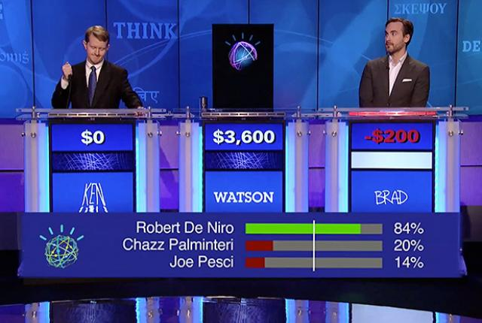
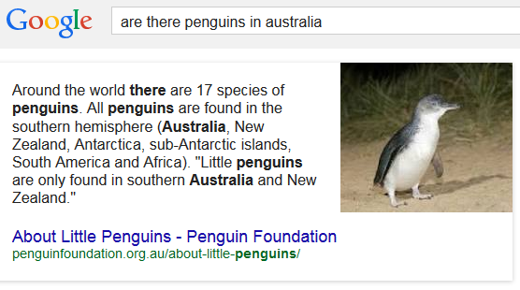
Answer Presentation
What is returned by QA system?
Single best answer vs. list of possible answers
Include or not confidence rating of answers
Include or not sources of answer
Reword answer properly or copy-paste text

Slide 51
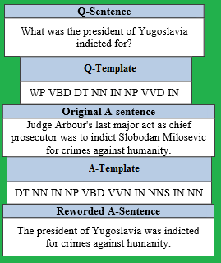
Answer Presentation
How to reword answers properly
Syntactic answer templates
Detect question syntax
Words’ part-of-speech and word order
Corresponding answer template filled it from question and answer words
Advantage: human-like answers
Semantic answer templates
Tag semantic content in answer
E.g. core answer, complementary information, justifications, constraints, etc.
Template selects which content to display and where
Advantage: can be tailored to devices or needs without losing critical info

Slide 52
Example of QA Systems: IBM Watson
Passage retrieval contains correct answer for 85% of questions in top 250 candidates
Evidence: passage search featuring candidate answer in context of question
Aggregate score of 50 features including taxonomy, geospatial, temporal, source reliability, gender, name consistency, relation, passage support, etc.
Query parsing, semantic role labelling, NER, etc.
Special type of question analysis to handle Jeopardy clues
Merge multiple instances of same answer

Slide 53
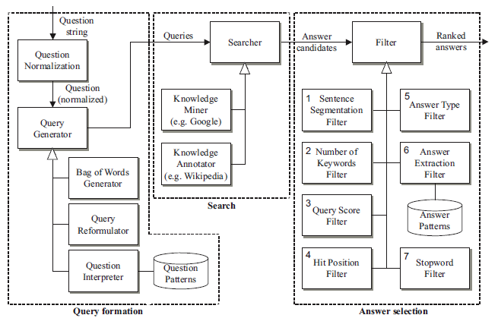
Example of QA Systems: Ephyra
Ephyra uses “filters” for answer selection
Selection and order can be changed

Slide 54
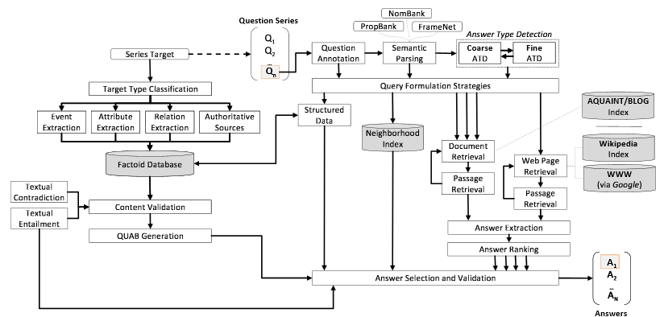
Example of QA Systems: LCC Chaucer-2
2nd place in TREC 2007 QA competition
Series of queries on each topic

Slide 55
Summary: Natural Language Processing
Zipf-Mandelbrot Law
Bag of Words representation
Stopwords, word stemming, collocations, TFxIDF
Classification
Bag of Words & cosine distance, Naïve Bayes
Information retrieval
Inverted index, Vector Space Model, Latent Semantic Indexing, text segmentation
Question Answering
Question analysis, passage retrieval, answer rating, answer presentation, examples

Slide 56
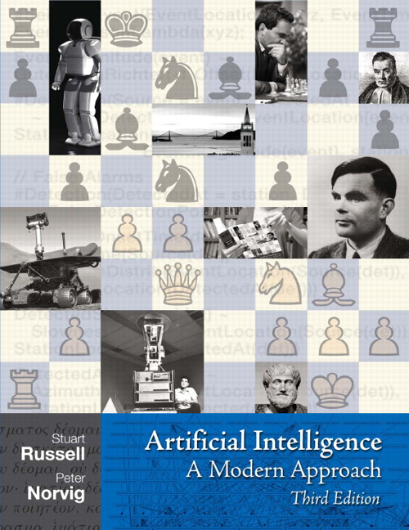
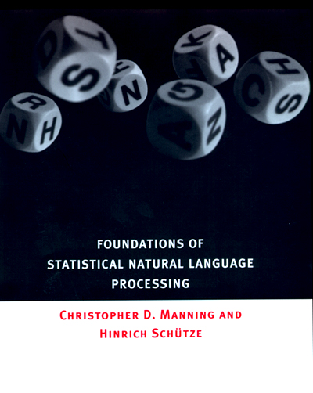
Further Readings

Slide 57
Further Readings
U. Côté Allard, R. Khoury, L. Lamontagne, J. Bergeron, F. Laviolette, and A. Bergeron-Guyard, “Optimizing Question-Answering Systems Using Genetic Algorithms”, FLAIRS-28 (2015).
F.B. Dian Paskalis and M.L. Khodra, “Word sense disambiguation in information retrieval using query expansion”, ICEEI, pp. 1-6 (2011).
D. Ferrucci, E. Brown, J. Chu-Carroll, J. Fan, D. Gondek, A. A. Kalyanpur, A. Lally, J. W. Murdock, E. Nyberg, J. Prager, N. Schlaefer, C. Welty, "Building Watson: An Overview of the DeepQA Project", AI Magazine, 31:3, pp. 59-79 (2010).
S. Harabagiu, D. Moldovan, M. Pasca, R. Mihalcea, M. Surdeanu, R. Bunescu, R. Gîrji, V. Rus and P. Morarescu. “FALCON: Boosting knowledge for answer engines”, Proceedings of TREC-9, pp. 479-488 (2000).
A. Hickl, K. Roberts, B. Rink, J. Bensley, T. Jungen, Y. Shi, J. Williams, “Question answering with LCC’s Chaucer-2 at TREC 2007”, Proceedings of TREC-16 (2007).
J. Luo, B. Meng and X. Tu “Selecting good expansion terms based on similarity kernel function”, NLP-KE, pp. 156-160 (2011).
B. Magnini, M. Speranza and V. Kumar. “Towards Interactive Question Answering: An Ontology-Based Approach”, IEEE ICSC '09, pp. 612-617 (2009).
B. J. Oommen, R. Khoury and A. Schmidt, “Text Classification Using Novel Anti-Bayesian Techniques”, ICCCI-7 (2015).
M. Razmara, A. Fee and L. Kosseim. “Concordia University at the TREC 2007 QA track”; Proceedings of TREC-16 (2007).
N. Schlaefer, R. Gieselmann, T. Schaaf, A. Waibel, A pattern learning approach to question answering within the Ephyra framework. LNAI, 4188:687-694. P. Sojka, I. Kopecek, K. Pala, (eds.): Springer. (2006)
D. Shen, R. Pan, J.-T. Sun, J.J. Pan, K. Wu, J. Yin, and Q. Yang. “Q2C@UST: our winning solution to query classification in KDDCUP 2005”, ACM SIGKDD, vol. 7, no. 2, pp. 100-110 (2005).
S. Song and Y.-N. Cheah, “An unsupervised center sentence-based clustering approach for rule-based question answering”, IEEE ISCI, pp. 125-129 (2011).

Slide 58
Thank You

