Slide 1
COMP 4106
Flocking and Particle Swarm Optimization

Slide 2
Collection Motion: Flocking
Notes:
Flocking is pervasive. We find it in fish, humans and caribou. It is everywhere.
It is believed to be advantageous because predators can’t easily “sneak up on us”.
Valuable information from the environment is quickly shared between all members of society.

Slide 3
Rules Governing Collective Motion
Notes:
The rules are simple. They are implemented in the NetLogo model called “Flocking”

Slide 4
Flocking
Boids ‘87
Applications
  Animated short (SIGGRAPH ’87)
    Stanley and Stella in: Breaking the Ice
  Movies
    1992 Tim Burton film Batman Returns – computer simulated bat swarms and penguin flocks
    Lion King – the stampede
Notes:
The YouTube movie shows boid-like flocking.
http://www.youtube.com/watch?v=3bTqWsVqyzE

Slide 5
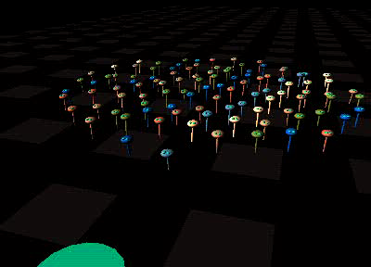
Object Avoidance
Notes:
Movie: 50s

Slide 6
Flocking Rules
Collision avoidance: avoid collisions with nearby flock members
Velocity matching: attempt to match velocity (speed and direction) with nearby flock members
Flock centering: attempt to stay close to nearby flock members
Notes:
There’s almost a zone in which repulsion occurs. Outside of this zone, attraction occurs. We see the term attraction-repulsion in the modelling literature.

Slide 7
Important Observations
It’s social.
Collective movement is emergent.
Flock members see only a neighbourhood; i.e., information exchange is localized.
Movement isn’t goal directed
Notes:
The NetLogo model doesn’t prefer any direction; however, a direction does emerge when the flock eventually emerges.

Slide 8
Influencing the Flock
Movement can be influenced.
Couzin/Krause showed only modest % of flock need a goal in order to make others follow.
Notes:
The remarkable result (rather like the binary bridge) is that the flock will make a choice if the difference between the various choices as represented by the subgroups with choice information is big enough.

Slide 9
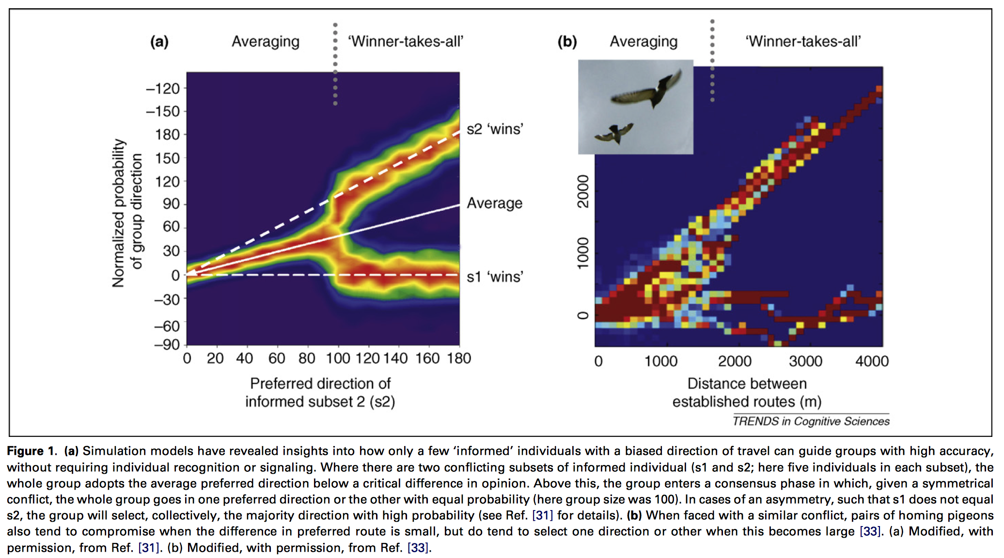
Influencing the Flock
Notes:
Figure 1a is the significant modelled result here. The Fig. 1 caption says it all. Fig. 1b represents experimentally-observed data.

Slide 10
Using the metaphor
Flock members are particles
Environment is n-dimensional space
N dimensions represent features of problem; e.g., an R^{N} function
Particles move through space, following a leader
Influenced by “neighbors”

Slide 11
PSO Introduction
Why “Particle”?
  Reynolds compared his distributed behavioral model of flocks, herds and schools to particle systems in computer graphics which are composed of individual agents, each with its own behaviour.
PSO is based on attempts to mathematically model the social behaviour of various biological creatures
  schools of fish (Breder, 1954)
  societies of people (Latané, 1981)
  flocks of birds (Reynolds, 1987)

Slide 12
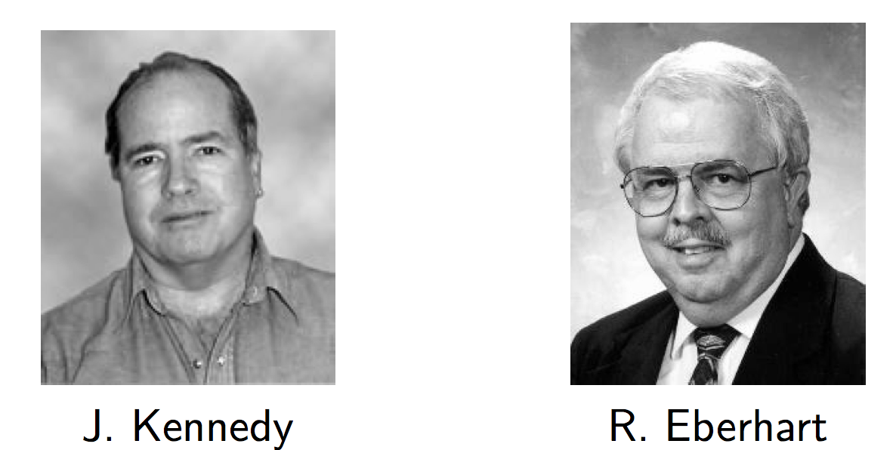
The Inventors
Notes:
PSO “invented” mainly by two people.
The first one is Russ, he is professor at the Purdue School of Engineering and Technology, in Indianapolis.
Co-author of Computational Intelligence PC Tools, published by Academic Press Professional in 1996, and also co-author of Swarm Intelligence, published by Morgan Kaufmann in 2001.

Slide 13
Part 1: United we stand
It’s a population-based or social search process
Notes:
The big boss told you to explore this nice search space for, say, find the highest summit. Unfortunately your team is quite ridiculous: just one stupid guy. Morever he does not like very much to be ordered.
So you moan “I can’t do the job, give me more people”. OK, OK, no problem, here is another one. Just like the previous one, though.
The question is “can you really use such a team?”. And the answer is “yes”, if you are able to define an extremely small set of extremely simple rules so that team members can follow them and work together, without any foreman.
That is what PSO does. Like, say, Genetic algorithms, PSO is a population based method, but unlike GAs, the underlying metaphor is cooperation instead of rivalry.
Nevertheless, there is, if I dare say, a kind of convergent evolution, for, on the one hand, some GAs do reduce pressure selection by using nesting and, on the other hand, some PSO variants do use selection to permanently update some parameters, like, typically, swarm size.
If we have time, we will see such variants, but, for the moment, we are just trying to understand the basic principles.

Slide 14

Cooperation example
We exchange information regarding
how well our search is going.
Notes:
To illustrate what “cooperation” means in PSO, here is a simplistic example.
As usual, the big fish is difficult to catch, hidden in the deepest part of the pond. At each time step, each fisherman tells to the other how deep the pond is at his place. At the very begininng, as the depths are quite similar, they both follow their own ways. Now, Fisherman 2 seems to be on a better place, so Fisherman 1 tends to go towards him quite rapidly. Now, the decision is a bit more difficult to make. On the one hand Fisherman 2 is still on a better place, but on the other hand, Fisherman 1’s position is worse than before. So Fisherman 1 comes to a compromise: he still goes towards Fisherman 2, but more slowly than before. As we can see, doing that, he escapes from the local minimum.
Of course, this example is a highly abstract one, but it presents the main features of a particle in basic PSO: a position, a velocity (or, more precisely an operator which can be applied to a position in order to modify it), the ability to exchange information with its neighbours, the ability to memorize a previous position, and the ability to use information to make a decision. Remember, though, all that as to remain simple.
Let’s now see more precisely these points.

Slide 15
Principles of Particle Behaviour (Kennedy, 1998)
Evaluate
  a particle evaluates its current situation
Compare
  a particle compares its current situation with those of neighboring particles
Imitate
  a particle tries to imitate those particles it perceives as being in a better situation
Notes:
After initialization, there are three processes involved in a PSO algorithm.

Slide 16
Continuous Particle Swarm
Proposed by Kennedy and Eberhart, 1995
  x_{i}(t) is where particle i is now
  p_{i} is a point where particle i was “happiest”
  p_{g} is where the “happiest” of the particles, in the neighborhood of i, was
  v_{i}(t) is the velocity of particle i
  φ₁ and φ₂ are uniformly distributed random numbers in [0, φ_{1,max}] and [0, φ_{2,max}] respectively
  Adjust Velocity:
  Change position:
Notes:
Pg represents the best value seen by members of the neighbourhood (however that is defined – more on that later).
The simplest neighbourhood is the whole flock; i.e., all of the particles.

Slide 17
Algorithm
Randomly place m particles in search space
Assign each particle a random velocity
For each iteration:
  Update p_{g} and p_{i} for each particle
  Compute new velocity for each particle based on locations of p_{i} and p_{g} and particle’s previous velocity
  Update each particle’s position
Notes:
Algorithmic specification of the 3 processes.
P_n = p_g (for single neighborhood)

Slide 18
Behaviour has 2 components
Individual
Social
Social because I get information shared from the neighbourhood.
NOTE: formula applies for a particle in N dimensions here; i.e.,
vector addition
Notes:
The first phi term represents the requirement that a particle search around the local best value.
The second phi term represents the requirement to move towards the region representing the best solution found.

Slide 19
Initialization. Positions and velocities
Notes:
Here you have another nice search space.
First step: you put some particles on it. You can do it at random or on a regular way, or both. How many? In practice, for most real problems with dimension between 2 and 100, a swarm size of 20 particles works quite well.
There are some mathematical ways to give an estimation, but a bit beyond the scope of this lecture. Also, as we will see some variants use an adaptive swarm size.
Second step: you define a velocity for each particle, usually at random. You can set all initial velocities to zero but, experimentally, it is usually not the best choice.
Remember that what we call “velocity” is in fact a move, just because time is discretized.

Slide 20
How to define the neighbourhood of a particle?
Everywhere
  All particles are in the neighbourhood of any given particle
Within a certain “distance”
  Euclidean distance, for example
A predefined set of particles
  Particle 5’s neighborhood includes particles 4 and 6, for example
Notes:
Neighbourhoods can be geographic or social. They can encompass ALL particles (although this doesn’t seem to be optimal).

Slide 21
Neighbourhoods
geographical
social
Notes:
Now, for each particle, we define what is called a neighbourhood. Although some variants use a “geographical” neighbourhood, that is to say compute distances and take the nearest particles, the most widely used neighbourhood is a “social” one: just a list of neighbours, regardless where they are.
So, you do not need to define a distance and that is a great advantage, for in some cases, particularly for discrete spaces, such a definition would be quite arbitrary.
Note that it can be proved (and it is intuitively quite obvious) that if the process converges any social neighbourhood tends to be also a geographical one.
Usually, in practice, social neighbourhoods are defined just once, at the very beginning, which is consistent with the principle “simple rules for simple agents”.
Now, the size of the neighbourhood could be a problem. Fortunately, PSO is not very sensitive to this parameter and most of users just take a value of 3 or 5 with good results.
Unlike for the swarm size, there is no mathematical formula, but like for the swarm size, there are some adaptive variants.

Slide 22
The circular neighbourhood
Particle 1’s 3-neighbourhood
1
8
2
7
3
Virtual circle
4
6
5
Notes:
The most commonly used neighbourhood is the circular one. The picture is almost self explanatory. Each particle is numbered, put on a virtual circle according to its number and the neighbourhood of a given particle is built by taking its neighbours on this circle.
An important point for rule simplicity is that each particle belongs to its neighbourhood. For example if a rule says “I have to check all my neighbours”, there is no need to add “and I have to check myself”. We will see that more precisely later.

Slide 23
Psychosocial compromise
My best perf.
i-proximity
p_{i}
Here I am!
The best perf. of my neighbours
x
p_{g}
g-proximity
v
Notes:
This may be the most important slide of this presentation, for it summarizes the core of the method.
Let’s take a bit time to comment it.
You are a particle.
You can compute how good your position is (that is to say you can compute the objective function at the place you are). You remember the best position you ever found (and the objective function value). You can ask your neighbours for this information they also have memorized, and choose the best one.
Now, you have three tendencies,
- audacious, following your own way (just using your own velocity)
- conservative, going back more or less towards your best previous position
- sheep-like, going more or less towards your best neighbour
What PSO formalizes is how to combine these tendencies in order to be globally efficient.

Slide 24
The historical algorithm
At each time step t
for each particle
Randomness inside the loop
for each component d
update the velocity
then move
Notes:
Here is the pseudo code of the algorithm.
As you can see the randomness is inside the loop on components.
As a result, when I say the particle is going towards its best previous position, it means in fact “towards a point which is around its best previous position”, that is to say a point within a given proximity.
And the same for the best previous position in the neighbourhood.
Let us see more precisely what it means.

Slide 25
Random proximity
Hyperparallelepiped => Biased
i-proximity
p_{i}
g-proximity
x
p_{g}
v
Notes:
Each random term defines a hyperparallelepiped inside the search space.
As you can see, it means that the “proximity area” around a given point is in fact biased (the point is not on the center). Nevertheless, the algorithm is so robust that it works quite good despite this bias, but, as you can guess, it can be improved by defining non biased proximities, namely hyperspheres. We can tell that the bias is increasing with the search space dimension.
In a way, this slide could be the end of the lecture, for you have now all what you really need to write your own Particle Swarm optimiser.
Now, of course, if you want to write a good one, some technical details are important. Also if you want to use PSO with non classical search spaces or non classical objective functions, discrete ones, in particular.
Before to see these points and some others, just have a look at a small animation.

Slide 26
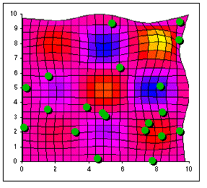
Animated illustration
Global optimum
Notes:
Run NETLOGO after slide.
At the very beginning, particles are randomly put on the search space.
There is just one global optimum and several local ones.
Watch the animation
As you can see, the particles are quite rapidly forming some sub swarms around sub optimums. As soon as a particle is quite near of the global optimum, the others go also towards it, so the probability to really find it does increase.
Of course, if the run shown in the animation was longer all particles would finally go towards this global optimum

Slide 27
Part 2: How to choose parameters
The right way
This way
Or this way
Notes:
I am sorry but in this part we have to do a bit more maths.
What I call here “parameters” are in fact just the coefficients in the formula which indicates how to update the velocity of a given particle.
Swarm size and neighbourhood size are also parameters but less important.
I mean you can perfectly use a swarm size of 20 and a neighbourhood of 3 for a large range of problems with good results.
On the contrary, PSO is more sensitive to the parameters we examine now.

Slide 28
PSO Issues
Prevent particle velocities from exploding
Decrease the probability of the particles getting stuck in “bad” local optima
Reduce the number of iterations required for a given quality of solution
Notes:
Velocity management is the main problem, although bias represents an issue too.

Slide 29
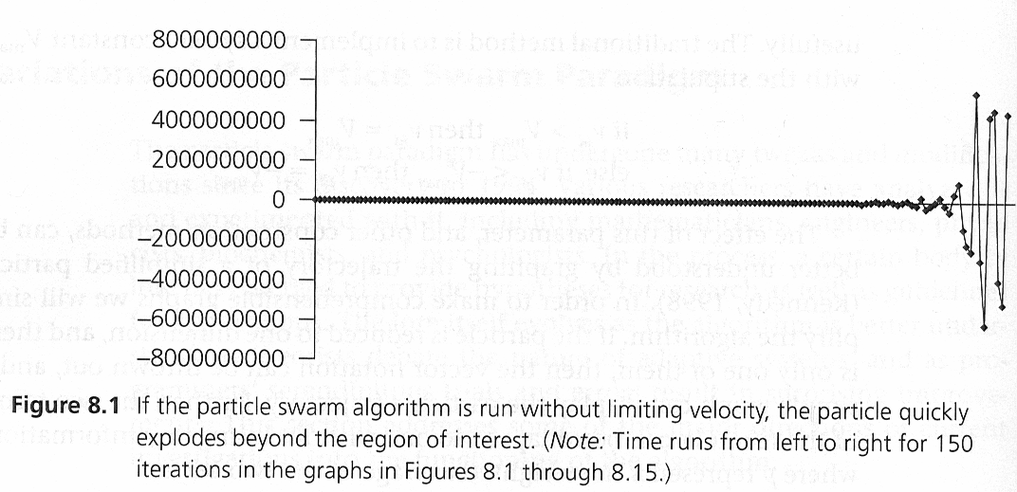
Variations: Prevention of Particle Explosion
It is possible, and undesirable, for |v_{id}| to become too large leading to instability
From Swarm Intelligence
Kennedy and Eberhart

Slide 30
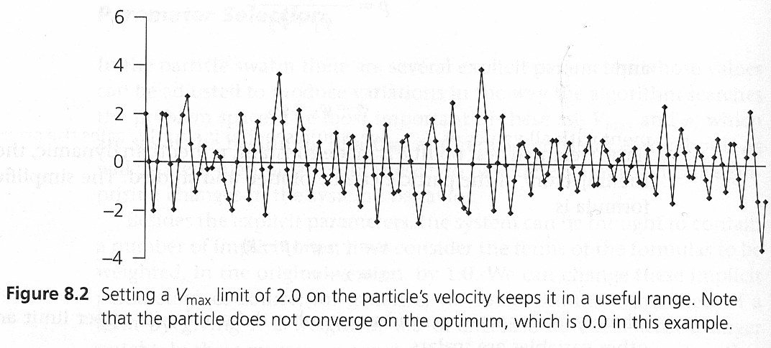
The simplest way to prevent the particle velocity from becoming too large is define a parameter V_{max} such that:
  if v_{id} > V_{max} then v_{id} = V_{max}
  if v_{id} < -V_{max} then v_{id} = -V_{max}
From Swarm Intelligence
Kennedy and Eberhart

Slide 31
Clerc and Kennedy, 2002, studied the effect of parameters φ_{1max} and φ_{2max} on v_{id}
  if (φ_{1max} + φ_{2max}) > 4 then a constrictor coefficient, χ, can be used to prevent velocity “explosion”
Notes:
This is called the Type 1” form.

Slide 32
Type 1” form
Global constriction coefficient
Usual values:
κ=1
ϕ=4.1
=> χ=0.73
swarm size=20
hood size=3
with
Non divergence criterion
Notes:
It can be proved that by using some constriction coefficients to modify the equations, your system won’t explode.
The most general form has 6 coefficients, but I show you here just an interesting particular case Clerc defined several years ago, among some others, and which has been used by Jim Kennedy for a lot of tests.
There are in fact just two parameters, called kappa and phi, and the global constriction coefficient khi is computed so that the system is non divergent.
Of course, as you know, it is usually impossible to prove that an algorithm like PSO, with some randomness, does converge towards the global optimum. Proofs show it converges towards something, but we only hope that thanks the interactions between particles this “something” is indeed a global optimum.
The good point is that we can easily tune the constriction coefficients so that the swarm has enough time to explore the search space without “exploding”.

Slide 33
5D complex space
A 3D section
ϕ
}
Convergence
}
Non divergence
Re(v)
Re(y)
Notes:
I don’t give any details here, but the behaviour of a particle is easier to describe in a 5 dimension complex search space.
Just for fun, I show you here a section of such a space. As you may notice, 4 is a phi value to avoid.
Non divergence means the particle in the phase space tends towards an attractor, whose shape can be perfectly described.

Slide 34
Move in a 2D section (attractor) for a single particle
Notes:
For example, we can see here such an attractor in the “velocity” plane of the phase space, that is to say the two coordinates are respectively imaginary and real parts of a given velocity component.
The circular move in the phase space is seen as an oscillating one in the real space.
If left alone, the particle does not converge. As I have said, it needs help of other particles. It is a bit more difficult to visualize, but convergence then means the radius of the attractor (which is here exactly a circle) tends towards zero.

Slide 35
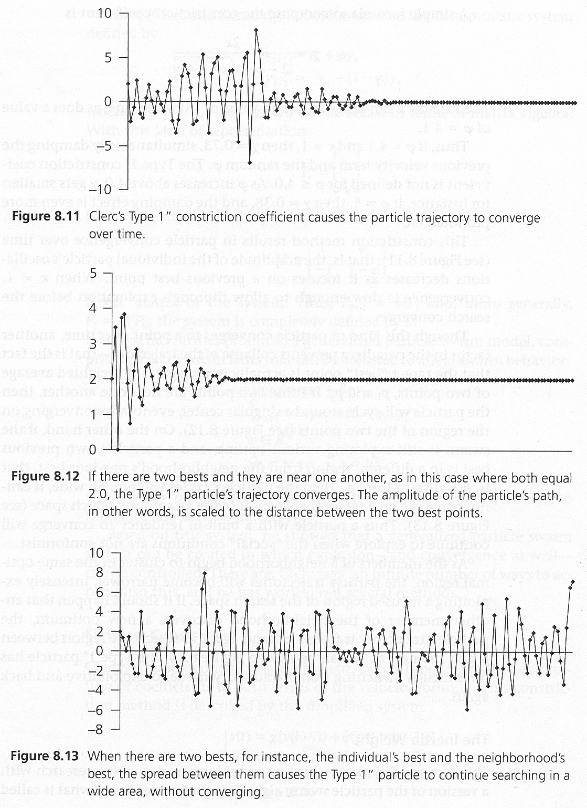
Single global optimum
Multiple optima
From Swarm Intelligence
Kennedy and Eberhart
Notes:
The graphs show empirically that the velocity is constrained. In the case of a single global optimum then it will converge to zero. If multiple global optima are present, then the velocity may oscillate.

Slide 36
Variations: Inertia Weight
A small generalization of the particle swarm investigated by Shi and Eberhart, 1998.
  each particle is given an adjustable inertia weight, w
  larger w → more global exploration
  smaller w → more local exploration
linearly decreasing w each iteration works well.
Notes:
Inertia

Slide 37
Functional Form: Inertia Factor
The following weighting function is usually utilized:
ω = ω _{max}-[(ω _{max}- ω _{min}) * iter]/maxIter
Where:
ω _{max} = initial weight,
ω _{min}= final weight,
maxIter = maximum iteration number,
iter = current iteration number.
ω _{max}
ω _{min}
0
maxIter
Notes:
Inertia decays to zero; i.e., we depend less and less on the velocity during the previous iteration.

Slide 38
Eberhart and Shi, 2000, compared the performance of 2 versions of the particle swarm:
Comparison method involved using each version to find the optimum of 5 functions:
  Sphere
  Rosenbrock
  Rastrigin
  Griewank
  Shaffer’s f6

Slide 39
Sphere:
Rosenbrock:
Rastrigin:
Griewank:
Shaffer’s f6:
Notes:
Other functions have been tested too. The state of the art is to use function generators which create classes of function.

Slide 40
Some functions ...
Griewank
Rastrigin
Rosenbrock
Notes:
Let us see now a few examples with some very well known test functions.
Of course far more tests have been done and there is now absolutely no doubt that PSO is efficient.

Slide 41
Constriction version performed better on all 4 functions.
Eberhart tried using V_{max} along with the constriction coefficient and found this improved the performance for solving 4 of the 5 problems
  V_{max} was set to the dynamic range of the variables

Slide 42
Zhang, Yu and Hu, 2003, proposed choosing w randomly each iteration, using the constrictor coefficient and V_{max}
  They used the Rosenbrock, Rastrigin and Griewank functions to test this method
  They found that this method performed better than linearly decreasing w for the Rosenbrock and Rastigrin functions
  Linearly decreasing w performed slightly better on the Griewank function

Slide 43
Variations: FIPS
FIPS: Fully Informed Particle Swarm (Mendes, Kennedy and Neves, 2004)
Let N_{i} be the set particles in the neighborhood of i
Notes:
We use ALL points in the neighbourhood, not just the best in the neighbourhood.
Remember LBT in ACO? This is similar.

Slide 44
The performance of FIPS was compared to that of PS with constrictor coefficient
  Sphere
  Rosenbrock
  Rastrigin
  Griewank10
  Griewank30
  f6
FIPS performed better on all functions

Slide 45
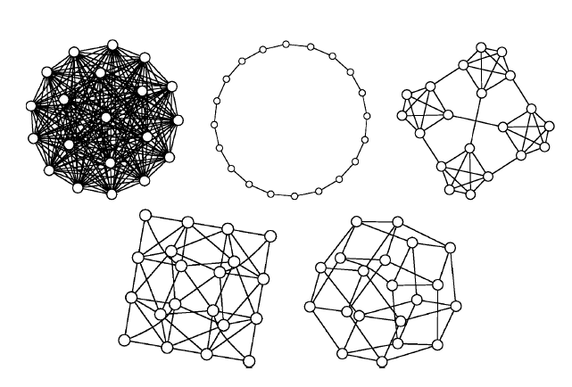
Variations: Neighborhood Topologies
Most topologies that are used in practice are fixed.
The topology used has a large impact on the performance of the particle swarm.
From Mendes, Kennedy and Neves, 2004
Notes:
Probably stop here.

Slide 46
Mendes, Kennedy and Neves, 2004, experimented with 5 different topologies (see figure on previous slide)
  They found FIPS performed best when using the square topology with each particle not in its own neighborhood
Mendes and Neves, 2004, experimented with 3289 topologies, with various statistics
  avg degree, avg path length, radius, diameter, clustering
  concluded that topologies with avg degree of 4 performed best

Slide 47
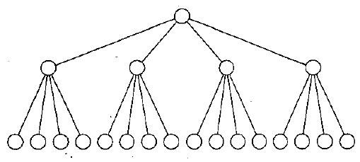
Janson and Middendorf, 2003, proposed a dynamic tree-like neighborhood topology, Hierarchical-PSO (H-PSO).
The neighborhood of each particle is itself and the particle that is immediately above it.
At each iteration, starting from the particle at the top
  compare each particle, i, with its immediate descendant, j.
  if i is worse than j then they exchange places in the tree.
  descend the tree in a breadth first fashion until all such pairs have been checked.
From Janson and Middendorf, 2003

Slide 48

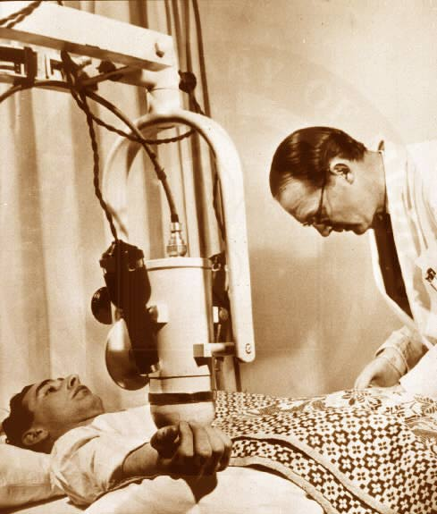

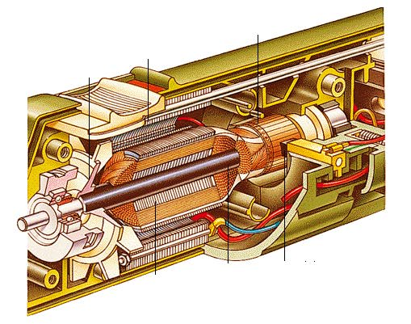
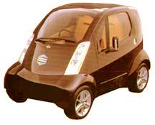
Applications
Medical diagnosis
Industrial mixer
Electrical generator
Electrical vehicle
Notes:
OK, all this is nice, but is PSO really used?
The answer is “Yes”.
Historically, PSO has been first proved to be far more efficient than back propagation to “teach” or “train” a neural network, typically from a few hours to a few minutes.
So it is not surprising that most of real applications are hybrid ones, using a neural network driven by a PSO algorithm.
It could almost be a rule: “if you have a system using a neural network, you can improve it by using also PSO”.

Slide 49
Applications
Cockshott A. R., Hartman B. E., "Improving the fermentation medium for Echinocandin B production. Part II: Particle swarm optimization", Process biochemistry, vol. 36, 2001, p. 661-669.
He Z., Wei C., Yang L., Gao X., Yao S., Eberhart R. C., Shi Y., "Extracting Rules from Fuzzy Neural Network by Particle Swarm Optimization", IEEE International Conference on Evolutionary Computation, Anchorage, Alaska, USA, 1998.
Secrest B. R., Traveling Salesman Problem for Surveillance Mission using Particle Swarm Optimization, AFIT/GCE/ENG/01M-03, Air Force Institute of Technology, 2001.
Yoshida H., Kawata K., Fukuyama Y., "A Particle Swarm Optimization for Reactive Power and Voltage Control considering Voltage Security Assessment", IEEE Trans. on Power Systems, vol. 15, 2001, p. 1232-1239.
Notes:
However, there are also some more recent applications using just PSO.
I show you here four references, so that you can have an idea of the diversity of the possible uses.
Don’t ask me what Echinocandin B exactly is, but the authors use PSO mainly for it gives very rapidly several solutions, just by modifying the random initialization.
It is far beyond the scope of this talk to explain the process involved here, but this is a classical optimisation problem: looking for the smallest set of smallest rules able to explain the behaviour of a neural network. The search space is extremely big, so PSO is used here for its speed.
From my point of view, the third one is the most interesting, for I had written the first PSO for TSP version two years ago. It was not very satisfying, and it couldn’t reach the level of the best specific algorithms. These military guys don’t think the same, for they have found a way to seriously improve my algorithm, and so that it runs about 80 times faster.
For the fourth one, one of the reasons the authors selected PSO was its capability to cope with to a non linear optimisation problem using both continuous and discrete variables.

