Slide 1
Camera Calibration
Dr. Gerhard Roth
Winter 2011

Slide 2
Finding camera parameters (intrinsic)
Can use the EXIF tag for any digital image
  Has focal length f in millimeters but not the pixel size
  But you can get the pixel size from the camera manual
  There are only a finite number of different pixels sizes because number of sensing element sizes is limited
  If there is not a lot of image distortion due to optics then this approach is sufficient (only linear calibration)
Can perform explicit camera calibration
  Put a calibration pattern in front of the camera
  Take a number of different pictures of this pattern
  Now run the calibration algorithm (different types)
  Result is intrinsic camera parameters (linear and non-linear) and the extrinsic camera parameters of all the images

Slide 3
Explicit camera calibration
Use a calibration pattern with known geometry
  In Opencv use a checkerboard
  Other systems use special targets with known 3d geometry
Write equations linking co-ordinates of the projected points, and the camera parameters
From images of the calibration target
  Intrinsic camera parameters
    (depend only on camera characteristics)
  Extrinsic camera parameters
    (depend only on position camera)
  In OpenCV the calibration process finds fx, fy, ox, oy, along with the distortion parameters
  We study a method that does not find the distortion parameters

Slide 4
Calibration using known 3d geometry
Use a calibration pattern with known 3d geometry (often a box, not planar)
Write projection equations linking known co-ordinates of a set of 3-D points and their projections and solve for camera parameters
Given a set of one or more images of the calibration pattern estimate
  Intrinsic camera parameters
    (depend only on camera characteristics)
  Extrinsic camera parameters
    (depend only on position camera)
We do not estimate distortion parameters

Slide 5
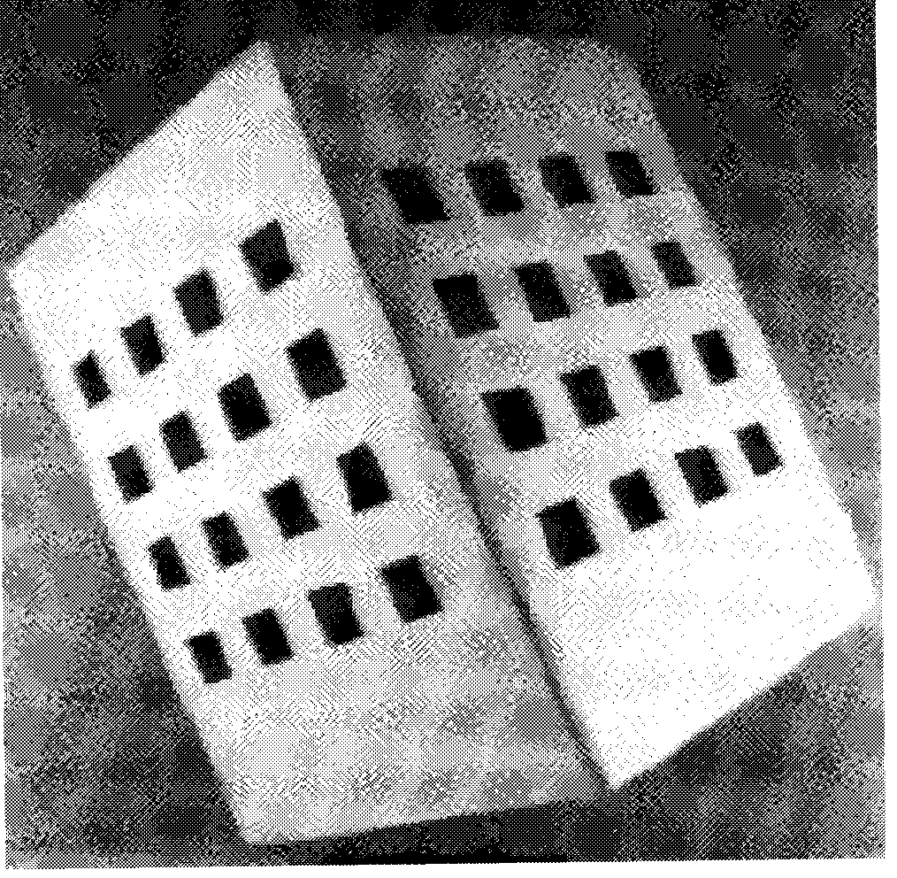
Estimating camera parameters
Projection matrix Calibration pattern

Slide 6
Camera parameters
Intrinsic parameters (K matrix)
  There are 5 intrinsic parameters
  Focal length f
  Pixel size in x and y directions, sx and sy
  Principal point ox, oy
But they are not independent
  Focal length fx = f / sx and fy = f / sy
  Principal point ox, oy
  This makes four intrinsic parameters
Extrinsic parameters [R| T]
  Rotation matrix and translation vector of camera
  Relations camera position to a known frame
  [R|T] are the intrinsic parameters
Projection matrix
  3 by 4 matrix P =K [R | T] is called projection matrix

Slide 7
Projection Equations
Projective Space
  Add fourth coordinate
    Pw = (Xw,Yw,Zw, 1)^{T}
  Define (u,v,w)^{T} such that
    u/w =xim, v/w =yim
3x4 Matrix Eext
  Only extrinsic parameters
  World to camera
3x3 Matrix Eint
  Only intrinsic parameters
  Camera to frame
Simple Matrix Product! Projective Matrix M= MintMext
  (Xw,Yw,Zw)^{T} -> (xim, yim)^{T}
  Linear Transform from projective space to projective plane
  M defined up to a scale factor – 11 independent entries

Slide 8
Two different calibration methods
Both use a set of 3d points and 2d projections
Direct approach (called Tsai method)
  Write projection equations in terms of all the parameters
    That is all the unknown intrinsic and extrinsic parameters
  Solve for these parameters using non-linear equations
Projection matrix approach
  Compute the projection matrix (the 3x4 matrix M)
  Compute camera parameters as closed-form functions of M

Slide 9
Two different calibration methods
Both approaches work with same data
  Projection matrix approach is simpler to explain than the direct approach
Direct approach requires an extra step
  There are also other calibration methods
But all calibration methods
  Use patterns with know geometry or shape
  Take multiple views of theses patterns
  Match the information across the different views
Perform some mathematics to calculate the intrinsic and extrinsic camera parameters
We look at simplified case of only one view!

Slide 10
Estimating the projection matrix
World – Frame Transform
  Drop “im” and “w”
  N pairs (xi,yi) <-> (Xi,Yi,Zi)
Linear equations of m
  2N equations, 11 independent variables
  N >=6 , SVD => m up to a unknown scale

Slide 11
Homogeneous System
M linear equations of form Ax = 0
If we have a given solution x1, s.t. Ax1 = 0 then c * x1 is also a solution A(c* x1) = 0
Need to add a constraint on x,
  Basically make x a unit vector
Can prove that the solution is the eigenvector corresponding to the single zero eigenvalue of that matrix
  This can be computed using eigenvector of SVD routine
  Then finding the zero eigenvalue (actually smallest)
  Returning the associated eigenvector

Slide 12
Decompose projection matrix
3x4 Projection Matrix M computed previously
  Both intrinsic (4) and extrinsic (6) – 10 parameters
From M^ to parameters (p134-135)
  Find scale |γ| by using unit vector R₃^{T}
  Determine T_{z} and sign of γ from m₃₄ (i.e. q₄₃)
  Obtain R₃^{T}
  Find (Ox, Oy) by dot products of Rows q1. q3, q2.q3, using the orthogonal constraints of R
  Determine fx and fy from q1 and q2 All the rests: R₁^{T}, R₂^{T}, Tx, Ty
  Enforce orthogonality on R by using SVD

Slide 13
Rotation Matrices
Are special 3 by matrices R
Rows and columns of R are mutually orthogonal unit vectors
Each row and column has unit norm
Dot product of each row with others is zero
Dot product of each column with others is zero

Slide 14
Ensuring the orthogonality of R
The computation of R does not take into account explicitly the orthogonality constraints on R
The estimate of R cannot be expected to be orthogonal:
We can "enforce" the orthogonality on using SVD:
Replace D (singular values) with Identity Matrix I:

Slide 15
Direct Approach
Main steps
  (1) Assuming that o_{x} and o_{y} are known, estimate all the remaining parameters.
  (2) Estimate o_{x} and o_{y}

Slide 16
Projection Equations (book notation)
Projection equations (camera and world)
Calibration equations
Using the projection equations and camera calibration information we get:

Slide 17
Projection Equations (book notation)
3D point P in world reference frame is
are the co-ordinates of P in camera frame
Extrinsic parameters, apply rotation then translation

Slide 18
Projection Equations (book notation)
Now let
Now assume that Ox, and Oy are zero then
Remember that x, y are now pixel (not camera) co-ordinates

Slide 19
Projection Equations (book notation)
If there are N points, A is an N by 8 matrix
  Need to solve A v = 0 but require an extra constraints
  This is a homogenerous system with constraints

Slide 20
Estimating Camera Parameters
Using magnitude of we can determine

Slide 21

Estimating Camera Parameters
Determine r₃₁, r₃₂, r₃₃
  Can be estimated as the cross product of R₁ and R₂:
  The sign of R₃ is already fixed (the entries of R₃ remain unchanged if the signs of all the entries of R₁ and R₂ are reversed).

Slide 22
Estimating Camera Parameters
Determine the sign of γ
  Consider the following equations again:

Slide 23
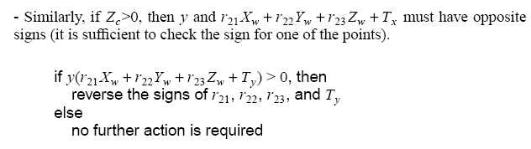
Estimating Camera Parameters
Must do more work to compute Tz and fx, and also to find Ox, Oy

Slide 24
Calibration Summary
Comparison of methods
  Direct approach requires extra step to find Ox, Oy
  Projection approach finds Ox, and Oy at same time
    Is simpler mathematically than the direct approach
  Both methods require a refit to find a “valid” R matrix
There are other calibration methods
  Zhang approach uses flat plane (implemented in OpenCV)
  Plane must be flat, but do not need 3D co-ordinates
But all calibration methods
  Have some known targets with known 3D geometry or shape
  Take a number of images of these targets
  From these measurements calculate the camera partakers
  Are essential for further processing like reconstruction

Slide 25
Multiple View/Camera Calibration
Previous math describes the calibration process for a single image
  We usually take multiple images of the same calibration target (from a variety of different views)
  Simultaneously find all extrinsic parameters and all the intrinsic parameters of the single camera
Also calibrate radial distortion using fact that there are straight lines in the pattern
OpenCV code can do this using a checkerboard pattern
Zhang’s algorithm is used most in practice

Slide 26
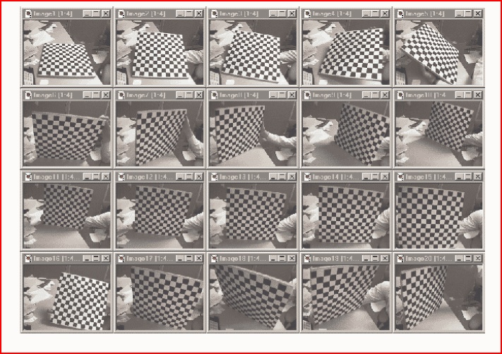
Input set of 2d Calibration Patterns

Slide 27
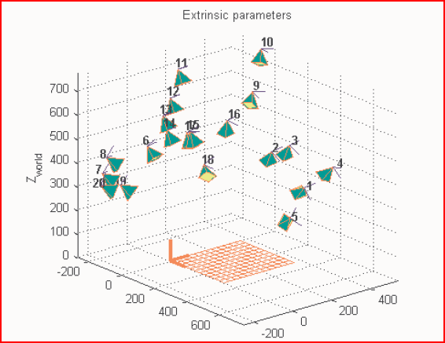
Final Camera positions and the pattern

