Slide 1
Contemporary applications

Slide 2
The state-of-the-art of health technologies
From telemedicine to digital therapeutics
Telemedicine
Telephone for nurses
Electronic Medical Record
“Heartphone”
Initially, only innovative resources for the transmission of clinical data (e.g., teleradiology)
The first technologies at the service of medicine
eHealth
- Mobile applications for monitoring and adherence to therapies
- Virtual worlds for consultation; Virtual Reality for rehabilitation; etc.
Digital resources help the patient keep track of therapies and health status
Healthcare technologies in the hands of the patient
Digital Therapeutics
Efficacy proven by controlled trials
They are prescribed by the doctor, deducted from the health insurance
Prime examples are Reset for addictions, BlueStar for diabetes
The FDA now recognizes some apps as digital drugs
technologies or drugs?

Slide 3
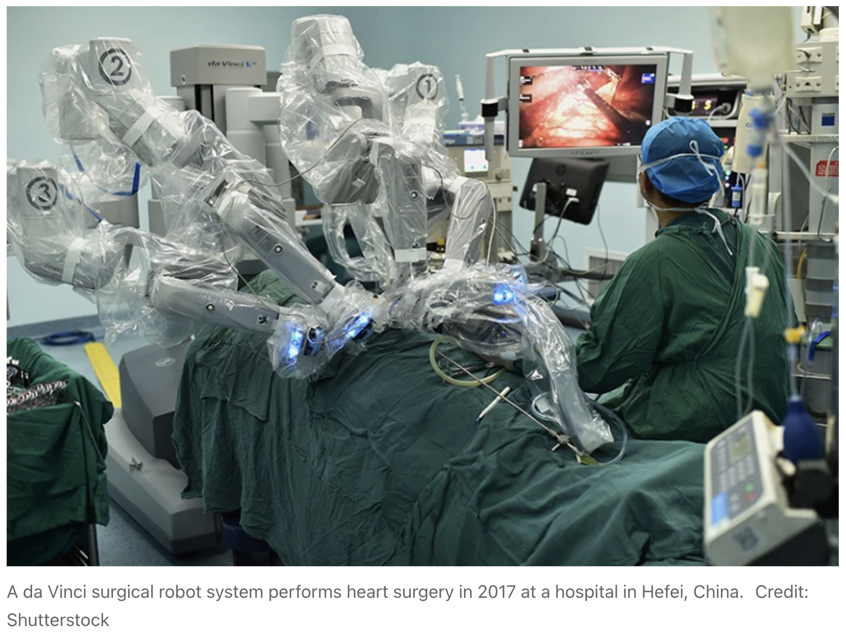
Virtual | Physical
Electronic health records Machine-learning for guiding treatment decisions | Robotic assistance in interventions Intelligent prostheses Elderly care
© iStock/elenabs
Based on Amisha et al. (2019)
Notes:
https://www.ncbi.nlm.nih.gov/pmc/articles/PMC6691444/

Slide 4
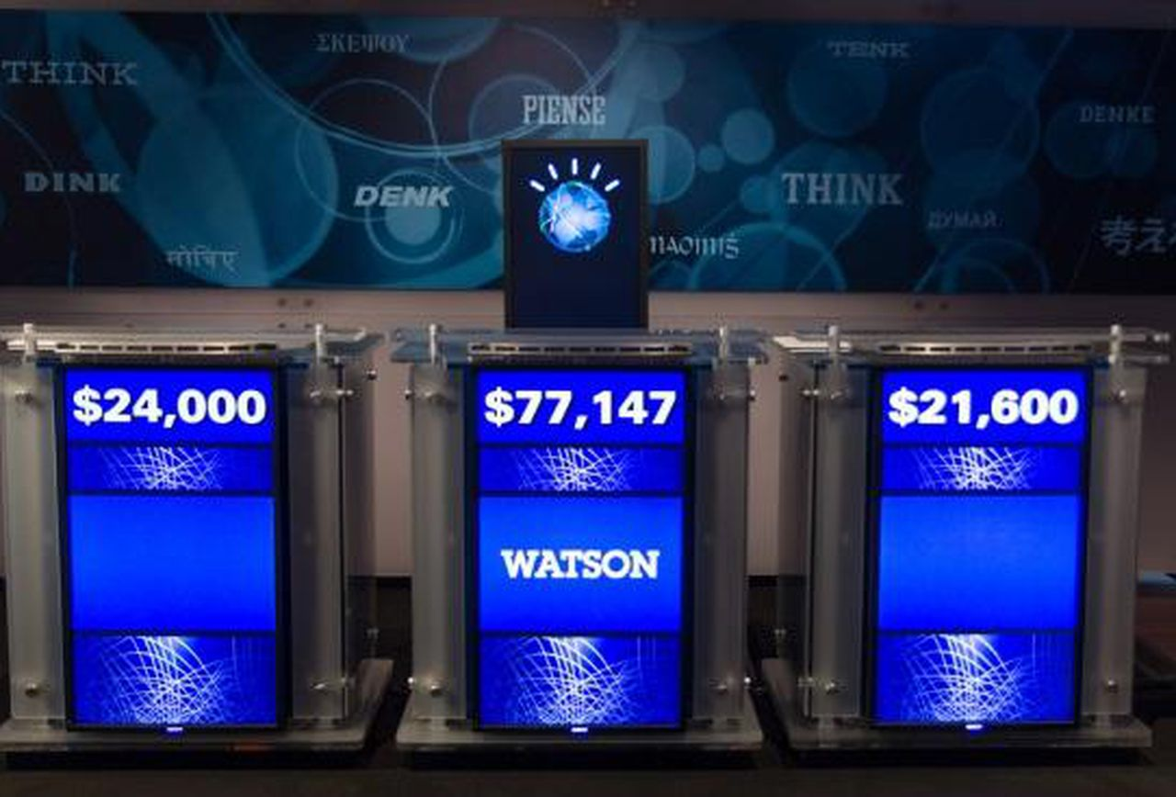
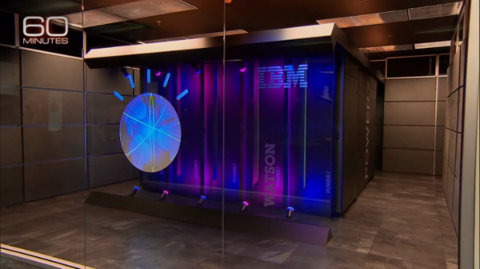
Watson for oncology
IBM's Watson is known for beating human gamers on TV quiz shows by showing that it understands natural language.
Today, Watson for Oncology helps clinicians identify personalized treatment pathways for patients:
It reads about 8,000 articles a day
It integrates and compares patients’ records
But it also makes mistakes; for example, in some studies, it appears biased on some variables or contexts

Slide 5
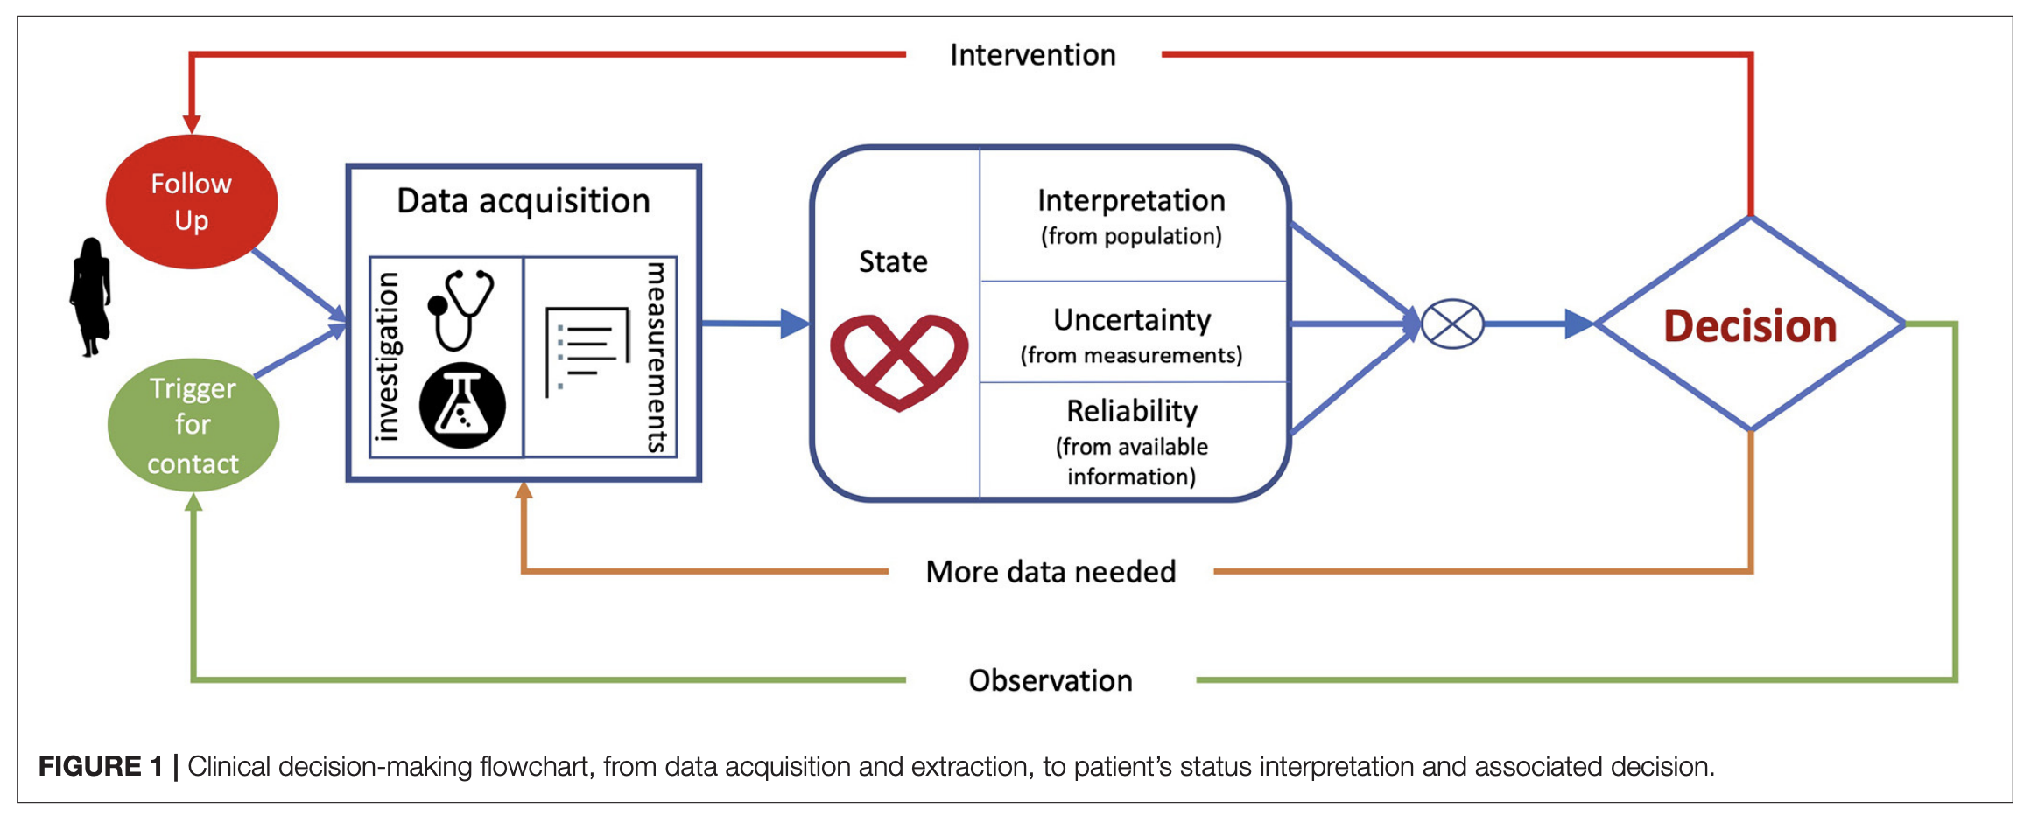
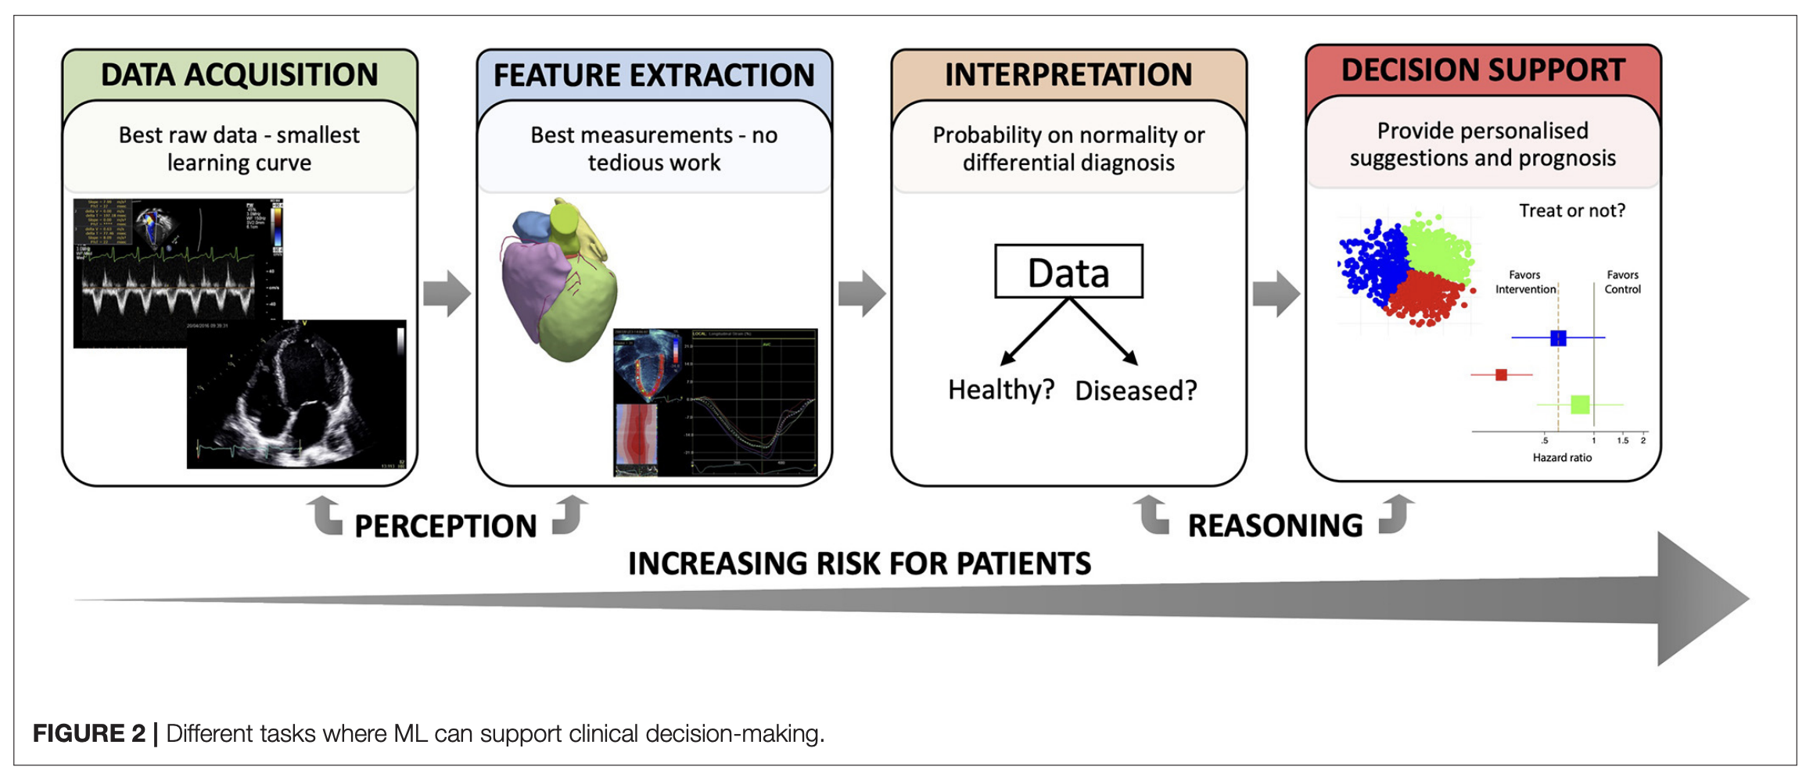
Clinical decision-making paradigm
Tasks that can be supported by AI (machine-learning)
Sanchez-Martinez et al. (2022)
Notes:
Deep learning in cardiology: https://www.frontiersin.org/articles/10.3389/fcvm.2021.765693/full

Slide 6
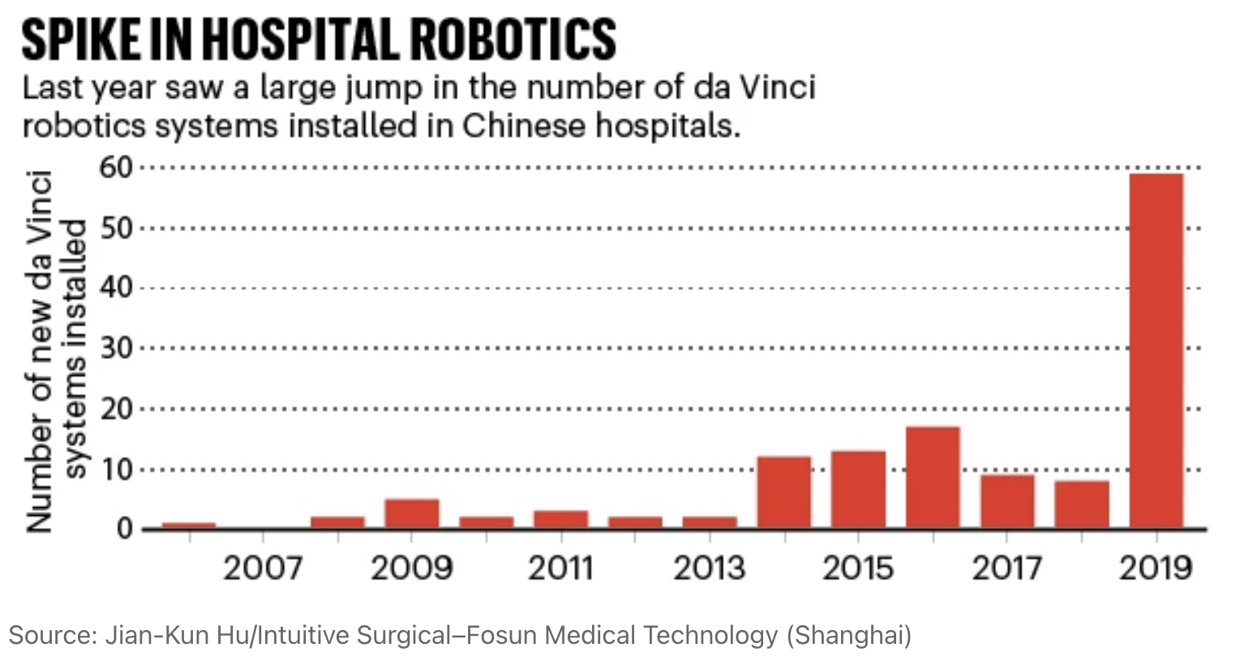
Sanchez-Martinez et al. (2022)
Notes:
See also: https://www.nature.com/articles/d41586-020-01795-7

Slide 7
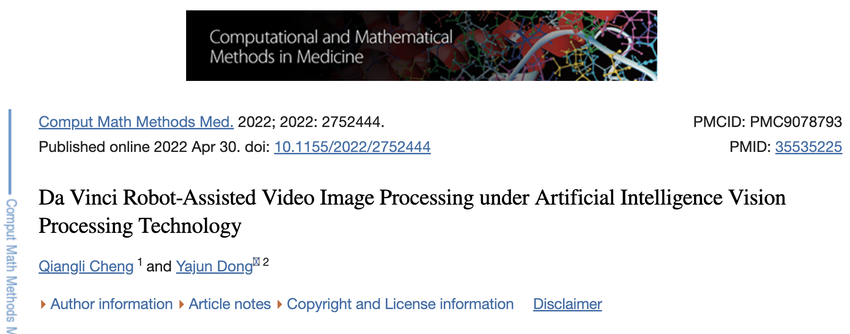
AI expectations in robotic surgery:
Learn from large sets of data
Recognise new trends
Relieve cognitive and physical stress
Redefine surgical care
Based on Nathan (2023)

Slide 8
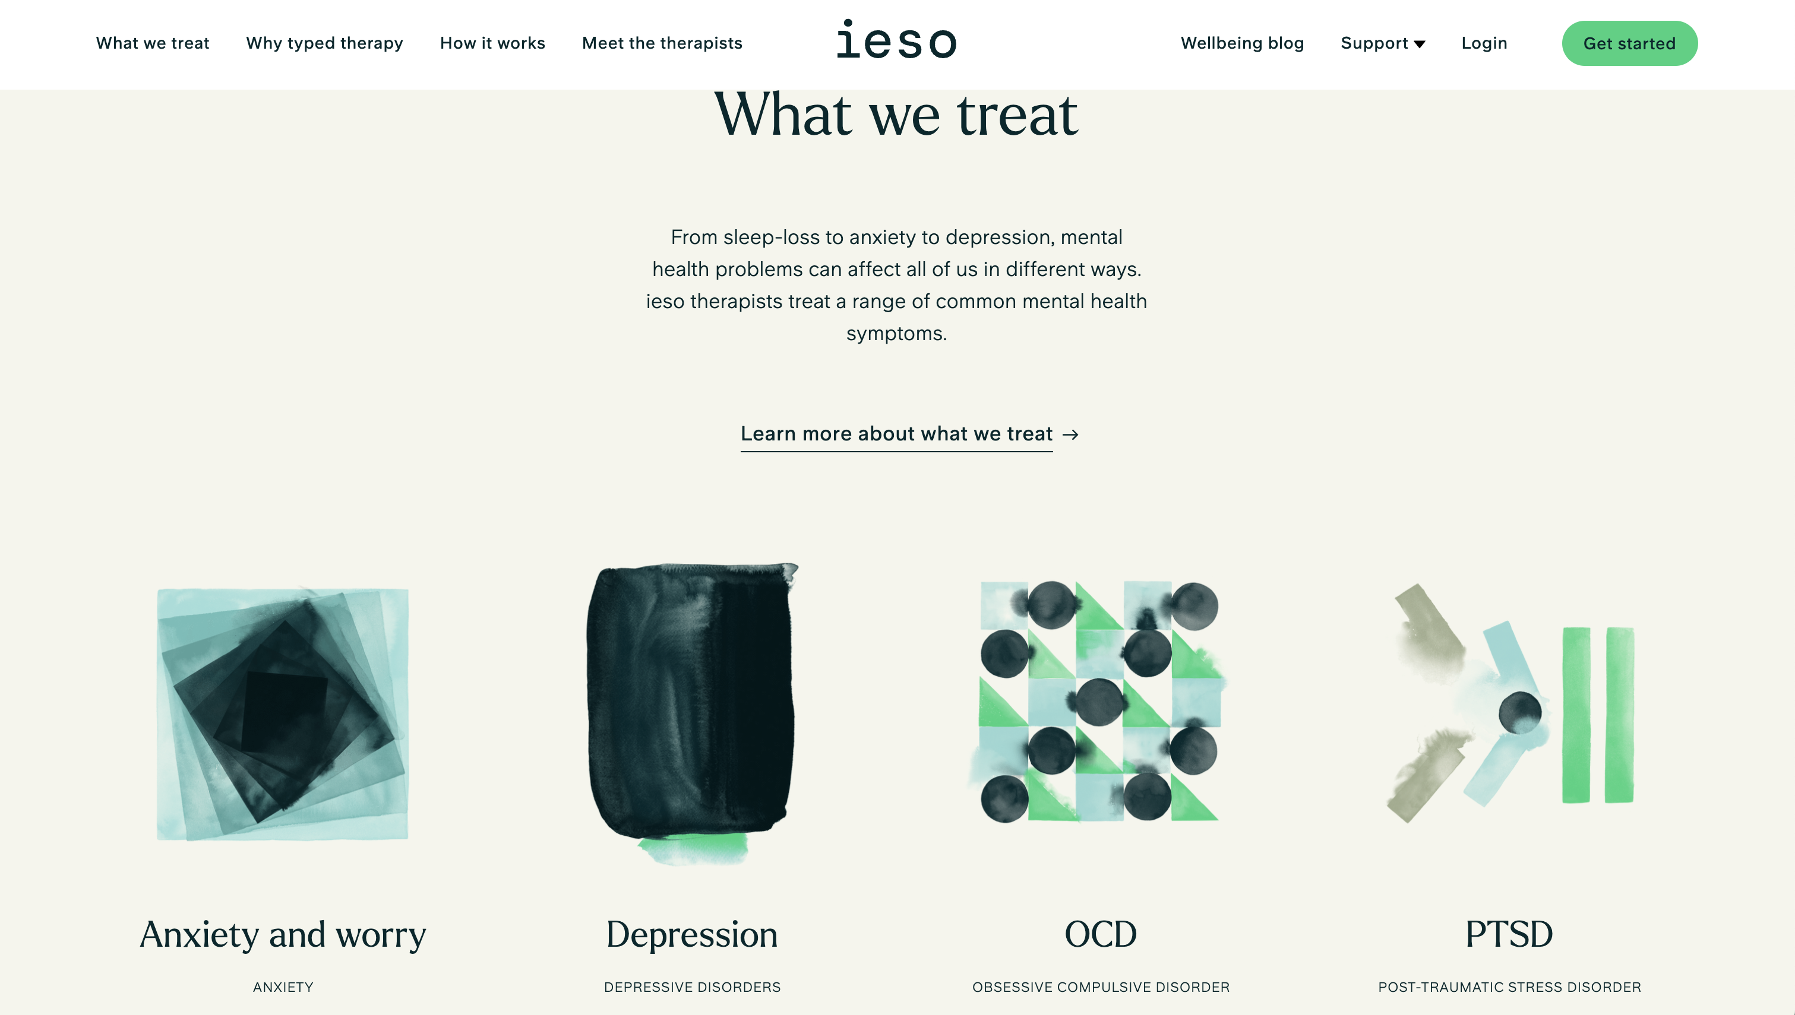
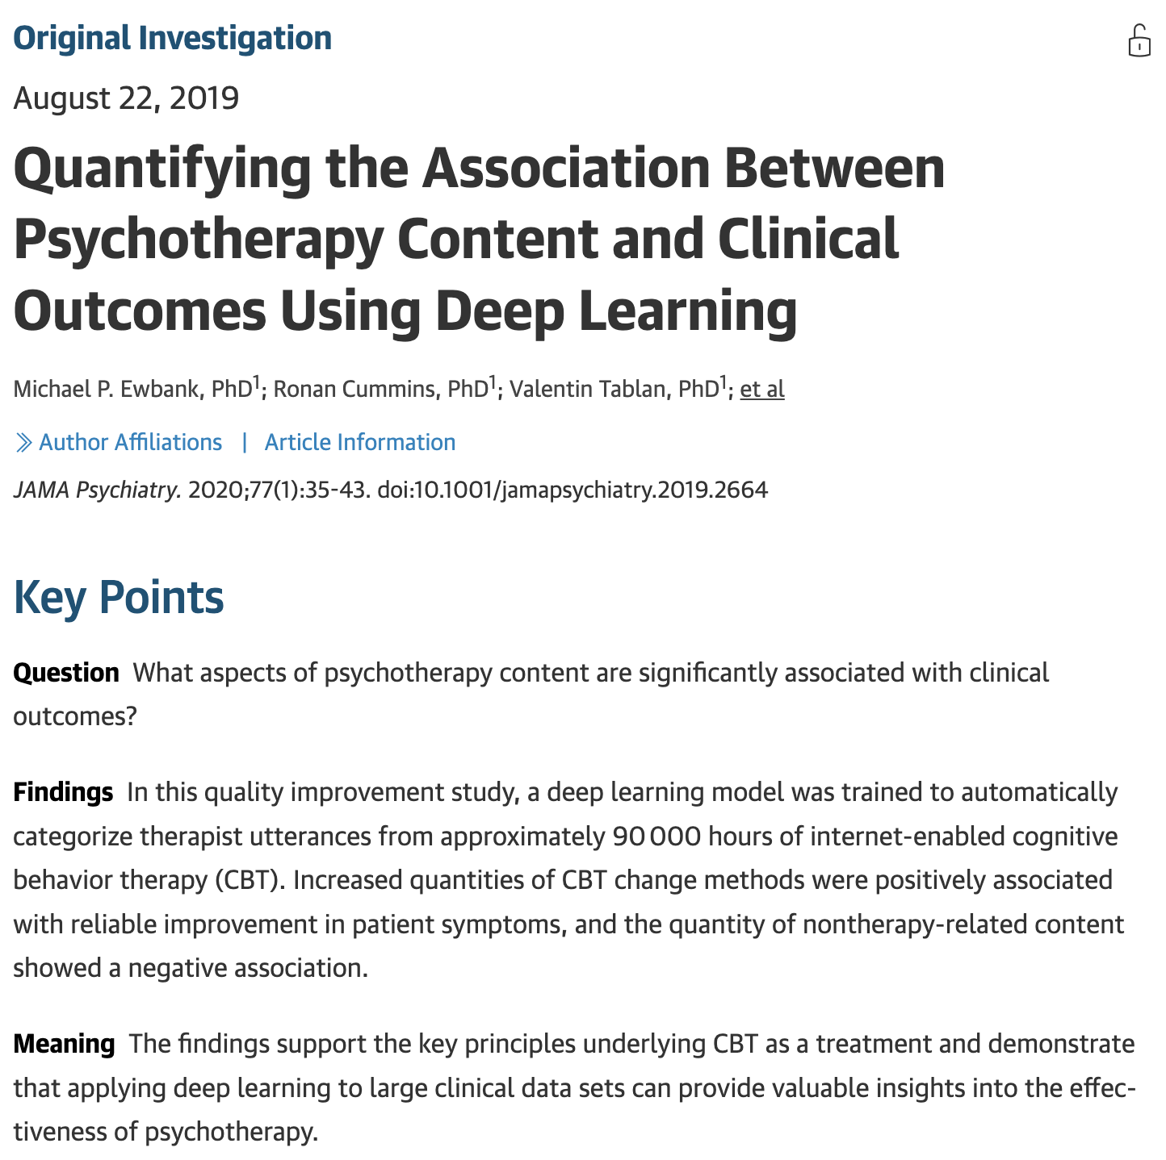
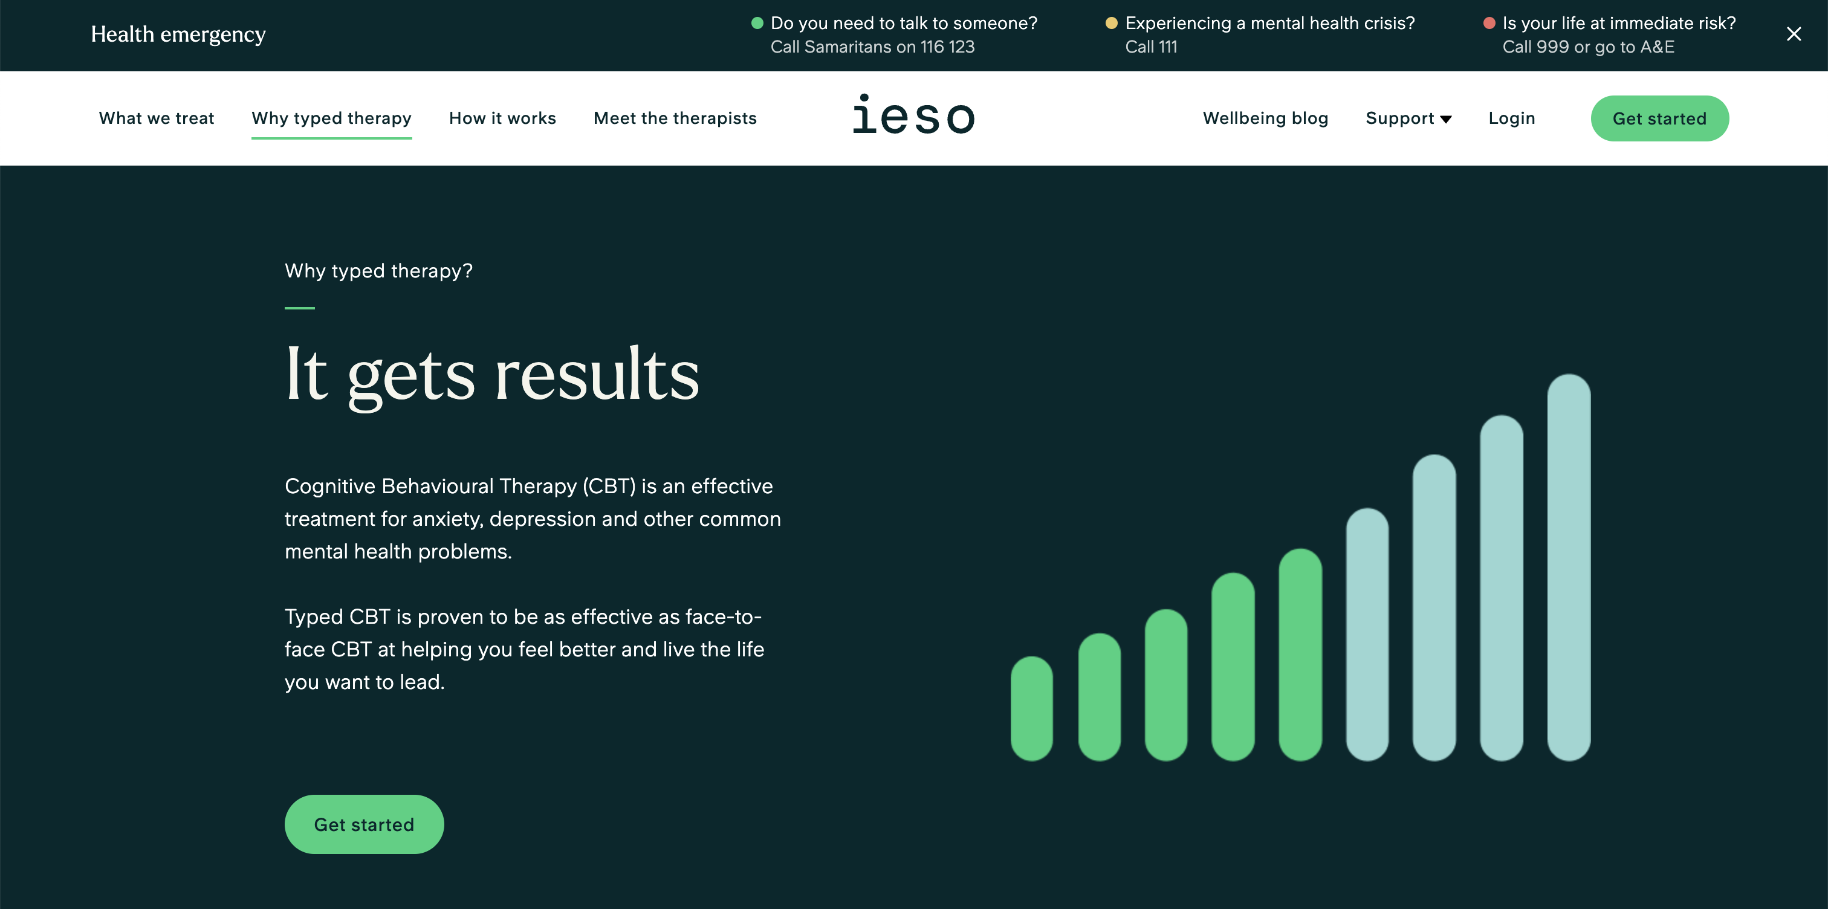

Slide 9
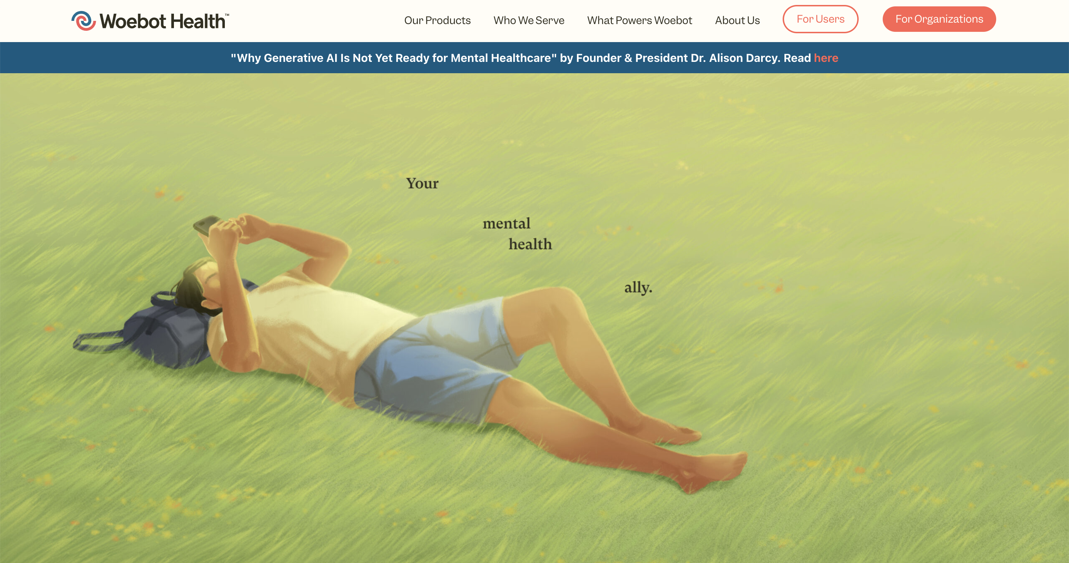
Artificial intelligence
Virtual reality
Natural language processing
Affective computing
+
+
+
= AI care providers (simulated psychotherapists, counsellors, coaches…) for interactive conversations
Embodied (avatars, robots; humanoid or not) or non-embodied systems (voice simulation)
Virtual or physical
Based on Luxton (2014)
Notes:
Mental health and psychotherapeutic support:

Slide 10
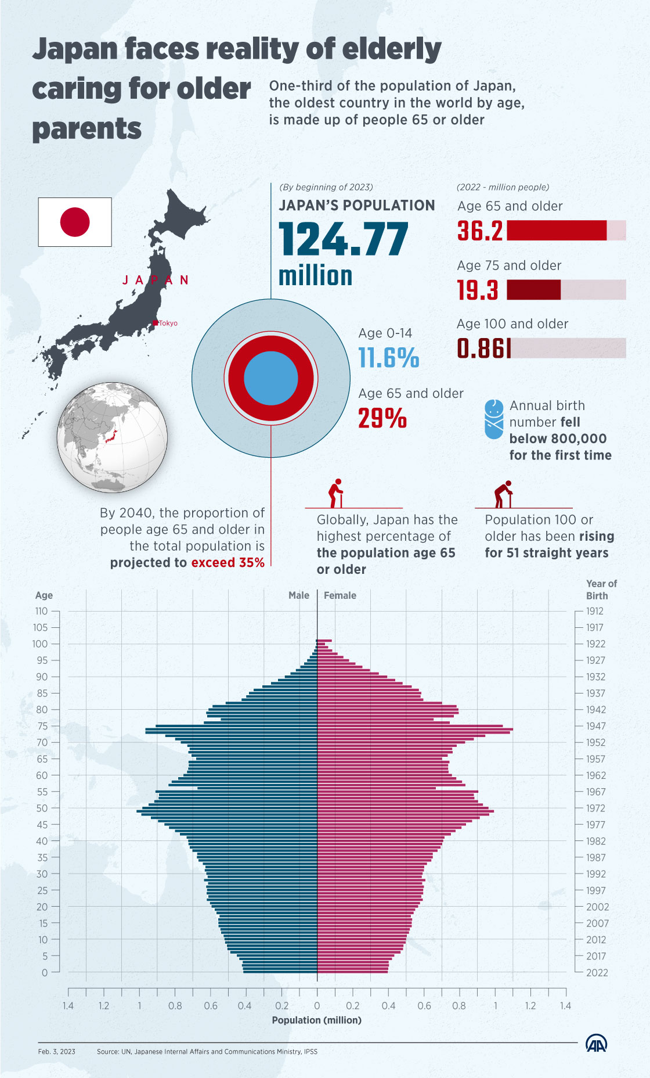
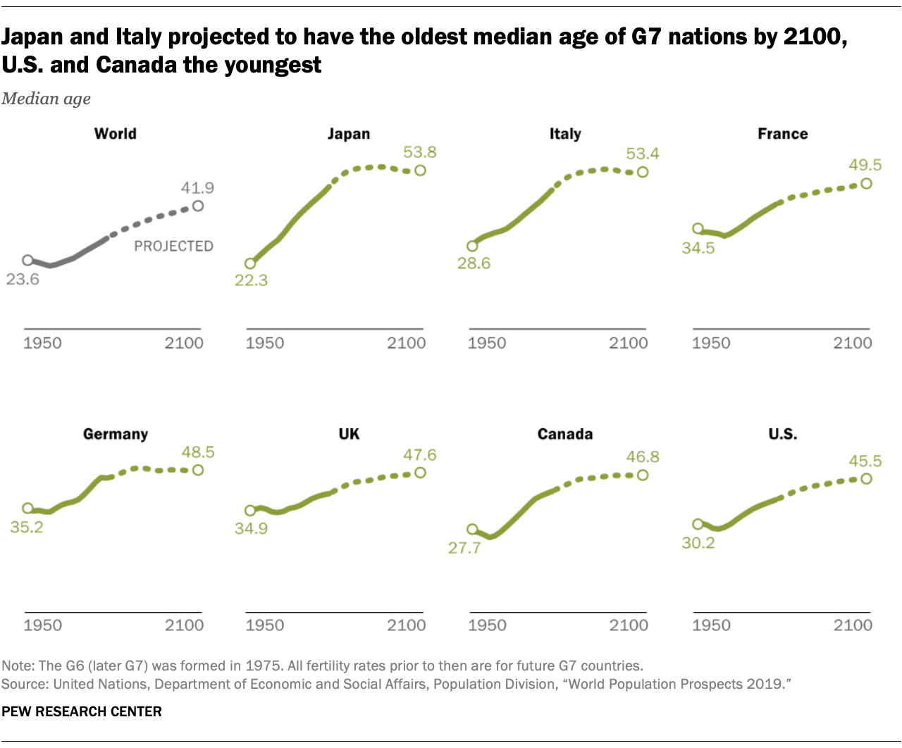
Notes:
Companion robots or “carebots”

Slide 11
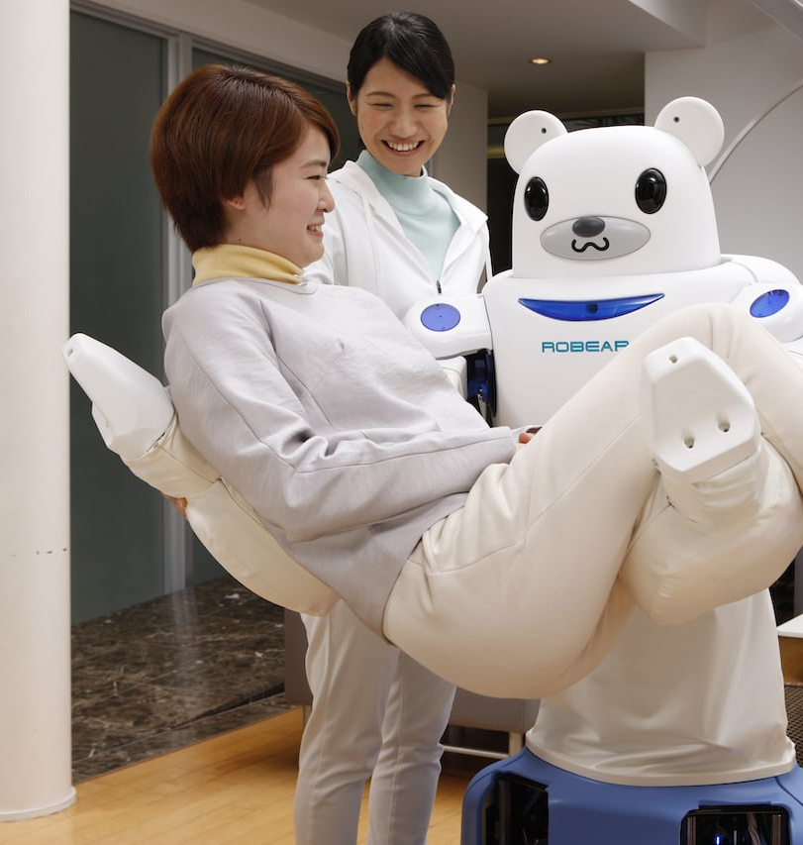
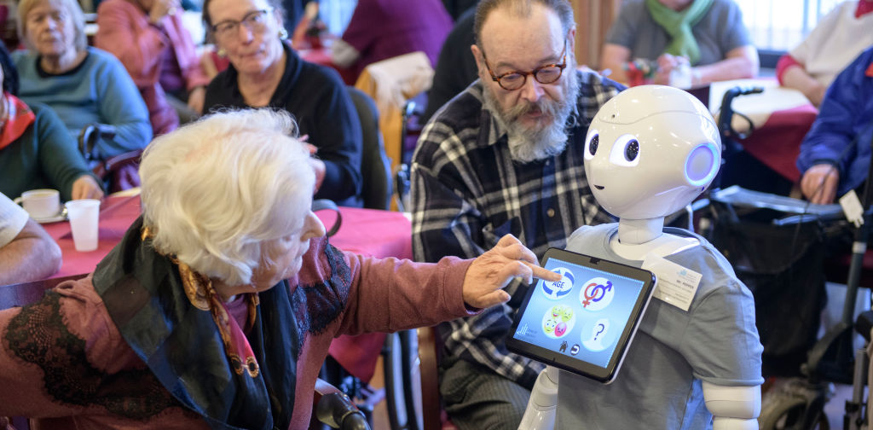
Notes:
Companion robots or “carebots”

Slide 12
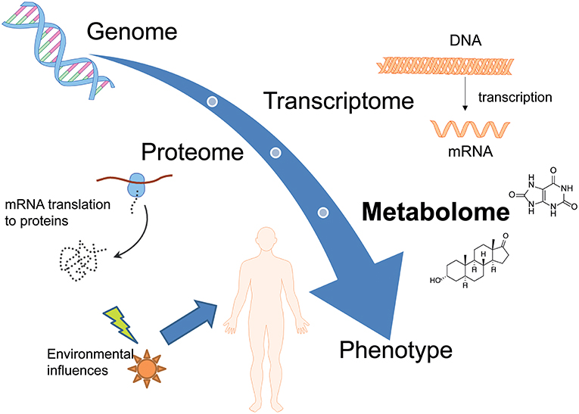
Personalised (or precision) medicine
PREDICT Test (Vanderbilt University Medical Centre, Nashville US) as an example:
Genes play a role in how we respond to medicines
Genome-informed prescribing
Pharmacogenomic information to predict and help prevent adverse drug events
Genetics

Slide 13
Some challenges for AI in healthcare

Slide 14
1. The data challenge
Machine learning algorithms achieve the most impressive results when they have large amounts of information at their disposal
Which data must we protect?

Slide 15
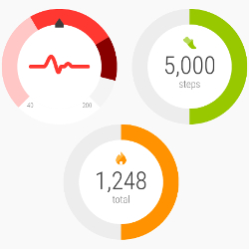
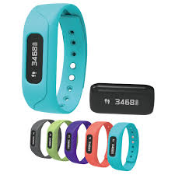
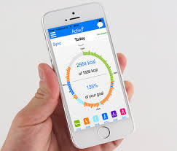
1. The Data challenge (II)
PERSONAL DATA
SENSITIVE DATA
(judicial data)

Slide 16
1. The Data challenge (III)
In the USA, only medical institutions have to abide by the regulations for medical data protection
But what if you voluntarily gave your genetic info to non-medical companies? Did you know these companies are selling people’s data to Big Pharma? (for billions of dollars…)

Slide 17
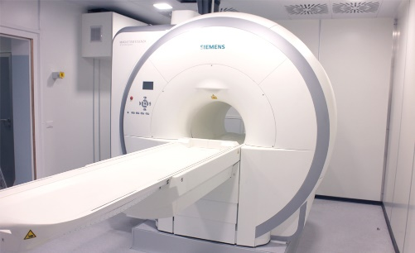
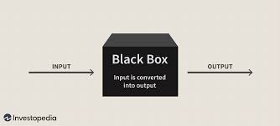
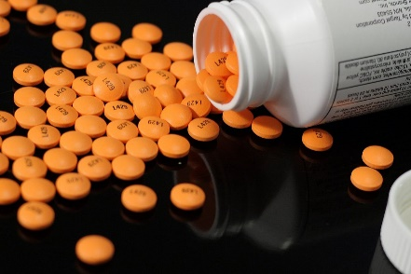
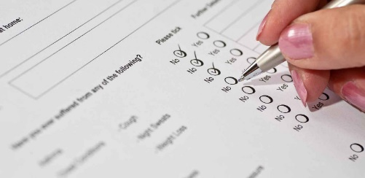
2. The challenge of accountability
How can we validate AI technologies?
Explainable AI
Responsible AI
Trust

Slide 18
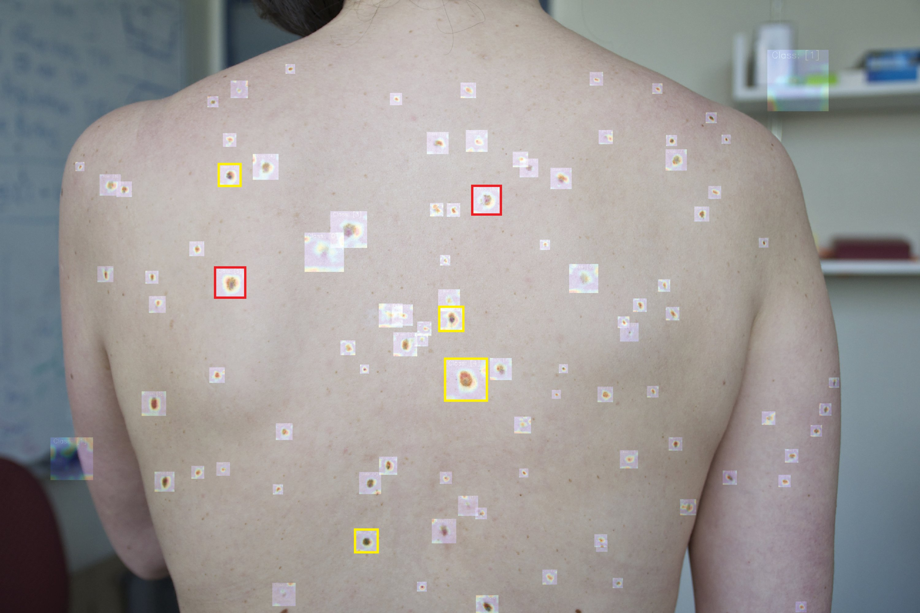
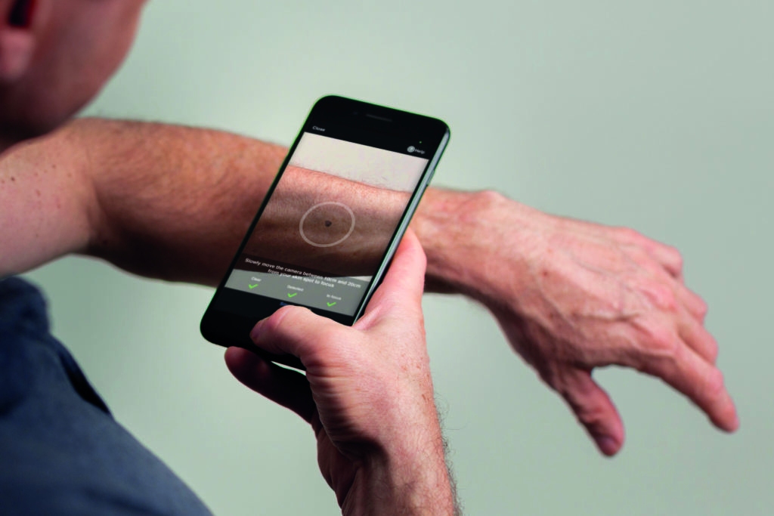
Source: MIT News (2021)

Slide 19
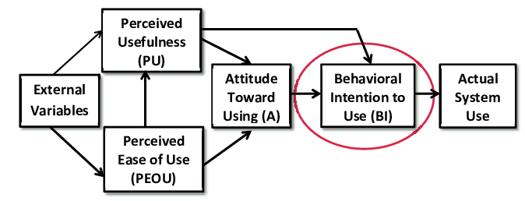
3. The challenge of acceptance
70/80%
Less than 50%
Notes:
There is a resistance to acceptance of medical AI especially from patients and next of kin.

Slide 20
What do patients think of AI?
A survey from PwC
47% if something doesn't go as planned, they don't trust AI to make medical decisions
38% AI and robots lack the "human touch" needed in medicine
36% only human doctors know how to go "beyond the data" to give the best recommendations
30% I don't understand technology enough to know if it would be more helpful or harmful in medicine
34% health is easier and faster
31% of diagnoses made by computers are fast and accurate
27% better treatment recommendations
27% always have access to/be in contact with a specialist via smartphone, etc.
Notes:
See: https://www.pwc.com/gx/en/industries/healthcare/publications/ai-robotics-new-health/transforming-healthcare.html
https://www.pwc.com/gx/en/industries/healthcare/publications/ai-robotics-new-health/ai-robotics-new-health.pdf

Slide 21
4. The challenge of overconfidence
There are two main definitions of overconfidence; both shed light on the risks of working with technology
AUTOMATION BIAS
This is then we trust machines more than we should
IMPROPER TASK ATTRIBUTION
This is when we use machines to solve problems that they were not designed to solve and assume that they are just as good

Slide 22
5. Challenges of distributed authority
Distribution of authority due to use of AI technologies in diagnosis introduces confusion in the system
For example, consider tools similar to DXplain that are (could be) available to patients
This undermines authority of doctors and diminishes patient’s trust
This decreases rates of adherence to prescriptions
Increases incentives for self-diagnosis (which is dangerous)
More likely to be attracted to alternative treatments/medicine

Slide 23
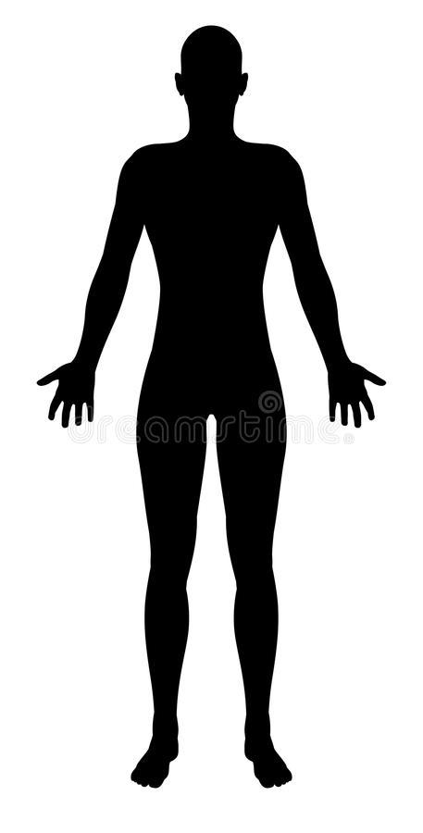
The patient today
More «entitled»
More active
Immersed in communications and alternative health opportunities
More prepared
More responsible for their health
More suspicious, possibly discouraged
Immersed in support networks

Slide 24
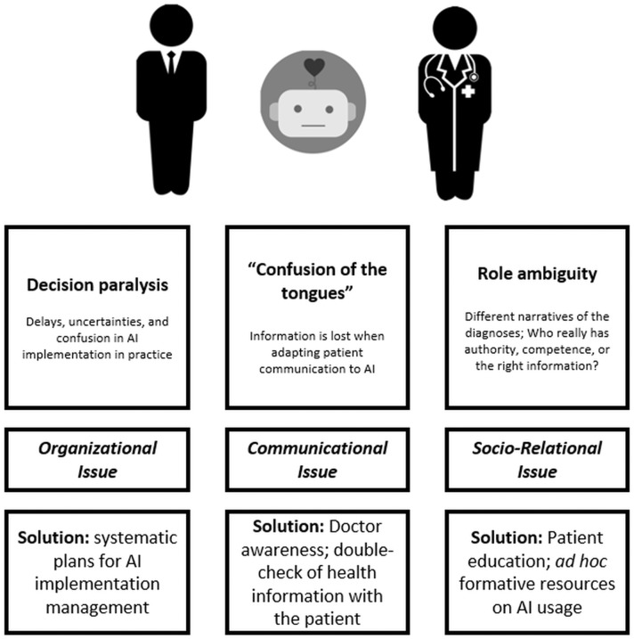
The third-wheel effect
“CONFUSION OF THE TONGUES”
Not all relevant information (e.g., patient testimony) could be easily translated into data for AI
What about the patient-doctor relationship?
DECISION PARALYSIS and DELAY
Uncertainties about AI implementation within everyday practice may affect time and procedures
ROLE AMBIGUITY
Patients may not understand the role of AI and reduce their perception of doctors’ authority and competence
Triberti, Durosini, & Pravettoni (2020), Frontiers in Public Health, 8
Notes:
https://www.frontiersin.org/articles/10.3389/fpubh.2020.00117/full

Slide 25
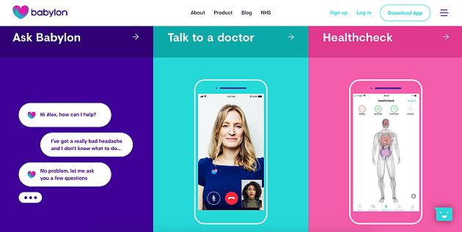
Examples of third-wheel effect
In the UK, it is possible to "talk" to an AI for an initial medical screening
An effective tool…
But, how can we know when critical information is lost?

Slide 26
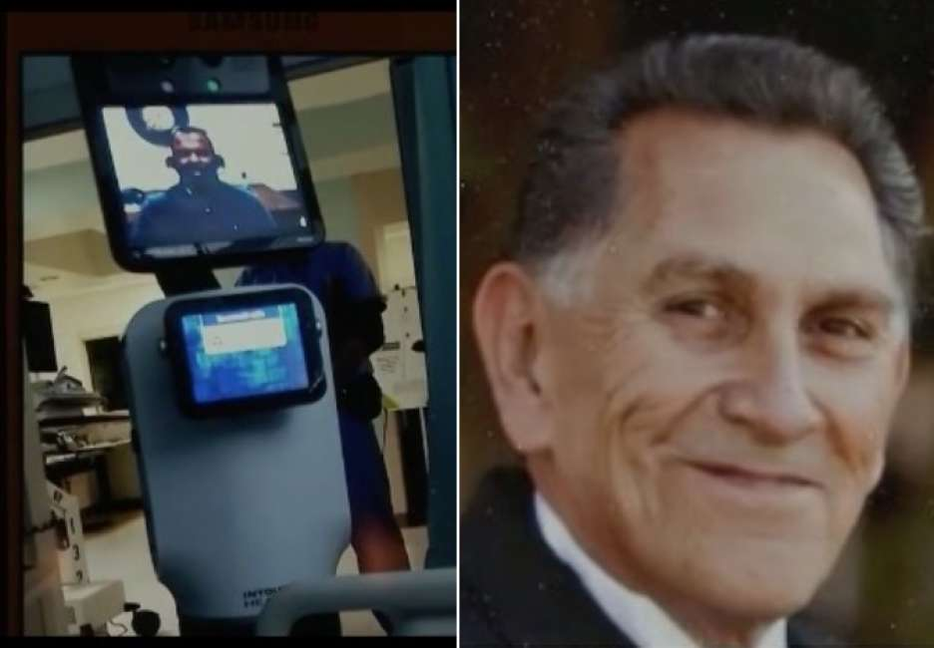
A patient case
Ernest Quintana, a chronic patient in Freemont, California, received the bad news about the impossibility to cure him through a moving robot
The doctor's activities do not end with a cure or therapy...
Getting "bad news" from a machine does a great disservice -> it is an example of overconfidence that could present with AI too

Slide 27
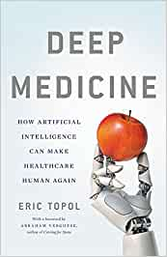
Facing the relationship challenge
Eric Topol argues that AI could be a resource for medicine if it helps doctors to recover the time lost in medical consultation
In other words, AI should take on the administrative and technical tasks of doctors, not the human relationships

Slide 28
Conclusions
We cannot prevent interactive and autonomous technology from becoming more and more part of the healthcare landscape
People's attitudes and behaviours in this regard are still largely unexplored area
Future Cognitive and Social Sciences research on AI will have to place great emphasis on understanding the human side of the relationship

Slide 29
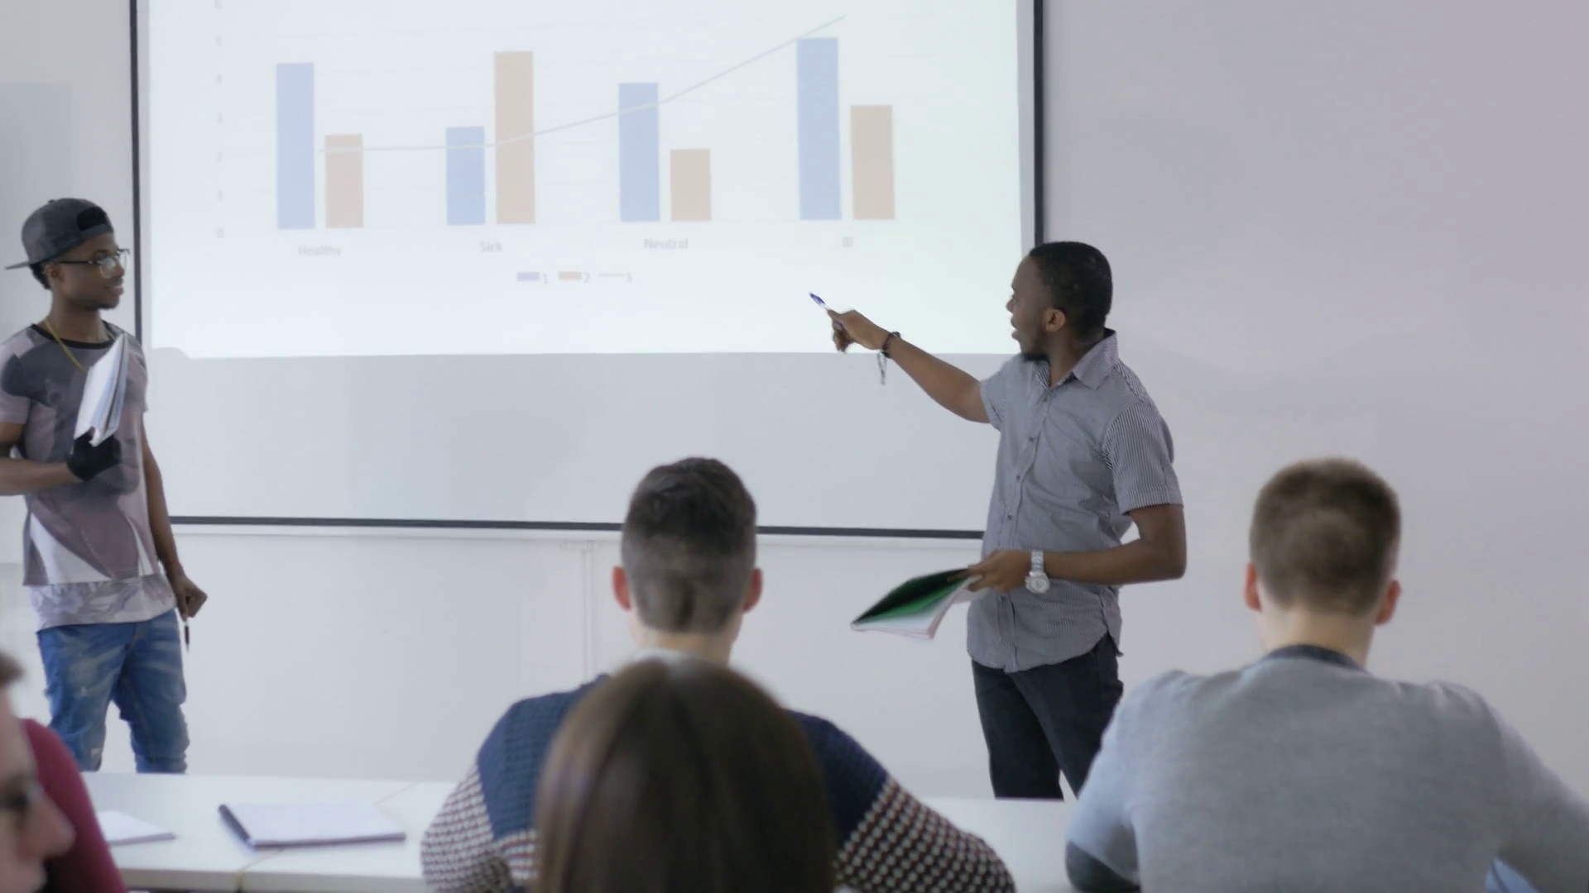
Feedback on your group presentation plans!
20 minutes
Notes:
Formative feedback to group work

Slide 30
Bibliography to know more
Panesar, A. (2019) Machine Learning and AI for healthcare. Apress
Topol, E. (2019) Deep Medicine: How Artificial Intelligence can make Healthcare human again. Basic Books
Triberti, S., Durosini, I., La Torre, D., Sebri, V., Savioni, L., & Pravettoni, G. (2022). Artificial intelligence in healthcare practice: How to tackle the “human” challenge. In C. Lim et al., (Eds.) Handbook of Artificial Intelligence in Healthcare: Vol 2: Practicalities and Prospects, 43-60.
Triberti, S., Durosini, I., & Pravettoni, G. (2020). A “third wheel” effect in health decision making involving artificial entities: A psychological perspective. Frontiers in Public Health, 8, 117.

Slide 31
AI, Society and Sustainability
(Session 4)
AI, user experience and ergonomics

Slide 32
Introduction
We have seen how AI could be used in healthcare and other sensitive contexts…
But: technology could also cause issues and dangers at many level
For this reason, historically a number of disciplines emerged to evaluate technologies and provided methods and tools to assess technology after, during or before usage, to make implementation more effective
In this lesson we will briefly see these disciplines and try to apply some of their tools
As we will see in the last part of the lesson, these skills and tools could be applied to AI, and virtually to any kind of technology that is expected to be used in sensitive contexts

Slide 33
How can we evaluate technology?
In technology there is often an efficacy bias – the idea that efficacy should be the main or sole criterium to consider if we want to know whether a technology is desirable
…but there are many others!
Safety
Expenditures/waste of resources (e.g., buying it, updating it)
Utilizability
Quality of user experience and adaptation to context
Acceptance and adoption

Slide 34
From Ergonomics to Usability

Slide 35
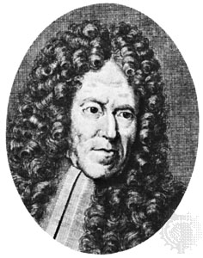
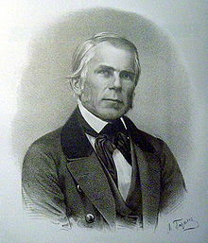
I. Ergonomics
Quam artem exerceat ?
«study of work based on truths from the natural sciences»
The date of birth of Ergonomics as a discipline coincides with the foundation of the Ergonomics Research Society by Murrell in Great Britain, 1949
Notes:
Bernardino Ramazzini, Wojciech Jastrzębowski (precursors of occupational medicine and ergonomics respectively)
Ramazzini (Carpi 1633 – Padua 1714), physician, was the first to understand that disease did not come from infections and lesions only, but also from repeated activity; he noticed that some health issues used to appear in people who worked specific jobs. He added to the list of fundamental questions to ask to patients: «what is your job?»
Jastrzębowski (1799-1882) was a polish naturalist and botanist. He invented the term «ergonomics» and imagined that it was possible to develop a «science of work» to improve productivity and safety

Slide 36
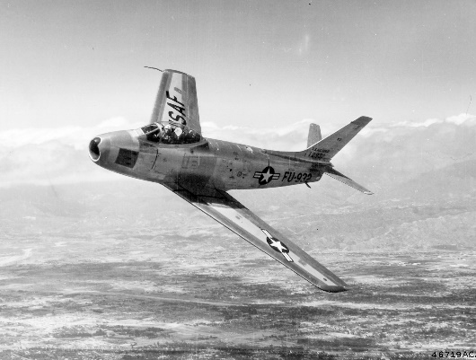
Basic history of modern ergonomics
The birth of ergonomics as we know it today is linked to the alliance between two disciplines that developed independently
Ergonomics
Human Factors
Developed in Europe
Originally interested in industrial work/production processes
Of physiological/biomechanical interest
Developed in the United States
Originally interested in reducing accidents in the use of military vehicles
Of a psychological/cognitive nature
HFE
Notes:
Ergonomics/Human Factors is interested in evaluating productivity and safety

Slide 37
Example of an ergonomical tool: analysis of errors
When the workload is too high (stress) or too low (vigilance risks), or when there are system design problems, this has a very specific effect on behavior
The probabity of ERRORS augments
SLIPS → motor/execution errors (e.g., when your hand slips)
LAPSES → cognitive/attentional errors (e.g., when you are distracted from the task)
MISTAKES → planning errors (e.g., the execution is ok but the whole procedure you enacted was wrong from the start)
VIOLATIONS → organizational errors (e.g., illicit actions; not respecting regulations)
Notes:
POSSIBLE FUNNY EXERCISE: you can select any «fails compilation» video from youtube and ask students to categorize videos according to the type of error
Take home messages:
It is not always easy to identify the type of error without analyzing context, procedure, and/or listening to employee’s testimony
When you can identify error types, it is easier to develop solutions to implement in the context (see next slide)

Slide 38
Preponderance of:
Modify direct affordances to facilitate action; e.g., zoom and space buttons; make handles and levers better suited to the hand; reduce or increase physical effort for activation; implement automatic safety devices; etc.
SLIPS
LAPSES
Intervene on the work environment to reduce sources of distraction; e.g., increase lighting; reorient workstations; increase breaks and intervene on timetables to improve vigilance; etc.
MISTAKES
Work on the clarification of work procedures; e.g., introducing targeted training; distribute tasks among different specialists; implement helpdesk solutions; conduct simulations; etc.
Adapt work procedures in organizational terms; e.g., changing roles and hierarchies; introduce reward and punishment systems; improve teamwork; prizes/incentives to good behavior; etc.
VIOLATIONS

Slide 39
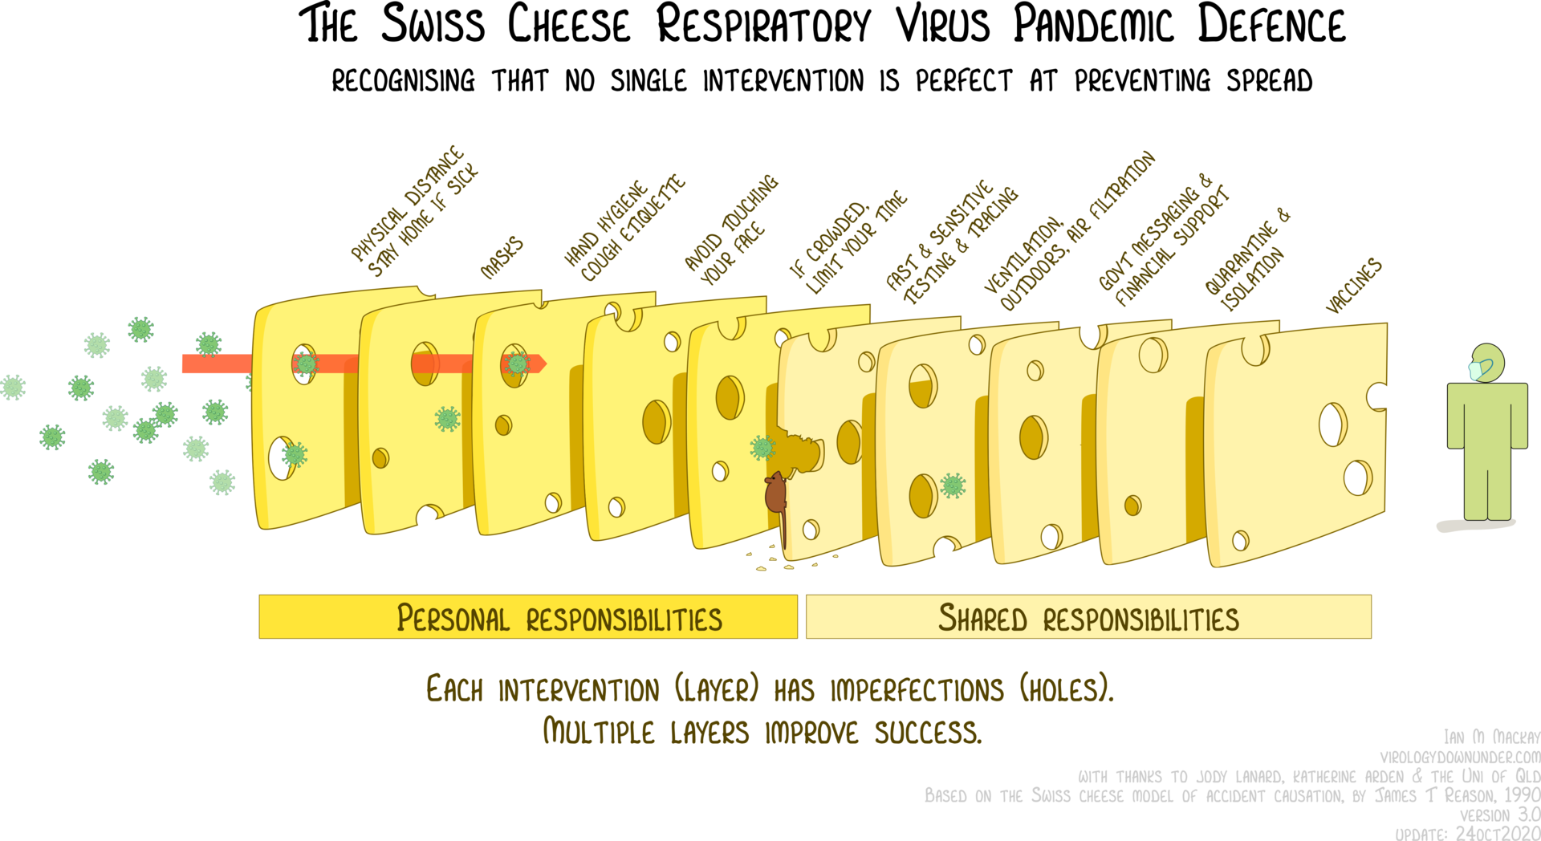
explanation of the model
Notes:
Reason also proposed the well-known Swiss cheese model of safety measures – here we can see it applied to the COVID-19 pandemic…
Basic explanation of the model: https://www.ncbi.nlm.nih.gov/pmc/articles/PMC1298298/#:~:text=James%20Reason%20proposed%20the%20image,by%20a%20series%20of%20barriers.
Concept: to obtain safety, you have to implement multiple measures that work as barriers and cover for each other weaknesses (the «holes» in the cheese) – a Swiss cheese safety infrastructure is always more reliable than any single-solution approach

Slide 40
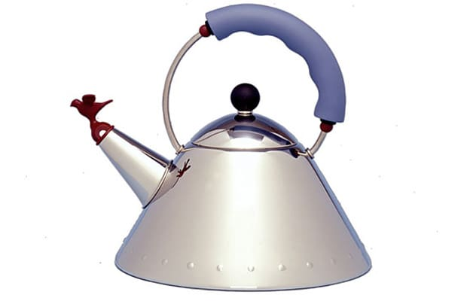
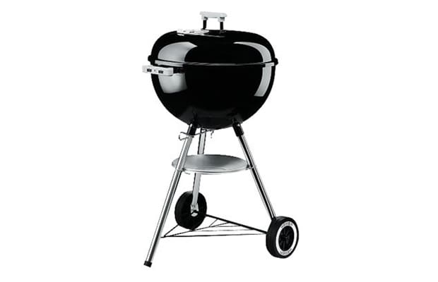
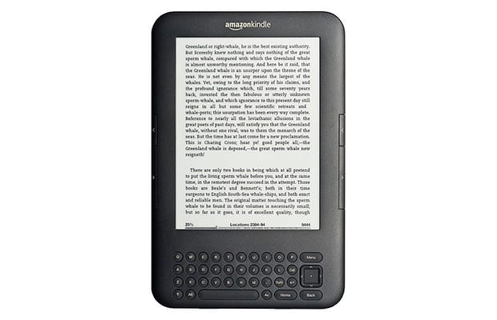
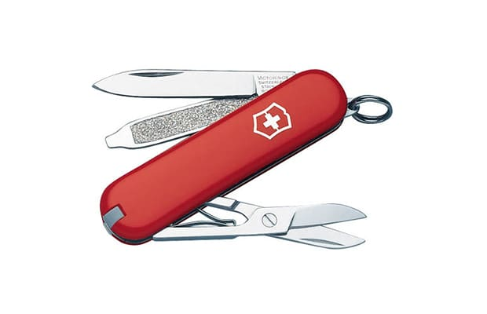
II. Usability
Difference between ergonomics and usability?
Usability emerges in the Eighties, when designers begin to include ergonomical prescriptions within industrial products
According to Nielsen, Usable products respect these criteria:
Learnability (no need for instructions)
Memorability (to remember how to use it is immediate)
Efficacy (it works as it should if used correctly)
Errors (easy to identify and correct)
Satisfaction (positive subjective experience of use)

Slide 41
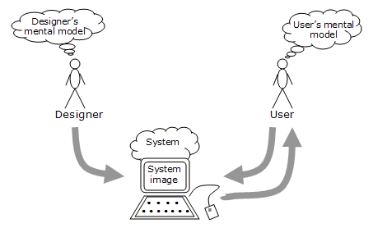
The System Image concept (Norman)
Notes:
Designers and users always have different, incommensurable representations of the technology – engineers, developers often do not understand this
The system image (the interface of the model) determines the user’s mental model
It is better, to achieve usability, to design interface based on users’ expectations and experience, not on the developer’s expert mental model

Slide 42
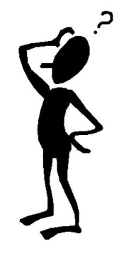
How to evaluate usability?
It is well known that some useful usability questionnaires exist – e.g., the System Usability Scale (SUS)
BUT
Don’t make the common mistake of resorting to questionnaires only! – Some generic «usability score» is meaningless if you do not know what you have to fix
The real methods to evaluate usability belong to two approaches:
ANALYZING TECHNOLOGY WITH AN EXPERT’S EYE
OBSERVING USERS THAT INTERACT WITH THE TECHNOLOGY
or

Slide 43
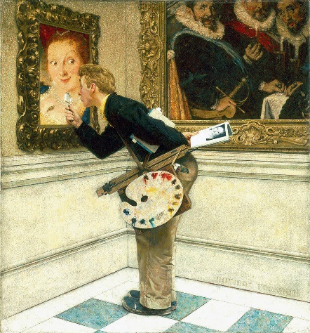
Usability Inspection
USABILITY INSPECTION collects methods that help expert evaluators to systematically analyze the technology or product, without involving final users
COGNITIVE WALKTHROUGH
HEURISTICS ANALYSIS

Slide 44
Cognitive walkthrough
It is an analysis process implemented according to specific phases, whereby the evaluators put themselves in the shoes of the users and systematically "walk through" the individual sections of the interface
Special forms are filled out, reporting the actions taken, the problems that emerged and the possible solutions for each step
Limits
Repetitive, time-consuming with complex interfaces
Gives no info on specific cases, preferred actions, differences between users
Advantages
cheap, systematic
Easy to learn and to master, even for non-expert evaluators

Slide 45
Heuristics analysis
It is an analysis technique whereby the evaluator (or group of evaluators) analyzes the technology from a holistic/global point of view, evaluating its compliance with a predetermined set of usability criteria
Given the complexity of the heuristics, there may be multiple evaluators, each reporting on a limited number of criteria that have been assigned to him/her
Limits
Sensitive to evaluators’ expertise and competence
Possibly expensive (if you hire high-level professionals)
Advantages
The technique able to identify the highest number of usability issues
Thanks to the holistic approach, it could identify issues related to the interface as a whole, not only specific functions

Slide 46
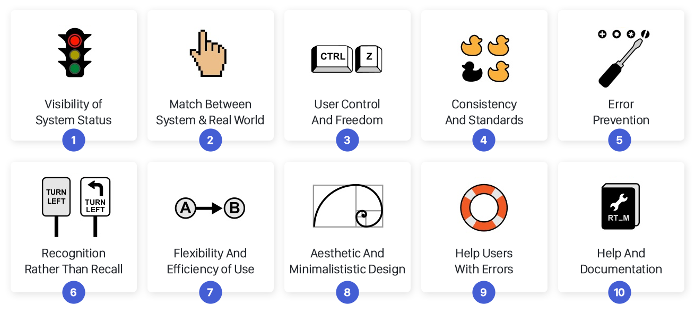
Nielsen’s 10 Usability Heuristics
(there are also specific sets of heuristics for specific technologies, e.g. Virtual Reality…)
Notes:
The 10 heuristics in detail: https://aelaschool.com/en/interactiondesign/10-usability-heuristics-ui-design/#:~:text=Nielsen's%20heuristics%20are%20general%20principles,friendly%2C%20and%20intuitive%20digital%20products.
EXERCISE: we can decide about any accessible website
Give groups of students a couple of heuristics each
They analyze the website in 5 minutes and each group reports on their opinion on the two heuristics regarding the website

Slide 47
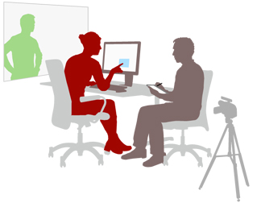
Usability Testing
USABILITY TESTING collects all those methods with which evaluators systematically observe the interaction with the technology/product by end users
In a typical Usability Testing there are usually 3 phases:
Preliminary questions
«tour» or «first impression» phase
Task-based phase
+ any final considerations from the user
Limits
Easy to manipulate, even without being aware of doing it
It does not identify issues related to context (because it is conducted in a laboratory)
Advantages
The technique able to identify the most serious usability issues
Easy to understand, to learn, and it could be funny/pleasant for the user
Notes:
This is a nice usability testing with a paper prototype that we could possibly show to students: https://www.youtube.com/watch?v=dNbh21-G_cQ&t
POSSIBLE EXERCISE: have a couple of students managing a usability testing in the class supervised by the professor – but it could be quite time consuming…

Slide 48
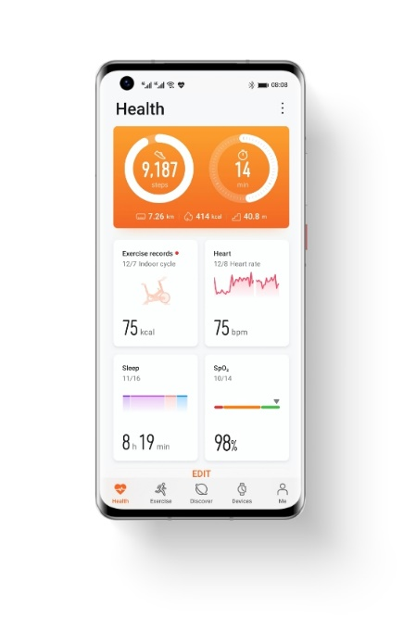
1. Preliminary questions
The participant is seated, and some useful questions are asked:
To make them feel comfortable
Getting to know the participant (e.g.: are them part of the target? Do they have experience with the product?)
To know the specific context (e.g.: in which situations and under what conditions does the user use similar products/technologies?)
Good morning, how are you today? Is this your first time participating in a usability test? (explanation of the objective)
Have you ever used apps to track your health? Have you ever heard of applications of this type?
Do you use your smartphone or tablet more? In what contexts? At what times of the day?

Slide 49
2. Tour phase
It is used to collect preliminary information of general interest, which may escape interaction tests
What is the first impression?
Why? In what sense? (specification questions)
What possible actions can you think of? What are the main functions of this site/product/system? (avoid targeted questions; note down any points of interest to modify the tests)

Slide 50
3. Task phase
The user is asked to take action to achieve specific objectives through the interface (previously decided)
It is used to test a large part of the interface
The tasks must be generic; you don’t have to tell the user what to do, e.g. Where to click exactly
Thinking aloud: the user is usually asked to speak out loud, to justify their choices
The user is left "free to make mistakes"; you correct them only when they have clarified (1) the reasons for the actions they performed, and (2) the causes of the error

Slide 51
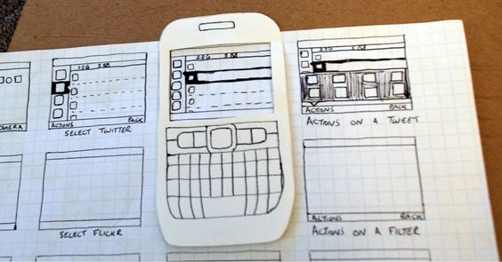
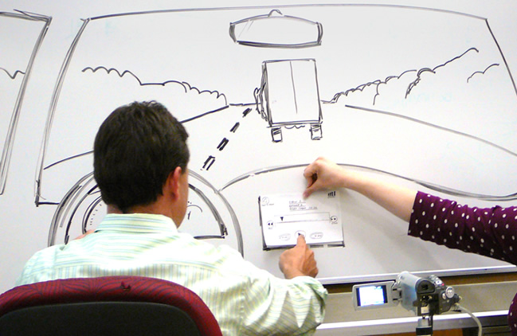
Usability testing: paper prototyping
User Testing is not only done with finished products, but also with prototypes, to anticipate and correct usage problems before the final design
An interesting resource in this sense is paper prototyping which allows you to prototype without the expense of web/IT development

Slide 52
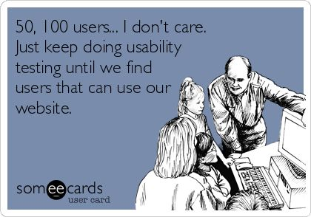
Usability testing: the debate on samples
A usability test is not a psychological experiment
We are not interested in extending results to a population
but
In identifying and describing issues within a system
Nielsen: «on average 5 participants are enough to evaluate a system»
Virzì: "it’s true, studies show that after 5 participants the same problems continue to emerge"
Caulton: « 5 participants may be sufficient, but:
More if the interface is complex, with many courses of action …
Many more if there are multiple product targets (e.g. 5 per target)»

Slide 53
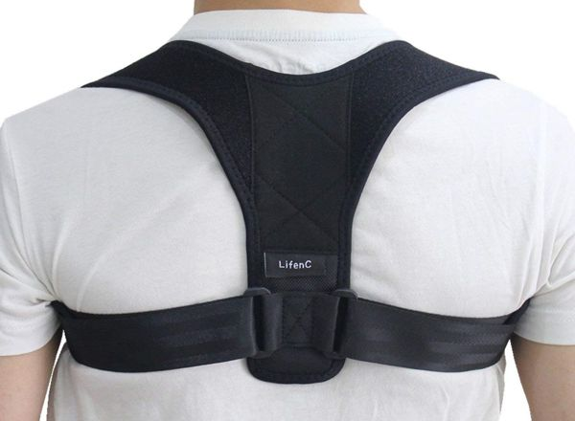
Is usability sufficient? A case example…
Notes:
Exercise: narrate this case to students and ask them to provide their opinion
(this was a real case of evaluation of a technology to support physical activity in old patients: they were given a bib to wear on the chest to analyze psychophisiological data; they were also given videos of physical exercises they could do in their home «using just a chair») – preliminary usability inspection and testing said the technology was ok to be implemented
Then you can show students the next slide with «solutions»

Slide 54
What emerged from the evaluation
Three main problems:
The usability test focused on the interface of the bib once worn; elderly patients experienced serious difficulty wearing it without the help of a caregiver
The use of a chair in most of the exercises (60%) led to execution errors, because the patients used chairs they had at home of different shapes and sizes
20% of patients underwent additional risks and efforts to prepare the spaces of their homes for performing the exercises

Slide 55
User Experience and User Centered Design

Slide 56
III. User Experience
Around the 1990s, research began to realize that usability is not the only, perhaps not even the main, element for the success of a product
EMOTIONS
CONTEXT
We prefer unusable objects if we have become fond of them
We are looking for complex experiences, not always "easy" (e.g.: video games)
Usability can be useless if the context is not considered ... Both in terms of physical (e.g.: Lowdermilk totem) and socio-cultural values
Notes:
Lowdermilk is a famous user experience designer
He designed an «information totem» for some large hospital in USA – he had put a lot of effort in sound design to make alerts and sounds from the system very clear for the users
When he later visited the hospital, he noticed that the hospital managers had put his totems near to fountains in the hospital garden. The sounds were inaudible due to the water noise. It is a funny example of how usability could be altered or nullified by context, independently of the good work on the interface

Slide 57
An instrument for User Experience: Contextual Inquiry
…is thought of for the first time in the context of the methods for contextual design developed by Beyer and Holtzblatt (1998)
It draws inspiration equally from interviews and ethnographic observation
Series of partly predetermined questions to collect information and opinions from the user; usually in semi-structured form
It comes from the techniques used by anthropologists to study the culture, behaviors and practices of indigenous peoples
It is a user interview conducted in the place/situation where you expect to implement or change the technology

Slide 58
Interesting output: workflow model
A possible outcome accompanied by descriptions is a «workflow model» or graphical model of the context.
It can depict, depending on your needs:
Model of organization and information flow;
Task/activity model (sequence of actions);
Artifact model (which describes the interactions between devices);
Model of socio-cultural influences, roles, boundaries;
Physical model showing the physical structure of the context (obstacles, sizes, distances, changes over time, lighting, sound distribution, etc.)
Note: these can all be made, but more often you decide which or which ones to use depending on the elements of interest

Slide 59
Portable PC
Notebook
class
student
student
student
chair
professor
computer
projector
Interactive whiteboard
Notes:
A simple example of a workflow model on information and artefact flow, which allowed researchers to identify, by observing the user experience, the poor integration of an interactive whiteboard tool in a teaching context

Slide 60
IV. Design for All
A « typical user » does not exist…
Design for All (DfA) emerged as a political-ideological response to User Experience
It was critized for not providing specific tools or methods; however, it is important to always take into account accessibility aspects

Slide 61
V. User Centered Design
Following the evolution of the objects of study, User Centered Design emerges …
Whose goal is «ensure that no aspect of the interaction between user and artifact escapes the knowledge of the Designer» (Garrett, 2010)
Through a change of perspective:
Research is no longer done to evaluate technology, but to guide the design itself
But how can this be achieved?

Slide 62
UCD - ISO 9241-210:2010 (revised 2019)
the ISO standard
Notes:
https://www.iso.org/standard/77520.html

Slide 63
Tools of UCD
In principle, UCD methods are based on data collection or on the rendering/simplification of information in order to guide design
DATA COLLECTION
INFORMATION RENDERING
Interviews, focus group, contextual inquiry, questionnaires and surveys
Personas, Scenarios, Empathy Map, Customer Journey…
These could be based on data or on designer’s knowledge and experience

Slide 64
Personas
Personas are fictitious profiles created to represent the characteristics and needs of "typical users" of a technology or product
Generic targeting information
Name and picture help the designer to visualize the persona
What forms of communication work with the persona?
Actual state (what is the persona doing to obtain their objective before the application)
Citations/typical phrases
Personal narrative
How will the persona arrive to the product
Brand and products the persona likes
Emotions and goals
Notes:
Personas and empathy maps (see next slides) are usually printed in large dimensions and hung on the wall, filled with post it notes or notes and constantly modified... this is done to always keep in mind the characteristics of the users and base the design of the technologies on them – these are precisely tools for providing information and facilitating the iterative design process itself, not evaluation

Slide 65
The empathy map
Created by designer Dave Gray, the Empathy Map is a useful tool for delving into the psychological characteristics of personas or real users
It allows you to organize and classify the internal states, behaviors and socio-contextual influences that determine users' choices and actions
Like personas, it can be based on data, or on the intuitions and reasoning of designers

Slide 66
Desires, aspirations, worries, «what matters» to them
thinking
hearing
seeing
Name
What others say: family,
friends, influencers
Environment, people, the market
saying and doing
Behavior, attitudes, appearance
suffering
gains
Fears, frustration, obstacles
Success, joy, what they could achieve
Notes:
EXERCISE: we could create a empathy map for an AI service in some real context with students…

