Slide 1
Can we use these tools with AI?

Slide 2
…but what is an interface?
We used this word a lot today… but what is it exactly?
According to Riva (2012), an interface is everything between the user and the system
It serves three purposes:
To represent the system and its functions through a “model”
To make the software visible
To facilitate and promote the interaction with the technology

Slide 3
AI’s drama
There is not a clear interface for AI!
Robots? Chatbots? A mobile app? A website-like page? A pdf output? → all of these could be interfaces for AI applications
Interface is not a secondary add-on for technology
When interface is bad:
- technology is not used or is used in the wrong way
- use systematically leads to errors
- technology that works well but has a bad interface is easily replaced by another that has a good interface but works poorly

Slide 4
Use Case: a robot with a smile
An Italian company had developed a robot with an AI system that could navigate small cities autonomously and collect people’s trash
It was tall like a short man and had a big smile on its face
It had sensors to avoid obstacles and could walk among people
It was tested successfully but, in the end, it could not be implemented in the real world
What do you think was the problem?

Slide 5
A hint from communication psychology
A smile is NOT a marker for positive emotions!
A smile is a social facilitator, i.e., we do most of our smiles to make other people feel at ease, to promote communication (.. of course, we can smile also when we are actually sad or angry …)
The robot was smiling continously with no reason; it invited communication without doing it
When people tried to interact with it, it just avoided them (sensors …)
The robot looked «stupid and asocial» – it made itself insufferable
When the developers tried to let it go collecting trash without supervision, vandals «attacked» it and broke it! … thousands of euros wasted
This is an example of social context issue that could have been prevented just with some UX/UCD interviews!

Slide 6
UX and the future of AI (I)
UX is important for implementation of AI
The techniques and resources we have briefly seen in this lecture could be very useful to drive decision making related to the utilization of AI in real-world contexts Some: golden rule
Always ask yourself: is AI really needed/worth it? Does this process actually improve when automated?
Besides “working well”, is it safe?
Is the interface effective in its three functions? (see also couple of slides before)
What emotions does AI generate in its users? Who actually are the users?
What happens when the technology is implemented in the real-world context? Do we actually know the context?
Notes:
The three levels of users according to UX:
First level users: those who directly interact with the technology
Second level users: those who are someway affected by the implementation of the technology without using it
Third level users: those who make any decision that affect the implementation of the technology in some context, without using it directly

Slide 7
Consider the three levels of users according to UX:
Those who directly interact with the technology
Those who are someway affected by the implementation of the technology without using it
Those who make any decision that affect the implementation of the technology in some context, without using it directly

Slide 8
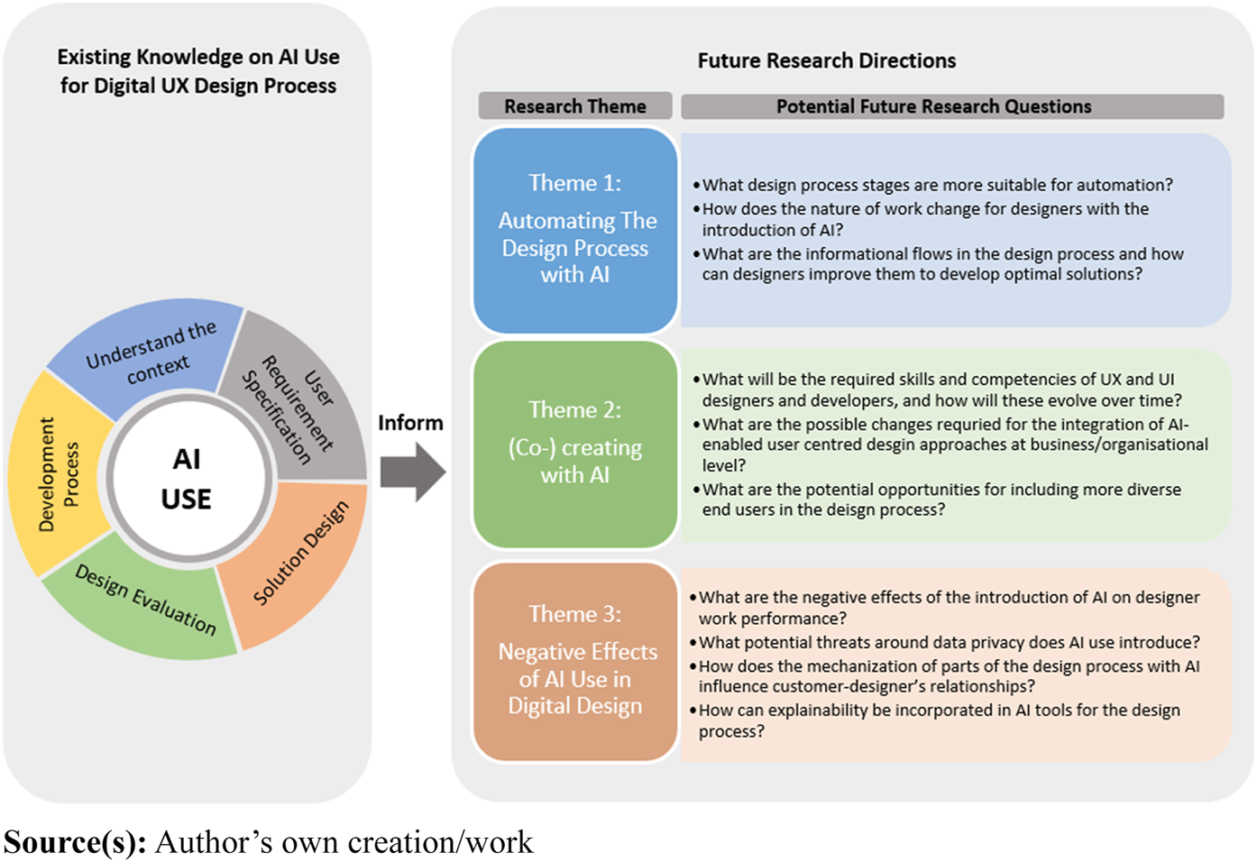
UX and the future of AI (II) -> AI for UX
Of course, AI could be implemented in the process of UX design as well
Reviews such as Stige et al.’s (2023) are identifying the areas for development of AI involved in UX research
https://www.emerald.com/insight/content/doi/10.1108/ITP-07-2022-0519/full/html?skipTracking=true
Notes:
https://www.emerald.com/insight/content/doi/10.1108/ITP-07-2022-0519/full/html?skipTracking=true

Slide 9
Think of potential uses of AI on UX and UCD, etc.
Furniture Design (and other devices)
Make people sit of a chair/sofa … place sensors to measure stress on different parts of the body -> submit for integrated analysis
2) Rapid Prototyping:
Create fast a cheap prototype (possibly 3D printing), easily modifiable
Possibly from “paper models” (recall the web interface and the girl)

Slide 10
Bibliography to know more
Stige, Å., Zamani, E. D., Mikalef, P., & Zhu, Y. (2023). Artificial intelligence (AI) for user experience (UX) design: a systematic literature review and future research agenda. Information Technology & People.

Slide 11
AI, Society and Sustainability
(Session 5)
AI and Environmental Sustainability

Slide 12
Today’s session
AI and environmental sustainability
AI for sustainability
Sustainability of AI

Slide 13
AI for sustainability

Slide 14
AI for sustainability
How can we leverage AI technology advancement for protecting natural environment
“The most urgent need in this context is not to have more powerful AI but to become smarter at where and how we use AI
There are so many unexplored opportunities.”
Lambert Hogenhout
Chief of Data Analytics at the Office for Information and Communications Technology

Slide 15
AI for sustainability
There are many opportunities for productive use of AI techniques to better maintain our natural environment
- From the originally produced energy in the power plants only 65% is consumed by the network
The remainig 35% is consumed by auxiliaty passive components (a.i., air conditioning and power systems)
Using AI to improve efficiency and change this distribution could yield huge environmental and economic benefits
- AI can also be used to improve energy efficiency in buildings by predicting energy usage patterns and optimizing enrgy consumption
- AI can aid in the development of renewable energy sources such as wind and solar power by predicting energy output, optimizing performance, and improving maintenance.
- AI can help create smarter energy grids by analyzing data from sensors, meters, and other devices.
Notes:
Data from https://www.nokia.com/networks/bss-oss/ava/energy-efficiency/

Slide 16
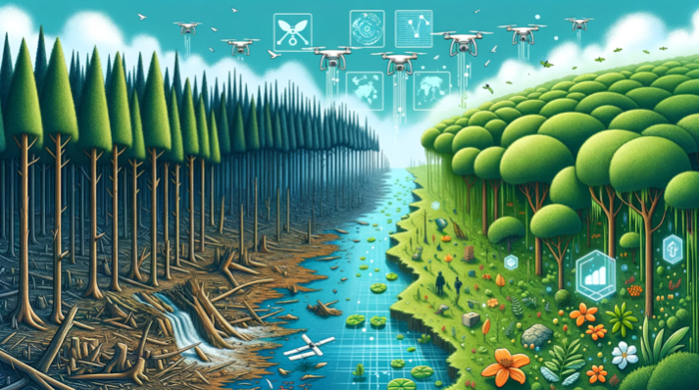
AI for sustainability
There are many opportunities for productive use of AI techniques to better maintain our natural environment
- AI can help address climate change by examining data on greenhouse gas emissions, carbon footprint, weather patterns, and other environmental factors
This can help inform policies and strategies for reducing emissions and mitigating the impacts of climate change
- AI can aid in biodiversity conservation by investigating data on species populations, habitats, and threats
This can help inform conservation strategies and improve our understanding of the complex relationships between different species and their environments
- AI can help improve waste management by analyzing data on waste production, collection, and disposal
This can help cities and municipalities optimize their waste management systems, reduce waste, and increase recycling rates.
Notes:
Data from https://www.nokia.com/networks/bss-oss/ava/energy-efficiency/

Slide 17
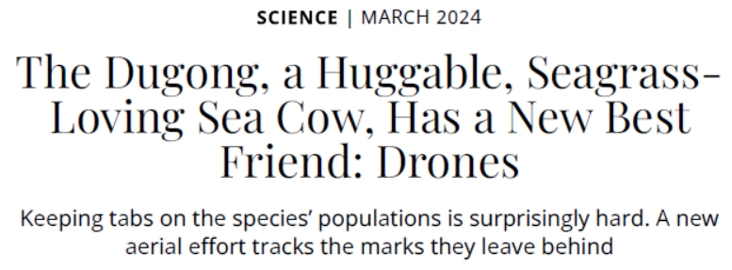
- Smart surveillance
Smart drones for surveillance endangered species populations: numbers, movements, patters in general, Illegal fishing/hunting
- Wildfire prevention: sensors in forest for early detection of wildfires
Deployed in West Canada: natural habitat protection, prevention of smoke production
Notes:
https://www.smithsonianmag.com/science-nature/dugong-huggable-seagress-loving-sea-cow-new-best-friend-drones-180983695/

Slide 18
Characterization of effective AI solutions
They must meet three criteria
Accessibility
The solution must rely on a proven technology that can be scaled and made readily available
Clear benefit
The solution must resolve a clear problem or user need
Actionability
The solution must offer recommendations that are easy to follow

Slide 19
Framework for using AI in combating climate change
Because of:
- digitisation and our capacity to gather large sources of data
- AI’s unique capacity to complete and interpret such large and complex data sets (e.g., on emissions, climate impact, deforestation, waste management, biodiversity etc.)
AI can be used to support all stakeholders in taking a more informed approach to combating carbon emissions and building a greener society
It can also be employed to help reorient global climate efforts toward the most at-risk regions (i.e., the Global South)
The use of AI offers an opportunity to make meaningful change at this critical moment
The Boston Consulting Group has created a a framework for using AI in combating climate change to categorise and critically analyse humanity's effort in this direction

Slide 20
Framework for using AI in combating climate change
Notes:
Discuss each topic, subtopic and most importantly examples.
From https://cdn-assets.inwink.com/de3a211c-d522-4534-8cb8-65999ca21469/c62eeb95-4510-4dbc-9256-41cecffec46d

Slide 21
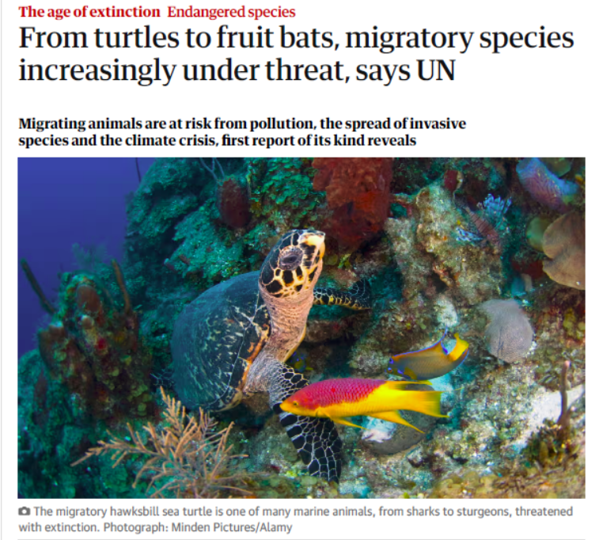
Notes:
https://www.theguardian.com/environment/2024/feb/12/from-turtles-to-fruit-bats-migratory-species-increasingly-under-threat-says-un

Slide 22
Framework for using AI in combating climate change
Accurate forecasting power of AI tools change how we think about climate change:
In the past, adaptation was often thought of as something that we did after the fact, in response to an event that had already occurred
Now we can take proactive approach to adaptation
This is essential to ensuring the resilience of our communities and our economy and protecting the most vulnerable among us
AI can help accelerate mitigation, adaptation and resilience efforts by providing the tools and data we need to make informed decisions

Slide 23
Where is AI having a tangible impact?
Three dimentions
Environmental monitoring and conservation
Climate change mitigation and adaptation
Agriculture and food
There are many other dimentions, but these three are perhaps the most bright examples
We will go through these three cases one by one

Slide 24
1. Environmental monitoring and conservation
Waste Management
Identification and separation of waste through visual perception (room for robotics)
- Drastically reduces contamination during separation
- Allows consumers to mix all recyclable goods
Smart sensors
- Fill-level sensors monitor the amount of waste in the bin and help determine whether collection is necessary
Waste fleet management
- Optimization of waste collection routes
Detection of illegal waste dumps
Identification of poluted areas on land and at sea based on the satelite imagery analysis
Notes:
https://www.rts.com/blog/ai-and-waste-management/
https://evreka.co/blog/how-to-utilize-from-ai-in-waste-management/

Slide 25
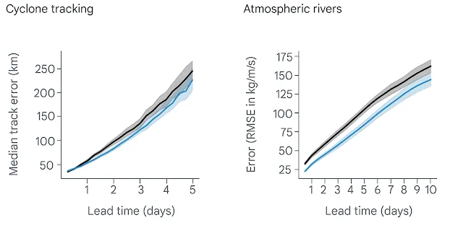
Environmental monitoring and conservation
Forecasting of Severe Weather Events
AI models can perform longer-term weather predictions very accurately
With AI we reach 99% accuracy
Move from say 95%.
This is decreasing error rate by 80%.
It also takes much less time allowing for
accurate and valuable early warning systems for severe weather events
AI can also be used to develop better and less wasteful evacuation plans
Notes:
In black a conventional weather prediction model, in blue an AI model
https://deepmind.google/discover/blog/graphcast-ai-model-for-faster-and-more-accurate-global-weather-forecasting/
https://www.science.org/content/article/ai-churns-out-lightning-fast-forecasts-good-weather-agencies

Slide 26
Environmental monitoring and conservation
Other Examples
Remote Sensing
- Using satellite imagery and AI algorithms to monitor deforestation, coral reef degradation, land use changes, and natural disasters
Wildlife Conservation
- AI-powered camera traps and sensors improve wildlife monitoring, tracking endangered species, and preventing poaching
Water Quality Monitoring
- AI systems analyzing data from sensors can autonomously monitor water quality in rivers, lakes, and oceans, helping in pollution detection and conservation efforts

Slide 27
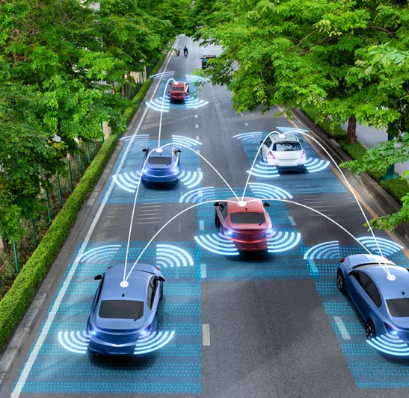
2. Climate change mitigation and adaptation
Transportation
Route optimization
Predictive maintenance
Efficiency in space use
Inventory and work-force management
Impact on safety and traffic accidents
Self-driving cards could reduce carbon emissions by 50% by 2050 through three factors
Driving electric
Optimising transportation systems (routes)
Proliferating ride-sharing

Slide 28
Climate change mitigation and adaptation
Other Examples
Smart Cities
- Cities filled with sensors could allow for extreme efficiency increases in terms of space and energy usage
Climate Modeling
- AI-enhanced climate models predicting climate patterns, extreme weather events, and sea-level rise, aiding in adaptation strategies
(Math models + ML + Weather observation)
Renewable Energy Optimization
- AI algorithms optimizing the generation, distribution, and storage of renewable energy sources, such as solar and wind power, maximizing efficiency
Carbon Capture and Storage
- AI technologies enhancing carbon capture and storage methods to reduce greenhouse gas emissions from industrial processes

Slide 29
3. Agriculture and food
Precision Agriculture
Precision irrigation
- Agriculture uses 70% of freshwater resources
40% of water is lost to poor water management
- Precision irrigation has potential to reclaim this 40% of water
Precision fertilizer
- Examples show that precision fertilizer use can produce 30% higher yields in peanut farming
Precision pesticide use
- This practice can half the damage of pesticide use on bio-systems
All these rely on high-tech sensors and AI-powered data analysis

Slide 30
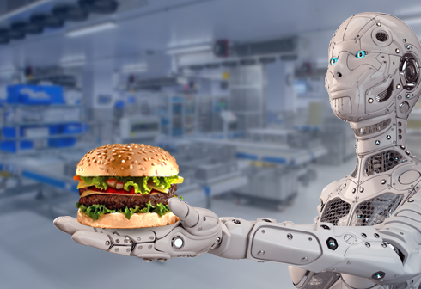
Agriculture and food
Other Examples
Food Recognition
Food Delivery Optimization
Smart Kitchen Management
Food Waste Reduction
Allergen and Ingredient Detection
Food Safety Monitoring
Personalized Nutrition and Diet Planning
Promoting sustainable food systems

Slide 31
Sustainability of AI

Slide 32
Sustainability of AI
Green AI
- Green AI is the emerging branch of AI technology that aims to reduce environmental impact of technology
The amazing technology that we have been discussing in this course does not operate free of problems
- It consumes lots of energy
It also produces sizable amount of electronic waste
These exacerbate the problems that we are using the technology to solve
Societies now strive to minimize the footprint of AI technologies on environment

Slide 33
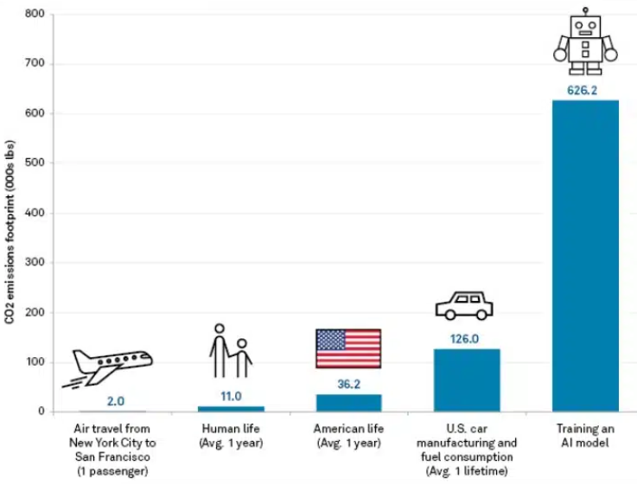
Energy usage
Training AI models and data center
running and maintenance is very
energy-intensive
It is not only about training one model,
the data center (computers) must be
kept running
The energy used is seldom green
energy

Slide 34
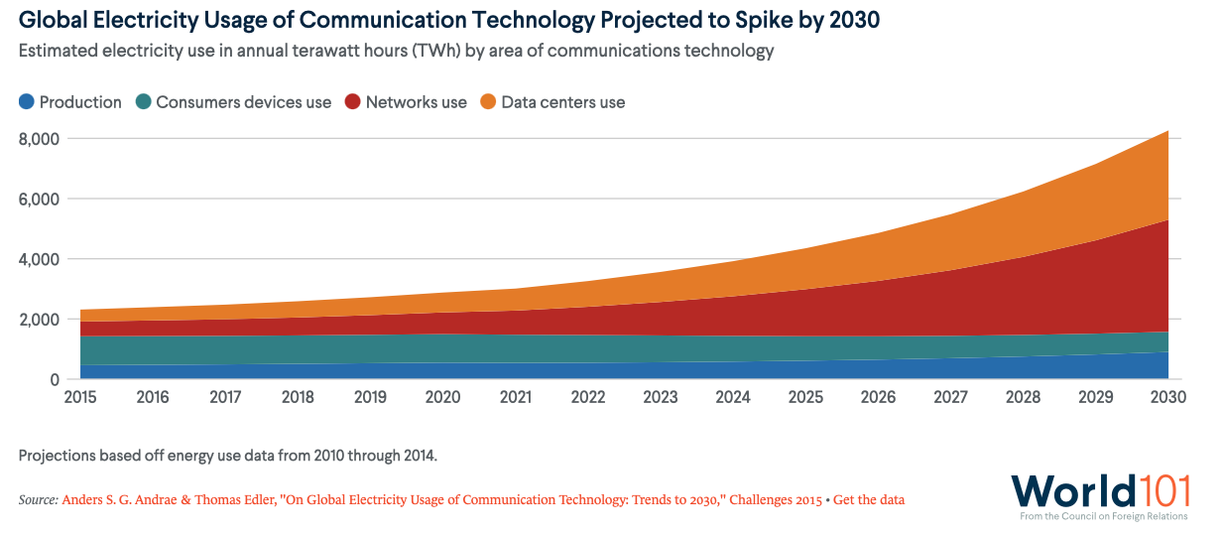
Energy usage
This industry is using as much energy as aviation industry, and is expected to grow

Slide 35
Energy usage
One of the key drivers of a more sustainable AI is modularity
- Modularity breaks down subsystems of a server into standard building blocks
- This system can reduce the amount of embodied carbon in a server's hardware components, and can be better used (for energy consumption)
The opportunities for greater energy efficiency within AI deployment will only expand over the next years
- Significant hardware optimization strides
- The rise of AI factories that train AI models while modulating energy consumption based on its availability
- Growth of liquid (instead of air) cooling
- (Much more powerful quantum computing? (less time, but wow much energy?)
Notes:
https://www.technologyreview.com/2024/01/10/1086259/deploying-high-performance-energy-efficient-ai/
https://www.ri.se/en/generative-ai-must-run-using-liquid-cooling

Slide 36
Waste production
- Electronics (a big component of part of AI hardware) are not as recyclable as we think
- In 2021, the world discarded an estimated 63.3 million tons of electronic waste, which outweighs the Great Wall of China
- E-waste contains hazardous chemicals, including lead, mercury, and cadmium, that can contaminate soil and water supplies and endanger both human health and the environment
- By 2050, the World Economic Forum projects that the total amount of e-waste generated will have surpassed 120 million metric tonnes
- The society does not seem to have great plans for how to deal with e-waste (except use AI to optimize its management)

Slide 37
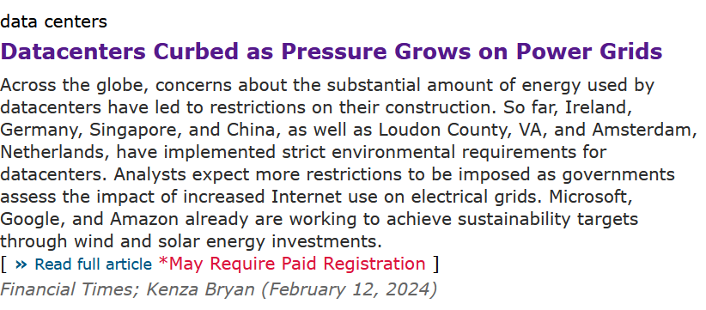
Using AI to tackle problems with AI
However, using AI to tackle problems generated with AI is problematic
- You will need to train the AI model that you will need to solve the problem
- This, clearly, generates a new problem (of the similar type)
- This new problem is probably smaller, but would require its own IA system to manage
- That system needs training etc.
This is a wasteful and potentially infinite loop
We will need more and greener innovations
to solve this!

Slide 38
Bibliography
How Can Artificial Intelligence Combat Climate Change? (2023) https://world101.cfr.org/global-era-issues/climate-change/how-can-artificial-intelligence-combat-climate-change
How AI Can Be a Powerful Tool in the Fight Against Climate Change (2022) https://cdn-assets.inwink.com/de3a211c-d522-4534-8cb8-65999ca21469/c62eeb95-4510-4dbc-9256-41cecffec46d?sv=2018-03-28
Harnessing Artificial Intelligence to Accelerate the Energy Transition (2021) https://www3.weforum.org/docs/WEF_Harnessing_AI_to_accelerate_the_Energy_Transition_2021.pdf
Deploying high-performance, energy-efficient AI (2024) https://www.technologyreview.com/2024/01/10/1086259/deploying-high-performance-energy-efficient-ai/

