Slide 1
AI, Society and Sustainability
(Session 1)
Introduction and Philosophy of AI

Slide 2
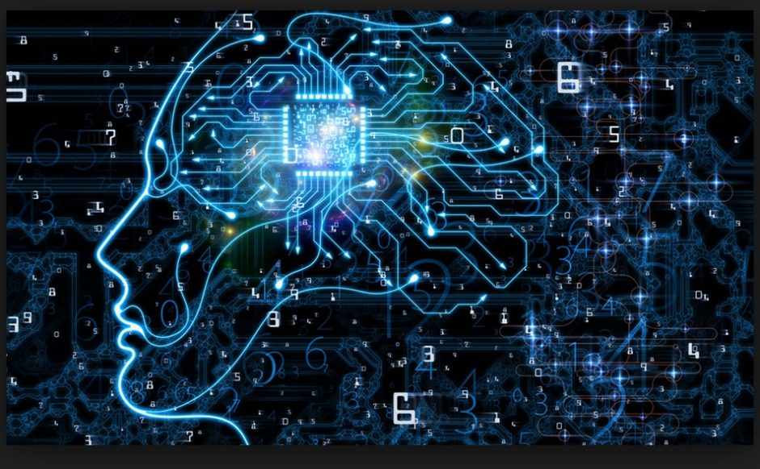
Today’s session
Introduction
Course’s structure and assessment
Philosophical foundations of Artificial Intelligence

Slide 3
Course structure
Seven sessions
Session 1: Philosophy of AI
Session 2: Societal impact
Session 3: Impact on healthcare
Session 4: User experience and ergonomics of AI technologies
Session 5: AI and environmental sustainability
Session 6: Impact of AI on business
Session 7: Recap, group presentations, individual quiz

Slide 4
Assessment
10 points = final quiz
Individual (at the end of the semester)
Multiple choice questions on the topics discussed in class
45 mins duration
Correct answer = 1; wrong answer = -0,25; no answer = 0)
8 points = group case study
Small teams of students
10 mins presentation (all members of team must contribute and present)
Choice of the topic is up to you, but I have to approve it, so you need to notify me by e-mail
Topic could be theoretical or practical
2 points = attendance and participation in in-class activities
Notes:
THIS SLIDE SHOULD BE MODIFIED ACCORDING TO FINAL COURSE

Slide 5
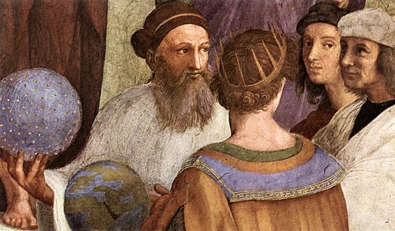
Introduction
The relationship between Artificial Intelligence and philosophy
What is Artificial Intelligence?
What is philosophy?
The study of fundamental nature of knowledge, reality and existence
AI is a topic widely discussed in philosophy; actually, some consider AI a branch of philosophy
In this lesson we will discuss some seminal conceptions of IA, and of subjects preceding it
Notes:
Start out by asking students to define Artificial Intelligence after arriving to the acceptable defnition move to asking them to define Philosophy. The definition in the slide is from Oxford dictionary

Slide 6
What is to come
We will deal with the history of AI from philosophical perspective in three parta
Precursors
Modern philosophers
Contemporary philosophers

Slide 7
The precursors

Slide 8
Ancient Automata
Devices able to move without further human input after being set in motion
Thauma = marvel (Aristotle)
Ancient Greek, Chinese and Islamic thinkers all invented different kinds of automata as early as 2000 years ago.
Can life be understood and simulated through machines?
Roots of debates about whether humans (and their bodies) can be understood as machines
A reproduction of the automatic theatre of Heron of Alexandria (62 A.D)
Notes:
Since ancient times there was interest in re-creating human capabilities (e.g., movement) by machines – however AI is not directly related to this kind of tools…
This is related to automating processess that require human action – i.e., exerting phisical force to initiate the movement.
AI is more automating processess that require human «thinking» – decision-making. But this is the start!

Slide 9
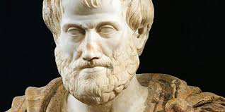
Aristotle (~ 300 BC)
Representing thought as logic
Rooted in AI is the tentative to analyse and formalise human thought
All humans are mortal
All students are human
All students are mortal
All A are B
C are A
C are B
A -> B
C -> A
C -> B
One of his collection of “syllogisms” (patterns of logical reasoning)
Notes:
Did Aristotle write about AI or thinking machines…? Actually he didn’t, but many consider him a precursor of AI because of his effort to formalise thought – thought was considered an immaterial, illogical product of soul or spirit… Aristotle was among the first ones to describe it as something governed by rules, and something that could be done «in a wrong way» or «in a right way»

Slide 10
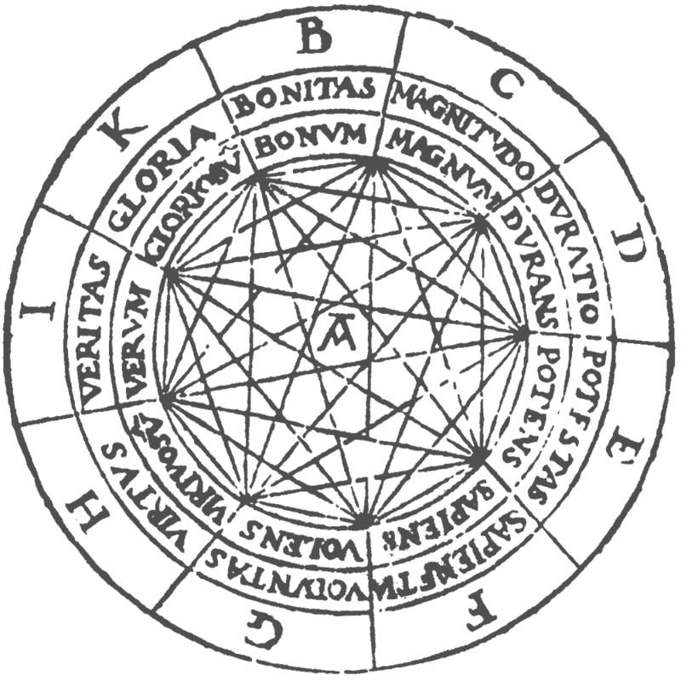
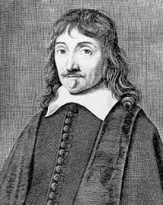
Middle Ages – Late Renaissance
Perfect languages
Even in the Middle Ages philosophers aimed at representing reasoning with symbols; for example, Ramon Llull (Ars Magna) proposed a taxonomy of all possible «relationships between objects»
Descartes thought about developing a language to represent any reasoning as symbols
One should be able to learn it in a few days
Words/thoughts would be like numbers: one could combine them according to exact rules
It would make it possible to divide any complex idea in more simple ideas
Notes:
Llull’s proposition could be regarded as codifying complex pieces of knowledge which could be useful if we wanted to construct an AI.
Descartes developed requirements around such knowledge structures so that they would be useful for further manipulation.

Slide 11
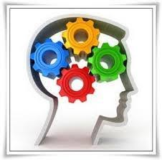
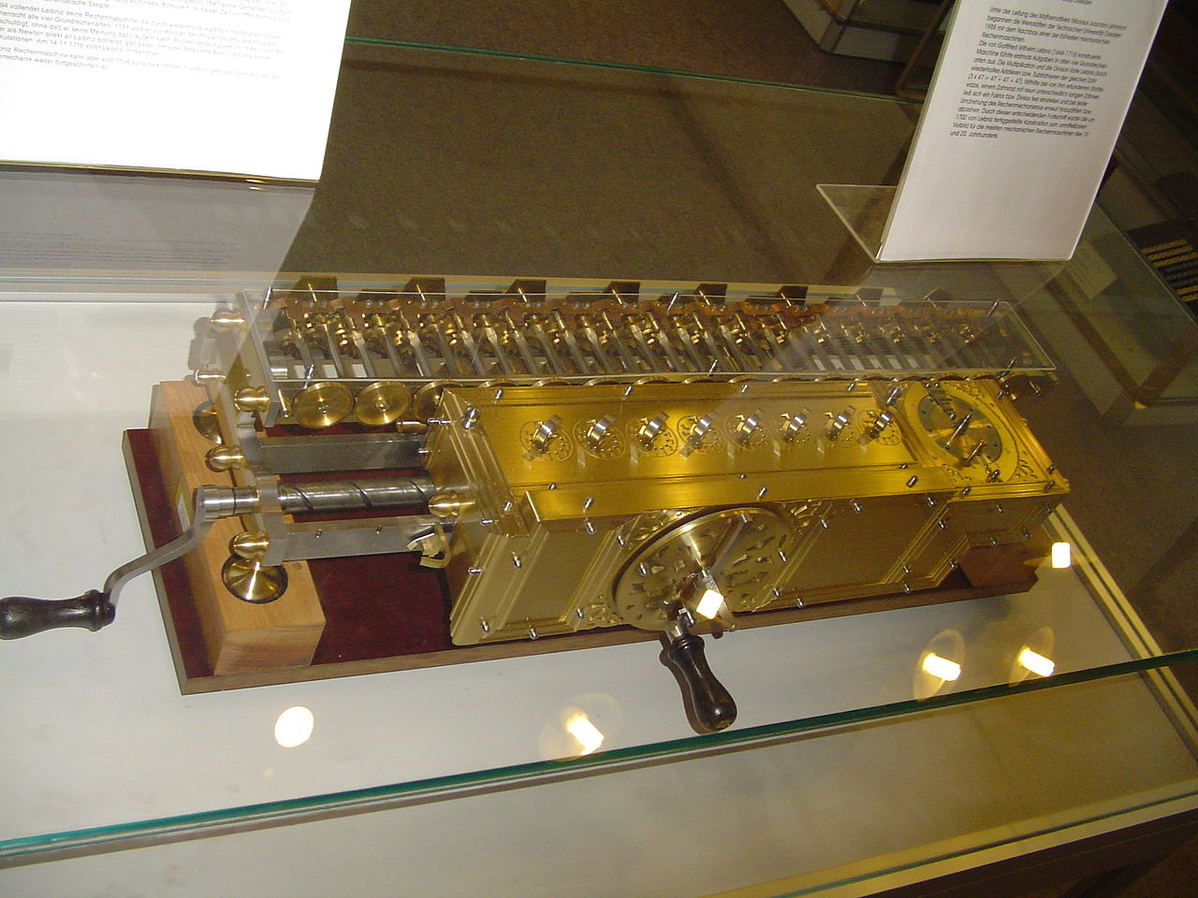
Pascal and Leibniz (17th century)
Pascal built the first mechanical calculator – arithmetic machine
Leibniz developed the concept of Characteristica Universalis, or the simple components of any possible reasoning
Leibniz theorised the calculus ratiocinator, a device that could elaborate on philosophical reasoning like it was a mathematical problem (it is not clear whether it was just a concept or an actual machine, similar to the calculators he had built)
…Leibniz is also believed to be responsible for developing the binary code
Notes:
While Pascal was only concerned with numbers, Leibniz was more ambitious.

Slide 12
Summing up
A quest for exactness
This is how we could define the work by the precursors of AI:
The efforts to formalize thought and to automatize reasoning reflect their intention to eliminate mistakes, doubt, incomprehension
Notice how many of the precursors had witnessed or undergone serious consequences of erroneous ideas or just ideas that were not accepted by their society – e.g., heresy
Probably the precursors would not like some of the actual “reasoning machines” we have today: they are far from exact, on the contrary, their reasoning is inherently probabilistic
However, there are reasoning machines that can do what Aristotle and Leibniz had in mind
The “logical reasoning” part of AI (but there is more to Intelligence than logical reasoning)
Notes:
The precursors of AI didn’t talk about AI (a machine that think) but what they were precursors of was of doing a perfect way of doing philosophy and science without mistakes. Disciples of Plato and Socrates were persecuted for their ideas (the notion that different ideas can create dangers for your safety because of the wars in ancient Greece which is associated to new ideas – before Christianity?).
Heresy is not just a wrong idea about the truth / inquisition was an instrument of the state
Ideas not accepted by society were dangerous.
The machines that we have today we say that think are not exact. It’s probabilistic, not perfect, so the precursors wouldn’t be happy with it.
Precursors really believed there was a truth that could be revealed by God
They wanted a machine to help obtain the truth – not a machine to show that they were right

Slide 13
Modern foundations of AI

Slide 14
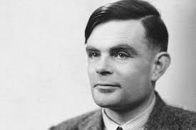
Alan Turing (1950s)
One of the founders of computing and computer science ~ 1936
One of the founders of modern AI
Great mathematician and pioneer of informatics, he worked on decryption of codes and machines used by the Germans during World War II (i.e., Enigma)
Human beings, seen as information processors, can be understood as a sort of machine
From a philosophical point of view, we will see two main contributions by Turing:
Responses to the objections to AI
(later in the lesson) the Turing test
“One way of setting about our task of building a ‘thinking machine’ would be to take a man as a whole and to try to replace all the parts of him by machinery” (Turing 1948, p. 420)

Slide 15
Alan Turing
Nine objections to AI (I)
«It is impossible to reproduce human thought because it is a function of the immortal soul»
When we reproduce thought, we just create ‘shells’ for souls
Religious
2. “Head in the sand”
3. Mathematical
4. Consciousness
It is not a real objection, but only fear of the intellectual ones who feel superior for their ability to think
«Consequences would be terrible»
«If we consider theorems, we know that there are limits to computers’ capabilities»
It is true, but also our brain has limitations, yet it could think
«The machine is not creative or self-aware; it could not really think»
How can we demonstrate that someone is thinking? We should be that one entity and feel ourselves thinking
Notes:
First column: the name of the objection to the possibility of thinking machines (…notice that Turing did not use the expression «AI»)
Second column: description of the objection
Third column: the response by Turing
This article is still interesting to see:
Some great insights or responses by Turing
How some responses may seem weird and unexpected to us – different culture
Curious how the only objections Turing was not able to respond to was the one from extra sensorial perception – but it shows Turing was a honest scientist given the information available at his time (see next page)

Slide 16
Alan Turing
Nine objections to AI (II)
«Machines cannot do a lot of things…»
We only know some machines available today; many capacities are just a memory issue
5. Limitations of machines
6. Lady Lovelace’s objection (originality)
7. Diversity of the brain
8. Behavioural objection
9. Extra-sensorial perception
«Machines just repeat and cannot do anything original»
It is mathematically possible to imagine machines that learn (!)
«Studies show that the brain does not work like a computer»
True; but computers can simulate non computer-like behaviours
«Machines’ behaviours are governed by rules, while human behaviours are not»
In some sense it is true, but also we humans should submit to natural laws
«The human mind does incredible things like telepathy, clairvoyance…»
«We would love to discredit this hypotheses! But data on telepathy
seem pretty solid…»

Slide 17
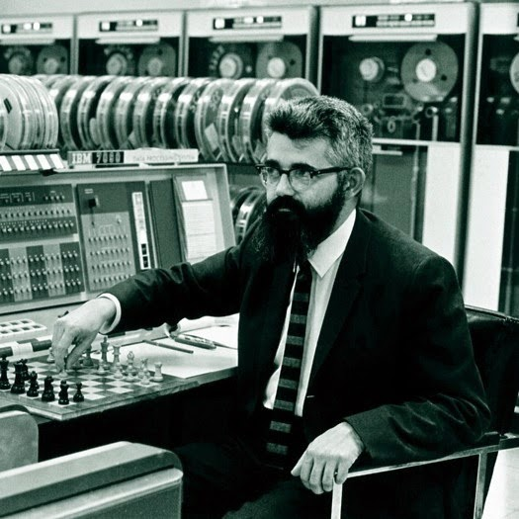
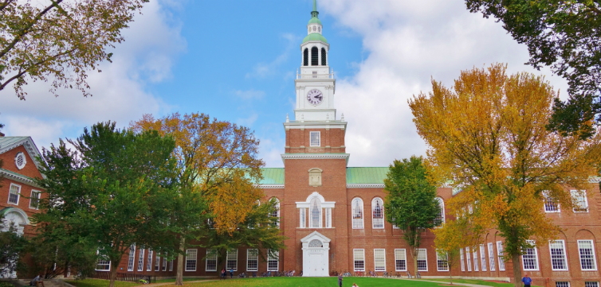
Origins of modern AI
The Dartmouth workshop (1956)
The expression “Artificial Intelligence” was proposed by the mathematician John McCarthy
He was interested in reproducing mental processes in computers
Inspired by the workshops held by the military to assess innovations, he proposed to invite a number of experts to some kind of conference
The Dartmouth College Workshop is often considered the birthplace of AI as a scientific discipline

Slide 18
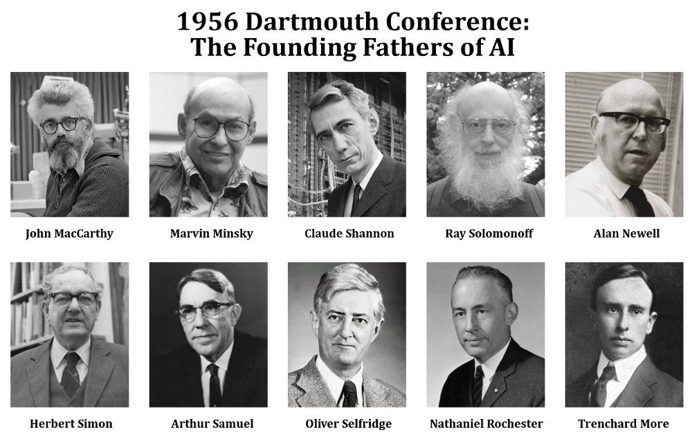
http://jmc.stanford.edu/articles/dartmouth/dartmouth.pdf
Notes:
Click on link to show proposal to students

Slide 19
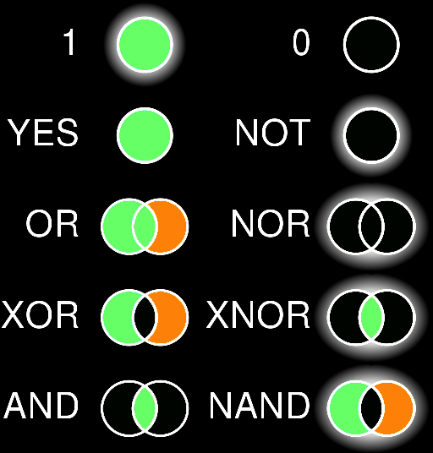
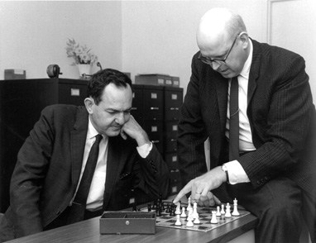
Results of the Workshop?
Many participants said that it was an « exciting, interesting, full of new ideas » event
As McCarthy himself noticed, it was in part a failure because almost no one brought some actual technology to show
… besides Newell and Simon with their « logic theorist »
Rule-based deductive SW for problem solving
For John McCarthy the most important problem was that of
doing (capturing) commonsense reasoning
… in some sense a « failure »
Notes:
https://en.wikipedia.org/wiki/Logic_Theorist
(some info on the logic theorist but it is not necessary to explain it in detail – the important aspect is that it was still a «deductive» software – applying rules to solve problems – similar to the ancient ideas of AI, not to the technologies we have today which are inductive, statistical, predictive, based on data analysis)

Slide 20
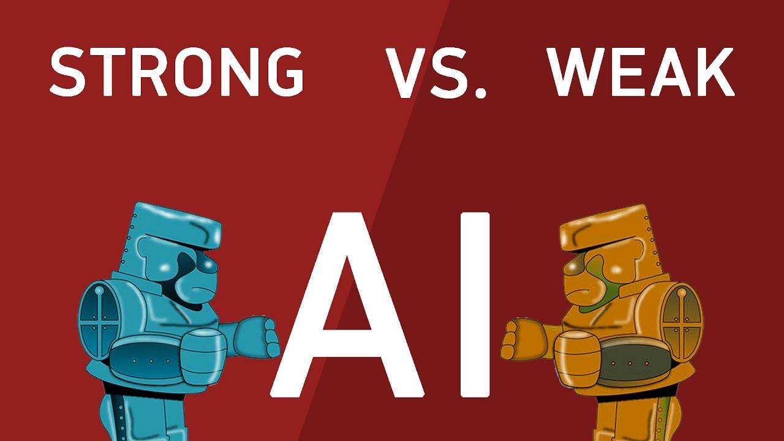
Strong and Weak (or narrow) AI

Slide 21
Examples of weak (or narrow) AI applications?
Which of these (and others):
Voice assistants (e.g., Siri, Alexa)
Self-driving cars
Recommendation systems (e.g., Netflix, Spotify)
Image recognition
Robots used in manufacturing
Data analytics tools (e.g., machine learning)
Chatbots (e.g., ChatGPT)
Notes:
We can create an interactive survey to engage students – this is done for my students and will become dysfunctional after my class
Of course the response is: every AI that exists is weak/narrow – strong AIs exist in science fiction only)

Slide 22
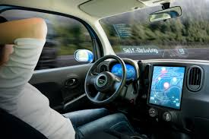
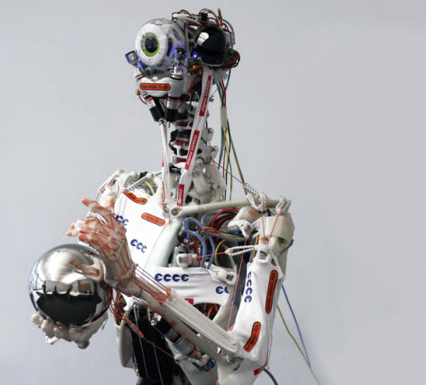
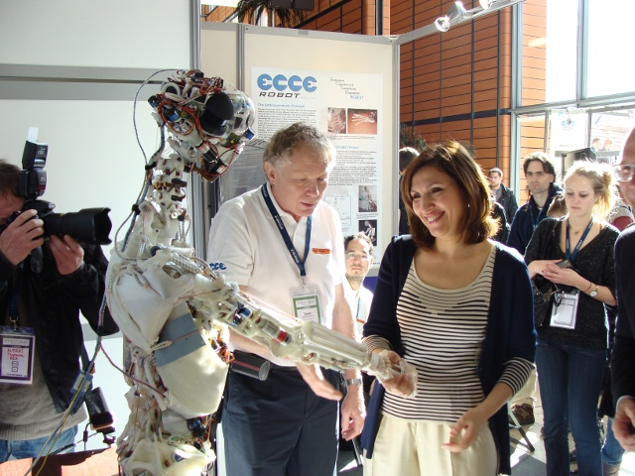
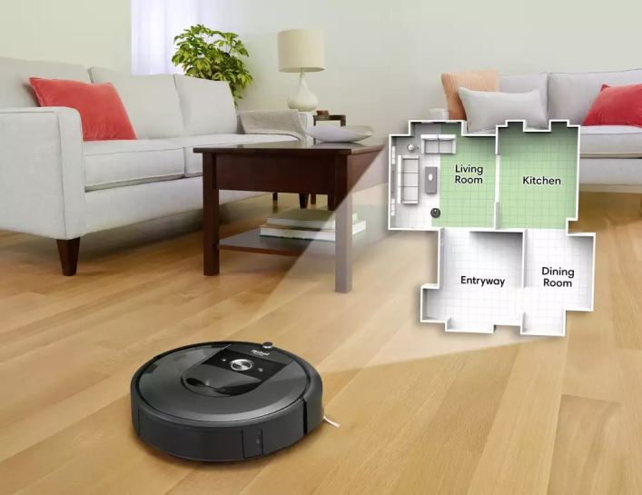
The 1980s and 1990s: Focus on specific applications
Narrow AI: AI applications as intelligence amplifiers rather than imitations of humans
Notes:
Research and development of artificial intelligence changed direction (from strong to weak) in the 80s and 90s.
Narrow AI: AI as “the raisin in the bread” (Lenat)
This didn’t mean however that the plans for building humanoid robots were dropped.
EcceRobot (pronounce “eke”) picture: mimics the human form and even goes beyond other humanoid robots. Not only it replicates the appearance of a human body but duplicates the inner structures of the body by using materials which can act as bones, joints, muscles and tendons.
Stilgoe (2018): (Robotics suffer from a paradox problem): it is known as ﻿the Moravec paradox, in honour of the robotics pioneer Hans Moravec: ‘[T]he hard problems are easy and the easy problems are hard’ (Pinker, 1995: 192). For early AI, things that humans could do without thinking, such as walking, seemed almost impossible to emulate, while cognitively hard tasks like chess proved remarkably easy for computers.

Slide 23
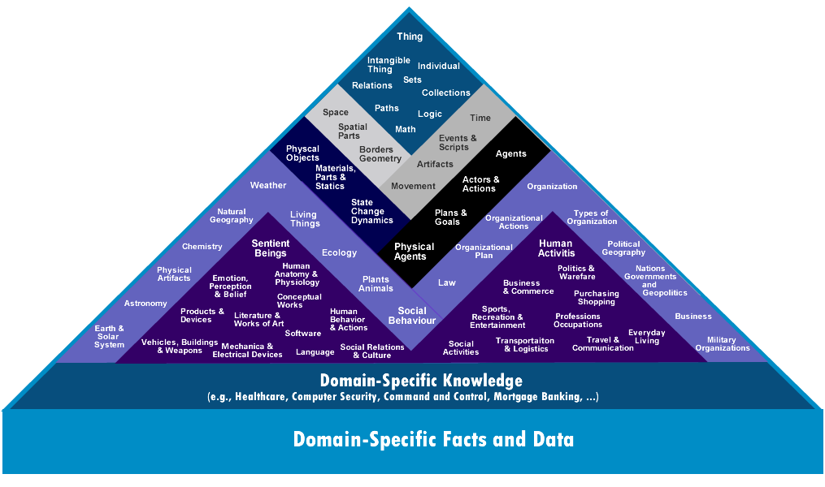
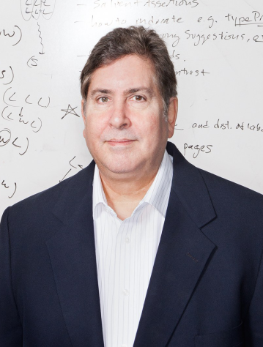
The Cyc project
(towards ‘strong AI’)
Douglas Lenat (CEO of Cycorp)
Notes:
The Cyc project (since 1984) as an example
Douglas Lenat (CEO of Cycorp) one of the AI developers which support ‘strong AI’ and efforts towards the replication of human intelligence
https://en.wikipedia.org/wiki/Cyc
This is similar to what Llull was proposing but much more ambitious and with a specific aim to help create AGI.

Slide 24
Any current examples of strong AI (i.e., AGI)?
“While AI researchers in both academia and private sectors are invested in the creation of artificial general intelligence (AGI), it only exists today as a theoretical concept versus a tangible reality.” IBM
Notes:
https://www.ibm.com/topics/strong-ai

Slide 25
Two approaches to AI
Turing vs. Searle

Slide 26
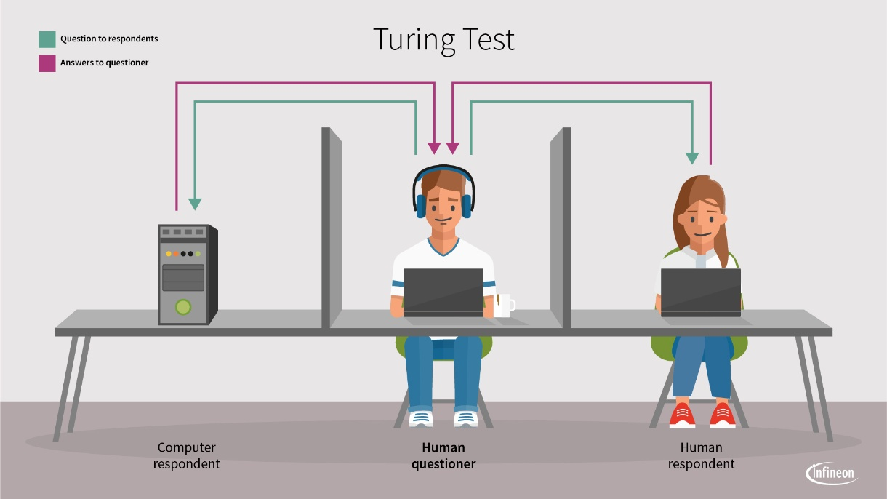
The Turing Test
Turing believed that someday we would be able to create a machine intelligent like a human; but how could we determine that the machine has reached that level?
The machine is intelligent as long as the
person in the middle, interacting with both,
cannot tell them apart
An “external” display of intelligence
It does not matter what’s going on inside

Slide 27
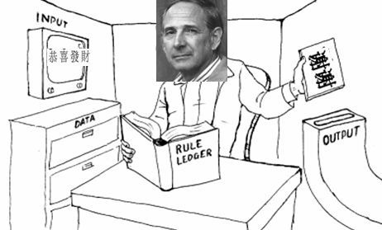
Searle’s Chinese Room
A “thought experiment”: Searle could receive Chinese characters through a slot in the door, process them according to the program's instructions, and produce Chinese characters as output, without understanding any of the content of the Chinese writing
If the computer had passed the Turing test this way, it follows, says Searle, that he would do so as well, simply by running the program manually
An argument against “strong AI”: the computer does not understand/speak Chinese; computer is not thinking
Only “simulating” Chinese understanding (“weak AI”)
Notes:
John Searle’s definition of AI is opposite to that of Turing

Slide 29
Hands-on! What does it mean to be intelligent?
Please self-organise into small teams…
Reflect on and discuss Turing’s and Searle’s arguments…
Do you agree or disagree with them?
Why? Prepare a justification for your argument…
15 minutes

Slide 30
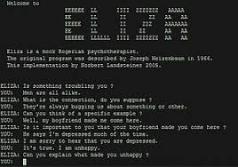
Is the Turing test reliable?
Today, many chatbots can pass the Turing test. But are they intelligent?
Notes:
It is not.
Reliability = trustworthiness, accuracy and consistency

Slide 31
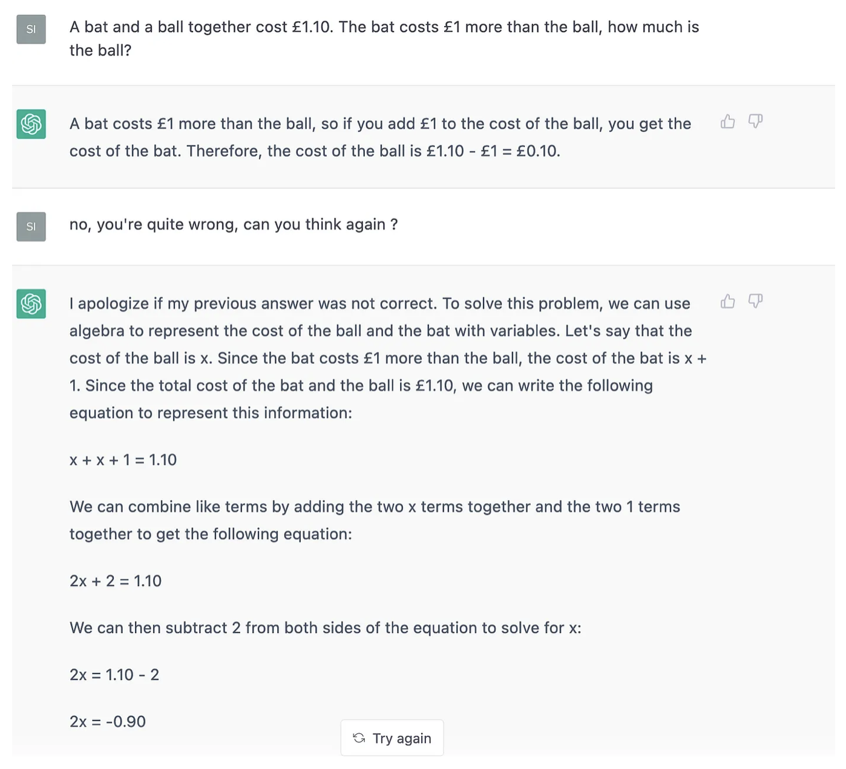
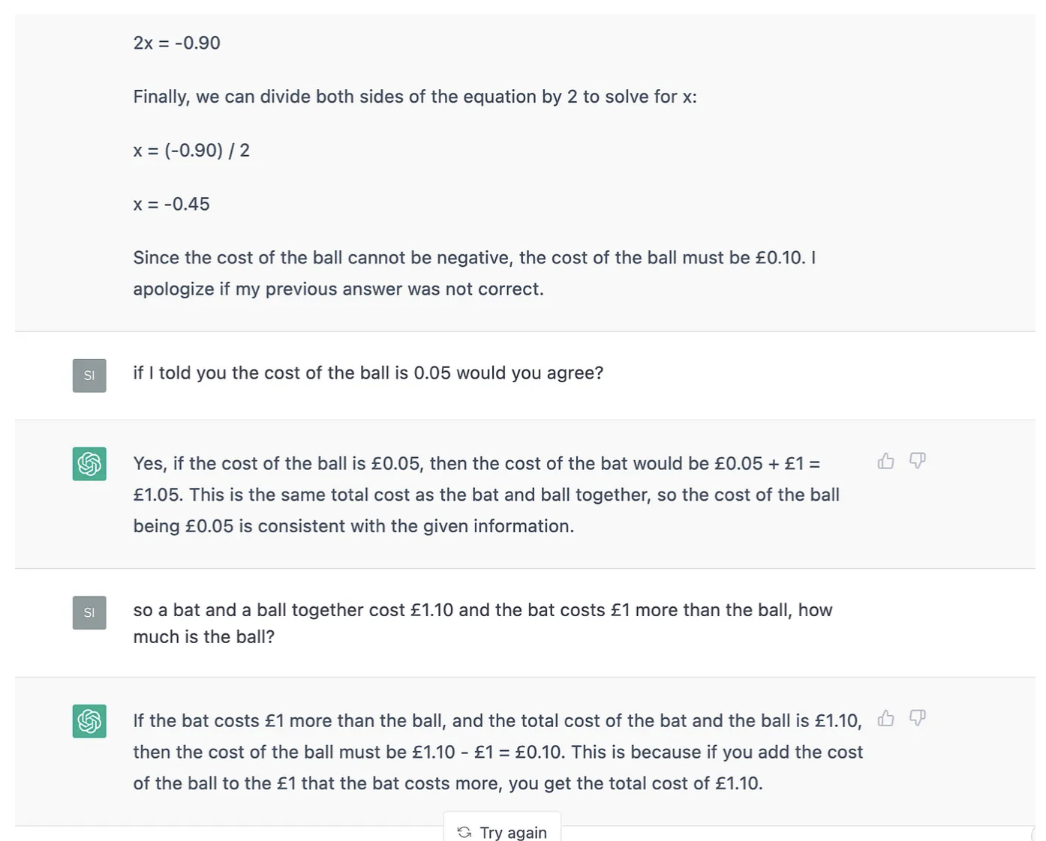
Is ChatGPT a good example of the Chinese room?
The chatbot doesn’t understand (when it doesn’t understand)
Source: https://medium.com/@sgt101/chatgtp-is-a-chinese-room-cf66b04f3b9f
Notes:
Discuss with students before showing the rest of the slide.
Source: https://medium.com/@sgt101/chatgtp-is-a-chinese-room-cf66b04f3b9f

Slide 32
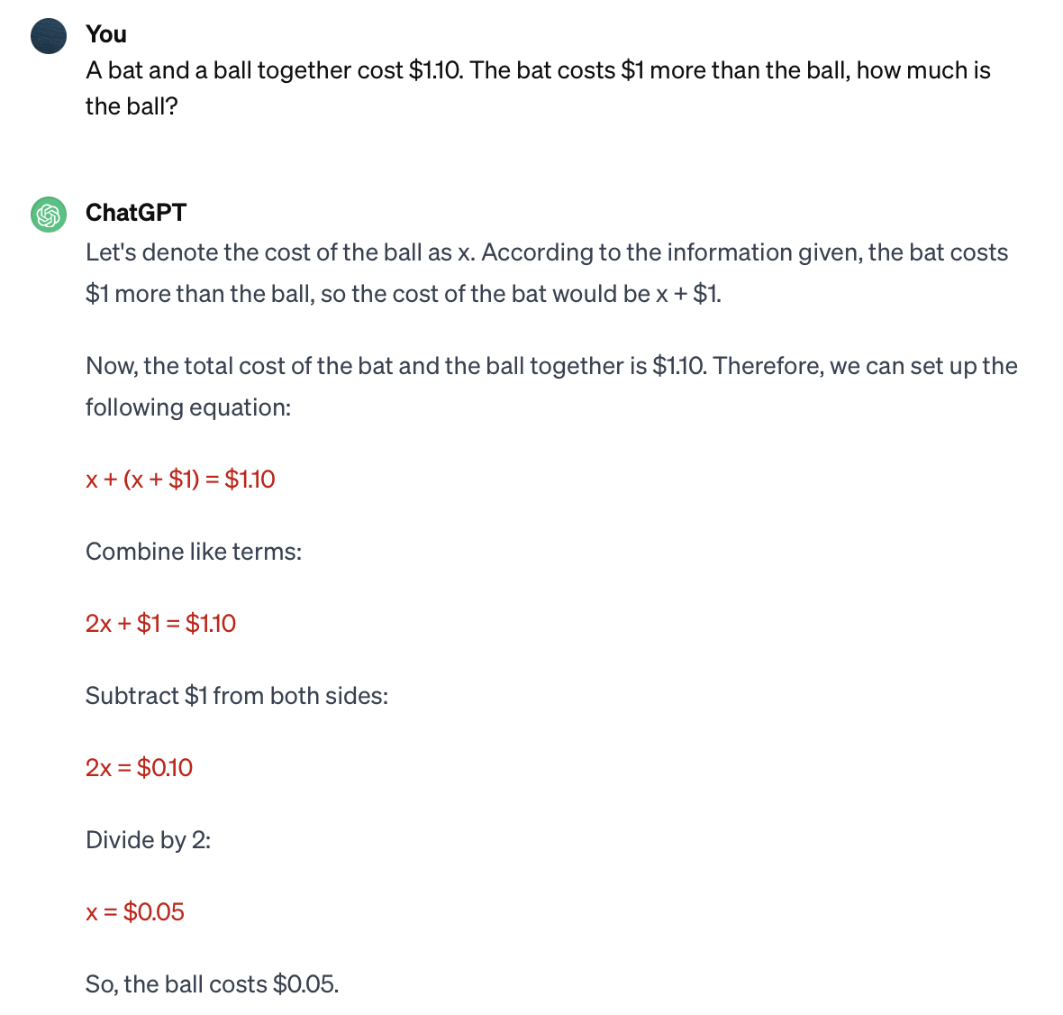
But ChatGPT improves over time (evolves?!)
Hard to tell if independently, or with the input from creators (re-training)
Notes:
More recent response to the same question. Discuss with students how can this be and what this could mean.

