Slide 1
ISTQB® in a Nutshell

Slide 2
WHAT IS THE ISTQB®?
ISTQB®: International Software Testing Qualifications Board (www.istqb.org):
Non-profit association
Founded in 2002
Headquartered in Belgium
Has its own constitution, rules and regulations
Composed of volunteer international Testing Experts
Responsible for the “ISTQB® Certified Tester” scheme worldwide
ISTQB® is the world’s leading organization for Software Testing Certification
Advancing
the software testing profession

Slide 3
ISTQB® ADVANCED LEVEL SMARTSHOW
ISTQB® Smartshow introduces the ISTQB® Certification in less than 3 minutes
http://www.youtube.com/watch?v=HrK1zhqyW4k

Slide 4
ISTQB® VISION
“To continually improve and advance the software testing profession by:
Defining and maintaining a Body of Knowledge which allows testers to be certified based on best practices, connecting the international software testing community, and encouraging research.”

Slide 5
ISTQB® MISSION
We promote the value of software testing as a profession to individuals and organizations.
We help software testers to be more efficient and effective in their work, through the certification of competencies.
We enable testers to progress their career through a Professionals’ Code of Ethics and a multi-level certification pathway that provides them with the skills and knowledge they need to fulfil their growing responsibilities and to achieve increased professionalism.
We continually advance the Testing Body of Knowledge by drawing on the best available industry practices and the most innovative research, and we make this knowledge freely available to all.
We set the criteria for accrediting training providers, to ensure consistent delivery of the Body of Knowledge, worldwide.

Slide 6
ISTQB® MISSION
We regulate the content and coverage of exam questions, the examination process, and the issuing of certifications by official examination bodies.
We are committed to expanding software testing certifications around the world, by admitting member boards into the ISTQB®. These boards adhere to the constitution, bylaws, and processes defined by the ISTQB®, and participate in regular audits.
We nurture an open international community, committed to sharing knowledge, ideas, and innovations in software testing.
We foster relationships with academia, government, media, professional associations and other interested parties.
We provide a reference point against which the effectiveness of testing services can be evaluated, by maintaining our prominence as a respected source of knowledge in software testing.

Slide 7
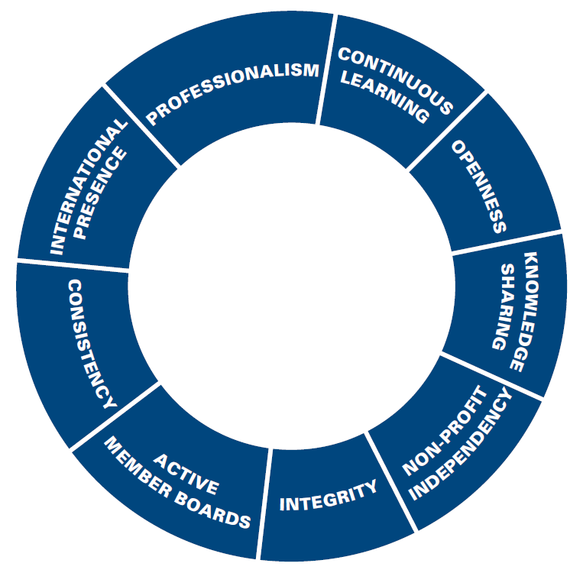
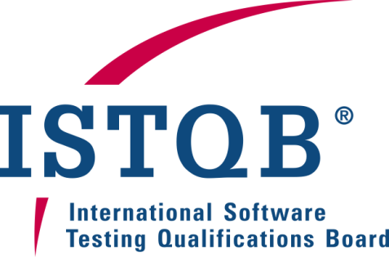
ISTQB® VALUES

Slide 8
SOFTWARE TESTING MARKET CHALLENGES Shortage of Skilled Labor
Technavio, an independent technology research and advisory company, analyzed the key challenges faced by the Global Software Testing Services market, highlighting in particular the “Shortage of Skilled Labor”
The Global Pure Play Software Testing Services market is growing rapidly, thus increasing the demand for skilled labor. However, this has created a disparity in supply and demand, as a result of which, sourcing and retaining skilled labor has become a challenge.
The shortage of availability of required skills is now becoming a major challenge for the independent software testing organizations.
Since the current educational system is not geared up to the required standards and demands of the market, this challenge is expected to have a bigger impact on the market in the future.
(Global Software Testing Services Market 2011-2015, Technavio)

Slide 9
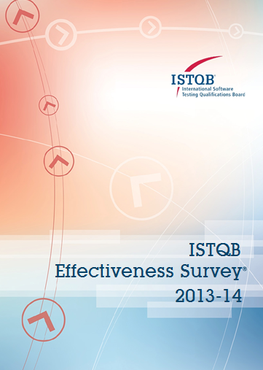
ISTBQ® EFFECTIVENESS SURVEY
As part of its commitment to continuous improvement and the advancement of the software testing profession, in 2013 ISTQB® conducted an international online survey for test engineers and managers.
The survey was open from June to September 2013 and several thousand responses were received from almost 70 countries; in particular, respondents were:
2855 test engineers
779 test managers
In the remainder of this presentation, references will be made to some key results of the survey
The full report is available for free download from the ISTQB ® Web Site

Slide 10
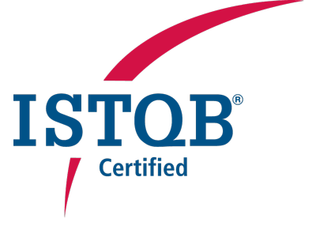
BENEFITS FOR PROFESSIONALS
International recognition of acquired competencies and skills
Authorized to use the “Certified Tester” logo (specifying the level of certification)
Whole of career path support, from Foundation to Expert level

Slide 11
BENEFITS FOR COMPANIES
ISTQB® certification can provide a competitive advantage for companies, promising a higher level of reliability of the applications being developed due to efficient and cost effective testing practices derived from the ISTQB® competencies
Consulting companies with certified staff can offer higher-level services to customers, increasing revenues and brand value
ISTQB® has defined a “Partner Program” for companies that engage a large number of certified testers

Slide 12
CONTENTS
3
Syllabi and Extensions
3.1
General Introduction
3.2
Foundation Level
3.3
Agile Tester
3.4
Advanced Level
3.5
Expert Level

Slide 13
ISTQB® SYLLABI AND GLOSSARY
ISTQB® has defined three levels of syllabi:
Foundation
Advanced (Test Manager, Test Analyst, Technical Test Analyst)
Expert (Improving the Testing Process, Test Management, Test Automation, Security Testing, etc.)
Syllabi are publicly available for download from the ISTQB® Website (http://www.istqb.org/downloads.html)
Syllabi are written by testing experts and continuously reviewed and improved
Terms used in the ISTQB® syllabi are defined in the ISTQB® Glossary (http://www.istqb.org/downloads/viewcategory/20.html)
Syllabi and Glossary are translated in many languages by the ISTQB® Member Boards; please refer to their Websites to download free-of-charge the documents translated into local languages

Slide 14
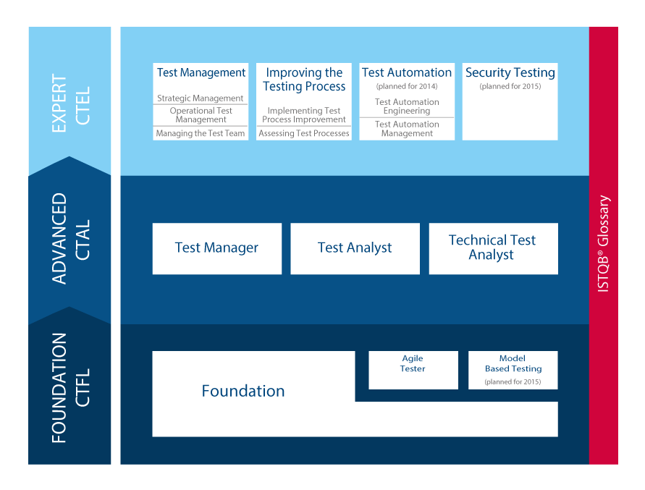
ISTQB® LEVELS AND SYLLABI

Slide 15
CONTENTS
3
Syllabi and Extensions
3.1
General Introduction
3.2
Foundation Level
3.3
Agile Tester
3.4
Advanced Level
3.5
Expert Level

Slide 16
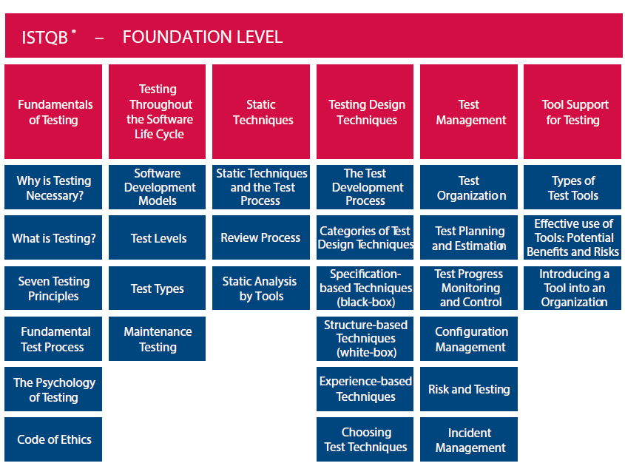
ISTQB® FOUNDATION LEVEL

Slide 17
CONTENTS
3
Syllabi and Extensions
3.1
General Introduction
3.2
Foundation Level
3.3
Agile Tester
3.4
Advanced Level
3.5
Expert Level

Slide 18
ISTQB® EXTENSIONS
In order to satisfy the increasing demand for vertical testing competences, ISTQB® has introduced the concept of “Extension”
An “Extension” is a training and certification module focused on a specific topic, for instance:
Domain-specific testing practices
Specific Testing Techniques
Specific Testing Methods
The ISTQB® Foundation Level Certification is a pre-requisite
The first extension is focused on “Agile Tester”, released in June 2014
MBT (Model-Based Testing) extension is also in road-map

Slide 19
THE CONTRIBUTION OF AGILE TESTERS
Agile testers should:
Collaborate in an agile team, being familiar with agile principles and practices
Adapt existing testing experience, knowledge, and best practices
Support the agile team in planning test related activities
Apply relevant test methods and techniques
Assist in test automation
Help business stakeholders define understandable and testable user stories and acceptance criteria
Work and share information with other team members
An ISTQB® Agile Tester should work effectively within an agile team and environment

Slide 20
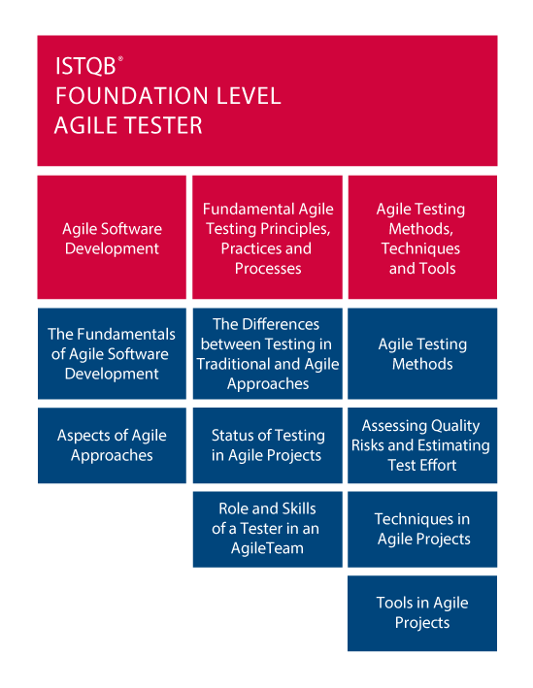
ISTQB® FOUNDATION LEVEL AGILE TESTER

Slide 21
LEARNING OBJECTIVES OF CHAPTER 1
The fundamentals of agile software development
Recall the basic concept of agile based on the Agile Manifesto
Understand the advantages of the whole-team approach
Understand the benefits of early and frequent feedback
Aspects of agile approaches
Recall agile software development approaches
Write user stories in collaboration with development, business representative and product owner
Understand how retrospectives can be used as a mechanism for process improvement in agile projects
Understand the use and purpose of continuous integration
Know the differences between iteration and release planning, and how a tester adds value to each of activity

Slide 22
LEARNING OBJECTIVES OF CHAPTER 2
Differences between testing in traditional and agile approaches
Describe the differences between testing activities in agile projects and non-agile projects
Describe how coding and testing activities are integrated in agile
Describe the role of independent testing in agile projects
Status of testing in agile projects
Describe the basic set of work products used to communicate the status of testing in an agile project, including test progress and product quality
Describe the process of evolving tests across multiple iterations and explain why test automation is important to manage regression risk in agile projects
Role and skills of a tester in an agile team
Understand the skills of a tester in an agile team
Understand the role of a tester within an agile team

Slide 23
LEARNING OBJECTIVES OF CHAPTER 3 (1)
Agile testing methods
Recall the concepts of test driven development, acceptance test driven development and behavior driven development
Recall the concepts of the test pyramid
Summarize the testing quadrants and their relationships with testing levels and testing types
For a given agile project, practice the role of a tester in Scrum team
Assessing quality risks and estimating test effort
Assess product quality risks within an agile project
Estimate testing effort based on iteration content and product quality risks

Slide 24
LEARNING OBJECTIVES OF CHAPTER 3 (2)
Techniques in agile projects
Interpret relevant information to support testing activities
Explain to business stakeholders how to define testable acceptance criteria
Given a user story, write acceptance test driven development test cases
Write test cases, for both functional and non-functional aspects, using black box test design techniques based on given user stories
Execute exploratory testing to support the testing of an agile project
Tools in agile projects
Recall different tools available to testers according to their purpose and to the activities in agile projects

Slide 25
CONTENTS
3
Syllabi and Extensions
3.1
General Introduction
3.2
Foundation Level
3.3
Agile Tester
3.4
Advanced Level
3.5
Expert Level

Slide 26
ISTQB® ADVANCED LEVEL
ISTQB® Advanced Level is composed of three independent modules:
Test Manager (AL-TM)
Test Analyst (AL-TA)
Technical Test Analyst (AL-TTA)
The ISTQB® Foundation Level Certification is a pre-requisite for all of them
When achieving all the three Advanced Modules, a “Full Advanced” certificate is issued

Slide 27
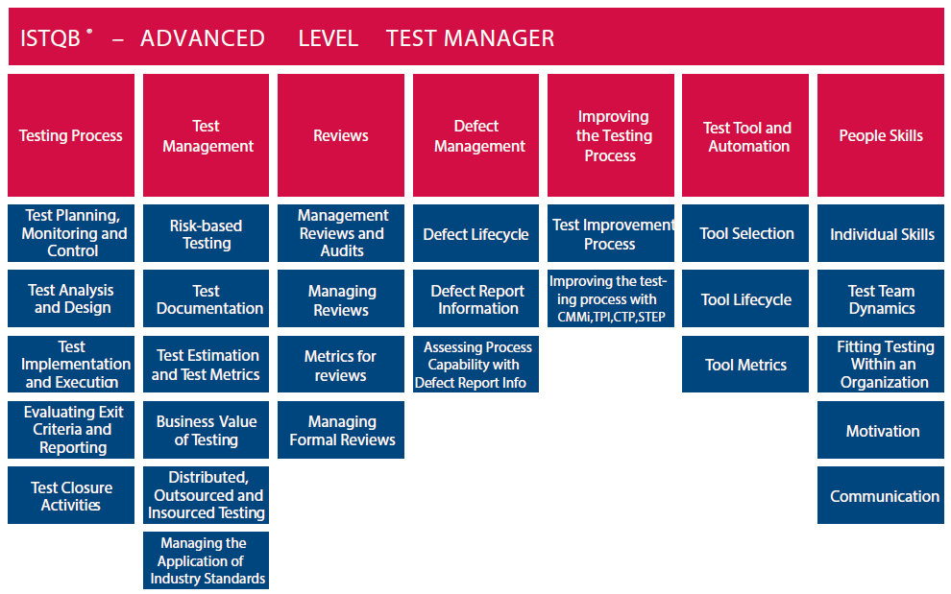
ISTQB® ADVANCED LEVEL TEST MANAGER (AL-TM)

Slide 28
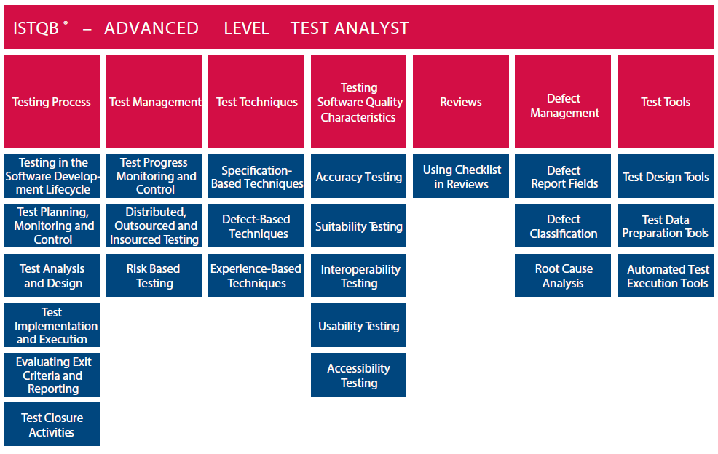
ISTQB® ADVANCED LEVEL TEST ANALYST (AL-TA)

Slide 29
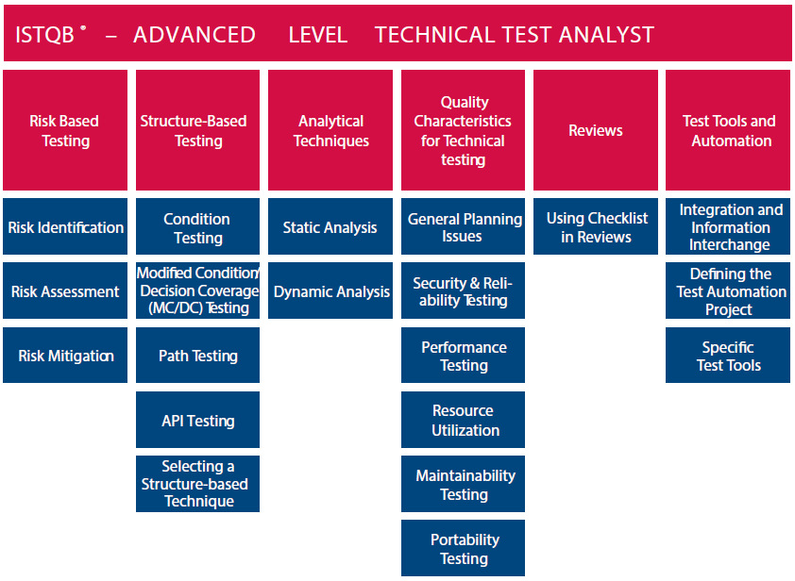
ISTQB® ADVANCED LEVEL TECHNICAL TEST ANALYST (AL – TTA)

Slide 30
CONTENTS
3
Syllabi and Extensions
3.1
General Introduction
3.2
Foundation Level
3.3
Agile Tester
3.4
Advanced Level
3.5
Expert Level

Slide 31
ISTQB® EXPERT LEVEL
For ISTQB®, Expert really means Expert
“A person with the special skills and knowledge representing mastery of a particular testing subject.
Being an expert means possessing and displaying special skills and knowledge derived from training and experience.“
Clearly stated expectations and business outcomes are established for each subject covered at Expert Level

Slide 32
STATUS OF EXPERT LEVEL SYLLABI
ISTQB®
Expert Level Syllabi
Improving the Testing Process
Test Management
Test Automation
Security Testing
Module:
Approved (June 2010)
Approved (June 2011)
In development (Planned for 2014)
In development (Planned for 2015)
Status:

Slide 33
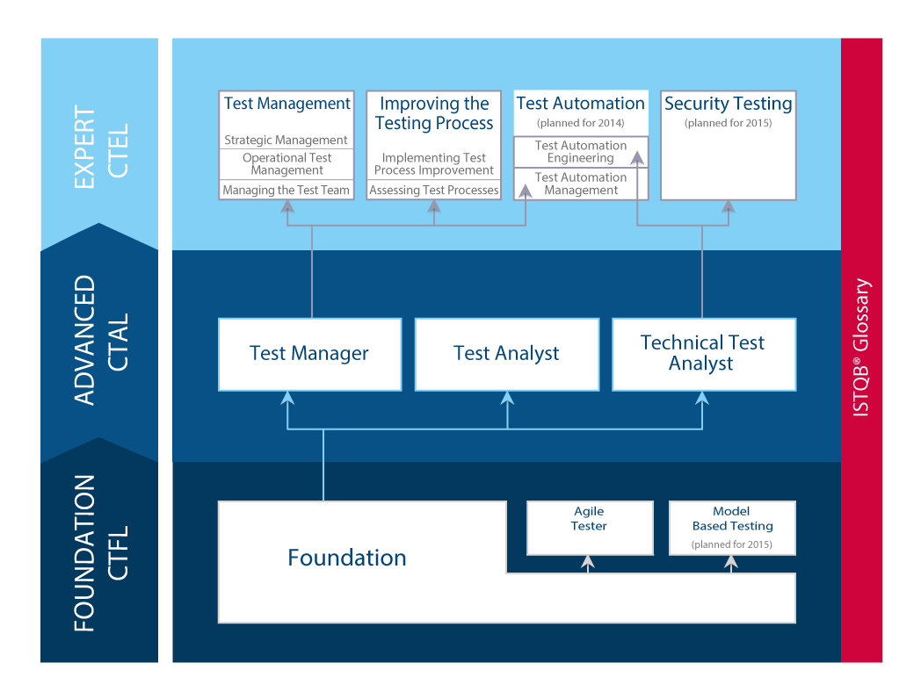
PRE-REQUISITES FOR EXPERT LEVEL
In the following, pre-conditions allowing to take Expert Level exams are shown:

Slide 34
ISTQB® EXPERT LEVEL TEST MANAGEMENT
The Expert Module “Test Management” is composed of three parts:
Strategic Test Management
Operational Test Management
Managing the Test Team
TEST MANAGEMENT
STRATEGIC TEST MANAGEMENT
MANAGING THE TEST TEAM
OPERATIONAL TEST MANAGEMENT

Slide 35
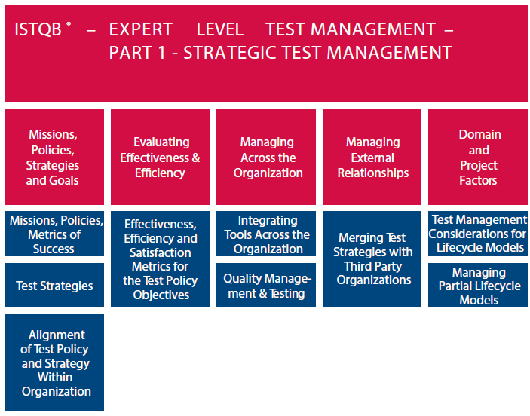
ISTQB® EXPERT LEVEL STRATEGIC TEST MANAGEMENT

Slide 36
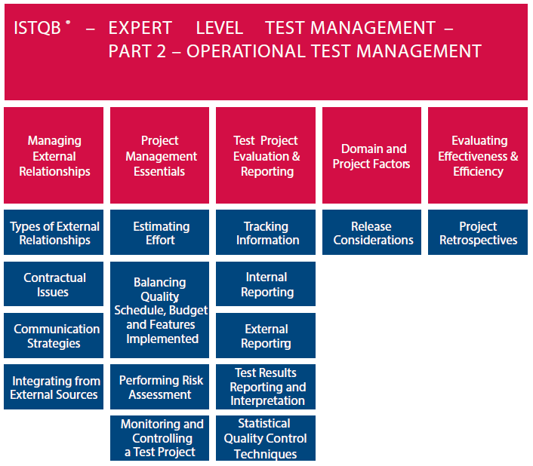
ISTQB® EXPERT LEVEL OPERATIONAL TEST MANAGEMENT

Slide 37
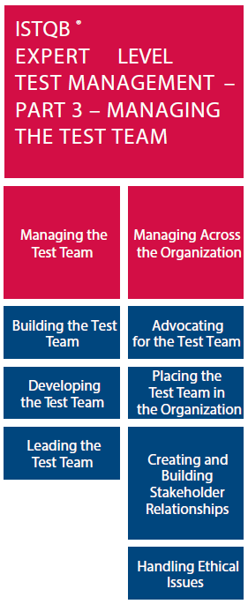
ISTQB® EXPERT LEVEL MANAGING THE TEST TEAM

Slide 38
ISTQB® EXPERT LEVEL IMPROVING THE TESTING PROCESS
The Expert Module “Improving the Testing Process” is composed of two parts:
Assessing Test Processes
Implementing Test Process Improvement
IMPROVING THE TESTING PROCESS
ASSESSING TEST PROCESSES
IMPLEMENTING TEST PROCESS IMPROVEMENT

Slide 39
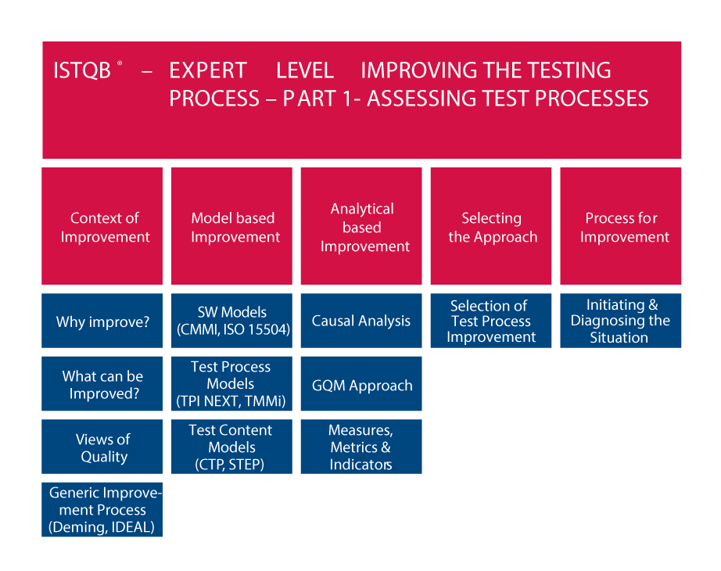
ISTQB® EXPERT LEVEL ASSESSING TEST PROCESSES

Slide 40
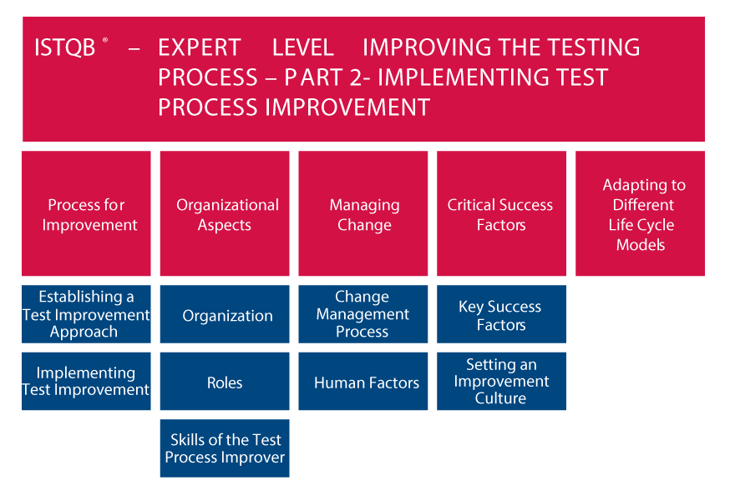
ISTQB® EXPERT LEVEL IMPLEMENTING TEST PROCESS IMPROVEMENT

Slide 41
CONTENTS
1
Introduction to ISTQB®
2
Syllabi and Extensions
4
5
8
Exams
Special Initiatives
Contacts
3
Benefits
ISTQB®: Worldwide Footprint
7
6
ISTQB® Partner Program

Slide 42
EXAMS
The exam is based on multiple-choice questions for Foundation and Advanced Levels
For Expert Level, an essay is also required
Exams can be attempted without having attended a training course (e.g. through self-study)
Number of questions and exams length:
Foundation exam and Extensions: 40 questions, length = 1 hour (75 minutes for candidates taking exams not in their native language)
Advanced exams: different lengths and questions, depending on the module (25% more time for candidates taking exams not in their native language)
MODULE | NUMBER OF QUESTIONS | EXAM LENGTH (IN MINUTES) | EXAM LENGTH FOR NON NATIVE LANGUAGE
ADVANCED TEST MANAGER | 65 | 180 | 225
ADVANCED TEST ANALYST | 60 | 180 | 225
ADVANCED TECHNICAL TEST ANALYST | 45 | 120 | 150

Slide 43
EXAM QUESTIONS
Questions are classified according to the cognitive level, the K-level (also known as level of knowledge):
• K1 = Remember (recognize a term or concept)
• K2 = Understand (able to explain a concept)
• K3 = Apply (select correct application of concept or technique)
• K4 = Analyze (can distinguish between facts and inferences for deeper understanding)
• K5 = Evaluate (can make judgments based on criteria and standards)
• K6 = Create (can put elements together to form a coherent or functional whole)
The number of questions for each topic is related to the length of the topic in the syllabus
For more details, see the FAQ section in the ISTQB® Website

Slide 44
CRITERIA TO ACHIEVE EXPERT LEVEL
Recommended :
At least 7 years of practical testing experience
Completion of Expert Level course
Mandatory:
ISTQB Foundation
ISTQB Advanced (depending on Expert Level module)
Completion of Expert Level course (if a non-public exam is taken)
Entry criteria
Exam passed (75%)
Experience levels (may be achieved before or after passing the exam)
At least 5 years of practical testing experience
At least 2 years of industry experience in the specific Expert Level topic
Exit criteria
The Exam

Slide 45
EXPERT LEVEL EXAM
A certification scheme at Expert Level must meet the expectations and perceptions of its stakeholders and has to be seen to be truly “expert”.
The exam therefore consists of a multiple-choice section and a written “essay” section
A score of 75% and above is required to pass
The exam
Duration: 1 Hour
25 Questions
Learning objectives covered: K2, K3, K4 (like in Advanced Level)
Multiple-Choice section
Duration:
Reading: ½ hour
Answering: 2 hours
Add ¾ hour for non-native speakers
Answer 4 questions out of 5
Learning objectives covered: Mostly higher learning objectives (K5,K6)
Essay section

Slide 46
MAINTAINING EXPERT LEVEL CERTIFICATION
An Expert Level certificate is valid for 5 years
Expert certification must be renewed using one of the following two options
Expert certification is not for life
A passed exam results in certification for a further 5 years
Repeat the exam
CECs may be achieved in a number of areas. For example:
Perform a professional testing activity
Take a relevant training course
Attend a testing conference
Present at a testing conference
Teaching a relevant training course
Write a testing article or book
Actively participate in a Working Group (ISTQB® Member Boards, SIGIST, ….)
Verifiable evidence must be submitted to the certifier
The Certification Extension Program is published by ISTQB®
Achieve 200 „Certification Extension Credits“ (CEC)

Slide 47
CONTENTS
1
Introduction to ISTQB®
2
Benefits
4
5
8
Exams
Special Initiatives
Contacts
3
Syllabi and Extensions
ISTQB®: Worldwide Footprint
7
6
ISTQB® Partner Program

Slide 48
ISTQB® - THE EVOLUTION
1998 | ISEB (Information Systems Examinations Board, part of the British Computer Society) develops the Certified Tester Syllabus. The first Software Testers are certified in 1998
2002 | The ISTQB® (International Software Testing Qualifications Board) is founded by 8 member boards: Austria, Denmark, Finland, Germany, Sweden, Switzerland, the Netherlands and UK.
2003 | The syllabus for the “Advanced Level“ is completed
2004 | First exams for “ISTQB® Certified Tester Advanced Level“ are released
2006 | The number of member boards grows steadily
2007 | The Foundation and Advanced Syllabi are enhanced
2009 | The number of Member Boards climbs further The number of certifications reaches 100,000
2010 | BCS withdraws the ISEB Test Practitioner scheme in favor of ISTQB Certified Tester Advanced Level. The first “Expert Level” syllabus is released
2011 | The number of certifications exceeds 200,000 globally Issue of additional Expert Level Syllabi
2012 | New version of the Advanced Level syllabus and Glossary Testing of Terms; Activation of the “ISTQB® Partner Program”; Activation of the “ISTQB® Conference Network”; Activation of the “ISTQB® Recognized Mobile app” program; Launch of the “ISTQB® international Software Testing Excellence Award”
2013 | The number of certifications exceeds 300,000 globally
2014 | Agile Tester Syllabus Expert Level Test Automation Syllabi

Slide 49
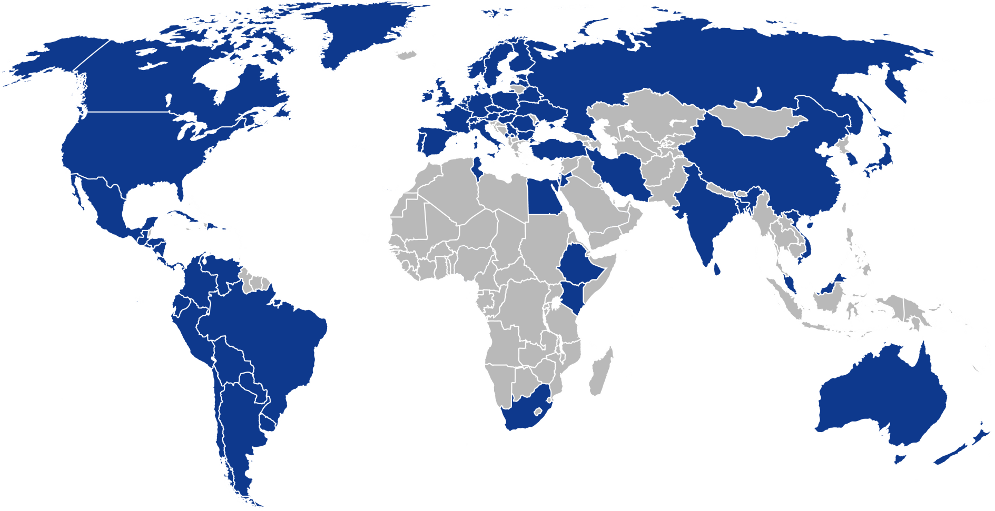
WORLD-WIDE COVERAGE
Countries covered by Member Boards (47 Member Boards covering 70 countries, representing over 90% of the world-wide GDP) and Global Exam Providers
Countries covered by Global Exam Providers
The list of Member Boards and Global Exam Providers is available on the ISTQB® Web Site

Slide 50
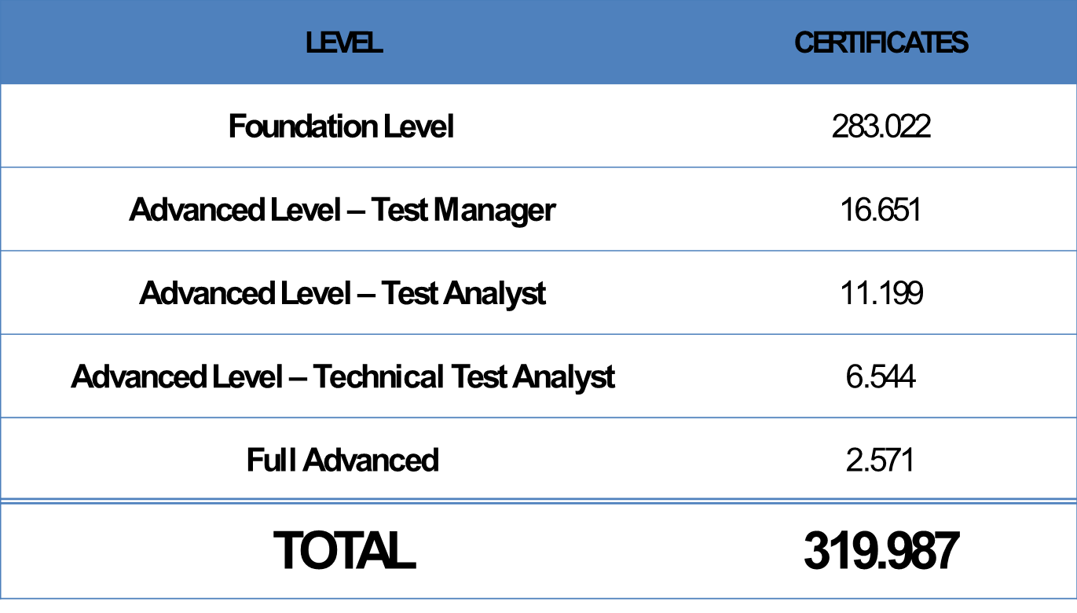
FOOTPRINT NUMBER OF CERTIFICATIONS
The distribution of Certificates issued by ISTQB® as of September 2013 is as follows:

Slide 51
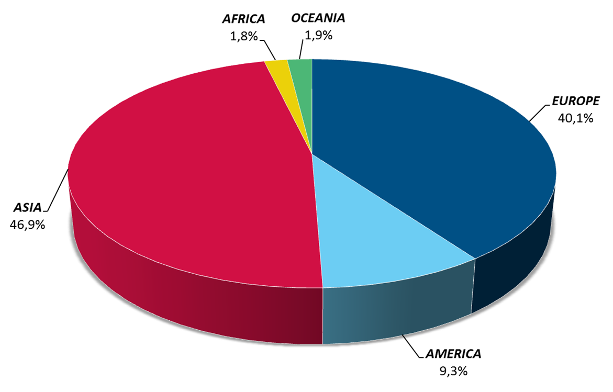
ISTQB® CERTIFICATES BY CONTINENT

Slide 52
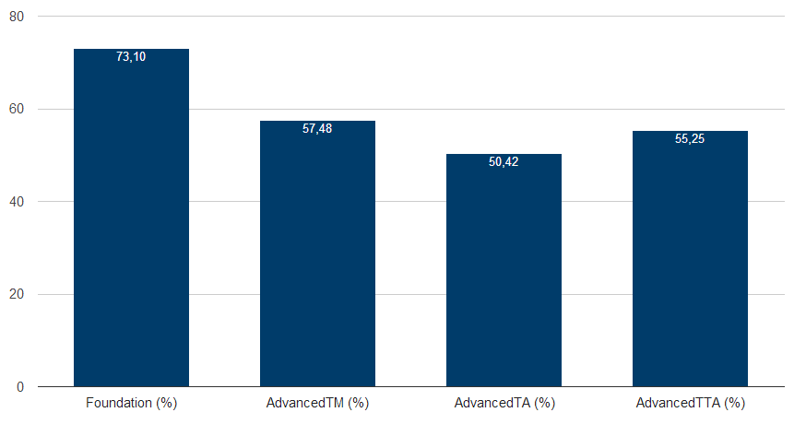
ISTQB® EXAM AVERAGE PASS-RATE

