Slide 1
Makers Club
Summer of Humans

Slide 2
My interests
I have long been interested in Articulated Figures
But I never had
Affordable Professional Level Tools
Things have changed recently
1. Metahuman from Unreal
2. Many affordable addons for Blender

Slide 3
IN GENERAL
There is so much knowledge OUT THERE
But
It's beyond one individual's capability to master it

Slide 4
No better time than now
Perhaps we can work together
To find the affordable tools
To figure out how to use them
To evolve demo software
Many tools build unbelievable facilities
But not exportable
Not real-time

Slide 5
Your interests
Maybe you want to improve your
Knowledge
Skills
Programmer ⇒ Artistically Oriented Programmer

Slide 6
Together
We can share
Good and affordable tools
"How to use" knowledge
Research ideas
Demos + Prototypes
Future Collaborations

Slide 7
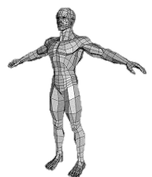
WHAT WE NEED TO KNOW
How to Draw: LOD (levels of detail)
How to Create
How to Animate (facial animation with speech)
How to Animate (whole figure)
How to Clothes, Add Hair
How to have characters interact with world (travelling, speaking, buddying up, interacting with game player)
Similar issues associated with terrain, buildings, props like benches, tables.
Will we have to learn PBR (Physically based rendering)

Slide 8
Takeaway

Slide 9
Goals
Professional Level Humans
Professional Level Environments
"Finding + learn to use" Professional Level Tools
Cheap
Everything shared
Demos leading to Playstation
Trying New ideas

Slide 10
What Got Me Going

Slide 11
Amazing Blender Technology
50 + Addons
Free to $120
Some key new developments with Unreal
What I could do with it
Create a new course
Create a new game
Learn
Build a Playstation demo
What are some problems
Some things meant for pictures, not games
Elaborate custom shaders can't be exported

Slide 12
What Caught My Eye

Slide 13
Metahuman by Unreal - Free
Profession Level Human Features
Professional Level Facial Animation
Advantages
Free
Disadvantages
For use only in Unreal

Slide 14
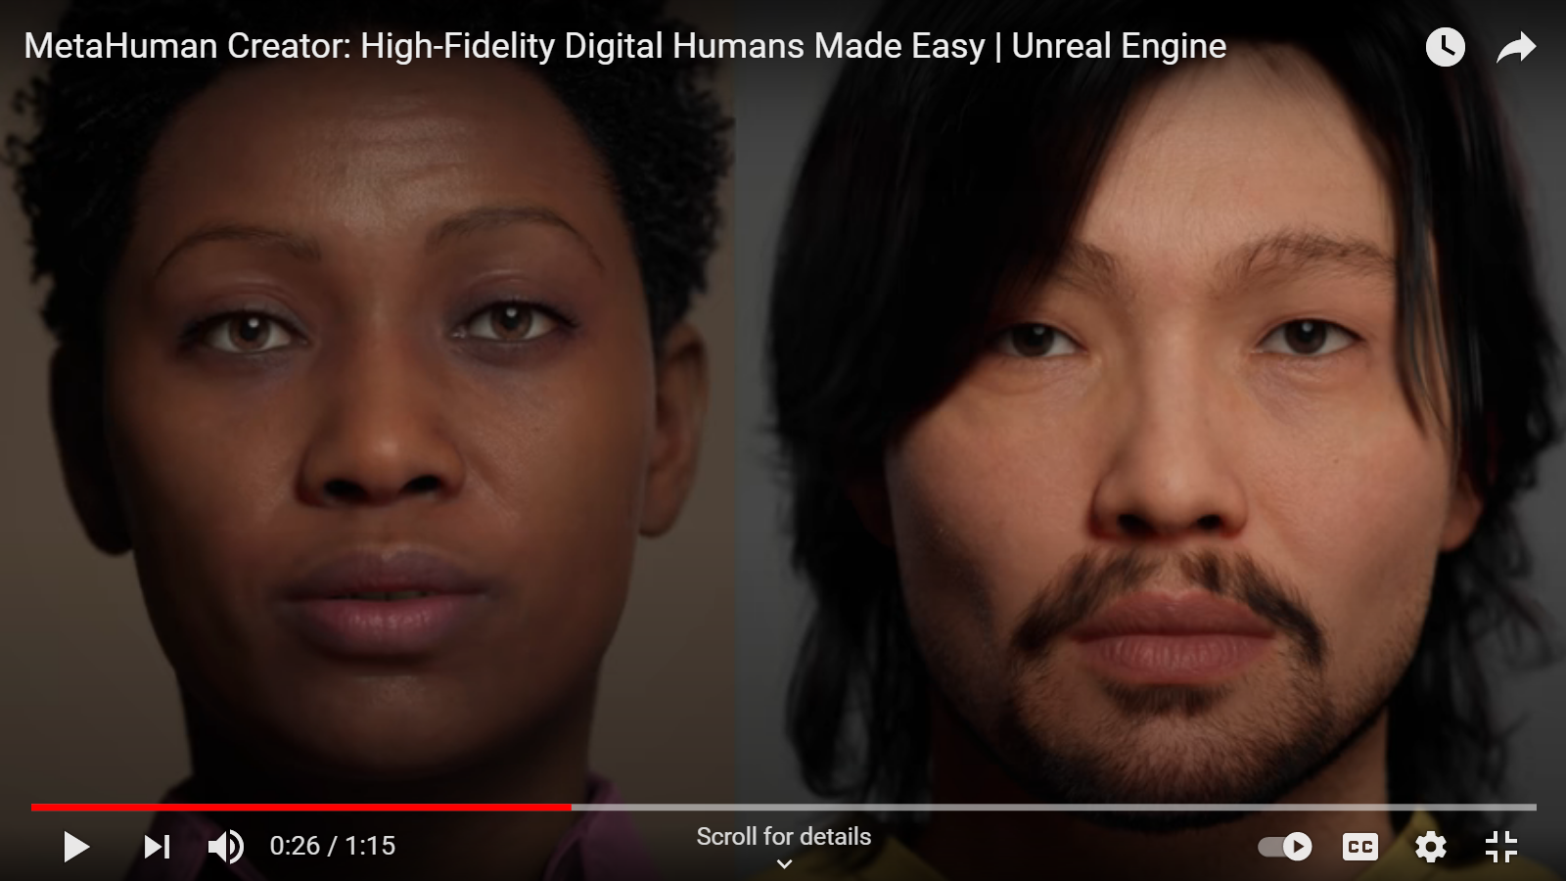
Metahuman by Unreal - Free
https://youtu.be/S3F1vZYpH8c

Slide 15
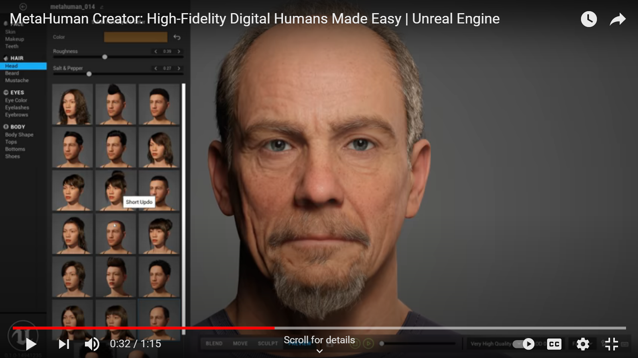
Metahuman by Unreal - Free

Slide 16
Human Generator for Blender - $69
Profession Level Human Features
Advantages
No limitations

Slide 17
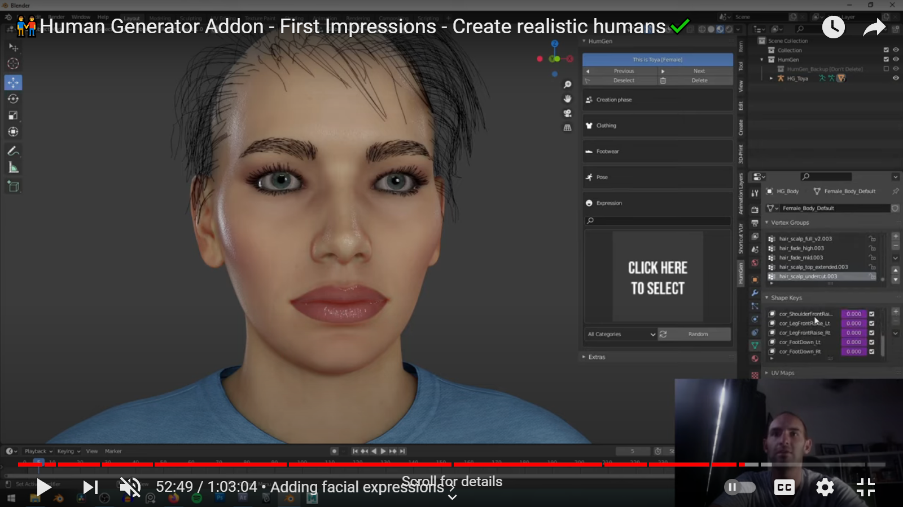
Human Generator for Blender - $69

Slide 18
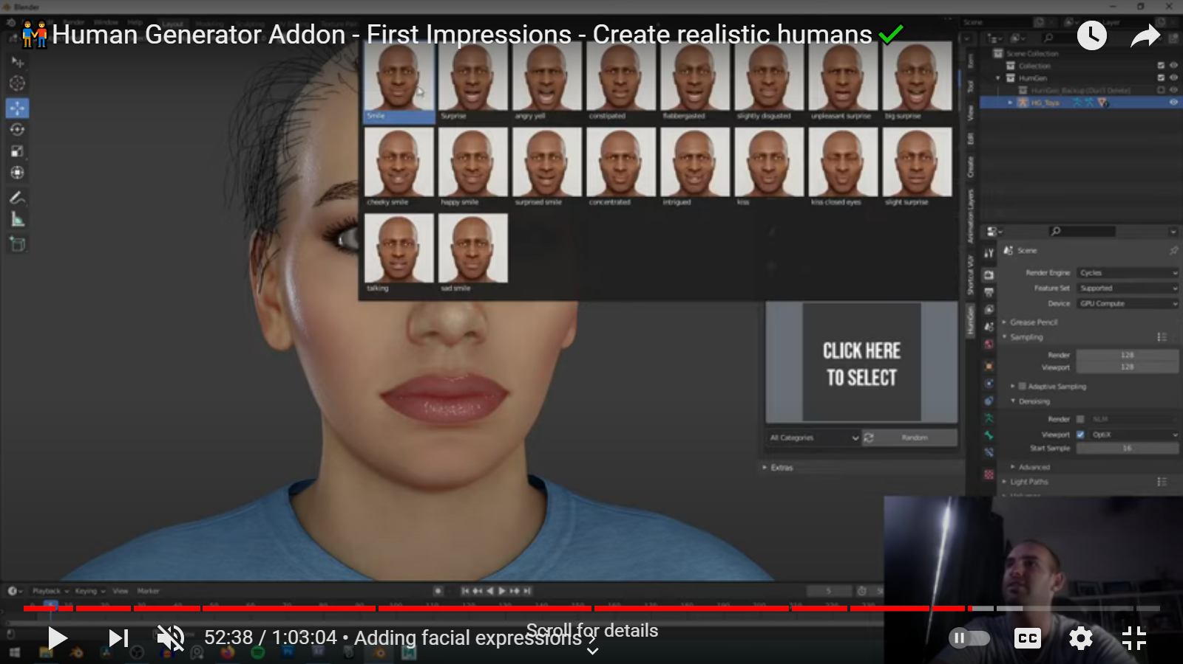
Human Generator for Blender - $69

Slide 19
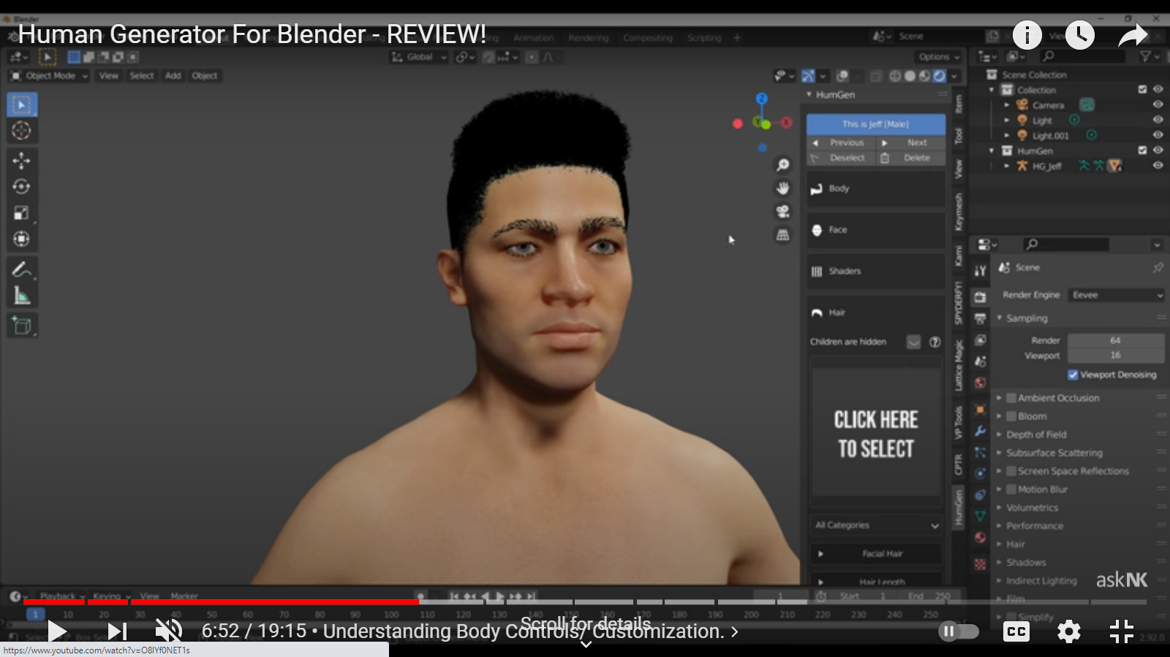
Human Generator for Blender - $69

Slide 20
FaceBlender for Blender - $399 Year
Profession Level Human Features

Slide 21
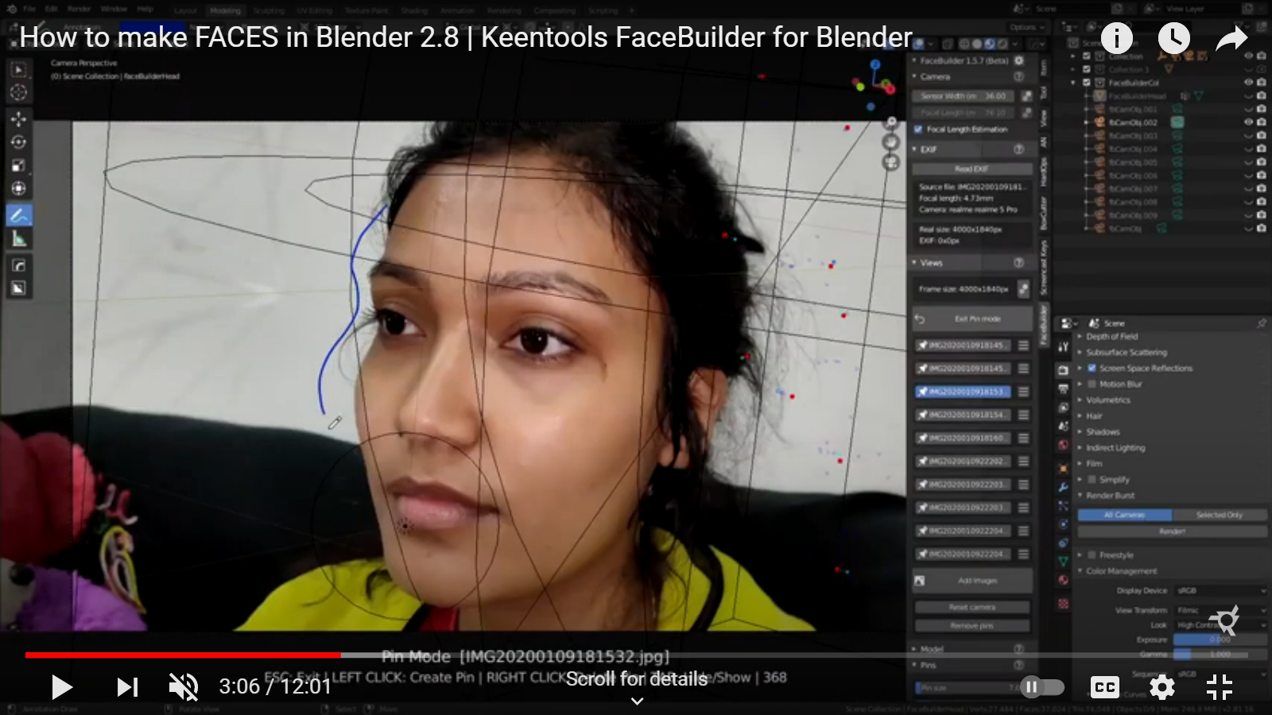
FaceBlender for Blender - $399 Year

Slide 22
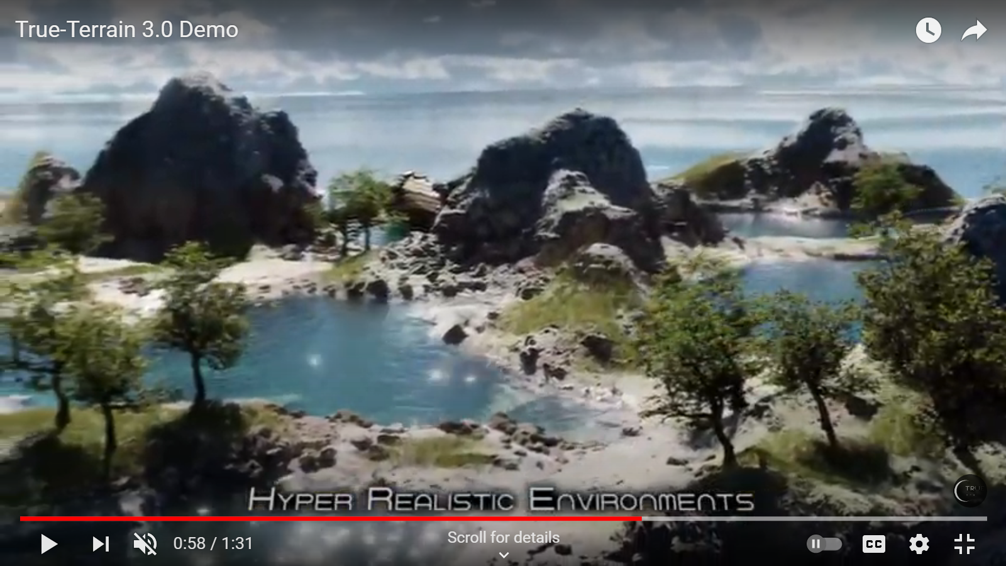
True Terrain 3.0 - $42

Slide 23
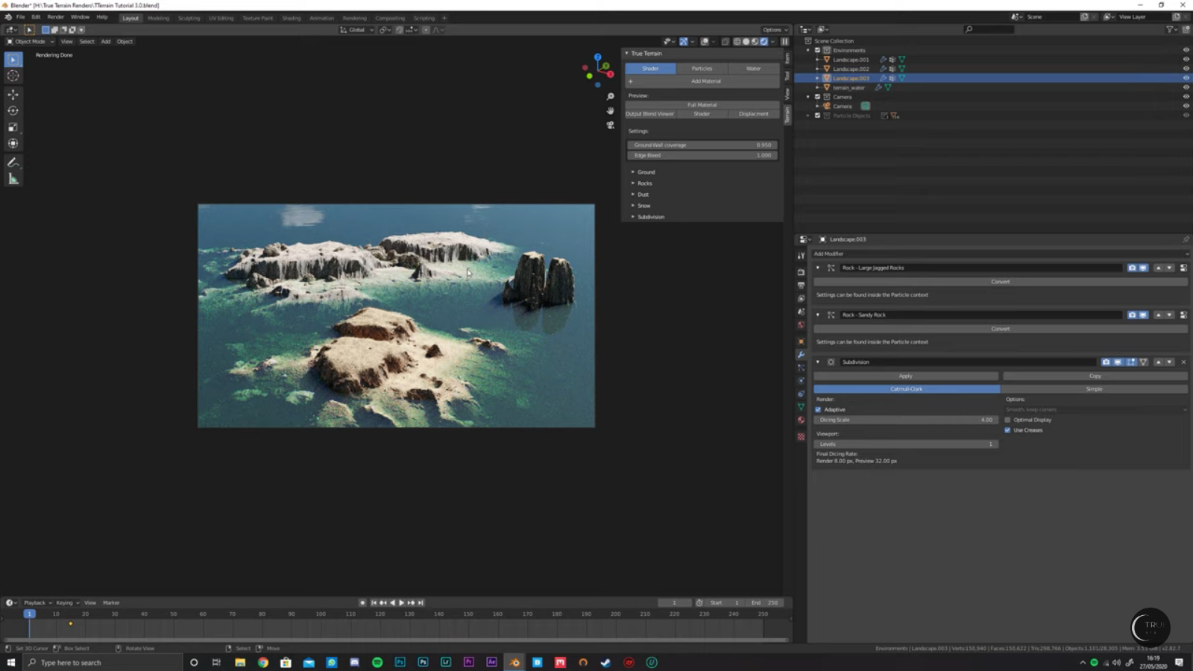
True Terrain 3.0 - $42

Slide 24
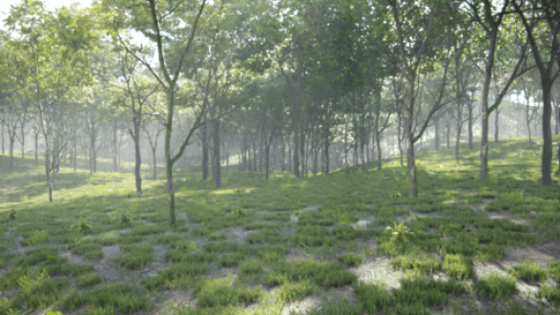
Vegetation Addon by B-production- $99

Slide 25
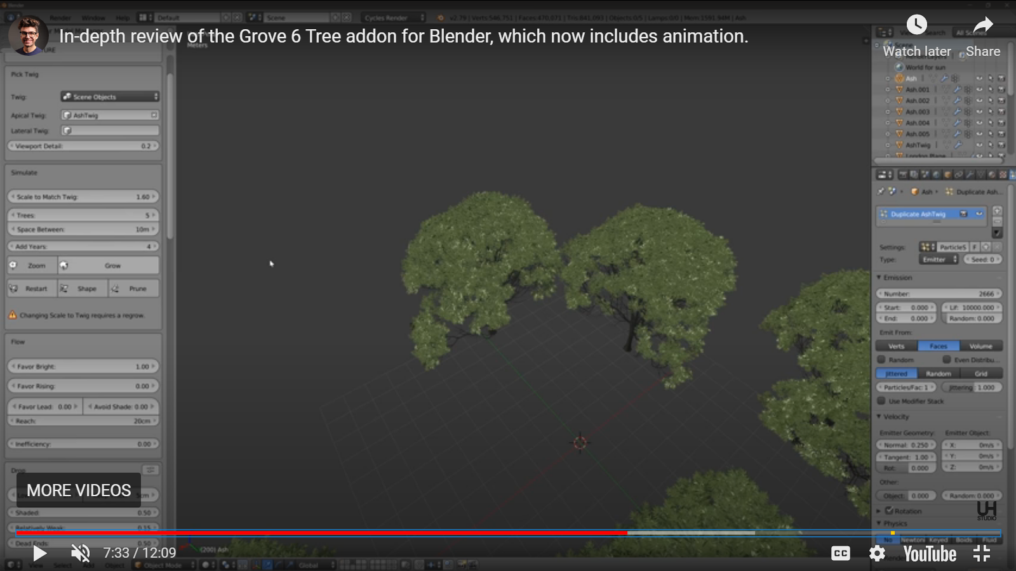
Blender Grove $120

Slide 26
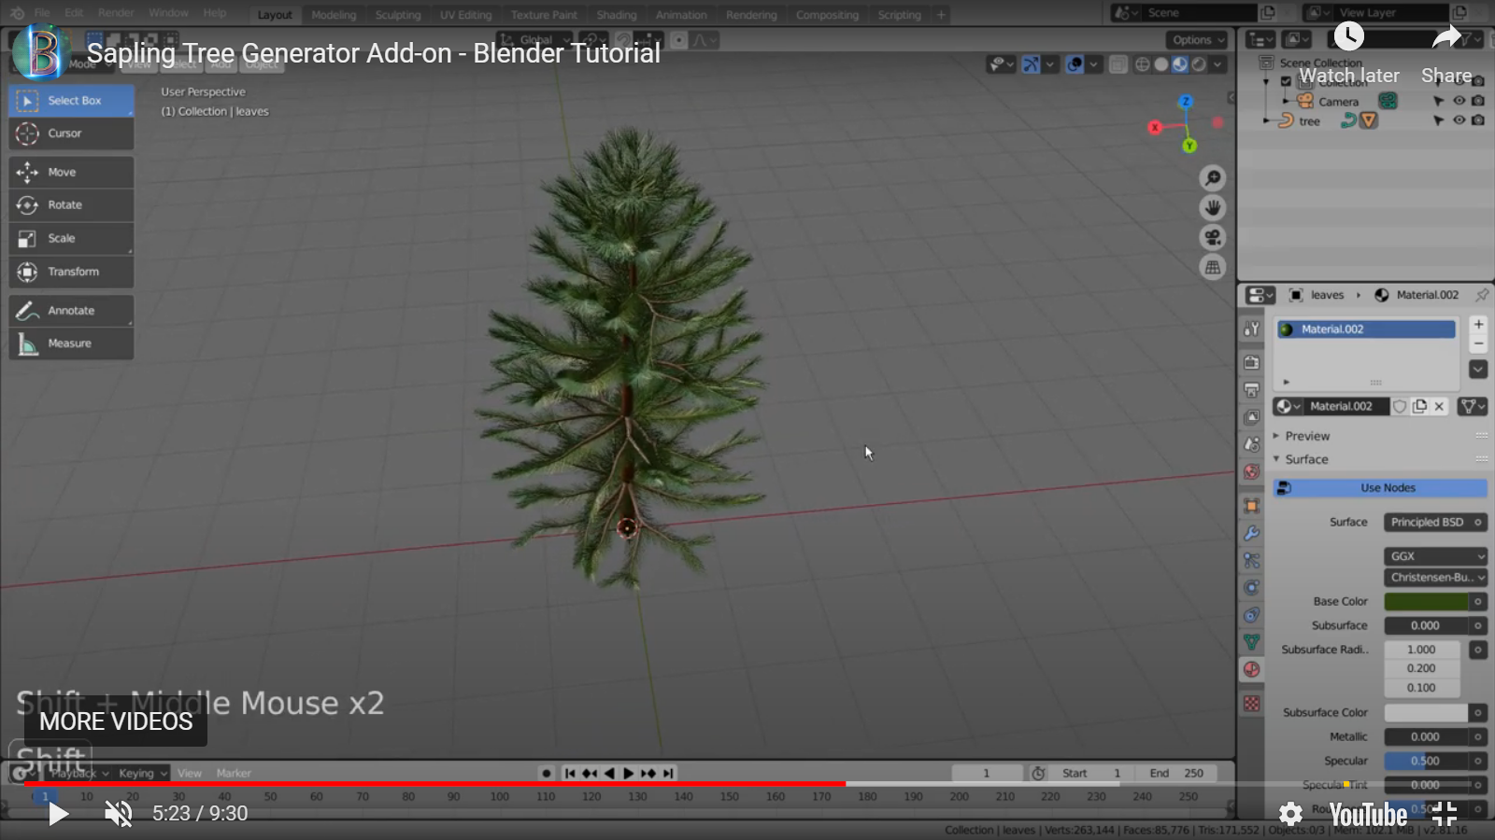
Sappling Tree Generator Addon $00

Slide 27
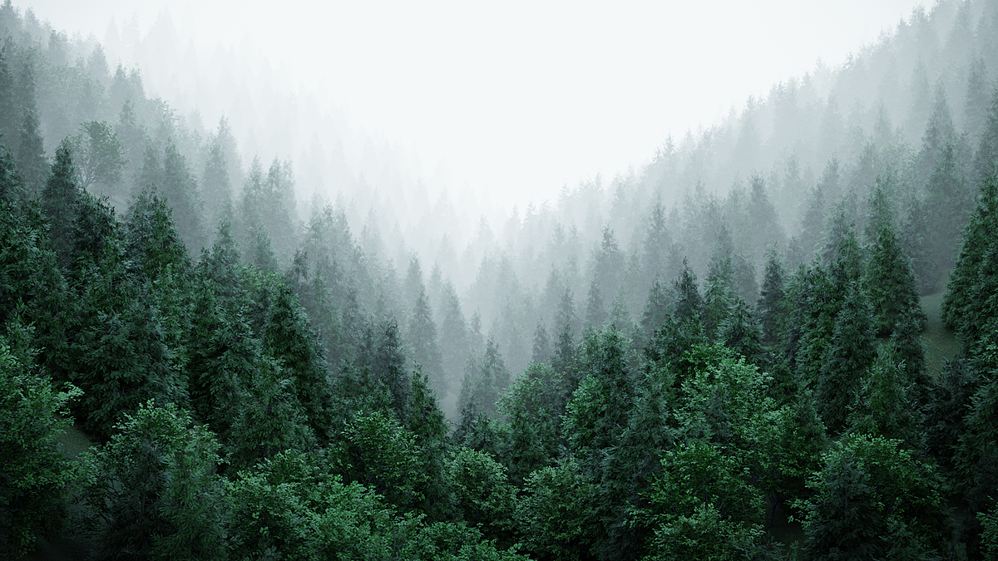
Real Trees $20

Slide 28
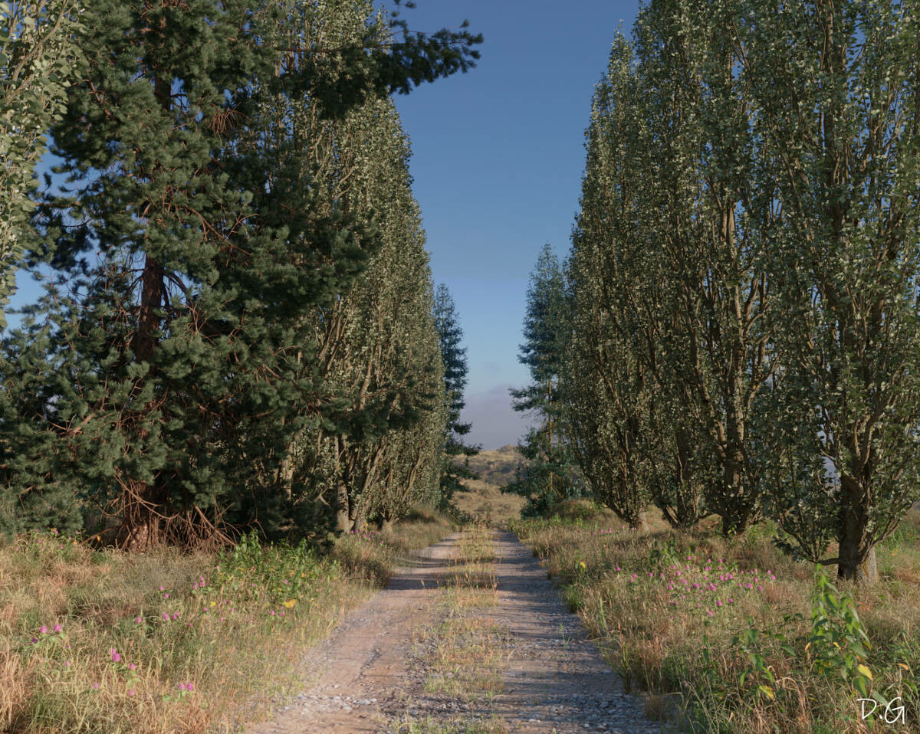
Grasswald $45 + 95

Slide 29
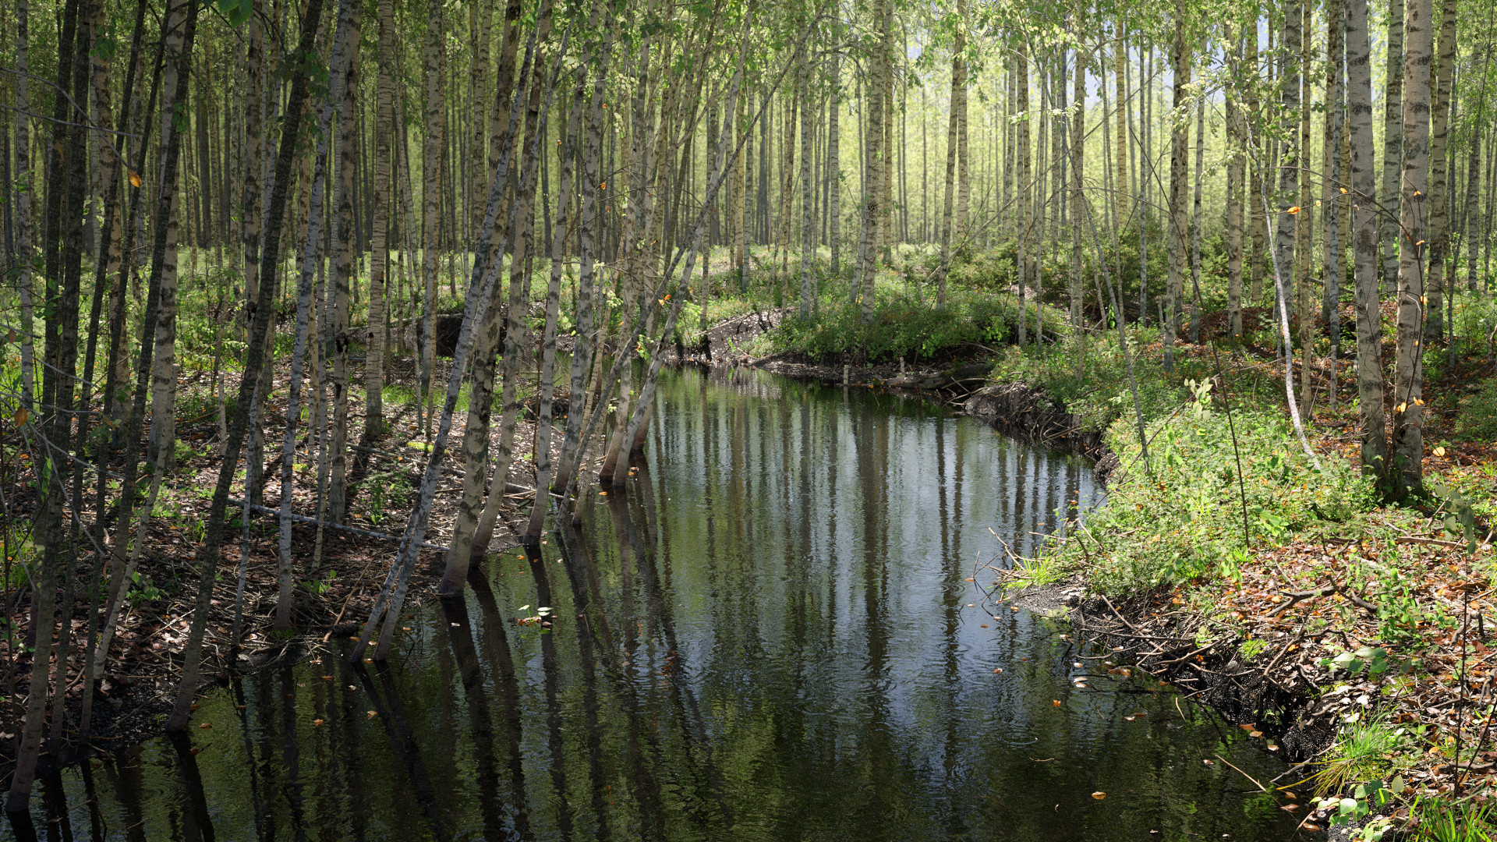
Grasswald $45 + 95

Slide 30
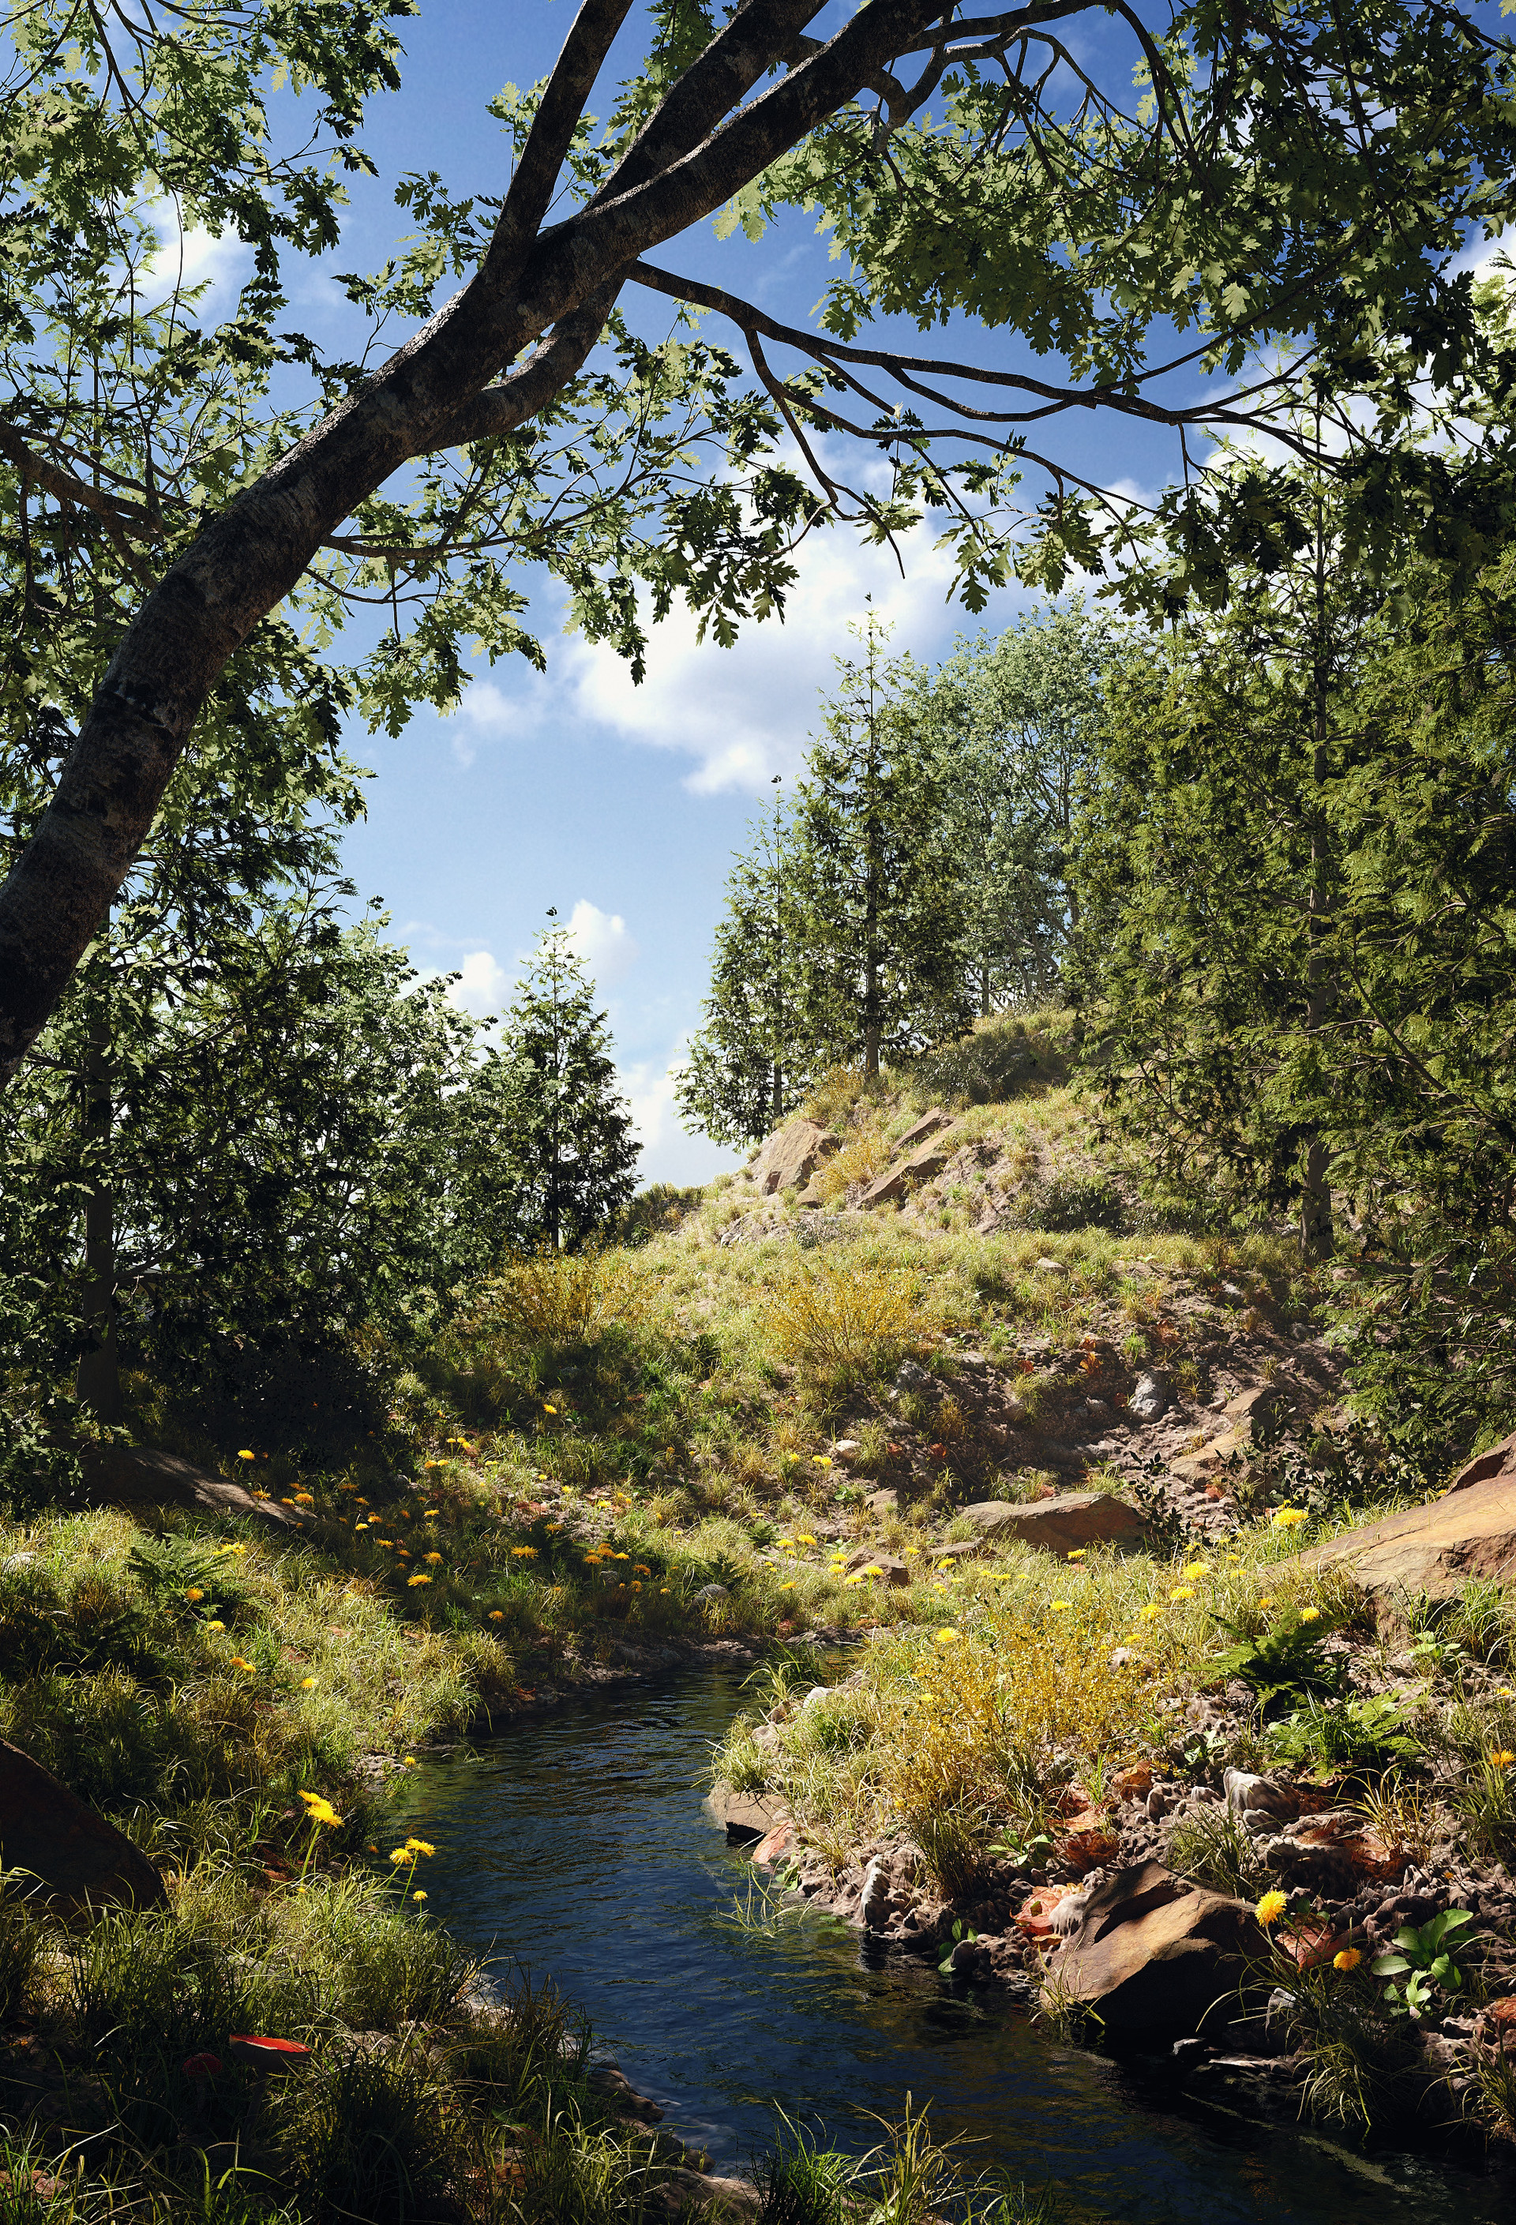
Grasswald $45 + 95

Slide 31
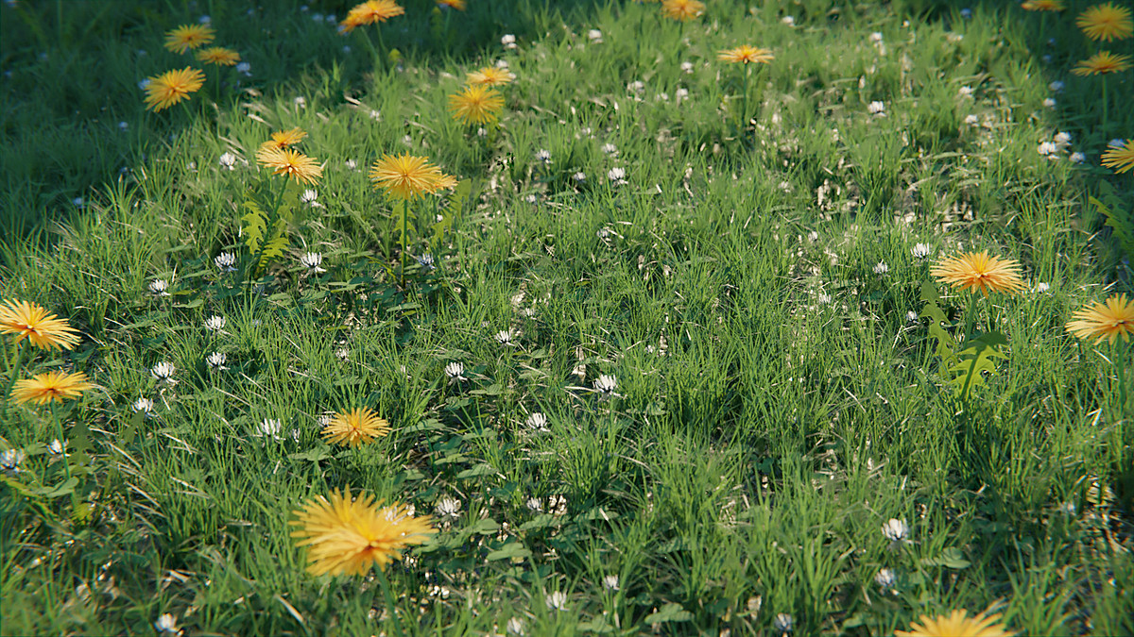
RealGrass by Wolf in Models $20

Slide 32
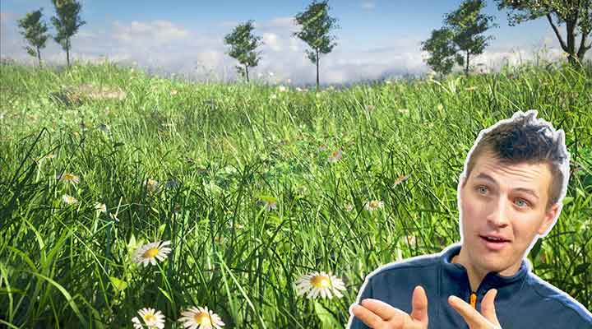
RealGrass by Wolf in Models $20

Slide 33
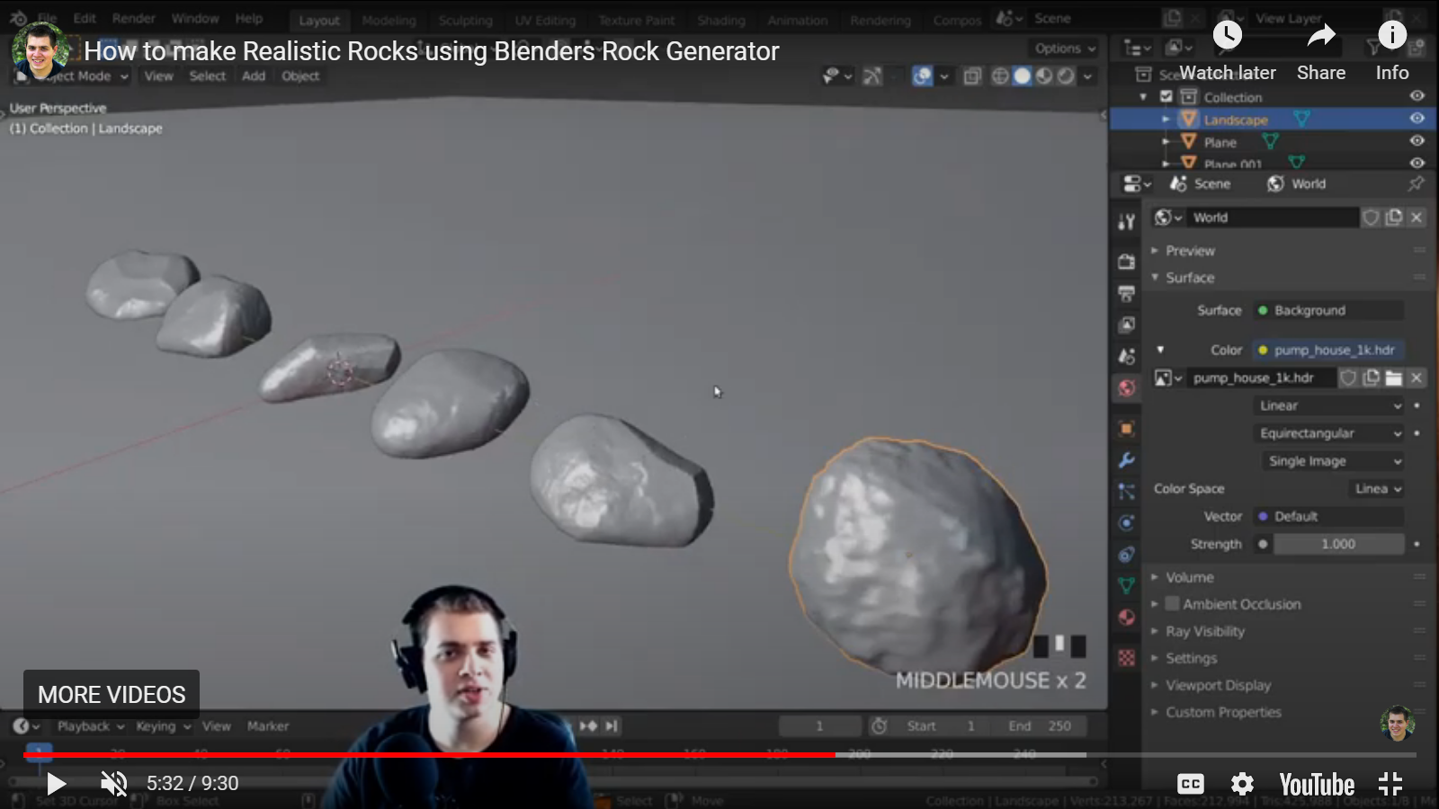
RockGenerator Addon $00

Slide 34
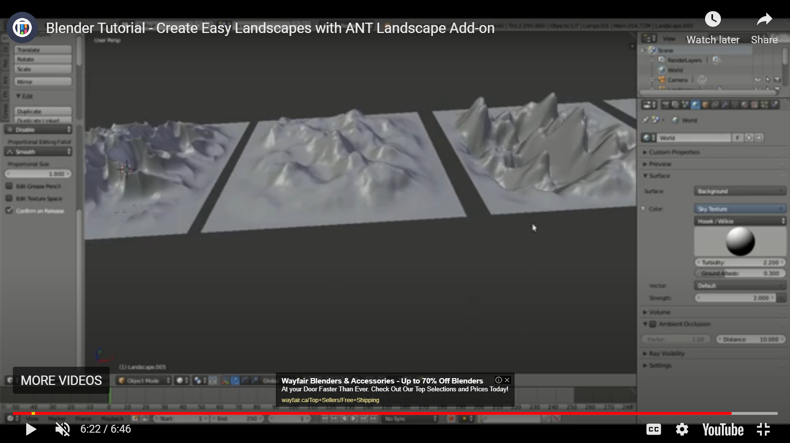
Ant Landscape Addon $00

Slide 35
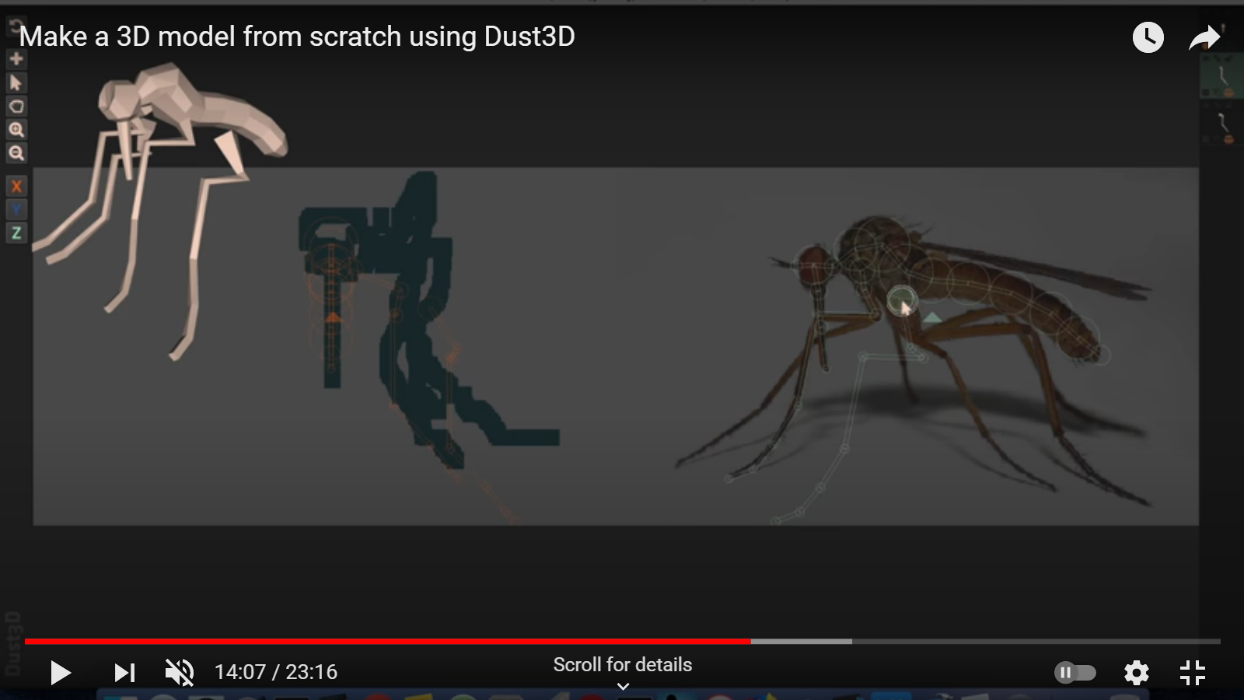
Dust 3D (Animal Maker) $00

Slide 36
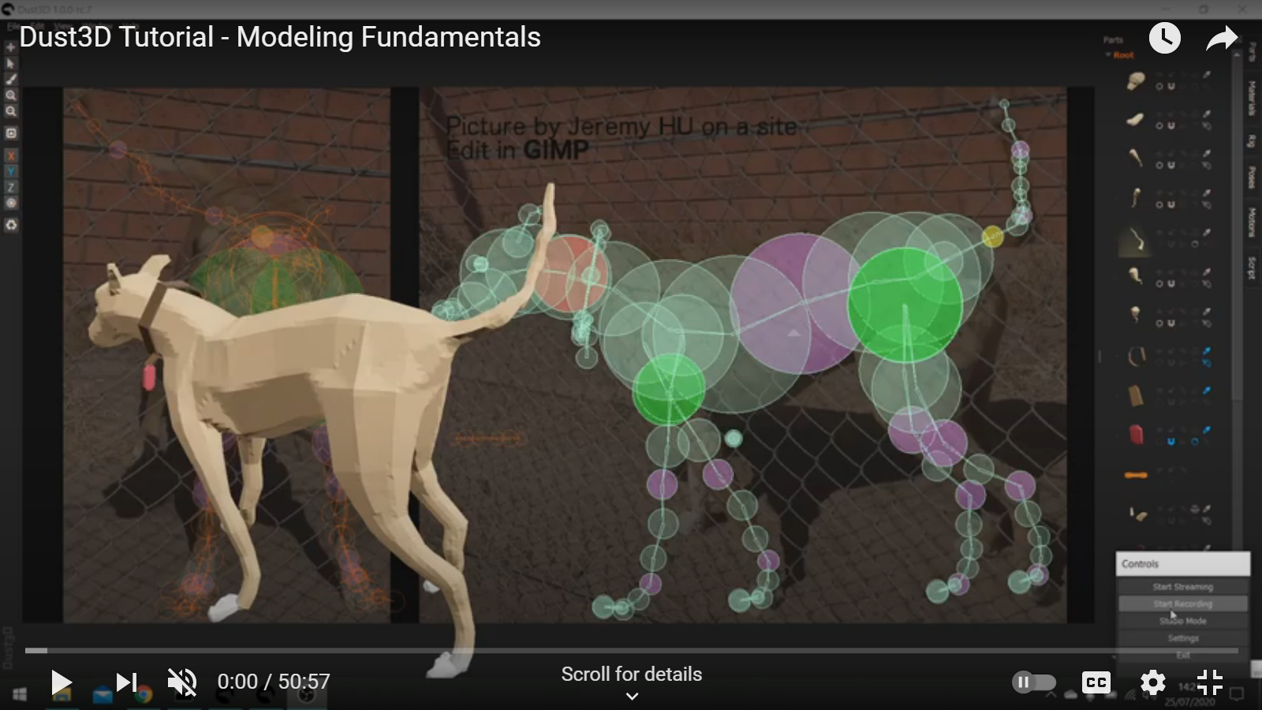
Dust 3D (Animal Maker) $00

Slide 37
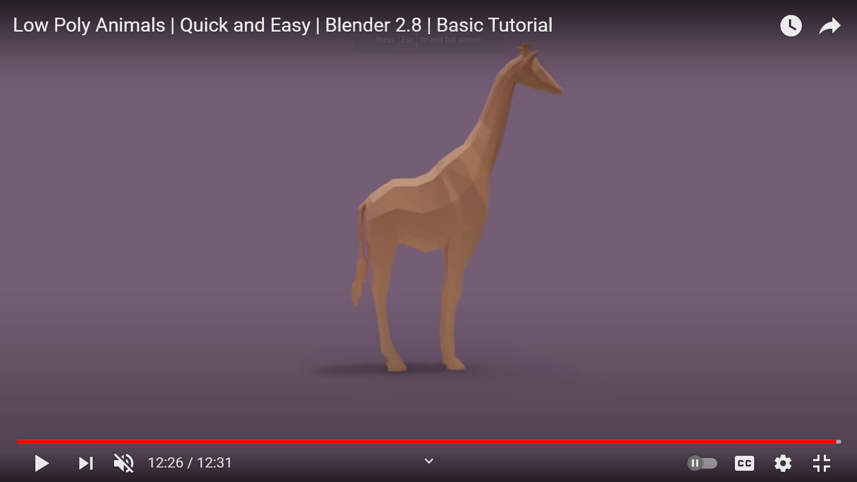
Dust 3D (Animal Maker) $00

Slide 38
Majic Uvs $00

Slide 39
Summary of Videos
In reverse chronological order

Slide 47
You
If you have time or the inclination
Try out things
Be part of a group
Learn
Develop software
Share
Me
Maybe I will learn enough
To build a real game
Be part of a group
To create a course
Many possible futures

Slide 48
List of addons That I Found
#1:
Metahuman + unreal
free but must use unreal
#2:
Human generator + blender
$68
#3:
True Terrain + blender
$27 + $42
#4:
Face Builder + blender
Free with Nuke ($149/yr)
#5:
Rock generator + blender
Free from GitHub
#6:
Magic Uvs + blender
Free + BUILT-IN
#7:
Dust 3D (animals)
Free
page 1 of 2

Slide 49
List of addons That I Found
#8:
Asset flinger
Free from GitHub
#9:
Citybuilder
$74 + $40 per city
#10:
Level Builder
$20
#11:
Building Tools
Free from GitHub
#12:
Hair tool from GumRoad
$42
#13:
Vegetation from Grasswalkd3D
Free+$42+$79+$99
#14:
Tree Vegetation BlenderMarket
$42 + $99
page 2 of 2

Slide 50
List of addons That I Found
#15:
Mirage3 (Terrain)
$25 from BlenderNation
#16:
SimpleBake (pbr)
$12
#17:
Decal Machine (decaling)
$50
#18:
Simply Clothes Pro
$33 from BlenderNation
#19:
Hair tool from GumRoad
$42
#20:
Sapling tree generator
Free
#21:
Transportation (vehicles)
$69
page 3 of 3

Slide 51
List of addons That I Found
#22:
Real Grass
$20 from BlenderNation
#23:
KitOps (decaling)
$1+$35)
#24:
Botaniq (trees)
$39 + $109
#25:
Piperator
$33 from BlenderNation
#26:
$42
#27:
Free
#28:
$69
page 3 of 3

Slide 52
List of addons That I Found
#22:
$25 from BlenderNation
#23:
$12
#24:
$50
#25:
$33 from BlenderNation
#26:
$42
#27:
Free
#28:
$69
page 3 of 3

Slide 53
Checklist
Does it look good in blender
Can you export from blender
Can you import into your code and draw it; e.g., do you have an appropriate shader and game engine facilities

Slide 54
Goals for End of Summer
50 people + 20 animals milling around
A surrounding environment with
Terrain
Very small town
Trees
Playstation?

Slide 55
What Do You Think?

