Slide 1
Color-Coding Method
Noga Alon | Raphael Yuster | Uri Zwick
Darshak Patel
COMP 5112/COMP4900G: Algorithms for Data Science
27-Nov-2024

Slide 2
Introduction
Purpose: Introduce a technique, "Color-Coding" for finding simple paths and cycles and subgraph for specified length in polynomial time.
Key Methods to discussed today:
  Random Coloring
A novel randomized method, for finding simple paths and cycles of a specified length k, and other small subgraphs, within a given graph G = (V, E).

Slide 3
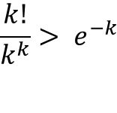
Random Coloring
Let G = (V, E) be a graph (directed or undirected).
Choose a random coloring of the vertices of G with k colors.
A colorful path is defined as a path where all vertices have distinct colors.
This looks very simple.
Each simple path of length k-1, has a chance to become colorful.
How much time is needed to find a colorful path of length k-1 in G, if one exists, or all pairs of vertices connected by colorful paths of length k-1 in G?
$$\frac{k!}{k^{k}}> e^{−k}$$

Slide 4
Lemma
Graph G = (V, E) , Here V=5
2
3
1
4
5

Slide 5
Graph G = (V, E) , Here V=5, E=5
2
3
1
4
5

Slide 6
Choose a random coloring of the vertices of G with k colors, c : V -> {1,2,..,k}; k=5
and a vertex s belongs to V.
2
Finds a colorful path of length k -1 that starts at s, if
one exists.
3
s
1
A path in G is said to be colorful if each vertex is colored by a distinct color.
4
5

Slide 7
To find a colorful path of length k -1 in G that starts somewhere, we just add a new vertex s0 to V.
We just add a new vertex s0 to V.
Color it with a new color 0 and connect it with edges to all the vertices of V.
We now look for a colorful path of length k that starts at s0.
2
3
1
s0
s
4
5

Slide 8
Lemma Proof
Example with V = 5 and E = 5
Let us now apply the algorithm to a specific graph with 5 vertices and 5 edges.
Consider the graph G = (V, E), where:
  V = {v1, v2, v3, v4, v5},
  E = {(v1, v2), (v2, v3), (v3, v4), (v4, v5), (v5, v1)}.

Slide 9
Proof (cont.)
The graph is a cycle of 5 vertices, and we assign the following coloring:
c(v1) = 1, c(v2) = 2, c(v3) = 3, c(v4) = 4, c(v5) = 5.
We are looking for a colorful path of length 4,
i.e., a path that uses all 5 colors.
We can apply the dynamic programming approach described above.

Slide 10
Proof (cont.)
Step-by-Step Application of the Algorithm
1. **Initialization**: Initially, we know that the path starting at v1 uses only the color 1:
C(v1, 0) = {1}, C(v2, 0) = ∅, C(v3, 0) = ∅, C(v4, 0) = ∅, C(v5, 0) = ∅.
1

Slide 11
Proof (cont.)
2. **Paths of Length 1**: From v1,
We can extend the path to v2, adding color 2:
      C(v1, 1) = {1}, C(v2, 1) = {1, 2}.
For other vertices:
      C(v3, 1) = ∅, C(v4, 1) = ∅, C(v5, 1) = ∅.
2
1

Slide 12
Proof (cont.)
3. **Paths of Length 2**: From v2,
we extend the path to v3, adding color3:
C(v3, 2) = {1, 2, 3}.
For other vertices:
    C(v4, 2) = ∅, C(v5, 2) = ∅.
2
3
1

Slide 13
Proof (cont.)
2
4. **Paths of Length 3**: From v3,
we extend the path to v4, adding color4:
C(v4, 3) = {1, 2, 3, 4}.
For other vertices:
C(v5, 3) = ∅.
3
1
4

Slide 14
Proof (cont.)
2
5. **Paths of Length 4**: Finally, from v4,
we extend the path to v5, adding color 5:
C(v5, 4) = {1, 2, 3, 4, 5}.
We have found a colorful path of length 4,
which uses all the colors 1, 2, 3, 4, 5.
The path is : v1 → v2 → v3 → v4 → v5.
3
1
s0
s
4
5

Slide 15
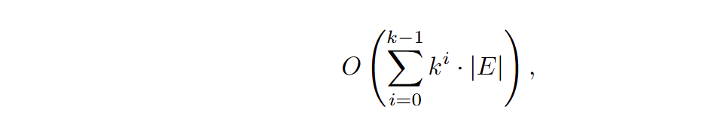
Proof (cont.)
The graph G contains a colorful path of length k − 1 with respect to the coloring c if and only if the final collection corresponding to paths of length k − 1 for at least one vertex is non-empty.
The number of operations performed by the algorithm is at most

Slide 16
Class Notes: 13.4.7 Color Coding
Consider the longest path problem in an undirected graph.
Input: An undirected simple graph G = (V, E) on n vertices and a positive integer k≤n.
Output: Does there exists a simple path consisting of at least k vertices in G.

Slide 17
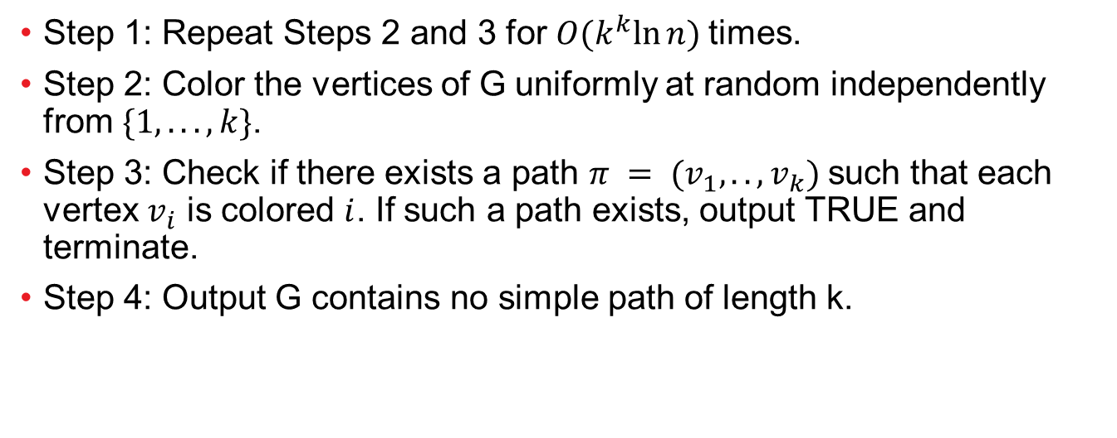
Color coding for finding long paths
Step 1: Repeat Steps 2 and 3 for $O(k^{k}ln⁡n)$times.
Step 2: Color the vertices of G uniformly at random independently from $\{1, . . . , k\}$.
Step 3: Check if there exists a path $π = (v_{1},..,v_{k})$such that each vertex $v_{i}$ is colored $i$. If such a path exists, output TRUE and terminate.
Step 4: Output G contains no simple path of length k.

Slide 18
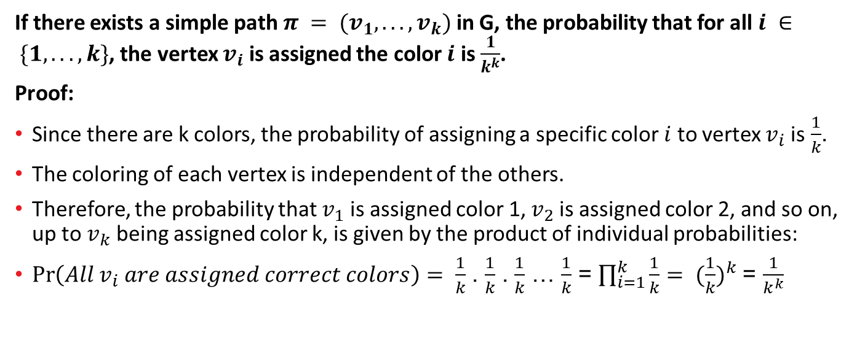
Lemma 13.4.29
If there exists a simple path $π = (v_{1}, . . . ,v_{k})$in G, the probability that for all $i ∈ \{1, . . . , k\}$, the vertex $v_{i}$ is assigned the color $i$ is $\frac{1}{k^{k}}$.
Proof:
Since there are k colors, the probability of assigning a specific color $i$ to vertex $v_{i}$ is $\frac{1}{k}$.
The coloring of each vertex is independent of the others.
Therefore, the probability that $v_{1}$ is assigned color 1, $v_{2}$ is assigned color 2, and so on, up to $v_{k}$ being assigned color k, is given by the product of individual probabilities:
$\operatorname{Pr}\left(All v_{i} are assigned correct colors\right)= \frac{1}{k}$ . $\frac{1}{k}$ . $\frac{1}{k}$ … $\frac{1}{k}$ = $\prod_{i=1}^{k}{\frac{1}{k}}$ ${= (\frac{1}{k})}^{k}$ = $\frac{1}{k^{k}}$

Slide 19
Questions ?

Slide 20
Refrences
Noga Alon, Raphael Yuster, and Uri Zwick. Color-coding. J. ACM, 42(4):844–856, 1995
Maheshwari, A. (n.d.). Design and analysis of algorithms: Lecture notes. Carleton University. Retrieved from https://people.scs.carleton.ca/~maheshwa/Notes/DAA/notes.pdf

