Slide 1
Shortest Path Based Sufficiency Condition for Hamiltonian Graphs
Tanvir Kaykobad

Slide 2
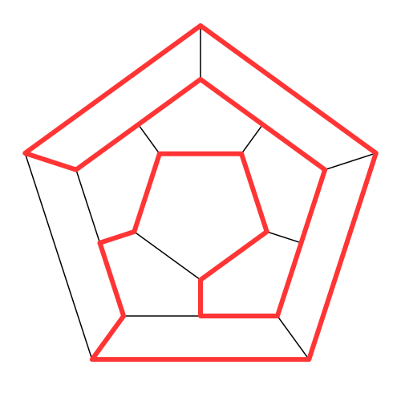
Hamiltonian Graph
A Hamiltonian Path is a path that traverses through each vertex of a graph exactly once
A Hamiltonian Cycle is a cycle that visits every vertex of the graph exactly once
A graph is Hamiltonian if it contains a Hamiltonian Cycle
Finding whether a graph is Hamiltonian is an NP-complete problem.

Slide 3
Existing Sufficiency Conditions for Hamiltonicity
Let be the degree of vertex u of a Graph and or be the distance between the vertices and . Let be a path of length (having vertices) from vertex to vertex .
Dirac’s Condition: In a simple graph, if for every vertex, then the graph is Hamiltonian
Ore’s Condition: In a simple graph, if for every nonadjacent pair then the graph is Hamiltonian
Rahman and Kaykobad: If for every nonadjacent pair of vertices of a simple graph , then the graph contains a Hamiltonian path.

Slide 4
Our Proposition
A graph is if there does not exist a set of vertices, whose removal disconnects the graph.
If a graph is not , it cannot be Hamiltonian
If for all non-adjacent vertices and of a simple graph , then the graph is Hamiltonian

Slide 5
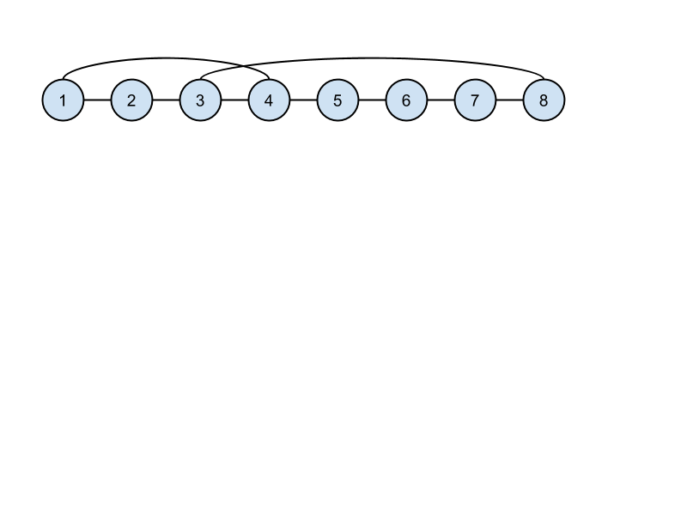
Cross-over edge
In a given path P with vertices indexed from left to right, if there is an intermediate vertex k such that k is connected to the leftmost vertex and its previous vertex (k-1) is connect to the rightmost vertex then these two edges are called edges cross-over edges.
If cross-over edges exist in a path, then a cycle can be created with all the vertices in the path.

Slide 6
Maximal Path
A maximal path is a non-extendable path that cannot be included in any cycle other than a Hamiltonian cycle.
Start with a single edge path
If crossover edges are found, the path forms a cycle, If there are any other vertices on the graph, we connect it to our cycle and remove one edge from the connecting vertex on the cycle to form our new path.
Extend the path on any side without revisiting the same vertex
If Step 3 is no longer possible and if the two ends of the path are adjacent, then it will form a cycle. We extend this cycle to a larger path.
When step 2, 3 and 4 are no longer viable, we have obtained our maximal path

Slide 7
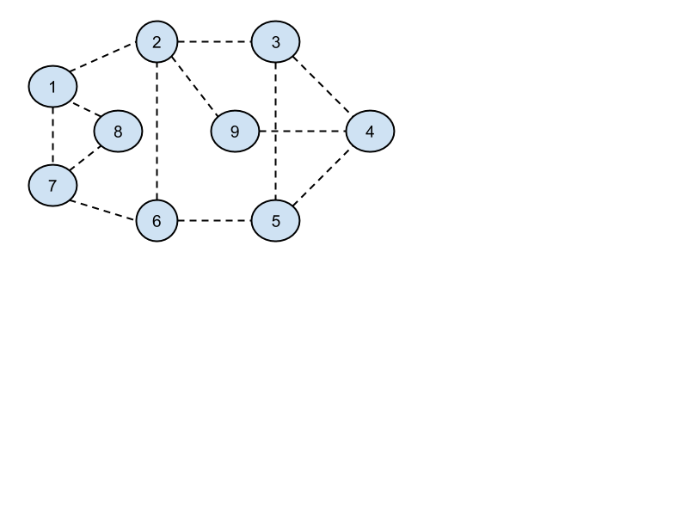
Maximal Path Example

Slide 8
Maximal Path Example

Slide 9
Maximal Path Example

Slide 10
Maximal Path Example

Slide 11
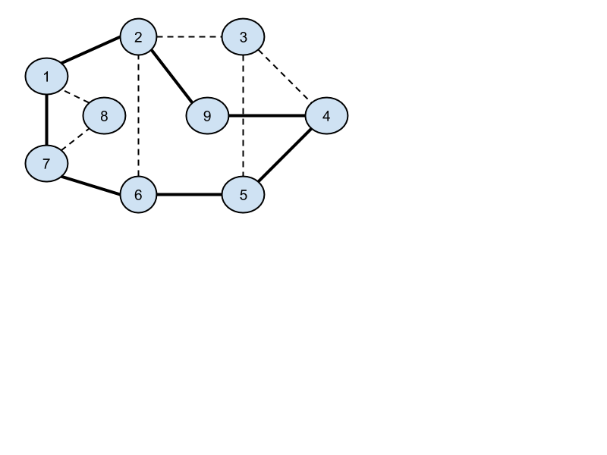
Maximal Path Example

Slide 12
Maximal Path Example

Slide 13
Maximal Path Example

Slide 14
Hamiltonicity
Given a simple 2-connected graph let P be a maximal path with i and j as the end vertices.
We will prove that if then the graph is hamiltonian.
We will cover our proof using 4 cases

Slide 15
Case
Since P is a maximal path, it cannot be included in any cycle other than a Hamiltonian cycle.
So let us assume that there is no cross-over edges.
If vertex i is connected to vertex k then vertex j cannot be connected to vertex . Now, since i is connected to vertices,
Hypothesis of the theorem asserts that
Hence . . That is . So P must be a Hamiltonian path.
Thus if end vertices of a maximal path satisfies the hypothesis of the theorem, it must be a Hamiltonian path.

Slide 16
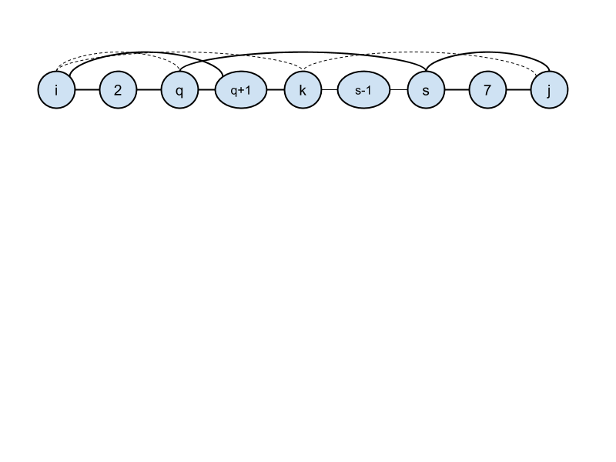
Case
Case
Let k be the rightmost vertex, vertex i is connected then all vertices to the left of k must also be connected to i and not to j. Similar argument will lead to all vertices to the right of k will be connected to j.
Since , vertex j must also be connected to k.
Now since the graph is 2-connected, vertex k cannot be a cut vertex. Therefore, there exists an edge with q to the left of k and s to the right. This will lead to the following cycle: which is Hamiltonian.
This case gives us an improvement on Ore’s condition

Slide 17
Case
In this case
Then and cannot be connected and there is no vertex because then the path length will be shorter
and can be adjacent to at most vertices. That is . So , which means P is a Hamiltonian path

Slide 18
Case
Since each vertex on path is adjacent to either i or j and not both, to deny crossover edges the path can be partitioned by vertex k such that all vertices up to are connected to i, and the rest are connected to j. This makes and k cut vertices
Now since the graph is 2-connected, vertex k cannot be a cut vertex. Therefore,
there exists an edge (q,s) with q to the left of k-1 and s to the right of k. Which is Hamiltonian OR
there exist two edges (q,k-1) and (k,s). First being a bridge for vertex (k-1) and the second for k2.

Slide 19
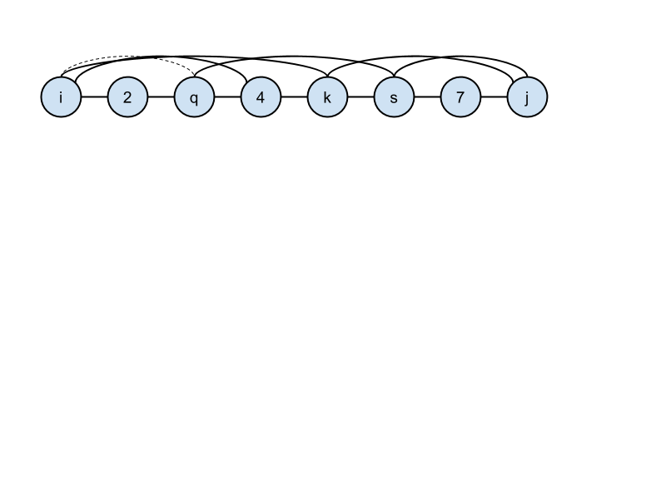
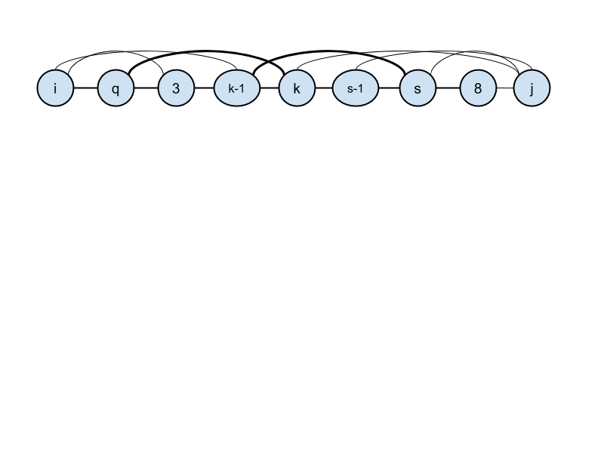
Case
If A: This will lead to the following cycle:
If B: This will lead to the following cycle: Therefore this must be a Hamiltonian cycle

Slide 20
Case
Let the intermediate vertices on the shortest path be where . Since vertices neighbouring to can neither be connected to i nor to j they must be vertices on the shortest path.
Vertices with index must be connected to i. The vertices with index in the same way should be connected to j.
Nonadjacent vertices of the shortest path cannot be connected since then the shortest path will be shorter. In order that none of the vertices be cut vertices we must have an edge connecting vertices with index <i1 to a vertex indexed ik-2 in which case again the path length will be shorter (in fact only 3!). Thus this case cannot arise.

Slide 21
Bibleography
Dirac, G. A. (1952), "Some theorems on abstract graphs", Proceedings of the London Mathematical Society, 3rd Ser. 2: 69–81
Ore, Ø. (1960), "Note on Hamilton circuits", American Mathematical Monthly 67 (1): 55
Mohammad Sohel Rahman and M Kaykobad and Mohammad Saifur Rahman, “A New Sufficient Condition for the Existence of Hamiltonian Paths”, Computers and Their Applications, pp. 56-59, ISCA, 2005

