Slide 1
Minimum Bottleneck Spanning Trees (MBST)
Dongfeng Gu

Slide 2
Outline
Definition
Relation between Minimum Bottleneck Spanning Tree (MBST) and Minimum Spanning Tree (MST)
Camerini’s algorithm for finding an MBST in an undirected connected graph
Camerini’s algorithm for finding an MBSA in a directed connected graph
Tarjan and Gabow Algorithm for MBSA

Slide 3
Bottleneck Edge
Bottleneck edges in a spanning tree are the edges with the maximum weight in the tree
1
2
4
6
5
3
6
8
8

Slide 4
Minimum Bottleneck Spanning Tree (MBST)
1
2
MBST is a spanning tree which has the minimum bottleneck edge value among all the possible spanning trees in a graph G(V,E).
4
13
6
5
3
14
9
6
8
8
14
12
10
11

Slide 5
MBST VS MST
Minimum Spanning Tree (MST) is necessary a Minimum Bottleneck Spanning Tree (MBST) while the opposite is not.
Therefore any algorithm that can find the MST can also find the MBST.
1
2
4
13
6
5
3
7
9
6
8
8
14
12
10
11
Notes:
if we replace the weight 3 edge with weight 7 edges, the new spanning is still a MBST, but it is not a MST.

Slide 6
Camerini’s algorithm in undirected graph
Given an undirected connected graph G(V,E). Let A be a subset of E such that W(e) >= W(e’) for all e Є A, e’Є B = E\A. Let F be a maximal Forest of G_{B} and η = N₁ , N₂ , N₃ … N_{c} , where N_{i} (i = 1,2,…,c) is the set of nodes of the i-th component of F
1
2
4
Weight of B: 1,2,3,4,5,6,6
Weight of A: 7,8,8,9,10,11,12,13,14
13
6
5
3
7
9
6
8
8
14
12
10
11
Notes:
Before we go into the details of the camerini’s algorithm we need to know some concepts and two theorems of it.
let’s still use the graph that we used previously as an example.

Slide 7
Camerini’s algorithm in undirected graph
Given an undirected connected graph G(V,E). Let A be a subset of E such that W(e) >= W(e’) for all e Є A, e’Є B = E\A. Let F be a maximal Forest of G_{B} and η = N₁ , N₂ , N₃ … N_{c} , where N_{i} (i = 1,2,…,c) is the set of nodes of the i-th component of F
N1
1
2
4
Weight of B: 1,2,3,4,5,6,6
Weight of A: 7,8,8,9,10,11,12,13,14
6
5
3
6
N2
N3
F of G_{B}
Notes:
after we remove all the red edge, which is subset A of graph G, we got G_{B} , then we find the forest of G_{B} .

Slide 8
Two theorems
Theorem 1: If F is a spanning tree of G, a Minimum Bottleneck Spanning Tree (MBST) of G is given by any MBST of G_{B} .
Theorem 2: If F is not a spanning tree of G, a MBST of G can be obtained by adding to F any MBST of G’, where G’ is the graph G_{A} collapsed in to η, i.e. G’ = (G_{A})_{η}.

Slide 9
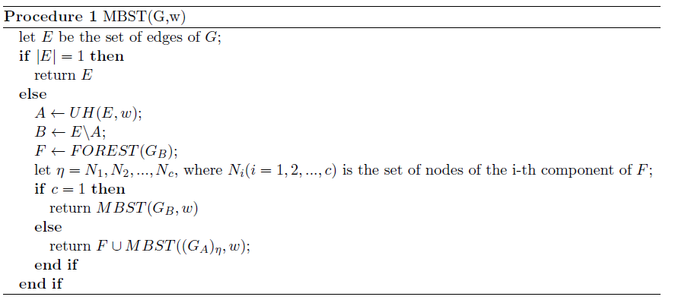
Pseudocode
Notes:
1. here is the pseudocode for the camerini’s algorithm, the procedure UH(E,w) will return a subset A of E such that all the edges in A are less weight than B, and it satisfied this condition

Slide 10

Pseudocode
Notes:
and FOREST return the maximum forest of (G_{B})
if c = 1, that means F is a spanning tree. then we run this line, if not we run the other line
these are the two theorems applied on the pseudocode

Slide 11
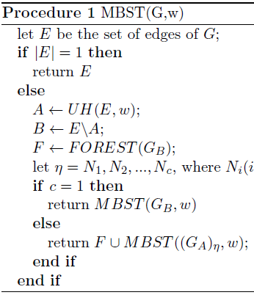
Example

Slide 12
Example
Notes:
As we can see in the graph, the c = 3, then we need to return the F U …

Slide 13
Example

Slide 14
Example

Slide 15
Example

Slide 16
Example

Slide 17
Example

Slide 18
Example

Slide 19
Example

Slide 20
Example

Slide 21
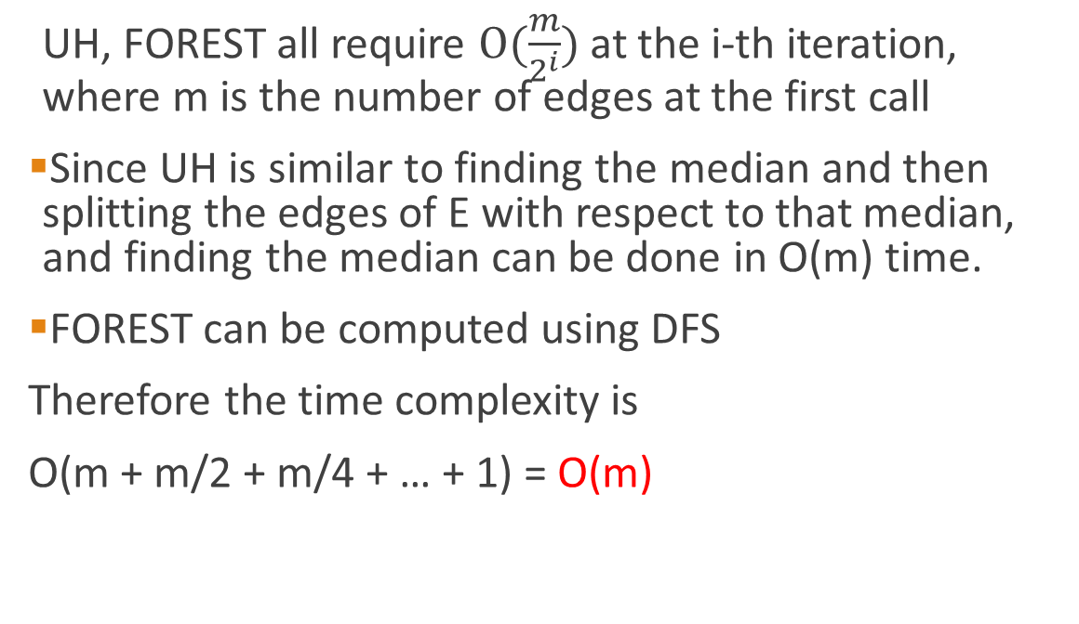
Time Complexity
UH, FOREST all require $O(\frac{m}{2^{i}})$ at the i-th iteration, where m is the number of edges at the first call
Since UH is similar to finding the median and then splitting the edges of E with respect to that median, and finding the median can be done in O(m) time.
FOREST can be computed using DFS
Therefore the time complexity is
O(m + m/2 + m/4 + … + 1) = O(m)
Notes:
That’s it for the camerini’s algorithm for an undirected connected graph. Next I will introduce the MBST in a directed connected graph.

Slide 22
Spanning arborescence (MBSA)
An arborescence of G(V,E) is a minimal subgraph of G which contains a directed path from a specified node “a” in G to each node of a subset V’ of V-{1}.
Node “a” is called the root of the arborescence. An arborescence is a spanning arborescence if V’ = V - {1}.
Root(a)
1
2
4
13
6
5
3
14
9
6
8
8
14
12
12
12
Notes:
Spanning arobrescense is the MBST in a directed graph, it can be expressed as MBSA, we need to know the follow concept of it.
as we can see in the left graph, the red line forms a spanning tree and it is a MBSA.

Slide 23
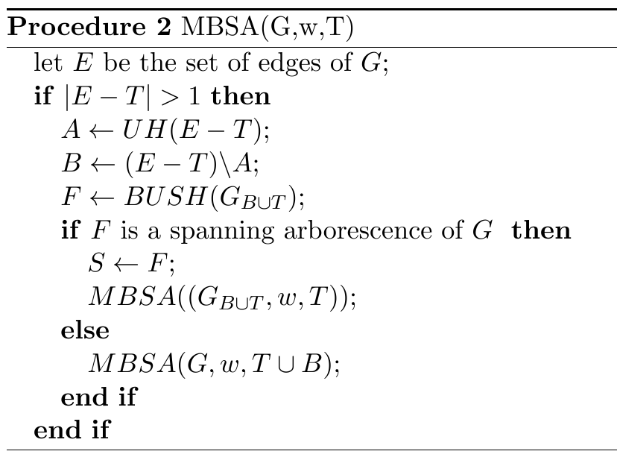
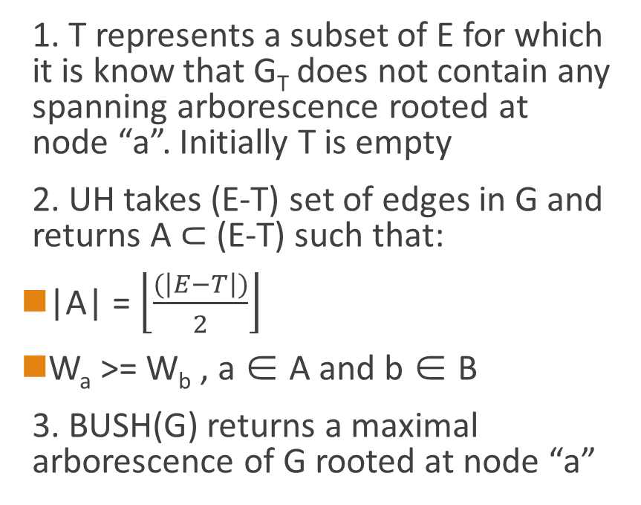
Camerini’s algorithm for MBSA
1. T represents a subset of E for which it is know that G_{T} does not contain any spanning arborescence rooted at node “a”. Initially T is empty
2. UH takes (E-T) set of edges in G and returns A ⊂ (E-T) such that:
|A| = $\left\lfloor \frac{(\left|E−T\right|)}{2}\right\rfloor$
W_{a} >= W_{b} , a ∈ A and b ∈ B
3. BUSH(G) returns a maximal arborescence of G rooted at node “a”
Notes:
The camerini’s algorithm for MBSA is pretty much the same as the camerini’s algorithm for MBST.
the UH function is exactly the same, but we have T variable, which represents a subset of E for ……
the BUSH …..
as usual, I will use an example to explain how the algorithm works.

Slide 24
Example

Slide 25
Example

Slide 26
Example

Slide 27
Example

Slide 28
Example

Slide 29
Example

Slide 30
Example

Slide 31
Example

Slide 32
Example

Slide 33
Example
Notes:
So F” is the final answer of this algorithm

Slide 34
Time Complexity
UH require O(m)
BUSH requires O(m) at each execution and the number of these executions is O(logm) since |E-T| is being halved at each call of MBSA
Sum up: O(mlogm)

Slide 35
Tarjan and Gabow Algorithm for MBSA
Let S be the distinguished root vertex of G, and F be the collection of vertices and their inclusion cost c(v)
Start with F having only node S
Select minimum c(v) in F and delete the S
For every edge(v,w), if w is not in F and not in Tree. Add it along with cost c(w) = weight(v,w) and make v its parent. If w already in F check if weight(v,w) < c(w) then make c(w) = weight(v,w) and make v become the parent of w

Slide 36
Example
F
Vertex X | C(v) | P(v) [parent of v]
6 | -∞ | -
5 | 2 | 6
4 | 4 | 6
Notes:
Let’s still take the previous graph from the camerini’s algorithm.

Slide 37
Example
F
Vertex X | C(v) | P(v) [parent of v]
6 | -∞ | -
5 | 2 | 6
4 | 4 | 6
1 | 1 | 5
2 | 6 | 5
Notes:
Let’s still take the previous graph from the camerini’s algorithm.

Slide 38
Example
F
Vertex X | C(v) | P(v) [parent of v]
6 | -∞ | -
5 | 2 | 6
4 | 4 | 6
1 | 1 | 5
2 | 6 | 5
5 | 3 | 4
remove->
Notes:
Let’s still take the previous graph from the camerini’s algorithm.

Slide 39
Example
F
Vertex X | C(v) | P(v) [parent of v]
6 | -∞ | -
5 | 2 | 6
4 | 4 | 6
1 | 1 | 5
2 | 6 | 5
2 | 5 | 1
replace->
Notes:
Let’s still take the previous graph from the camerini’s algorithm.

Slide 40
Example
F
Vertex X | C(v) | P(v) [parent of v]
6 | -∞ | -
5 | 2 | 6
4 | 4 | 6
1 | 1 | 5
2 | 5 | 1
3 | 7 | 2
Notes:
Let’s still take the previous graph from the camerini’s algorithm.

Slide 41
Example
F
Vertex X | C(v) | P(v) [parent of v]
6 | -∞ | -
5 | 2 | 6
4 | 4 | 6
1 | 1 | 5
2 | 5 | 1
3 | 7 | 2
4 | 8 | 3
remove->
Notes:
Let’s still take the previous graph from the camerini’s algorithm.

Slide 42
Example
F
Vertex X | C(v) | P(v) [parent of v]
6 | -∞ | -
5 | 2 | 6
4 | 4 | 6
1 | 1 | 5
2 | 5 | 1
3 | 7 | 2
End
Notes:
Let’s still take the previous graph from the camerini’s algorithm.

Slide 43
Time Complexity
This algorithm runs in O(|V|log|V| + |E|) time if Fibonacci heap was used to implement F.
Compare to the Camerini’s algorithmO(|E|log|E|) , if a graph has much more edges than vertexes, then the Tarjan and Gabow algorithm is better.

Slide 44
Reference
[1]P.M. Camerini, The Min-Max Spanning Tree Problem And Some Ex- tensions, Information Processing Letters, Vol. 7, Num. 1, January 1978\newline
[2]H.N. Gabow, R.E. Tarjan, Algorithms for Two Bottleneck Optimization Problems, Journal Of Algorithms 9 (1988) 411-417\newline

Slide 45
Thank You!
Question?

